Slide 1
GEOS 22060/ GEOS 32060 / ASTR 45900
What makes a planet (unin)habitable?
Lecture 13
Weathering feedback, continued
Tuesday 18 February 2020

Slide 2
What controls the weathering rate?
Water supply (to flush away dissolved products)
CO₂ concentration (acidity; thermodynamics)
Temperature (→ kinetics)
Reactive surface area (uplift/tectonics/erosion)
Today: Refining the carbonate-silicate weathering feedback hypothesis: shift from direct T to indirect hydrologic control

Slide 3
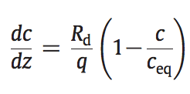
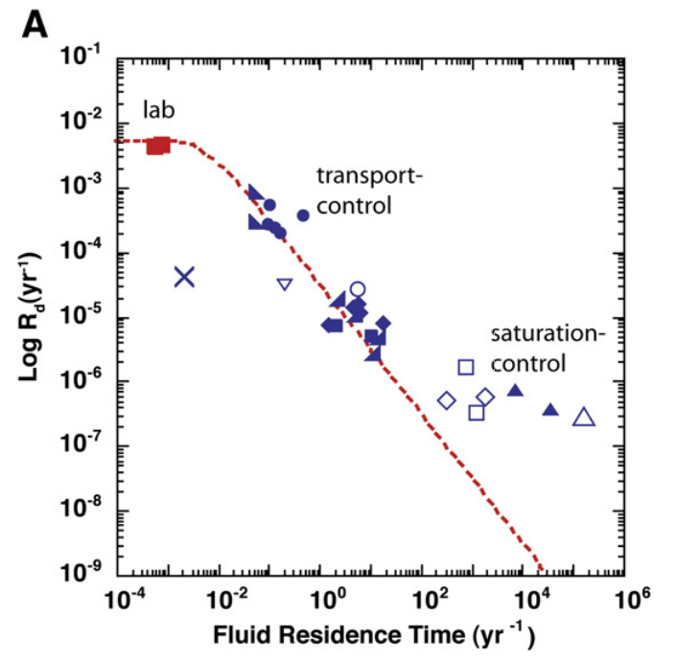
What accounts for the lab-vs.-field discrepancy in weathering rates? What is the role of flushing?
Maher 2010
(on the required
reading list)

Slide 4
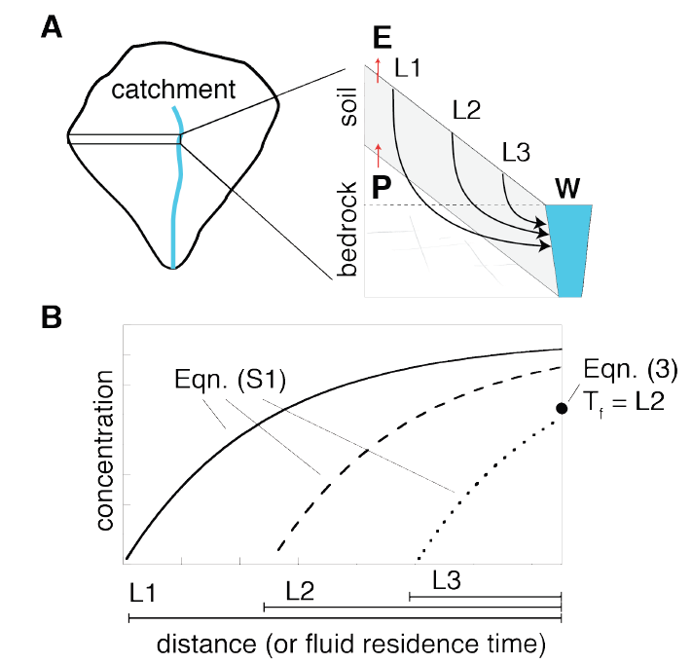
The next part of today’s lecture follows Maher & Chamberlain, “Hydrologic Regulation of Chemical Weathering and the Geologic Carbon Cycle,” Science, 2014 (required reading)

Slide 5
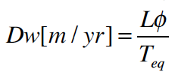
Damkohler number
(widely used)
“Damkohler Coefficient”
(used only by Maher & Chamberlin 2014)
multiply by q
integration over an exponential distribution of travel times not
shown (see Maher & Chamberlin 2014, supplementary
equations S6-S8)

Slide 6
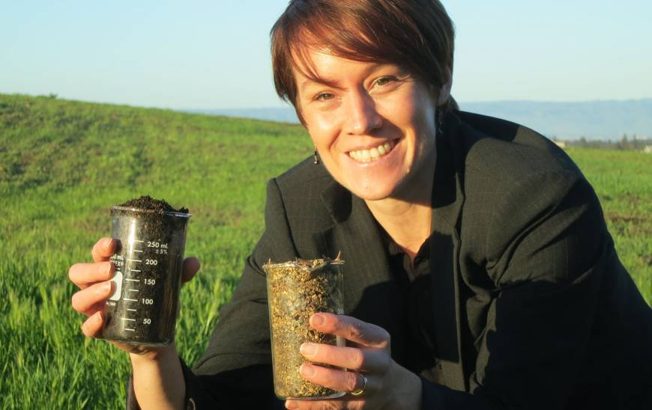
Main controls on solute flux: age of soil and travel-time of fluid
Central California
marine terrace
chronosequence
young soil, more reactive
old soil, less reactive

Slide 7
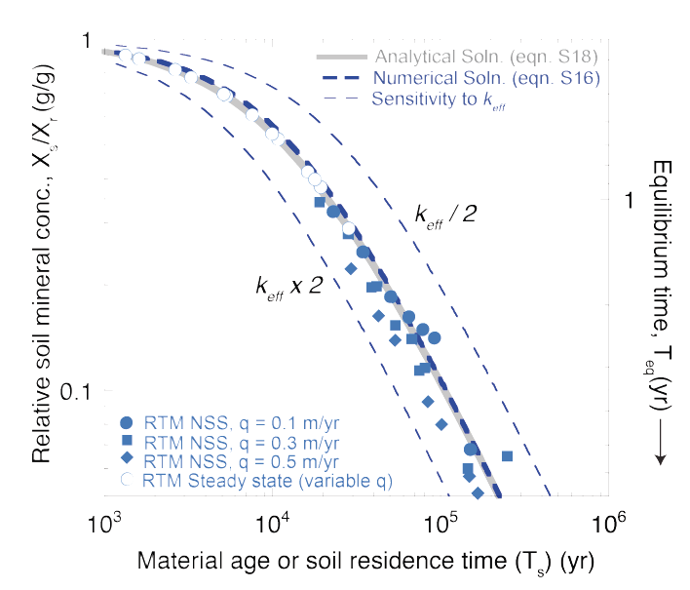
Symbols: output from a reaction-transport model Curves: analytic fit

Slide 8
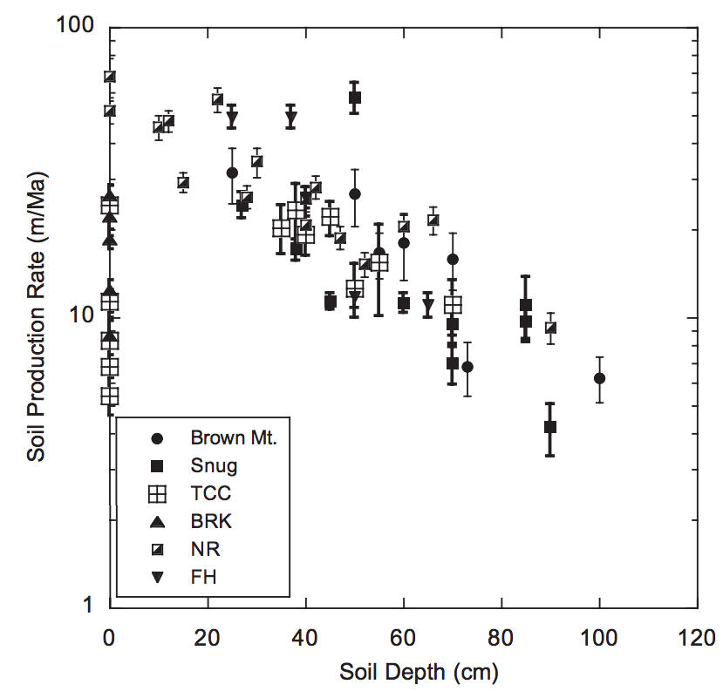
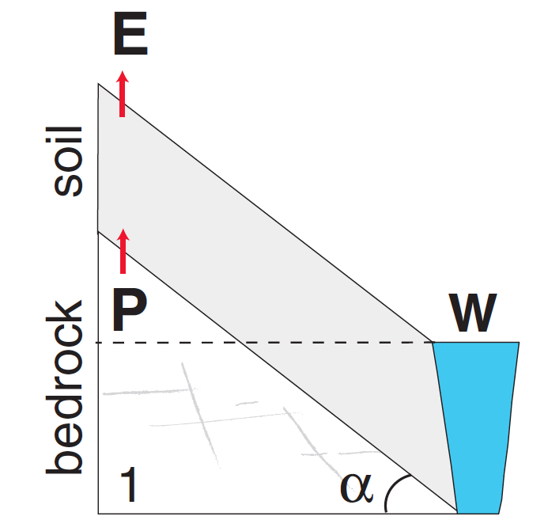
Soil Production rate approximately balances
Erosion rate (and, less precisely, rock uplift rate)
Negative feedback
on soil thickness
Heimsath et al.,
Earth Surf. Proc. & Landf.
2009
Mountain soil thicknesses
are usually <~O(1) m

Slide 9
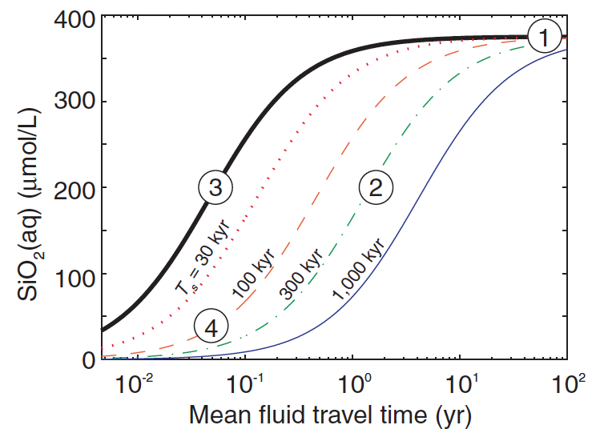

Slide 10
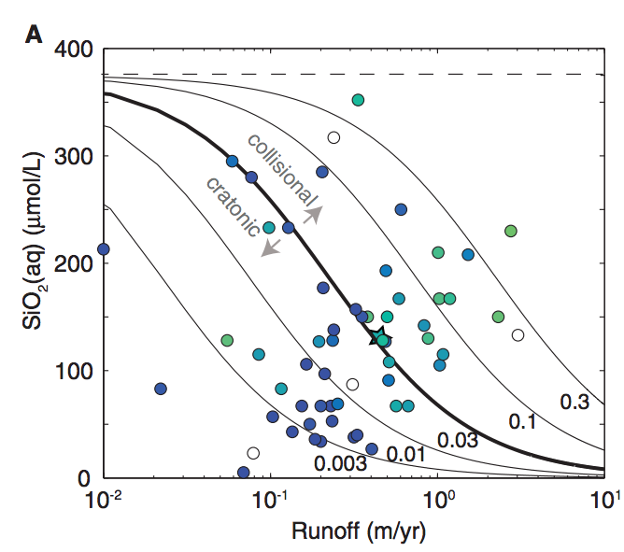
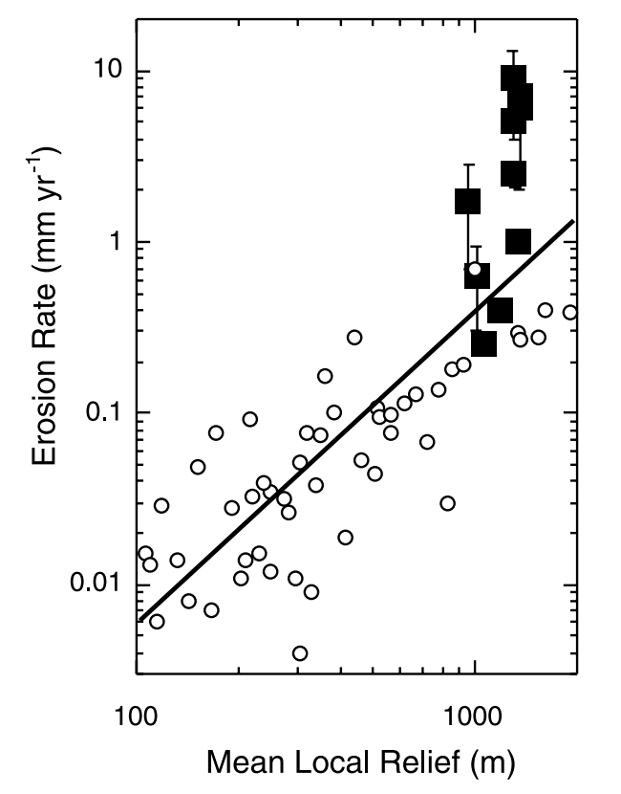
0.3
0.03
Note: effect of orographic precipitation
0.003
mm/yr
rock
uplift
(local relief: 10 km window)
Montgomery & Brandon
EPSL 2002: negative feedback on mountain height

Slide 11
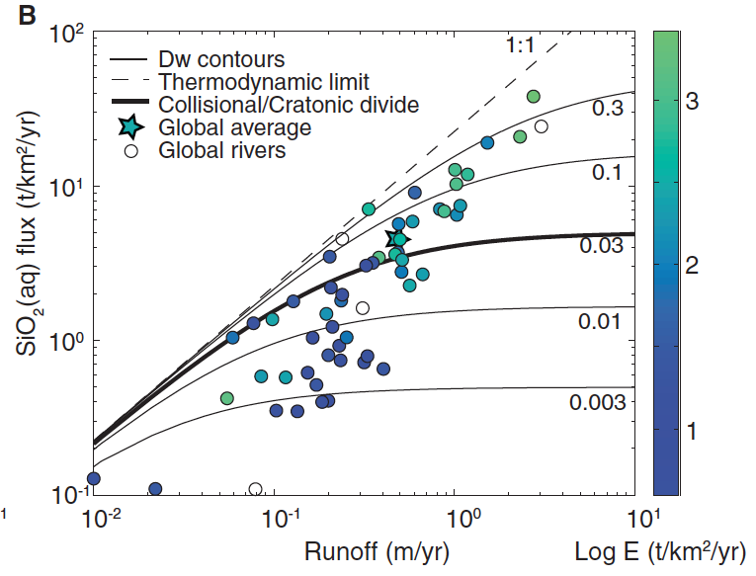

Slide 12
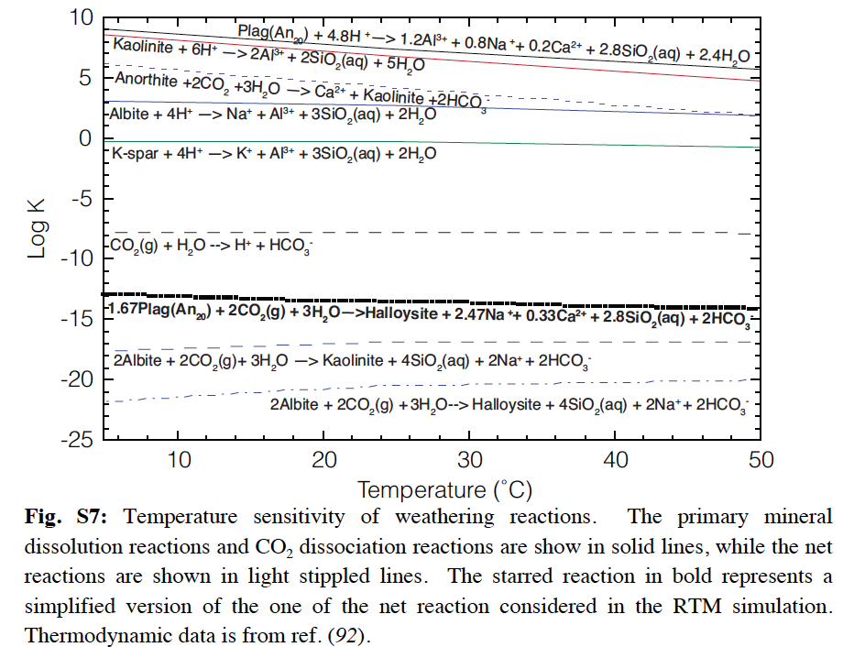
Where’s the effect of temperature?

Slide 13
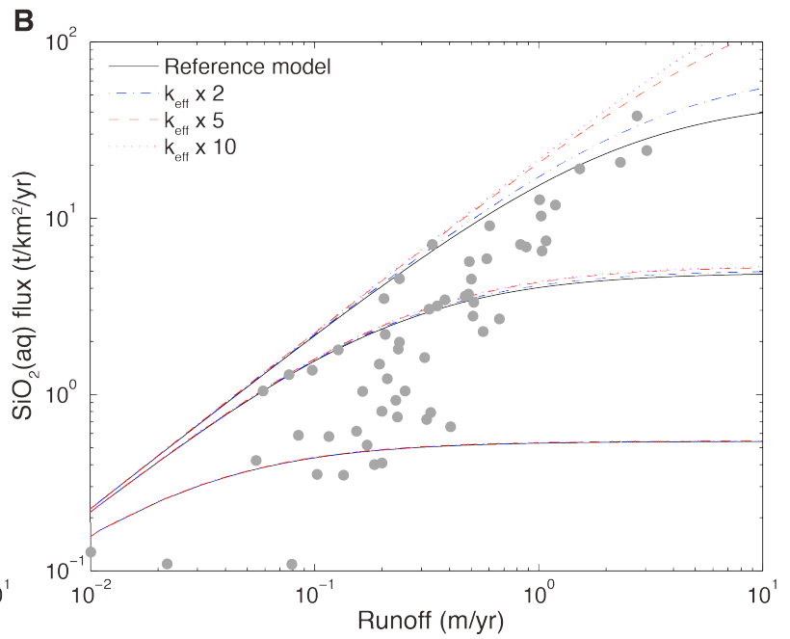
Where’s the effect of temperature?
Direct effect of T is small;
strong indirect hydrologic
effect.

Slide 14
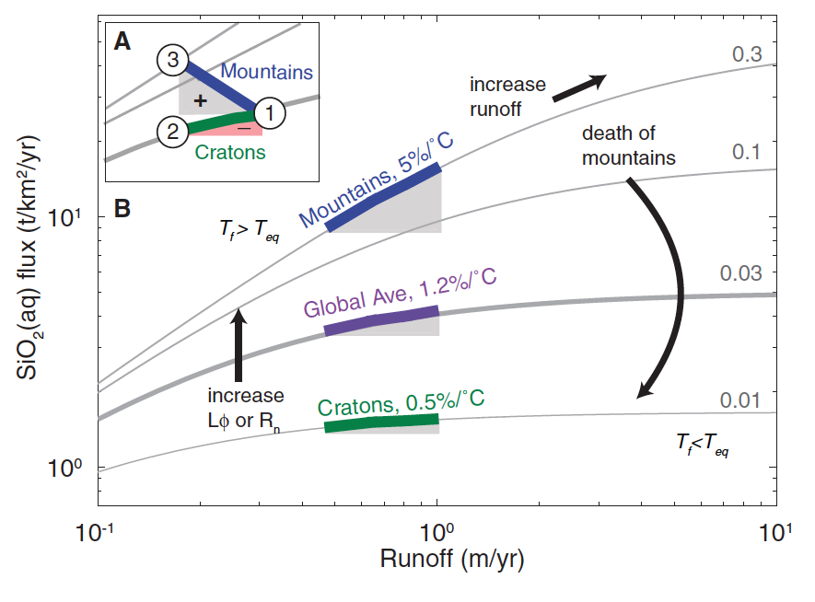
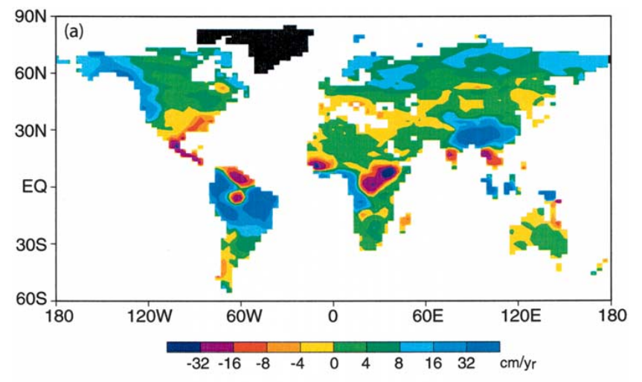
f_{w} = fraction of fresh minerals
Manabe et al.
Climatic Change
2004
or f_{w}
Maher & Chamberlain Science 2014:
Earth’s thermostat is mediated by wetting of mountain belts in response to global warming
runoff change (cm/yr)

Slide 15
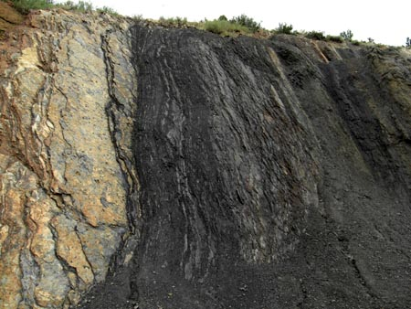
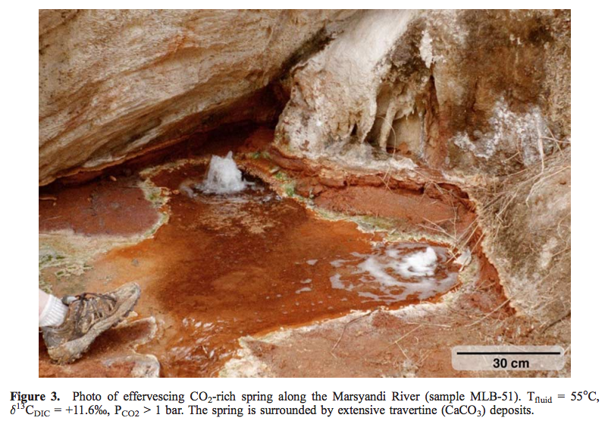
Mountain belts also release CO₂ (via metamorphic decarbonation and by oxidation of C in uplifted shale, coal)
Evans et al., G³, 2008
Colorado Front Range organic-rich shale
Bickle, Terra Nova, 1996

Slide 16
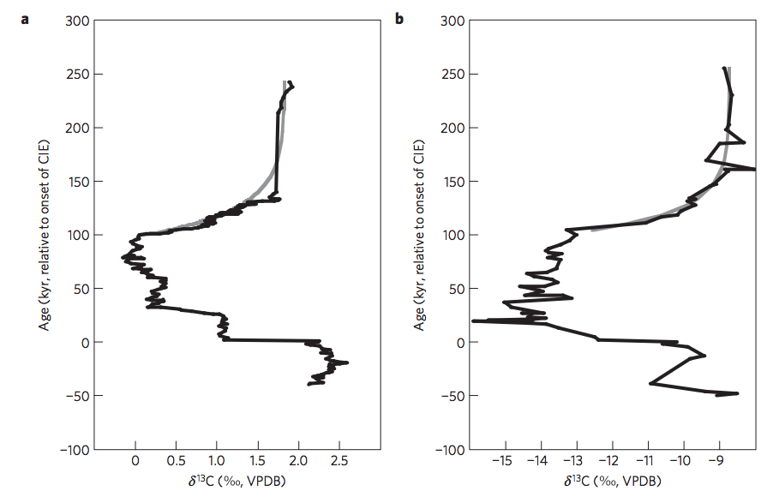
Return to the Paleocene-Eocene Thermal Maximum (55 Mya): consistent with Maher & Chamberlin?
PETM: geologically-rapid injection of isotopically light C → global warming.
how did Earth’s climate recover?
Bowen & Zachos,
Nature Geoscience 2010

Slide 17
Predictions of M&C 2014 for the PETM:
Extent of weathering should increase
(clay mineralogy reflecting deeper weathering)
Rainfall should increase (at least in mountainous zones relevant to weathering).

Slide 18
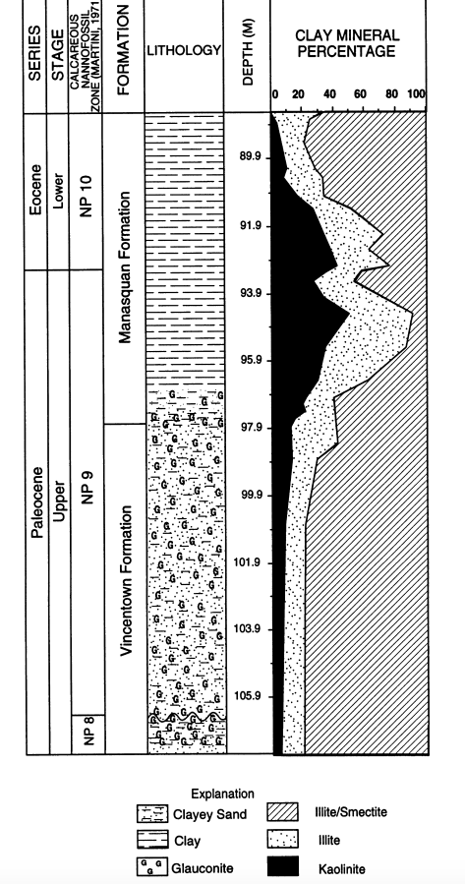
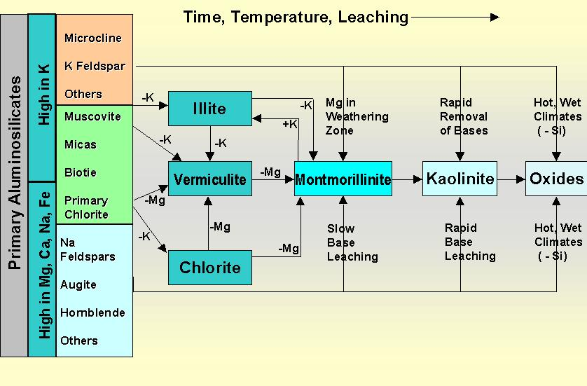
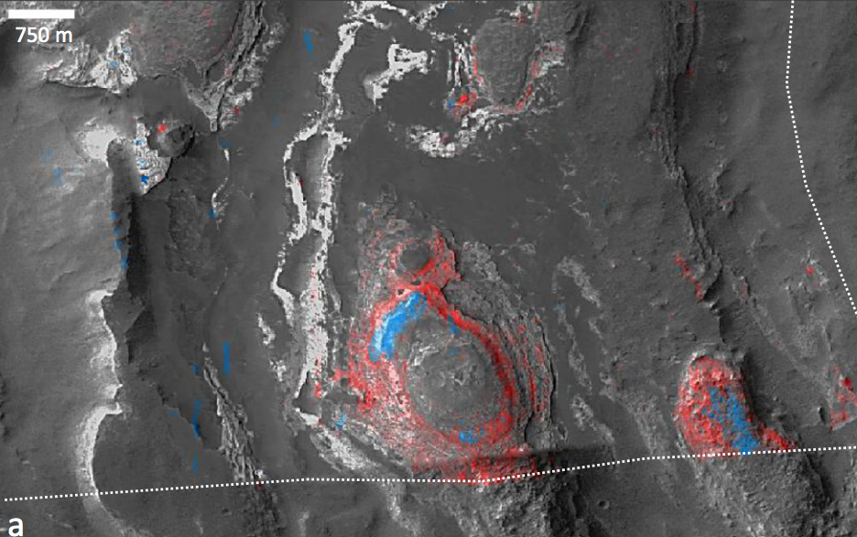
There is a global kaolinite spike at the PETM
Kaolinite = clay formed from thorough intense leaching of parent rock; associated with humid climates
Gibson et al.
Sedimentary
Geology 2000
blue: kaolinite
red: smectite
Also found on Mars
(Carter et al. Icarus 2015)

Slide 19
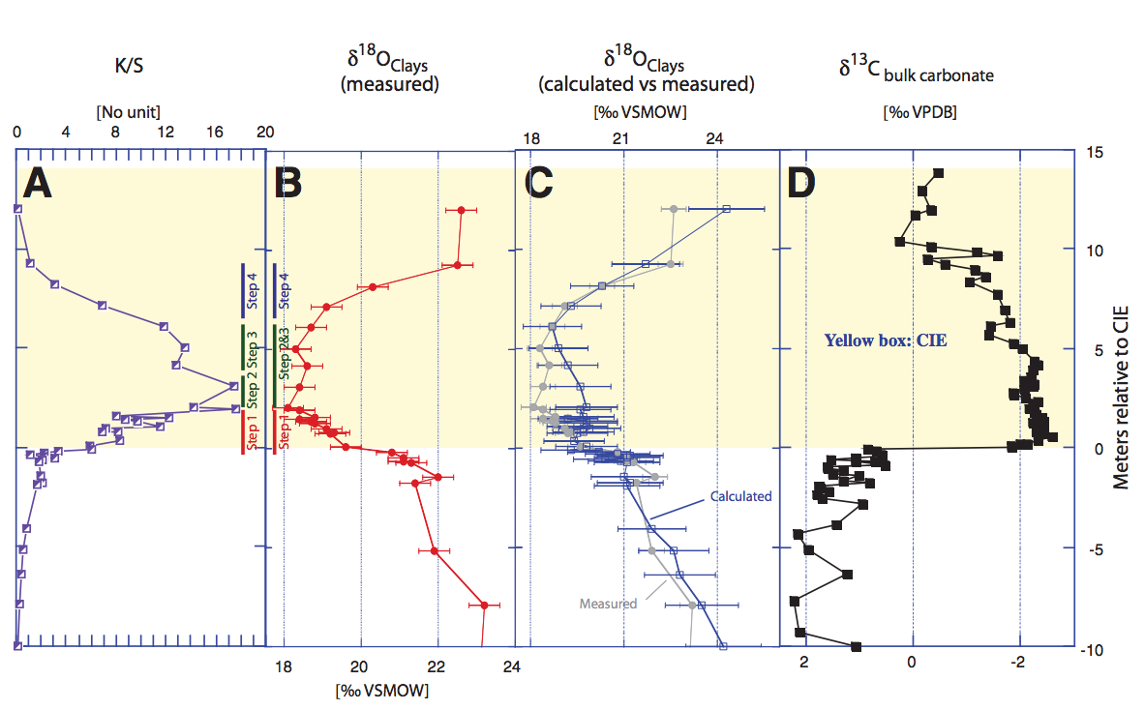
The age of the kaolinite is uncertain
John et al. Geology 2012
Massive increase in physical erosion
(stripping of previously-leached laterites)
John et al. Paleoceanography 2008

Slide 20
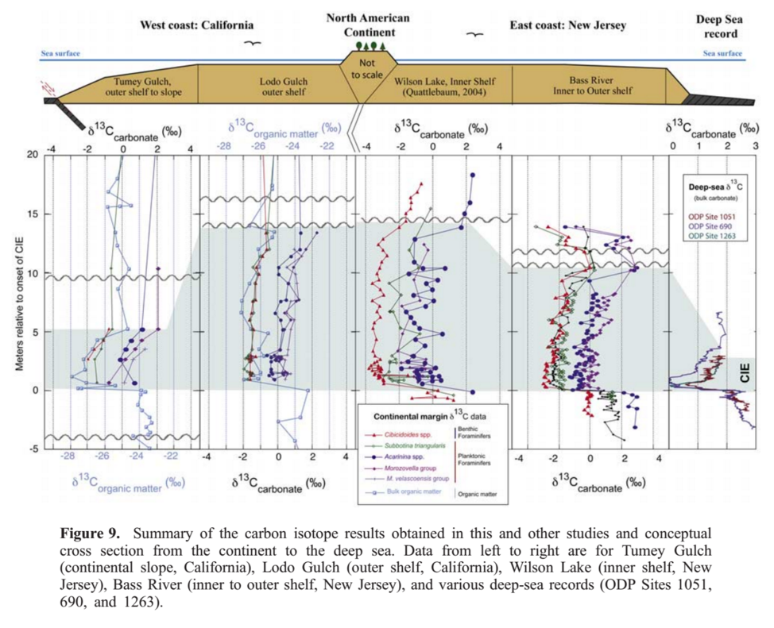
Physical removal of Cretaceous laterites at the PETM?
John et al. Paleoceanography 2008

Slide 21
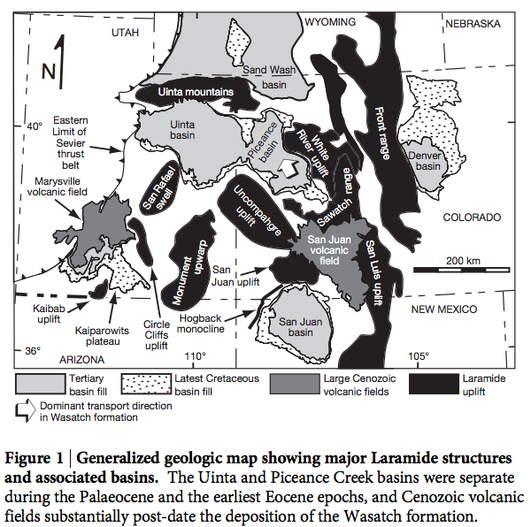
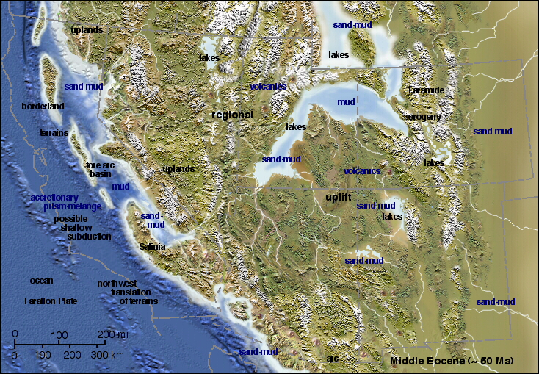
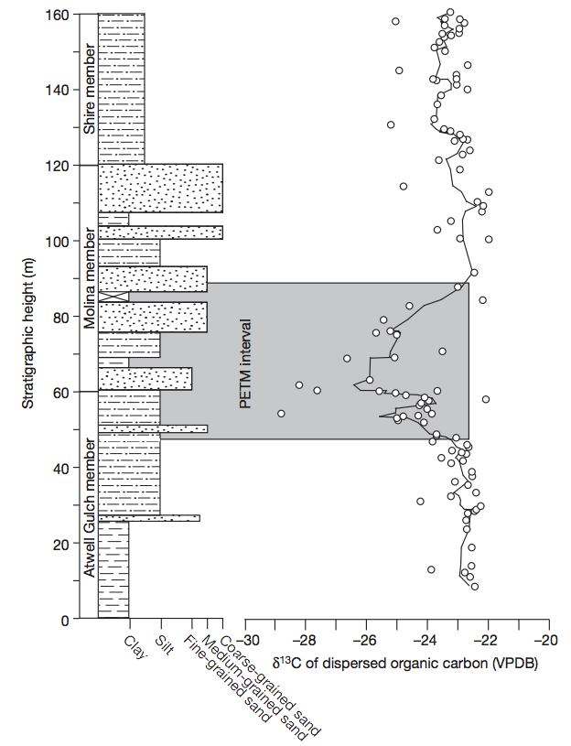
Evidence for hydrological change in mountainous regions

Slide 22
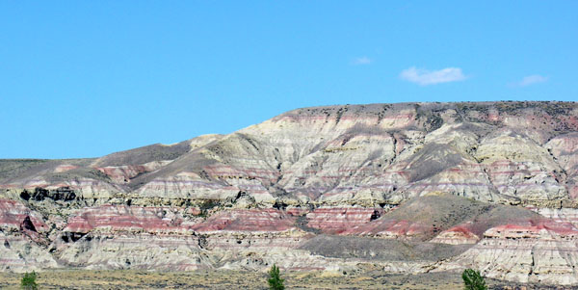
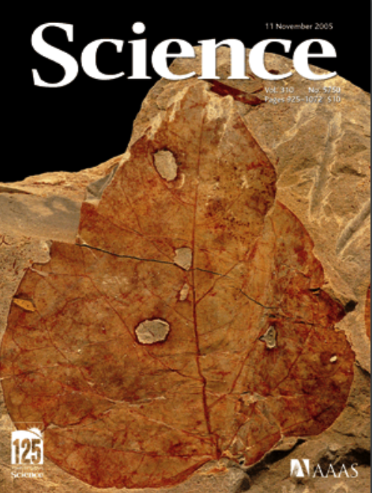
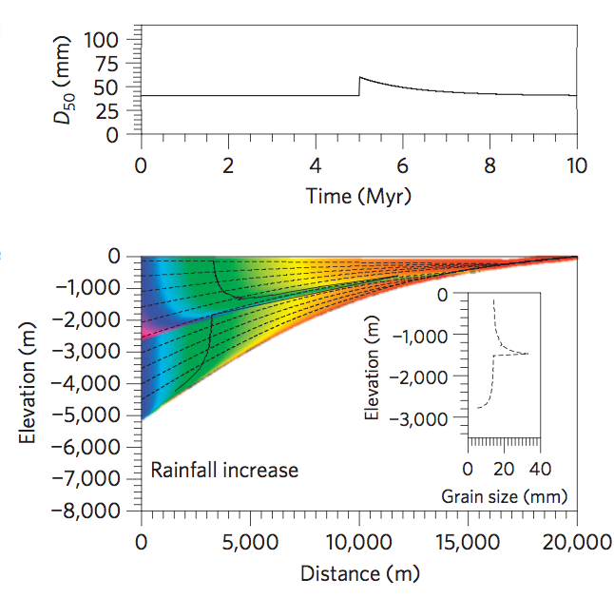
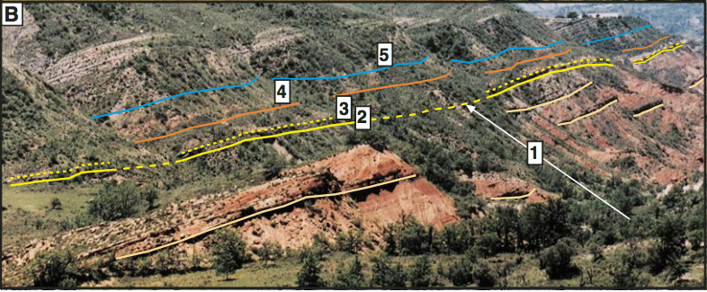
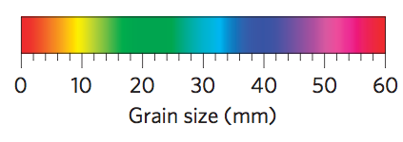
Polecat Bench, Wyoming: excellent
floral record
(Wing et al. Science
2005)
floral indications
of initial drying
followed by return to
wetter conditions
Pyrenees: Schmitz & Pujalte, Geology 2007
Model: Armitage et al. Nature Geoscience 2011

Slide 23
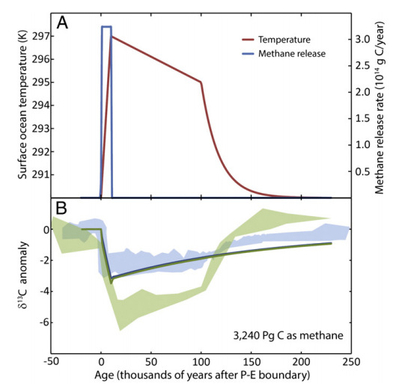
Severe data-model mismatch when only temperature-dependent silicate weathering is considered
alternatives:
organic-matter oxidation,
volcanism
“recovery
problem”
“body problem”
Bowen 2013

Slide 24
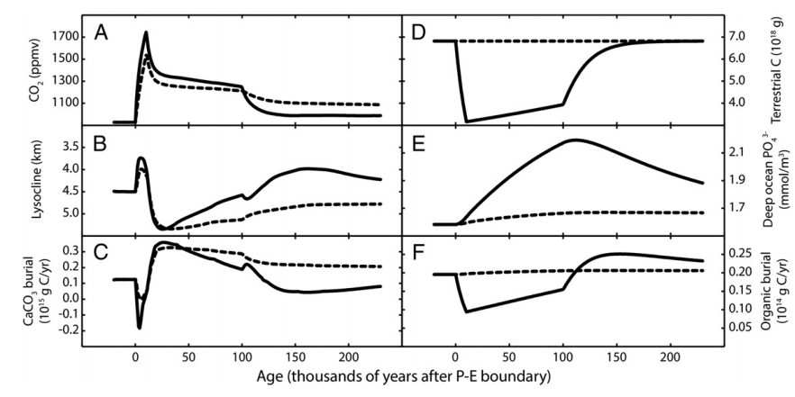
Is the carbonate-silicate weathering feedback enough to explain the data?
Lysocline ~ seafloor depth above
which carbonate is unstable
Dashed lines: without organic matter feedbacks
Solid lines: with organic-matter feedbacks
Bowen 2013

Slide 25
Key points from the required reading
Transport limitation vs. kinetic limitation
Conceptual understanding of hillslope- and watershed-scale weathering, controls on fluxes, relative timescales

Slide 26
Key points – a look under the hood of the carbonate-silicate feedback hypothesis
Main fluxes and reservoirs in the long-term carbon cycle: what is the evidence for a negative feedback?
Testable elements of the carbonate-silicate weathering hypothesis: how well do they hold up to testing?
Evidence from past shocks to the Earth system and present-day weathering bearing on the carbonate-silicate weathering hypothesis.
- Testing hydrologic control on silicate weathering rates as an explanation for recovery from the PETM
- Alternative, organic-carbon explanations
Possible explanations for the lab-vs.-field discrepancy in weathering rates: the role of flushing.

Slide 27
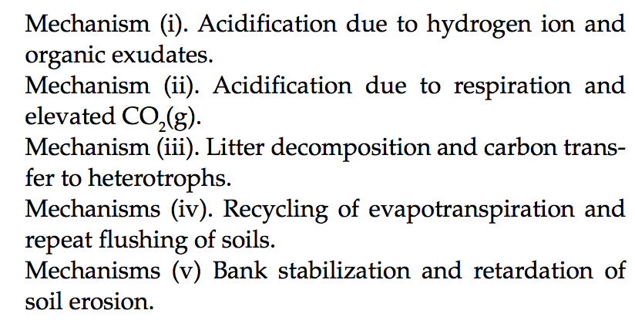
Evolution of land plants ~0.4 Ga likely had major effects on geologic carbon cycle:
Beerling & Butterfield 2012

Slide 28
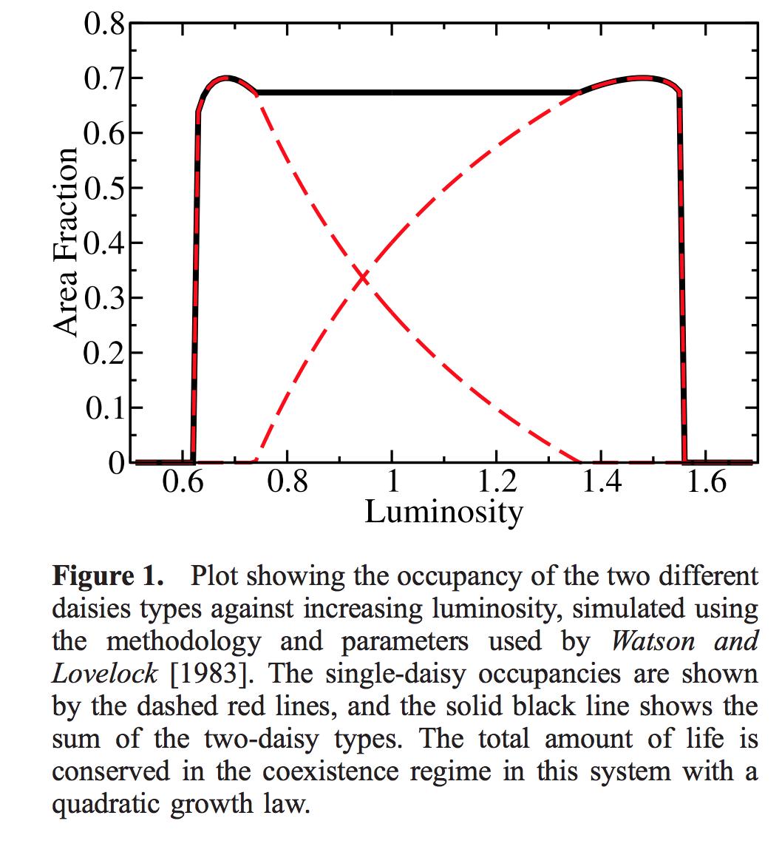
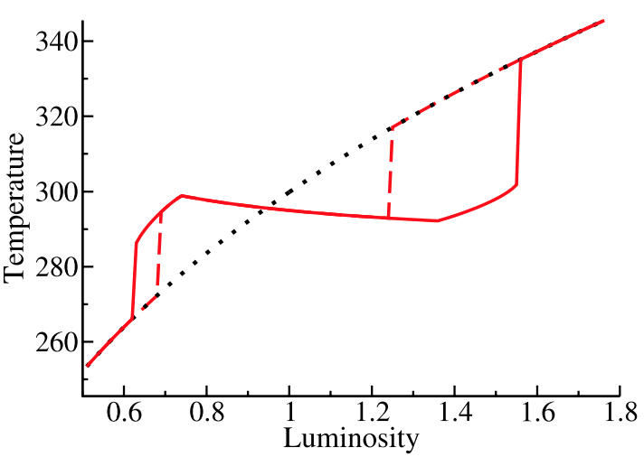
Gaia hypothesis – biosphere in the driving seat – due to Lovelock, recent developments by Lenton
“Daisyworld”: an idealized, toy model to illustrate the Gaia hypothesis
Wood et al. Reviews of Geophysics 2008

Slide 29
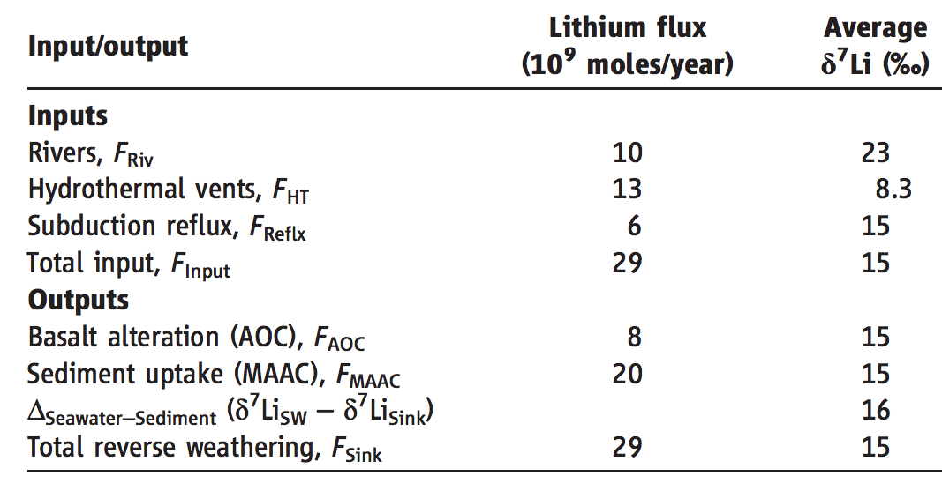
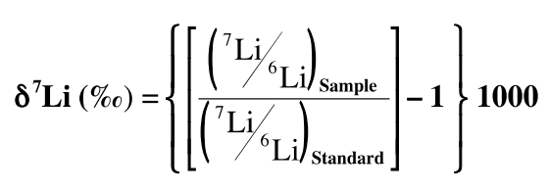
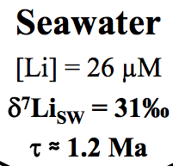
A new proxy for weathering: ⁷Li - A water-soluble trace element - During weathering, Li-7 preferentially partitions into river water, and Li-6 partitions into secondary minerals (clays)
Misra & Froelich, Science 2012
Lithium cycle is mostly in silicate rocks and aluminosilicate clays; none in carbonates.
High weathering intensity (e.g. soils in hot, wet, tectonically passive cratons):
Congruent weathering, Low riverine ⁷Li concentrations reflecting source bedrock.
Low weathering intensity (e.g. mountains, Himalaya):
Incongruent weathering, High riverine ⁷Li concentrations reflecting incomplete dissolution.

Slide 30
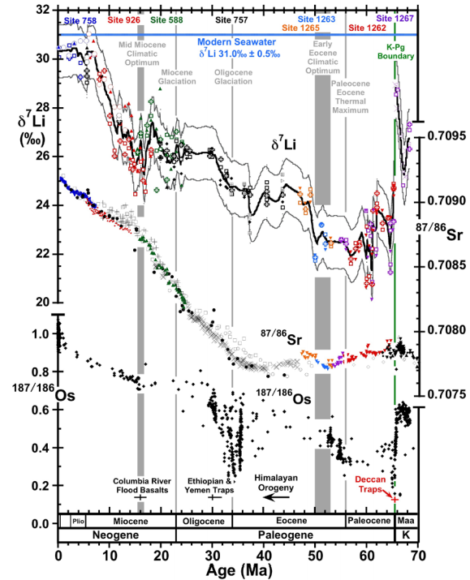
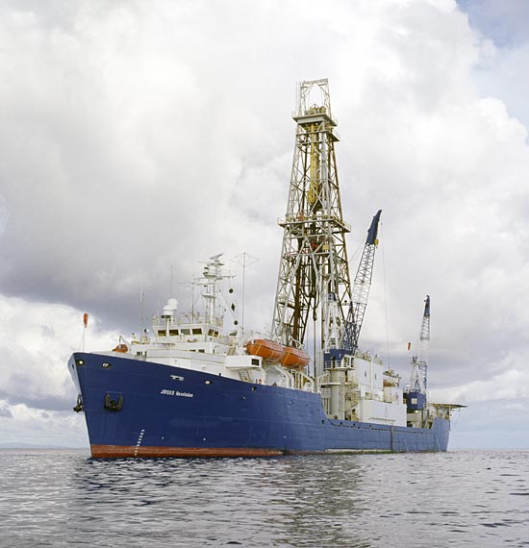
Misra &
Froelich , Science, 2012
Ocean Drilling Program

Slide 31
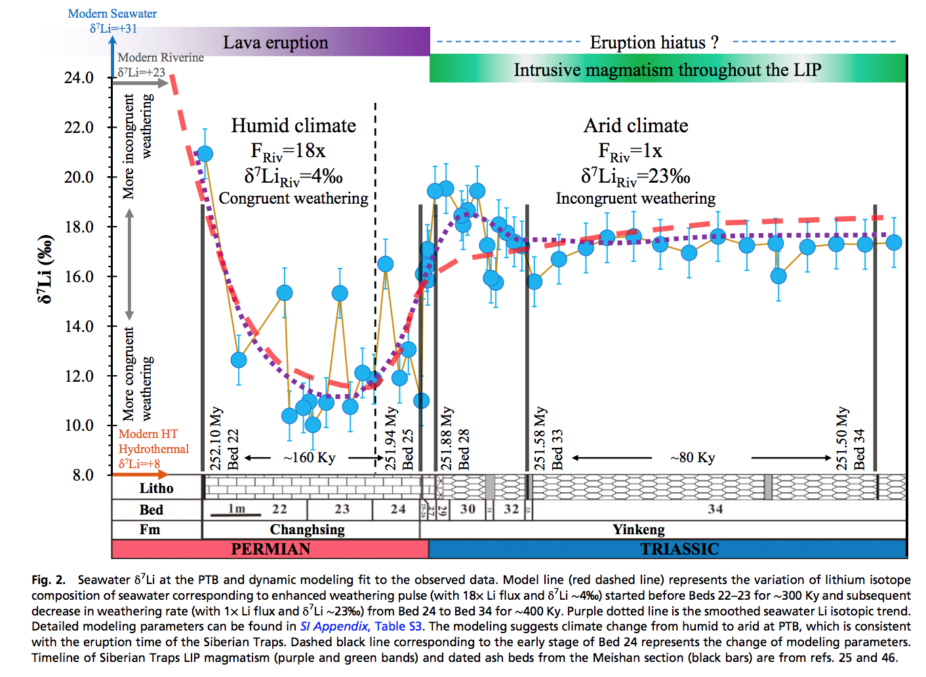
Enhanced silicate weathering occurred at the Permo-Triassic boundary (largest mass extinction in the fossil record).
Sun et al. PNAS 2018

Slide 32
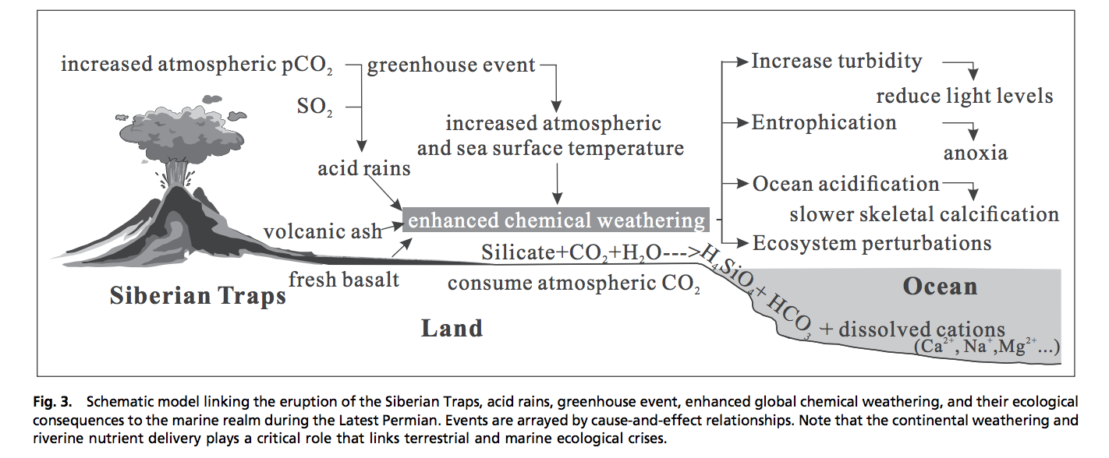
Enhanced weathering at the Permo-Triassic boundary may have contributed to the mass extinction.

Slide 33
Summary and discussion of carbonate-silicate weathering feedback
There is strong evidence for a negative feedback stabilizing climate over >300 Kyr timescales on Earth.
The carbonate-silicate weathering feedback hypothesis is the currently leading hypothesis for this negative feedback.
However, other hypotheses (e.g., organic-carbon feedbacks) may contribute, and research is ongoing to determine which mechanism is the primary control on Earth’s long-term climate.

Slide 34
Nutrient supply
Konhauser 2009

Slide 35
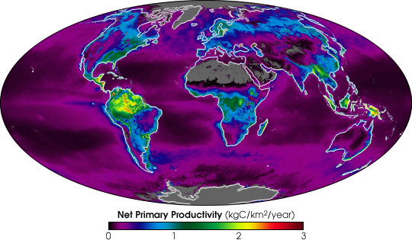
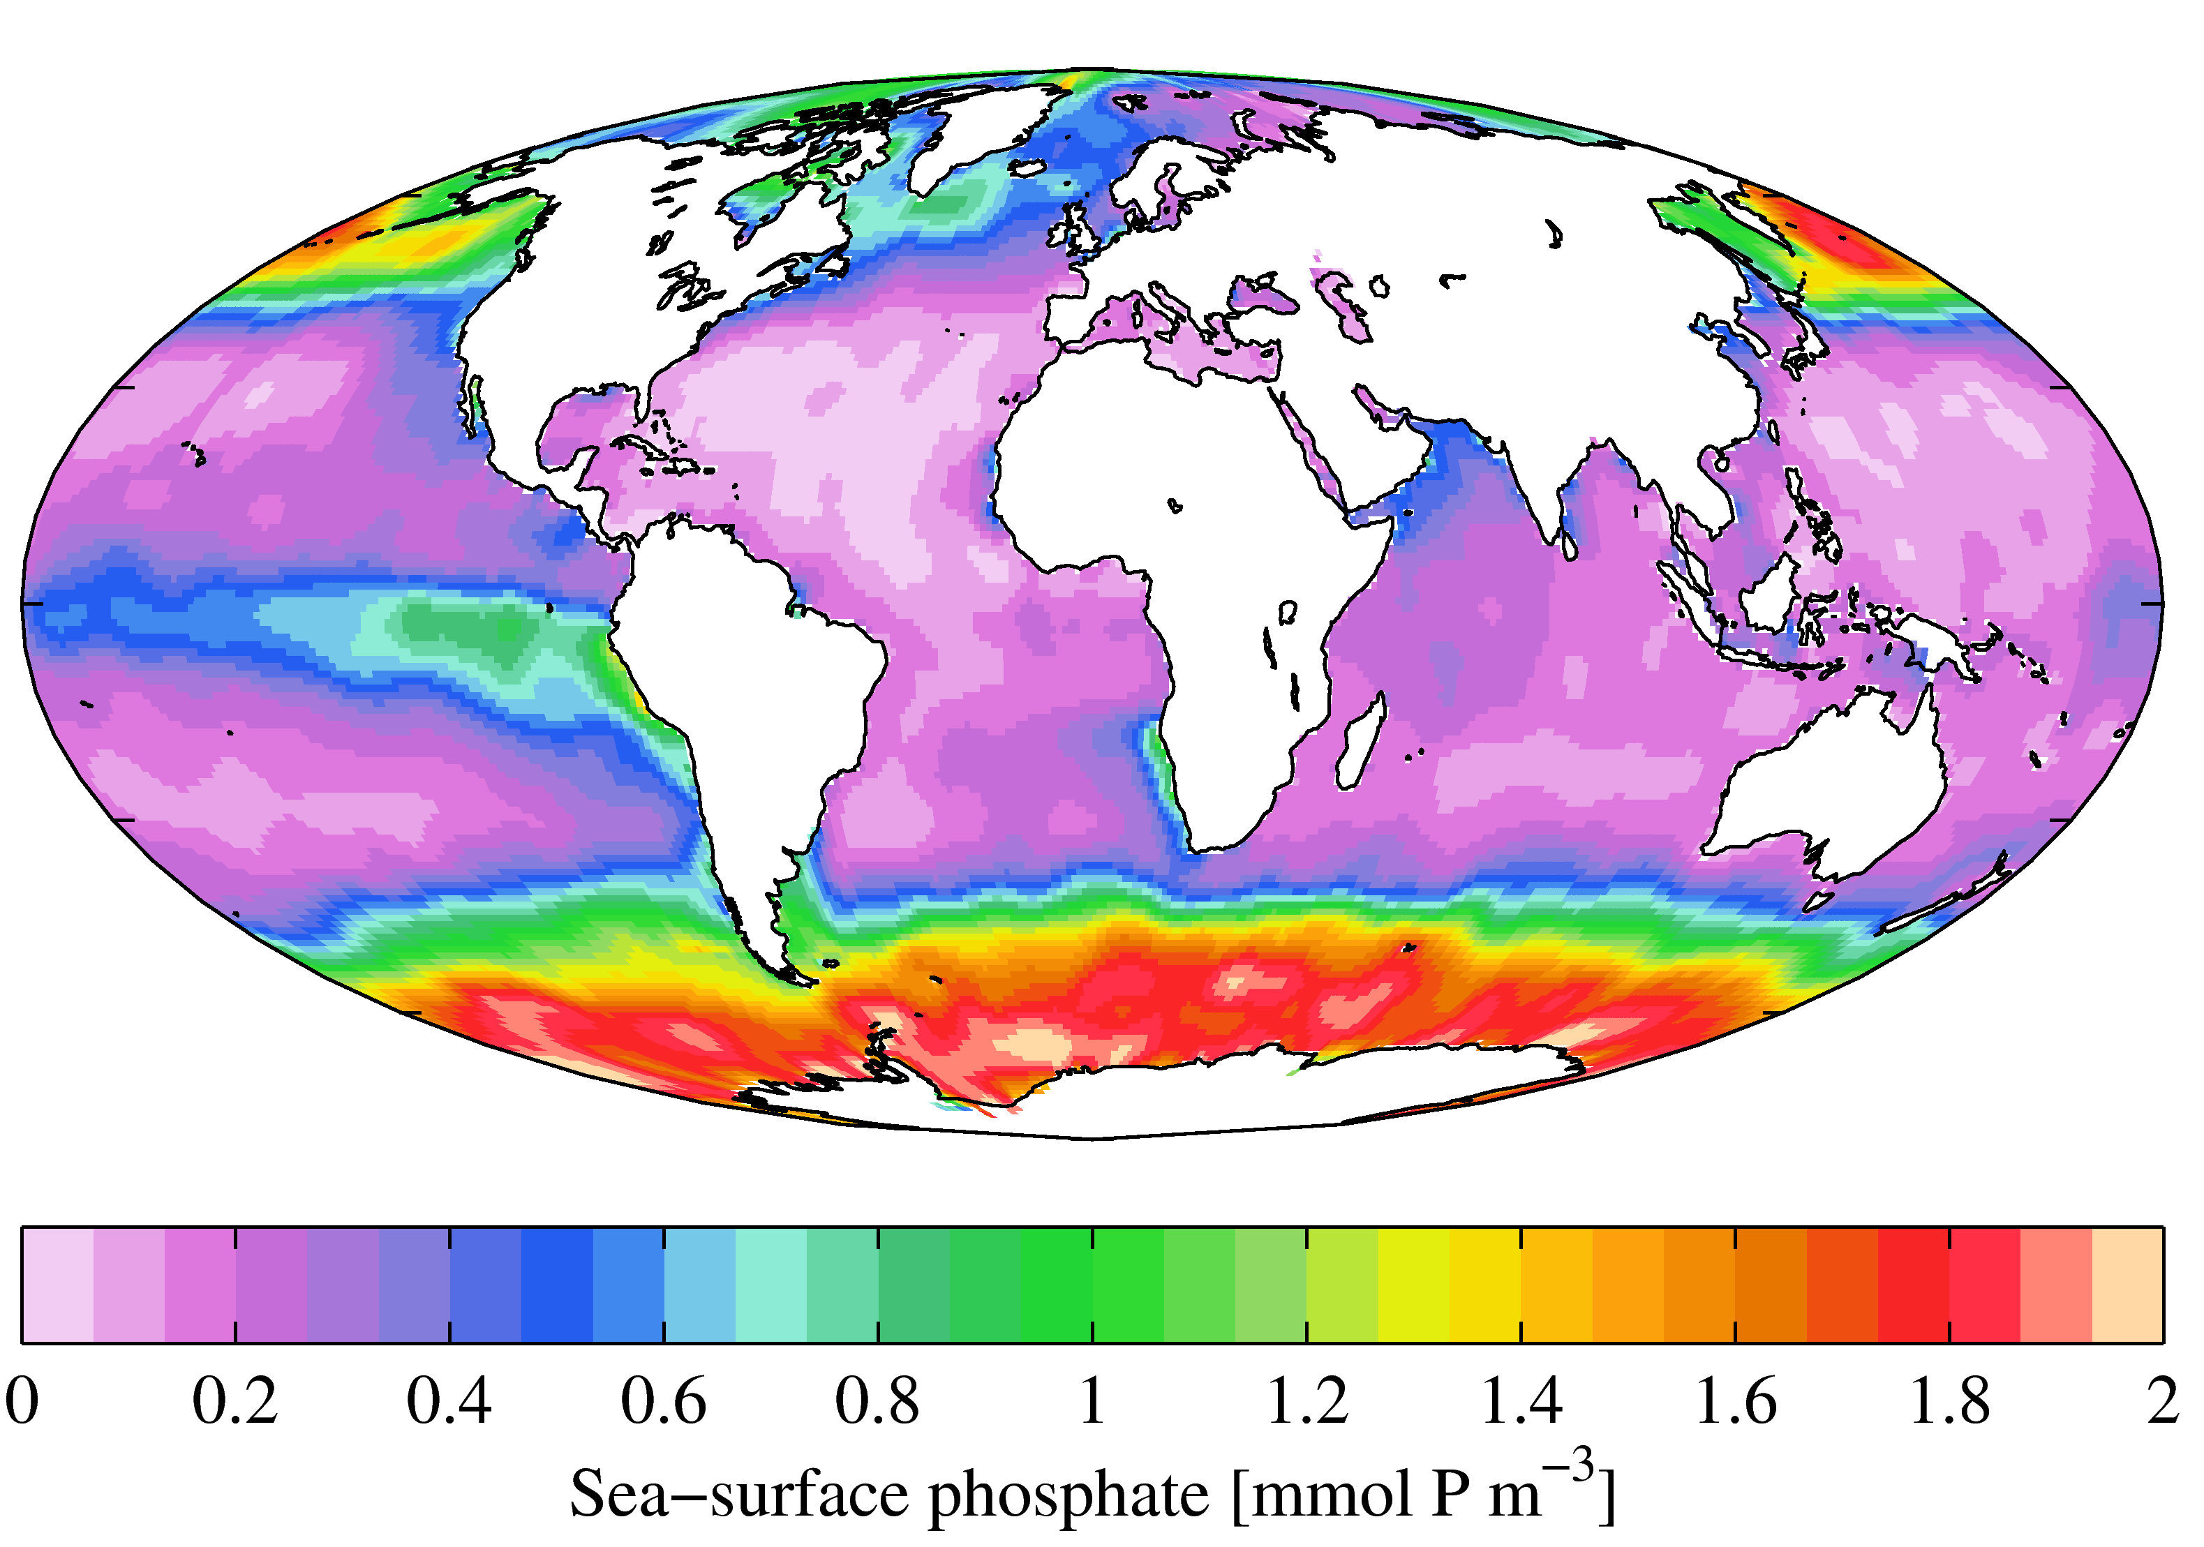
Present-day primary productivity is dominated by oxygenic photosynthesis which evolved
2.3 Ga (perhaps earlier). Productivity in the ocean is currently limited on geologic timescales
by the availability of P (and, locally, the availability of Fe) derived from continental weathering.
NASA Earth Observatory
Fe-poor region
World Ocean Atlas

Slide 36
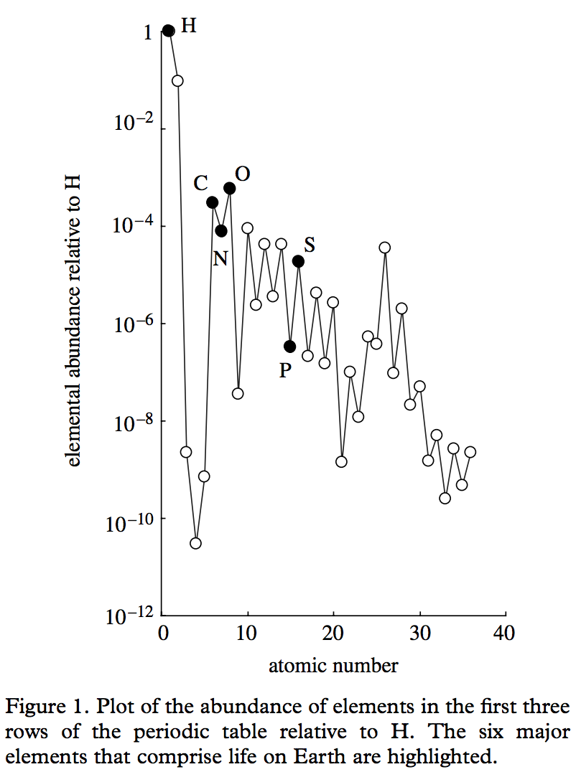
Redfield ratio – C:N:P = 106:16:1
life = CHONPS + some transition-metal catalysts
metalloenzymes involving
Fe, Ni, Cu, Mn, Co, Mo, and Zn
are central to microbial ecology.
E.g., the first nitrogenase had 38 Fe-atoms
Falkowski & Godfrey,
Phil. Trans. Roy. Soc. A 2008

Slide 37
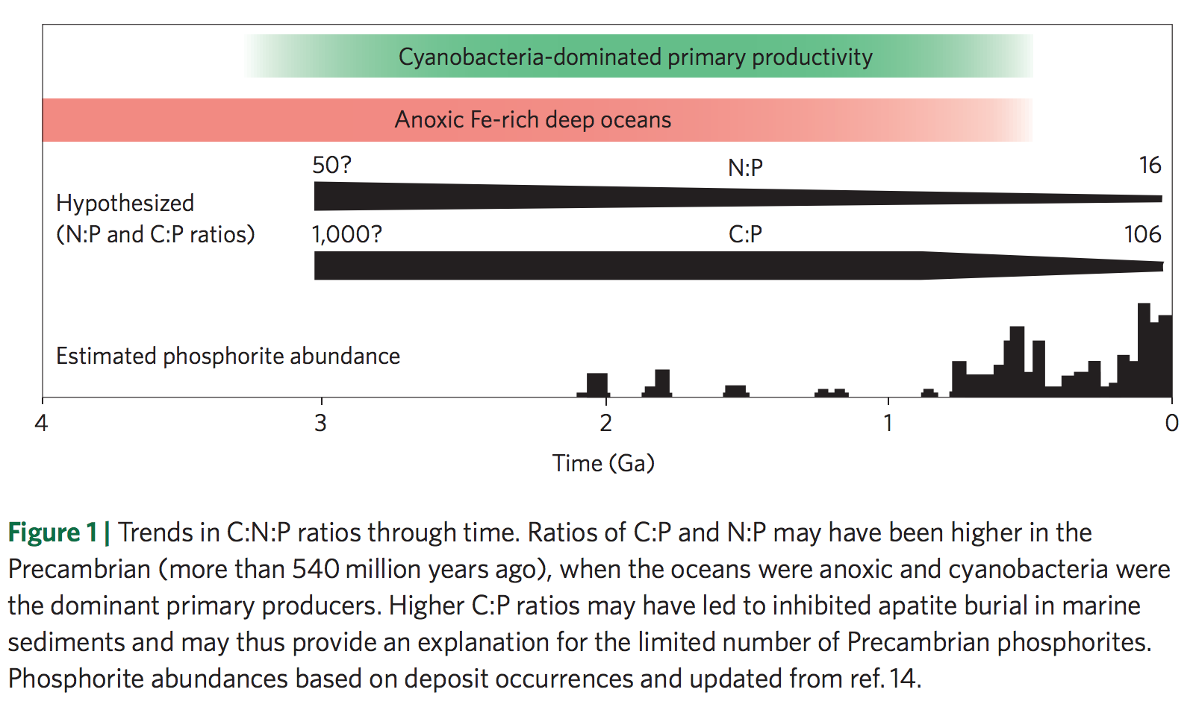
Redfield ratio may have changed over geologic time
Planavsky 2014

Slide 38
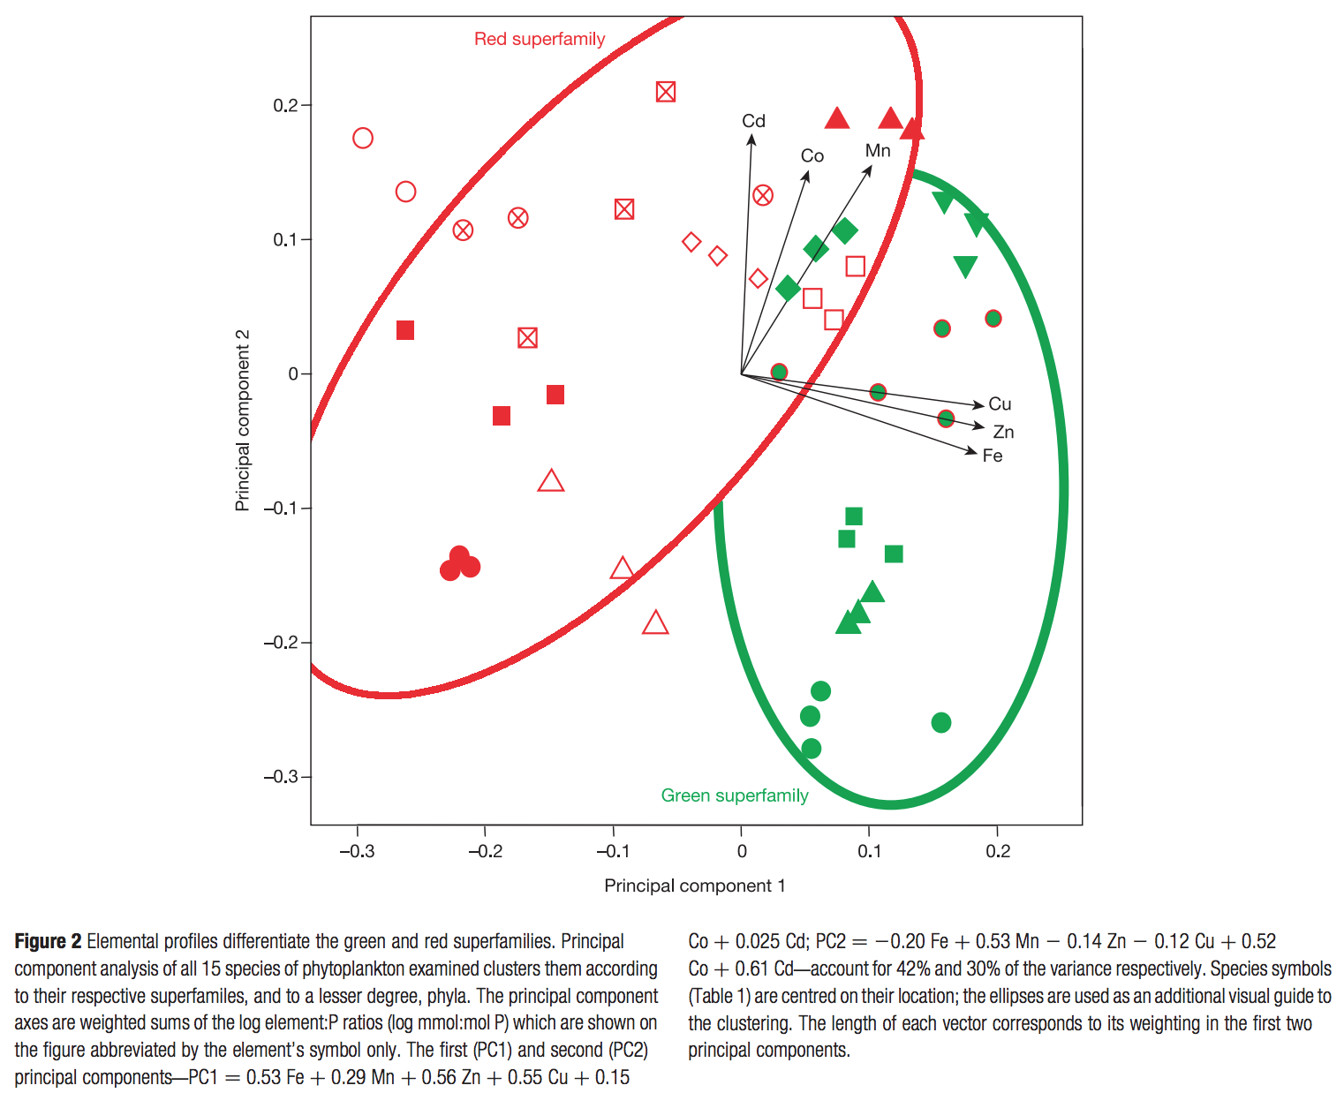
Nutrient preferences
are correlated
to ecological shifts
over geologic
time
dominant today
chlorophyll c, a
Quigg et al. Nature 2003
dominant pre-250 Ma
chlorophyll a & b
Marine phytoplankton

Slide 39
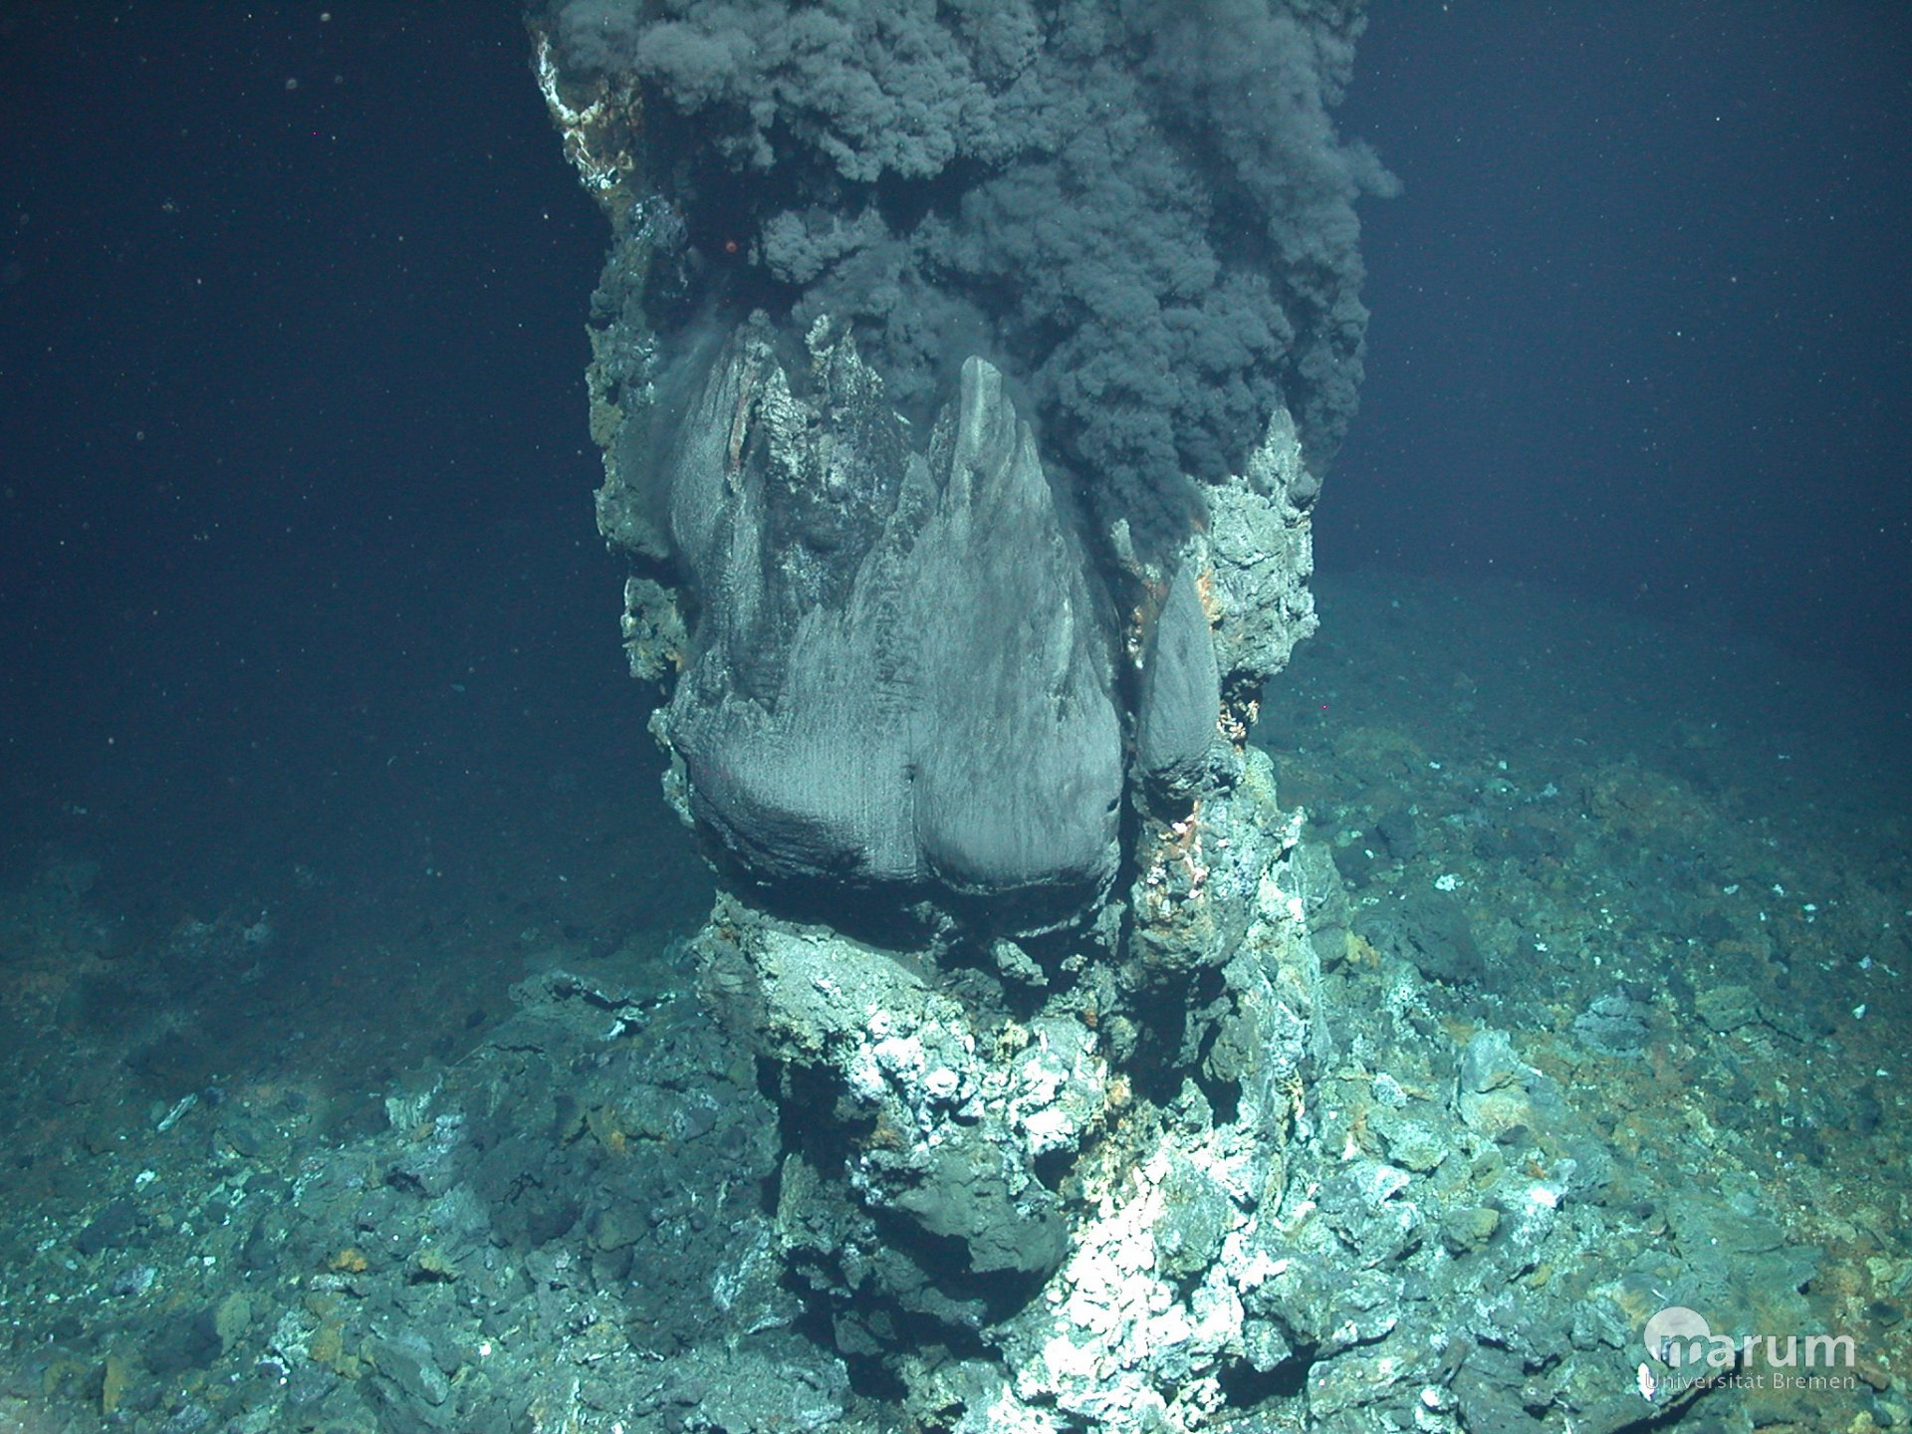
Hydrothermal vents:
“backup” nutrient source on worlds without land
support chemoautotrophs today
possible site for the origin of life

Slide 40
Immediately after the origin of life(?) Abiotic organic matter for early heterotrophs
K. Konhauser, ‘Geomicrobiology,’ 2009

Slide 41
Methanogenesis is a possible pre-photosynthetic energy source
Mars: unconfirmed reports of
unknown amounts of atmospheric CH4
Earth: Sleep & Bird 2007 table
Today: 100 Gton C/yr (approx. 2000 Tmol/yr )
ExoMars TGO: first science results last month

Slide 42
Early photosynthesis was limited by the availability of reductants
e.g. Fe²⁺ from weathering, sulfides (S²⁻) from hydrothermal vents …
Reduction of H₂O would be ideal, but this required a complicated evolutionary innovation that only happened once in Earth history (in an early cyanobacterium) and may have taken 2 Gyr to occur (Fischer et al., Annual Reviews, 2016). Water oxidation requires an oxidant with a potential of +0.8V (2x what is found in any anoxygenic phototroph). Water splitting system is from one clade of prokaryotes, the other photosystem from a separate clade.

Slide 43
Fluxes vs. stocks: A caution for extrapolation of nutrient flux / productivity calculations to planets-in-general
Example: Oxygen
Suppose a P-starved planet had evolved O2 photosynthesis, but the O2 production rate
was 10,000 times less than on today’s Earth (due to P limitation). Could O2 build up
to the level on today’s Earth?
Net primary productivity ~ 100 Gton/yr

Slide 44
Key points
Mechanisms by which biology / organic carbon sequestration might affect long-term climate regulation
Understand/explain the Daisyworld model
How ⁷Li may be used to track weathering intensity vs. time: examples from the geologic record
Discuss nutrient limitation on modern Earth; pre-photosynthetic Earth; and Earth when dominated by anoxygenic photosynthesis.

Slide 45
Backup/additional slides

Slide 46
A new proxy for weathering: ⁷Li
Misra & Froelich, Science 2012
Lithium cycle is mostly in silicate rocks and aluminosilicate clays; none in carbonates.
High weathering intensity: Low riverine ⁷Li concentrations.
Low weathering intensity (e.g. mountains): High riverine ⁷Li concentrations.

Slide 47
0.9% increase
Dissolved Li 50 Ma
suspended Li today?
(Other interpretations
possible).
Misra &
Froelich 2012
Ocean Drilling Program

Slide 48
Evidence for increased chemical weathering at the PETM
Dickson et al., P³, 2015
mbsf = meters below sea floor

Slide 49
Seasonal and interannual variability
Gislason et al. 2009
Icelandic watersheds showing a large,
recent temperature increase
(natural experiment)

Slide 50
Testing the prediction of a pole-to-equator increases in weathering rates

Slide 51
DeConto et al., Nature 2012: polar permafrost as a carbon capacitor

Slide 52
Large-scale organic carbon burial offshore in deltas today
Sequestration of petrogenic C moderates
C release from eroding coal, org.-rich shale
Sequestration of biospheric C draws down
CO2 from atmosphere/ocean.
Galy et al. Nature 2007
Galy et al. Nature 2015*
* Optional reading this week

Slide 53
Survival chances of terrestrial organic matter are slight unless deposition is fast (usually only for the deltas of rivers draining fast-eroding mountain belts)
Because re-oxidation of
organic matter (both terrestrial
and marine) is usually efficient,
oil and coal are rare in the rock
record.

