Slide 1
GEOS 22060/ GEOS 32060 / ASTR 45900
What makes a planet habitable?
Lecture 14
Biological feedbacks → Mars
Tuesday 18 February 2020

Slide 2
Volunteers needed for Planavsky 2014

Slide 3
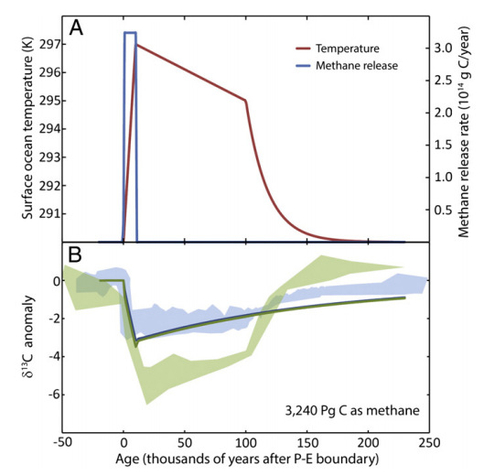
PETM: Severe data-model mismatch when only temperature-dependent silicate weathering is considered
alternatives:
organic-matter oxidation,
volcanism
“recovery
problem”
“body problem”
Bowen 2013

Slide 4
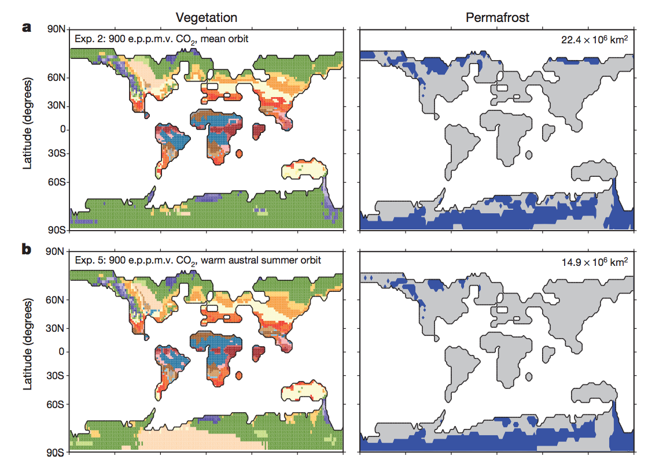
PETM: role of organic carbon in climate system recovery? DeConto et al., Nature 2012: polar permafrost as a carbon capacitor

Slide 5
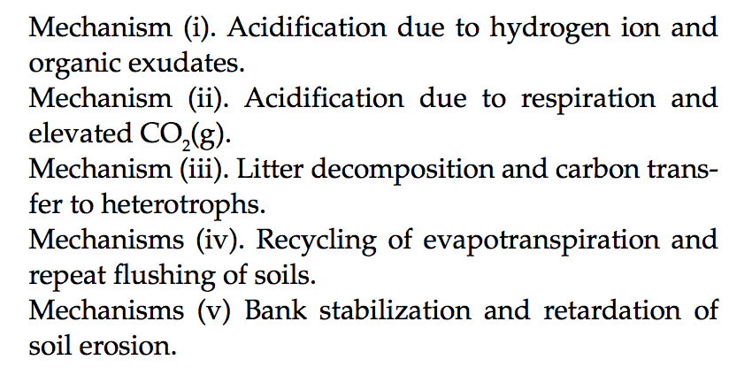
Evolution of land plants ~0.4 Ga likely had major effects on geologic carbon cycle:
Beerling & Butterfield 2012

Slide 6
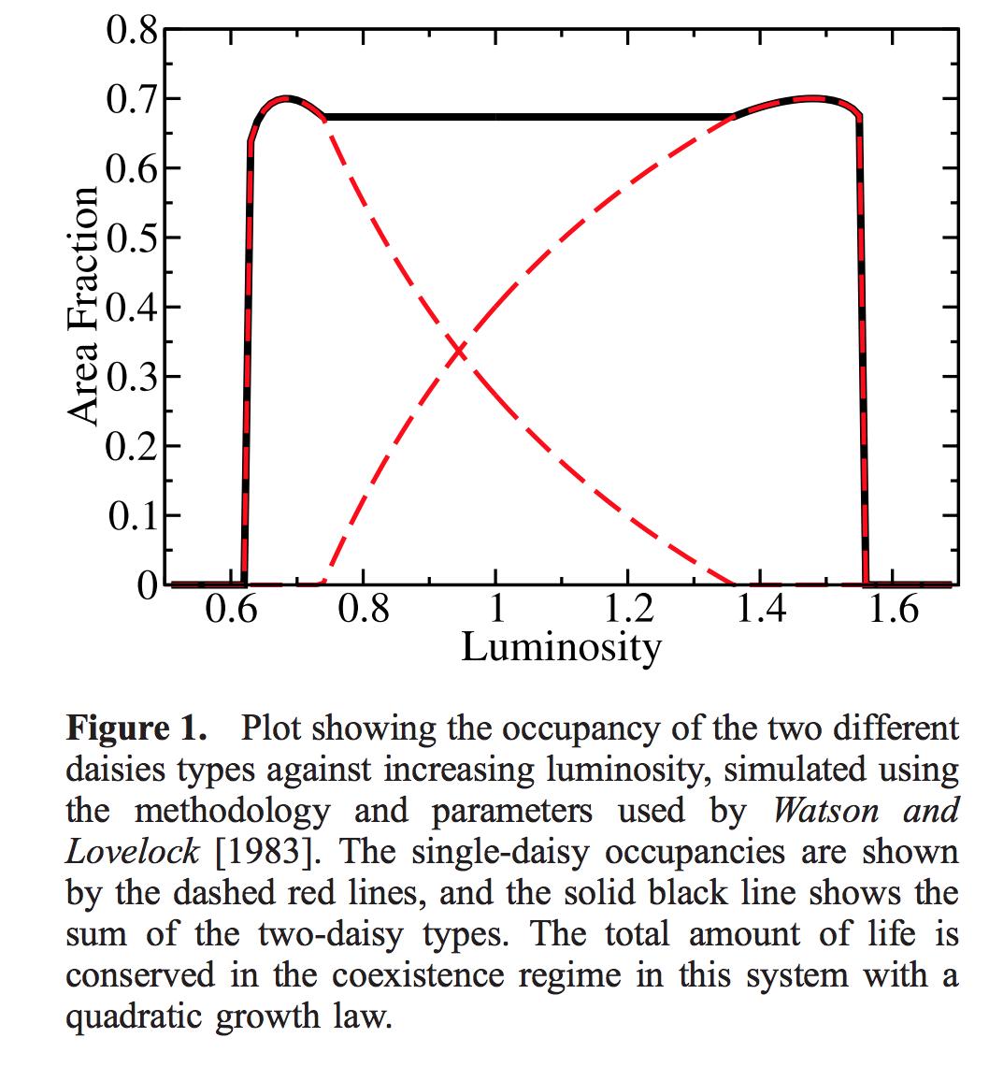
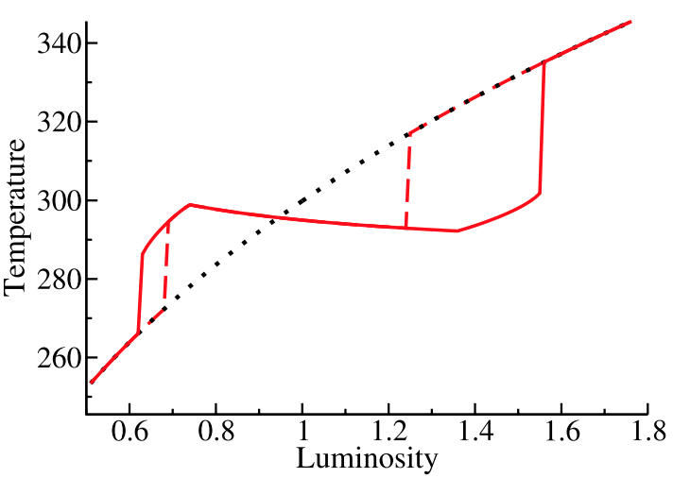
Gaia hypothesis – biosphere in the driving seat – due to Lovelock, recent developments by Lenton
“Daisyworld”: an idealized, toy model to illustrate the Gaia hypothesis
Wood et al. Reviews of Geophysics 2008

Slide 7
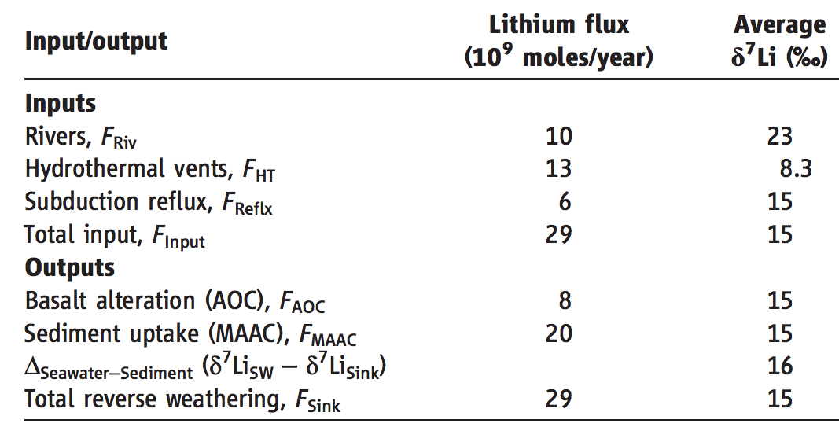
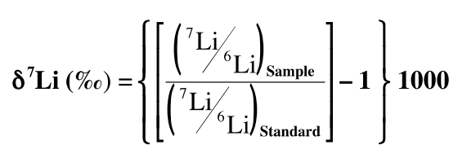
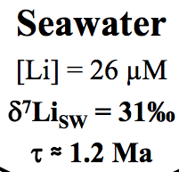
A new proxy for weathering: ⁷Li - A water-soluble trace element - During weathering, Li-7 preferentially partitions into river water, and Li-6 partitions into secondary minerals (clays)
Misra & Froelich, Science 2012
Lithium cycle is mostly in silicate rocks and aluminosilicate clays; none in carbonates.
High weathering intensity (e.g. soils in hot, wet, tectonically passive cratons):
Congruent weathering, Low riverine ⁷Li concentrations reflecting source bedrock.
Low weathering intensity (e.g. mountains, Himalaya):
Incongruent weathering, High riverine ⁷Li concentrations reflecting incomplete dissolution.

Slide 8
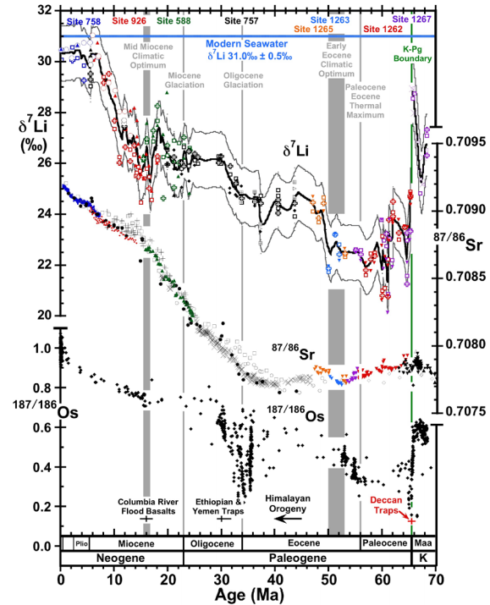
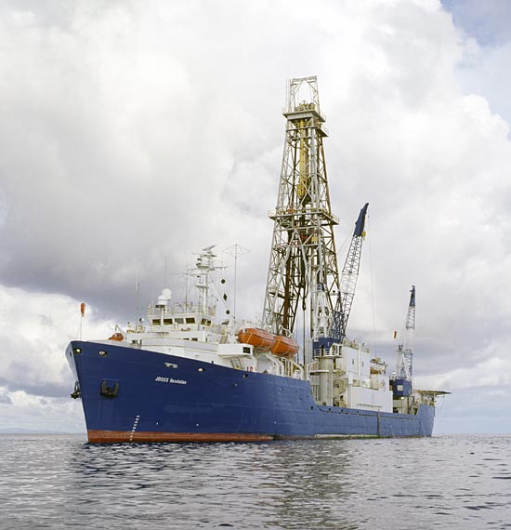
Misra &
Froelich , Science, 2012
Ocean Drilling Program

Slide 9
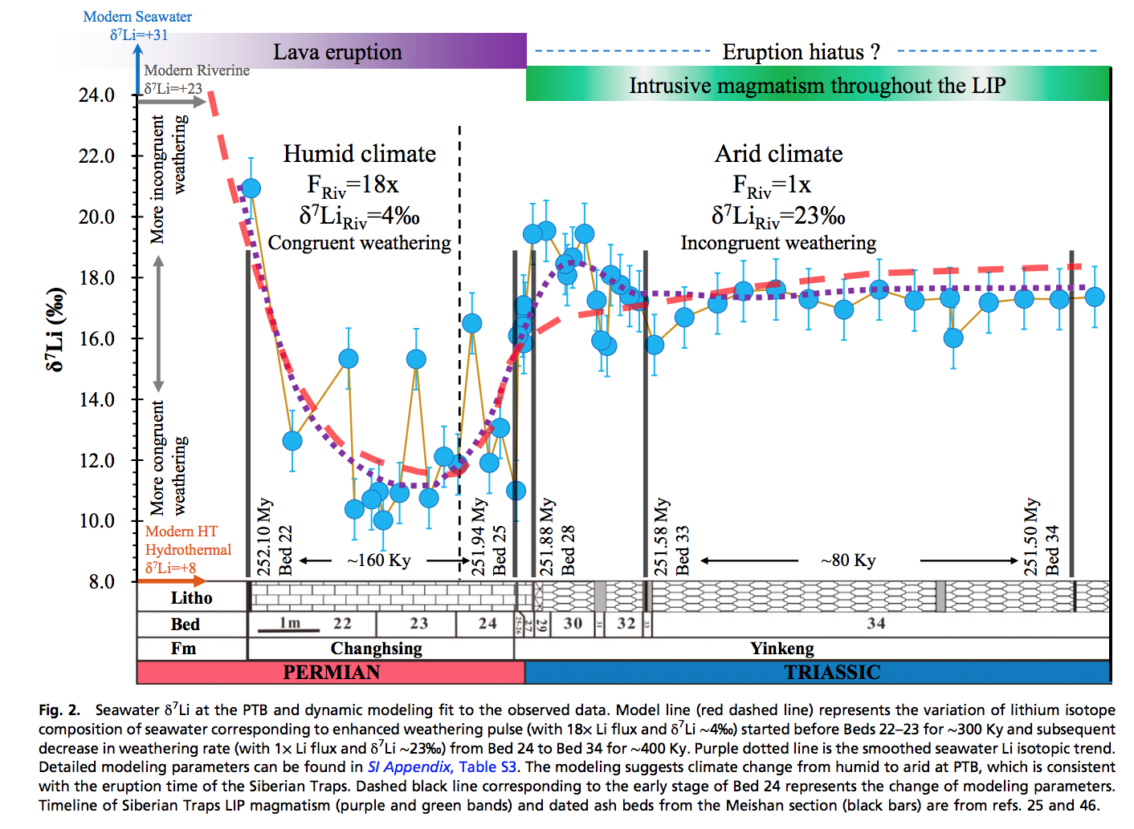
Enhanced silicate weathering occurred at the Permo-Triassic boundary (largest mass extinction in the fossil record).
Sun et al. PNAS 2018

Slide 10
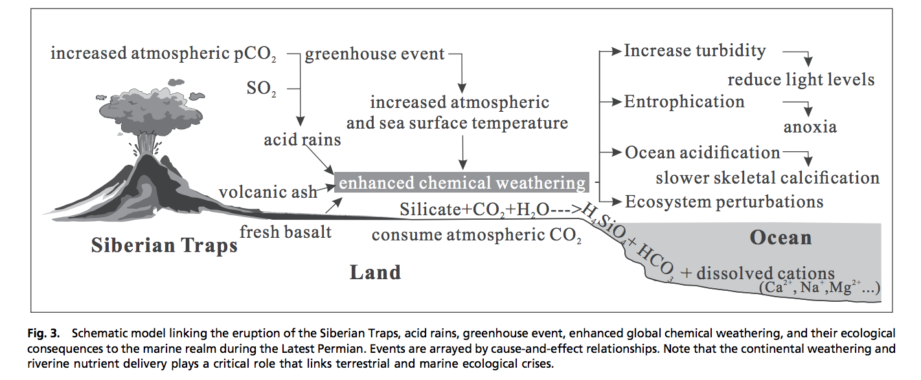
Enhanced weathering at the Permo-Triassic boundary may have contributed to the mass extinction.

Slide 11
Summary and discussion of carbonate-silicate weathering feedback
There is strong evidence for a negative feedback stabilizing climate over >300 Kyr timescales on Earth.
The carbonate-silicate weathering feedback hypothesis is the currently leading hypothesis for this negative feedback.
However, other hypotheses (e.g., organic-carbon feedbacks) may contribute, and research is ongoing to determine which mechanism is the primary control on Earth’s long-term climate.

Slide 12
Nutrient supply
Konhauser 2009

Slide 13
Nutrient availability and nutrient limitation

Slide 14
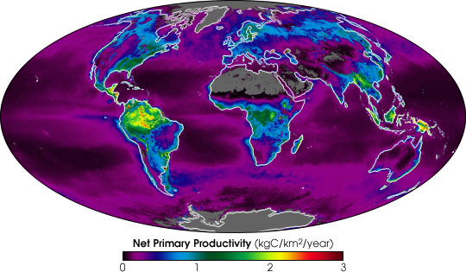
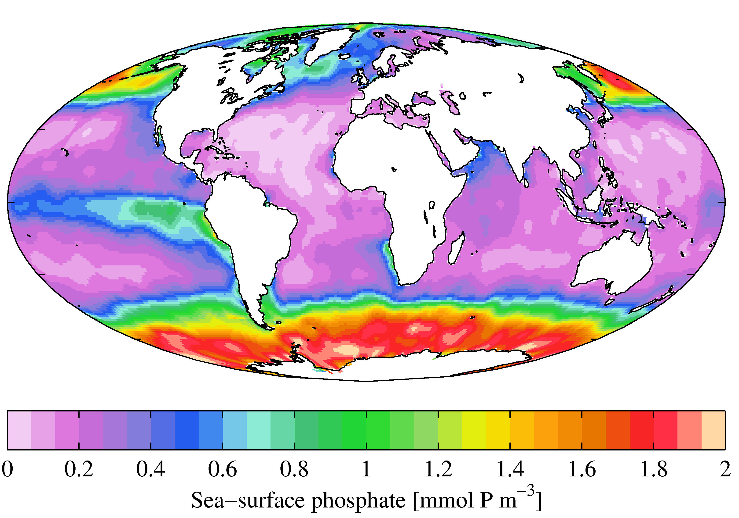
Present-day primary productivity is dominated by oxygenic photosynthesis which evolved
2.3 Ga (perhaps earlier). Productivity in the ocean is currently limited on geologic timescales
by the availability of P (and, locally, the availability of Fe) derived from continental weathering.
NASA Earth Observatory
Fe-poor region
World Ocean Atlas

Slide 15
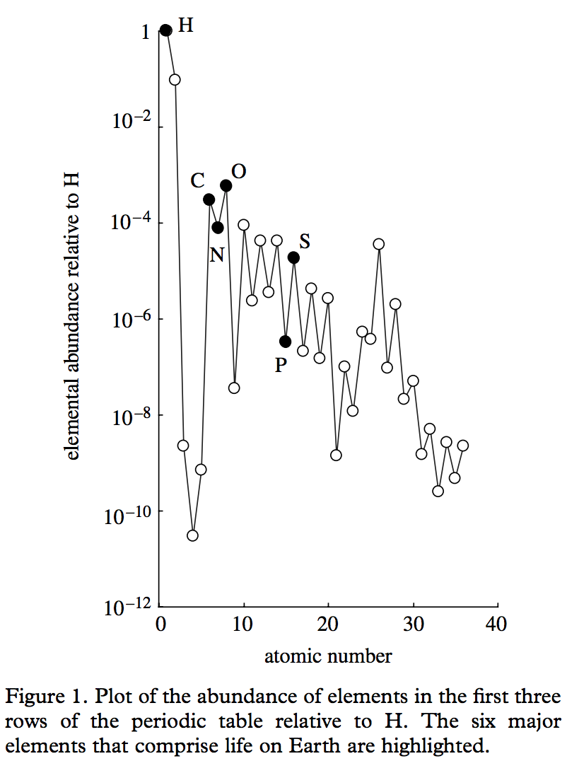
Redfield ratio – C:N:P = 106:16:1
life = CHONPS + some transition-metal catalysts
metalloenzymes involving
Fe, Ni, Cu, Mn, Co, Mo, and Zn
are central to microbial ecology.
E.g., the first nitrogenase had 38 Fe-atoms
Falkowski & Godfrey,
Phil. Trans. Roy. Soc. A 2008

Slide 16
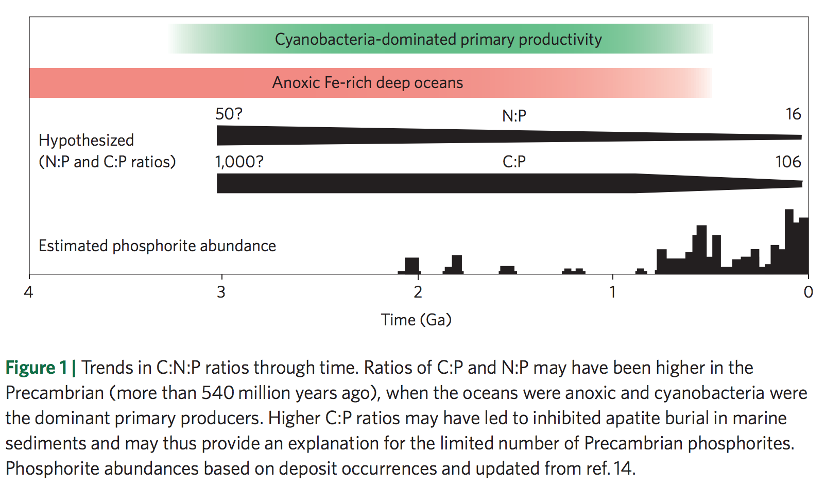
Redfield ratio may have changed over geologic time
Planavsky 2014

Slide 17
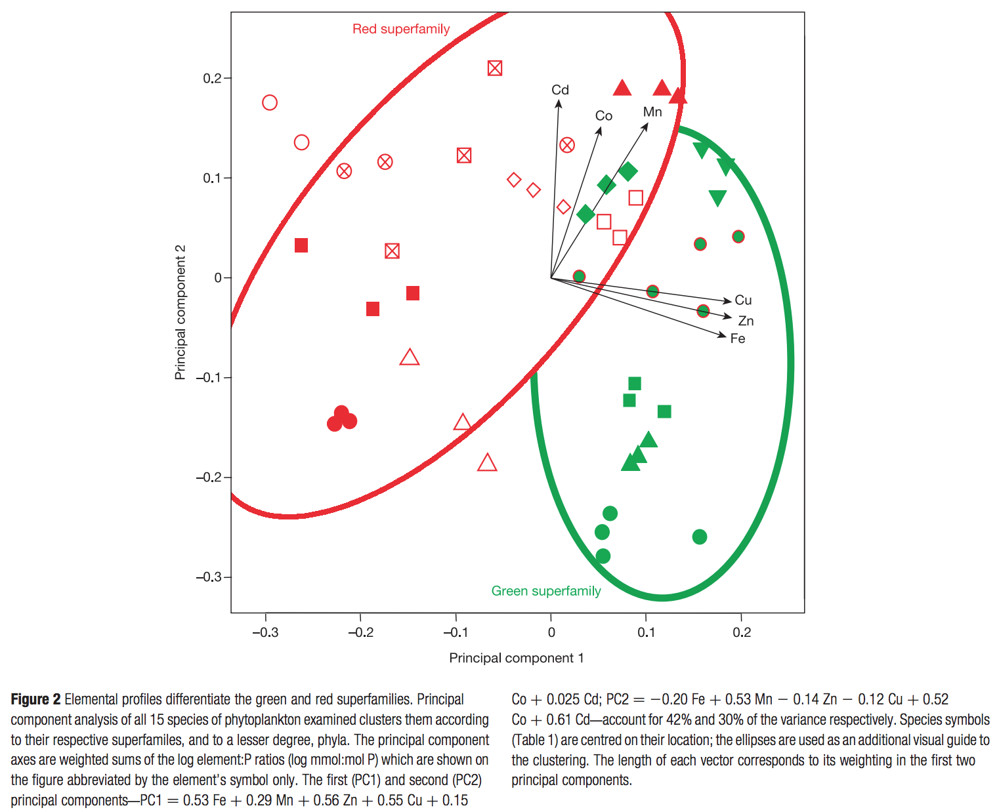
Nutrient preferences
are correlated
to ecological shifts
over geologic
time
dominant today
chlorophyll c, a
Quigg et al. Nature 2003
dominant pre-250 Ma
chlorophyll a & b
Marine phytoplankton

Slide 18
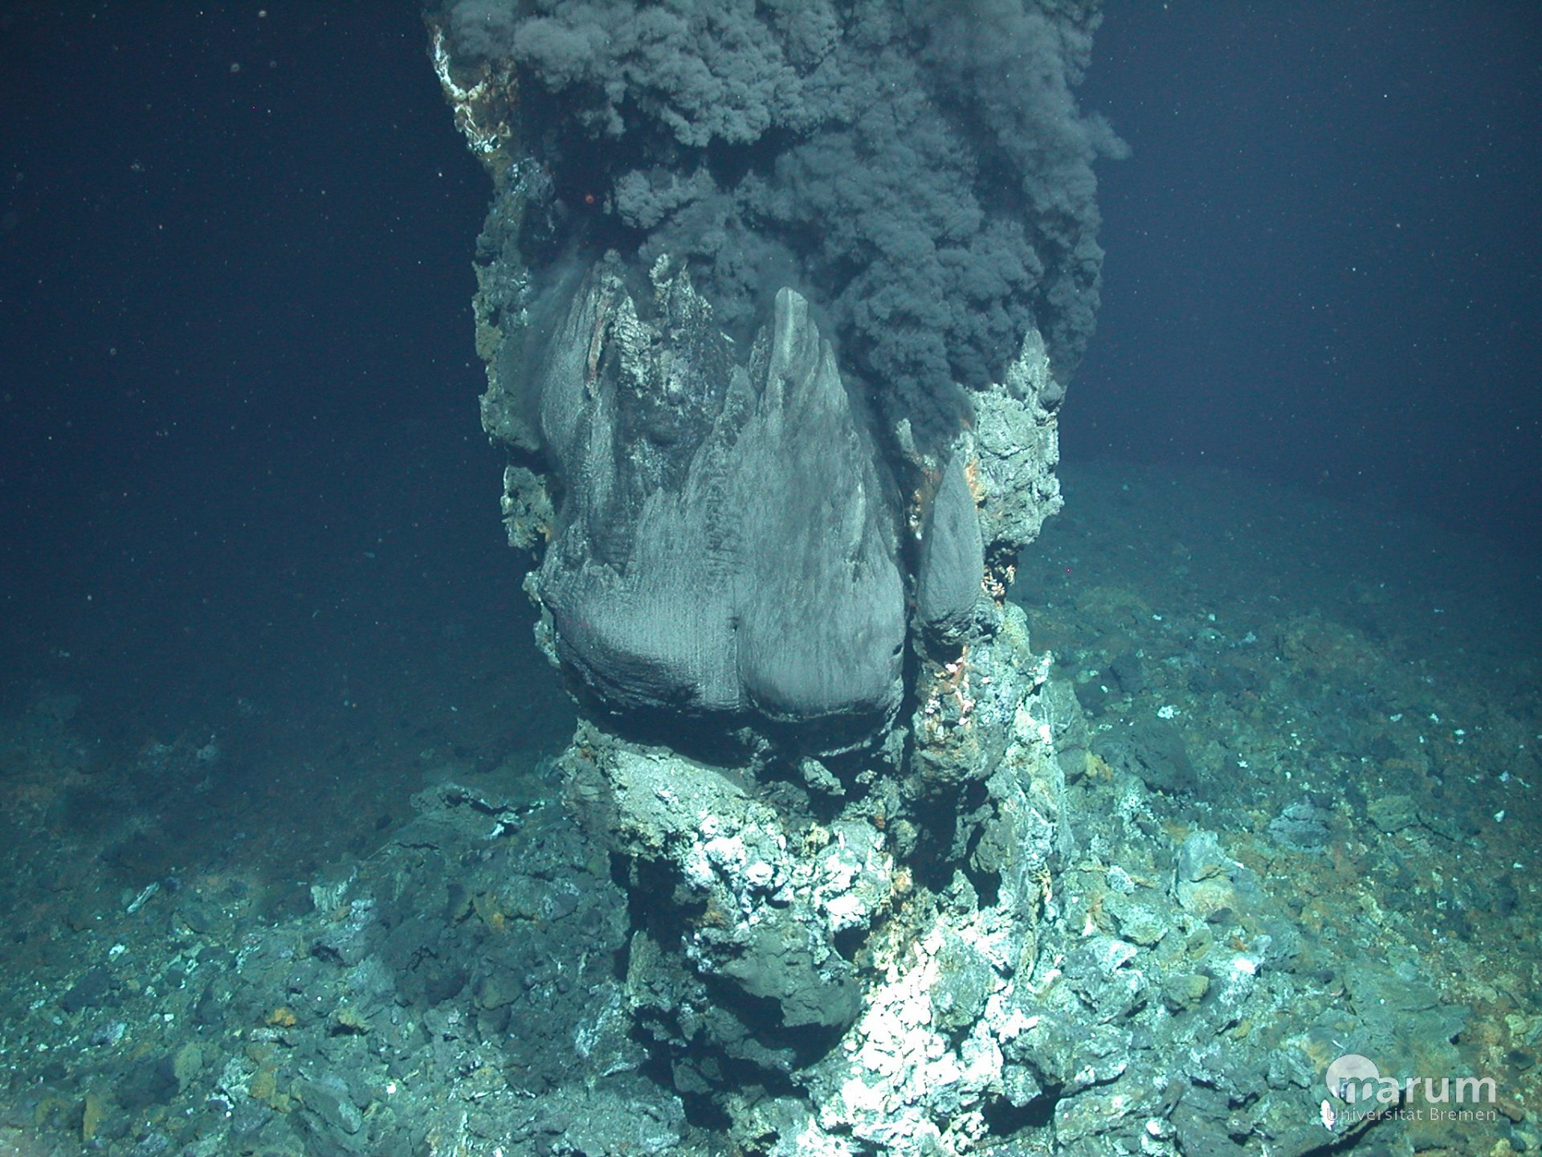
Hydrothermal vents:
“backup” nutrient source on worlds without land
support chemoautotrophs today
possible site for the origin of life

Slide 19
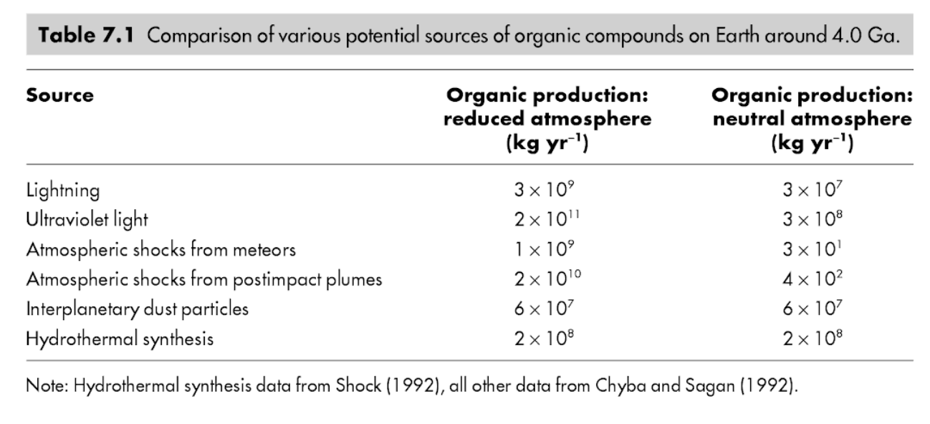
Immediately after the origin of life(?) Abiotic organic matter for early heterotrophs
K. Konhauser, ‘Geomicrobiology,’ 2009

Slide 20
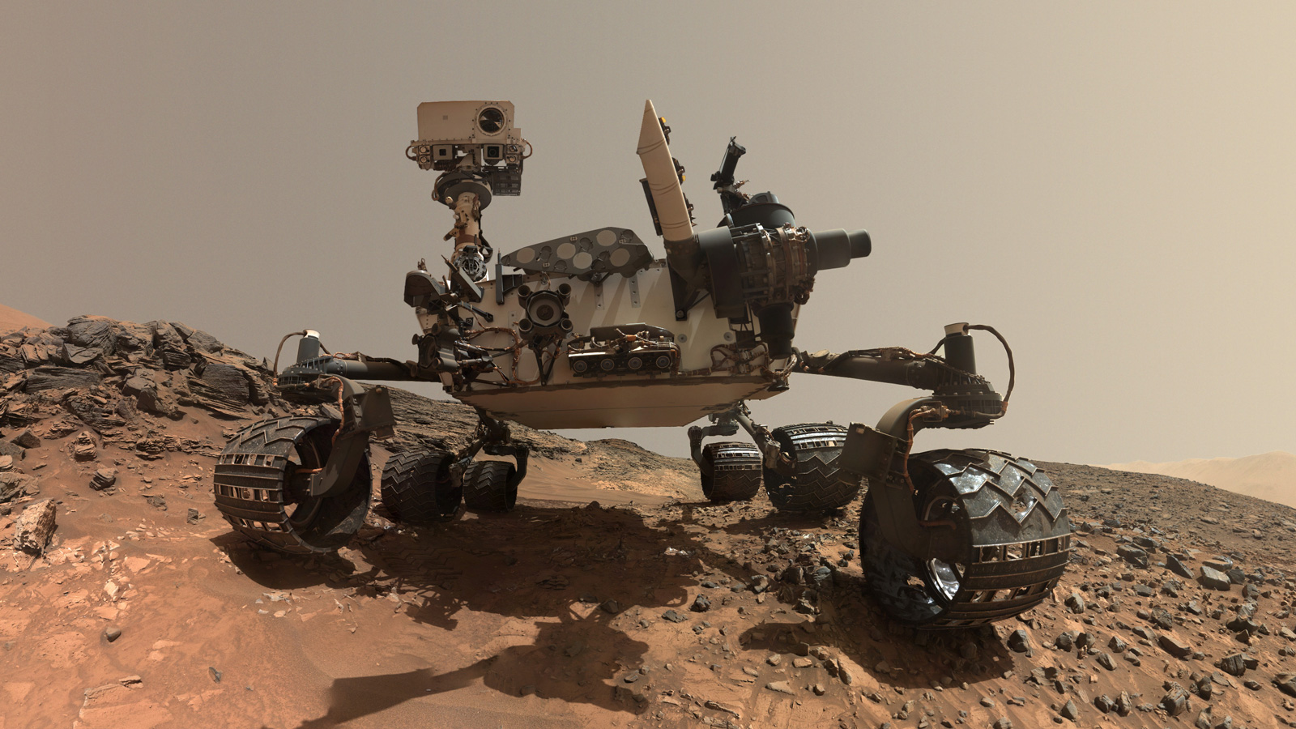
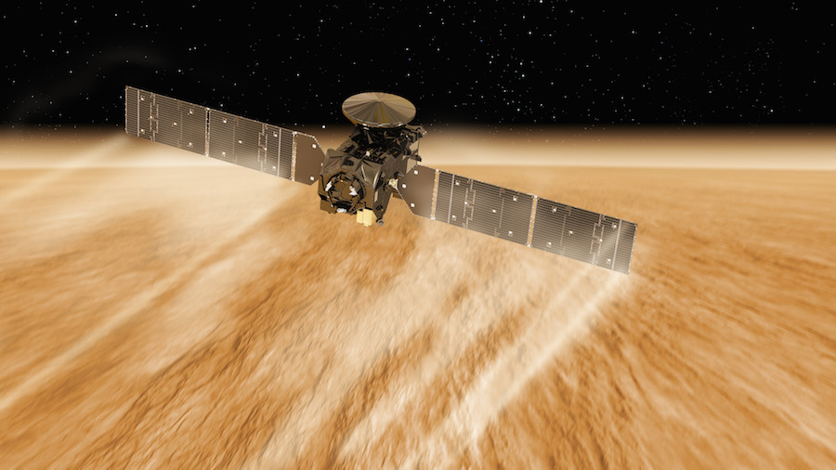
Methanogenesis is a possible pre-photosynthetic energy source
Mars: unconfirmed reports of
unknown amounts of atmospheric CH4
Earth: Sleep & Bird 2007 table
Today: 100 Gton C/yr (approx. 2000 Tmol/yr )

Slide 21
Early photosynthesis was limited by the availability of reductants
e.g. Fe²⁺ from weathering, sulfides (S²⁻) from hydrothermal vents …
Reduction of H₂O would be ideal, but this required a complicated evolutionary innovation that only happened once in Earth history (in an early cyanobacterium) and may have taken 2 Gyr to occur (Fischer et al., Annual Reviews, 2016). Water oxidation requires an oxidant with a potential of +0.8V (2x what is found in any anoxygenic phototroph). Water splitting system is from one clade of prokaryotes, the other photosystem from a separate clade.

Slide 22
Key points
Mechanisms by which biology / organic carbon sequestration might affect long-term climate regulation
Understand/explain the Daisyworld model
How ⁷Li may be used to track weathering intensity vs. time: examples from the geologic record
Discuss nutrient limitation on modern Earth; pre-photosynthetic Earth; and Earth when dominated by anoxygenic photosynthesis.

Slide 23
Mars

Slide 24
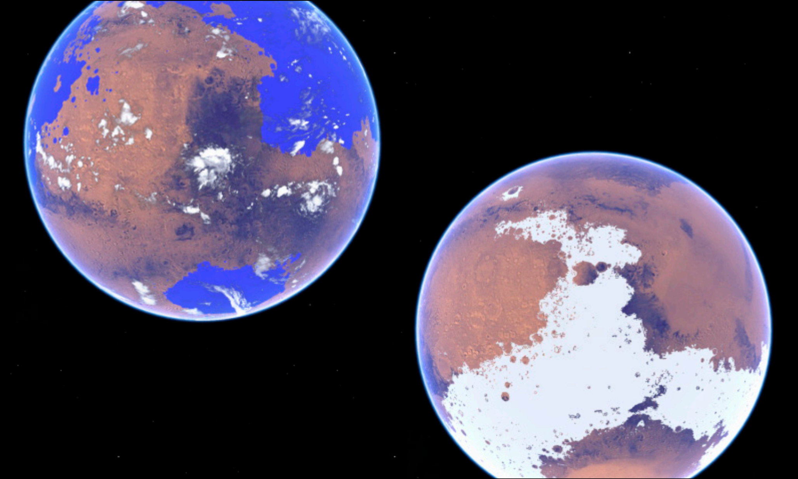

Slide 25
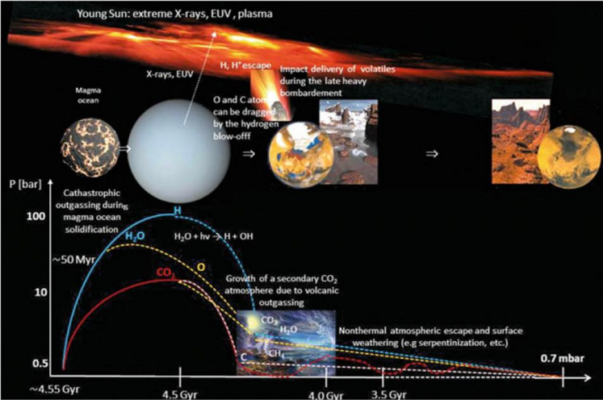
Main drivers of atmospheric decline: escape-to-space (including impact erosion)
Lammer et al., Space Science Reviews, 2013

Slide 26
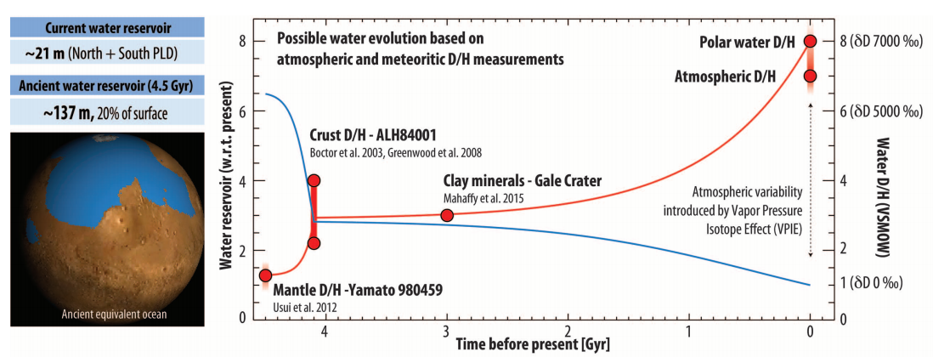
Evidence for water loss over time
Villaneuva et al., Science 2015

Slide 27
Climate stabilization on early Mars
MODERN MARS CLIMATE
CARBON FEEDBACKS?
SULFUR FEEDBACKS?
HYDROGEN?
INTERMITTENCY?

Slide 28
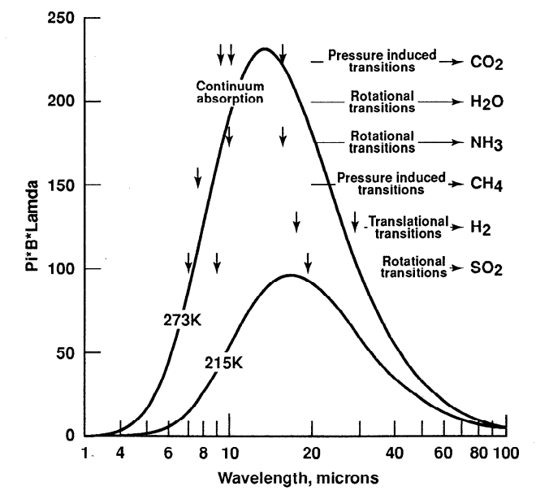
Haberle et al. JGR-Planets 1998

Slide 29
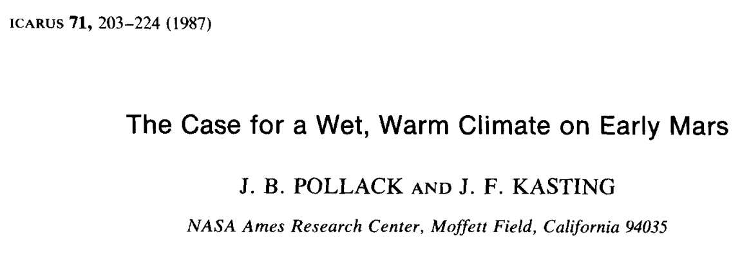
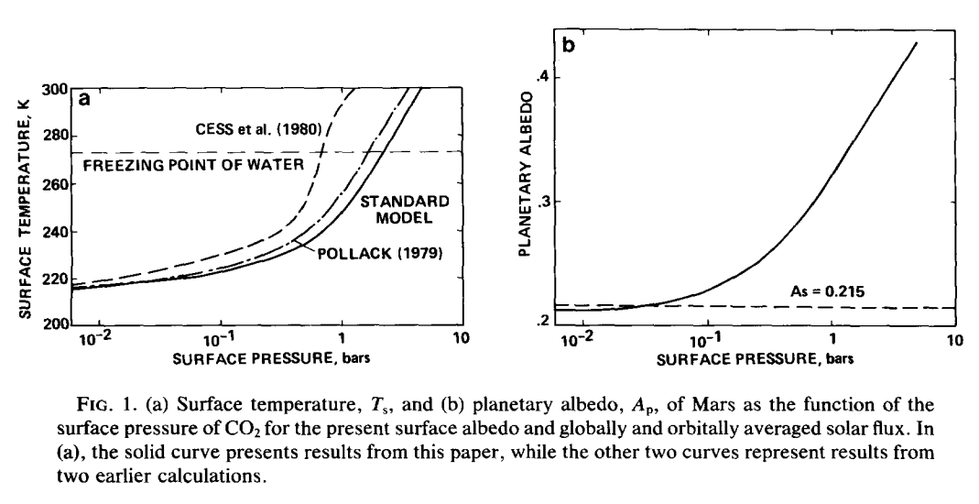

Slide 30
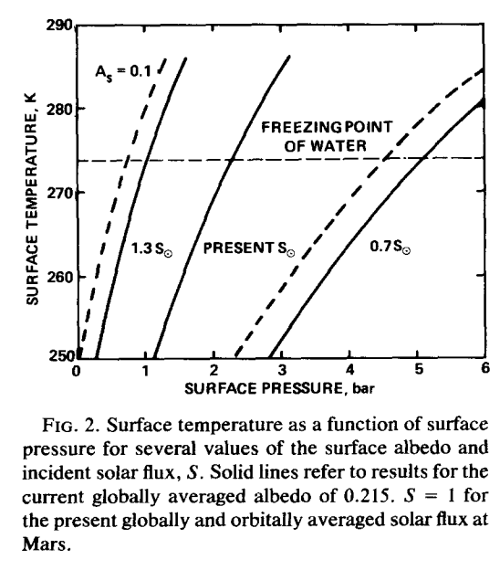

Slide 31
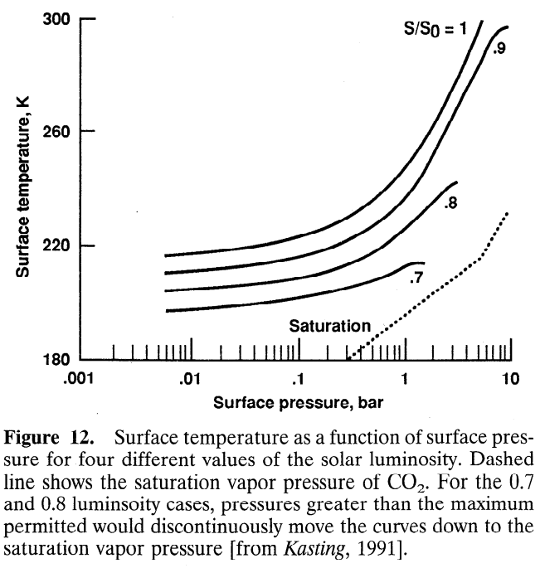
CO₂ condensation limits warming
Haberle,
JGR-Planets,
1998

Slide 32
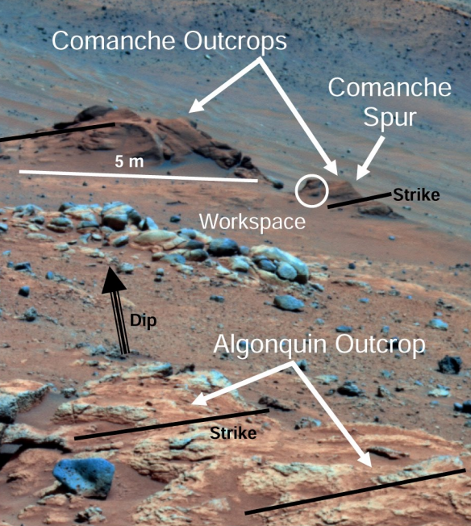
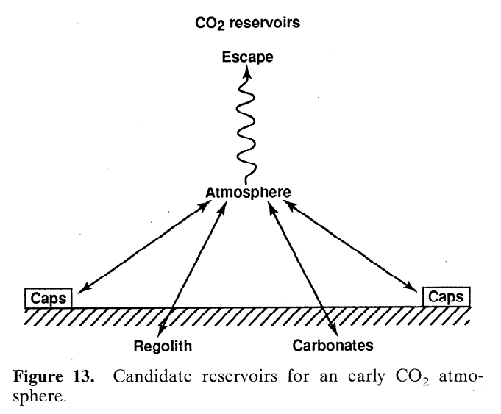
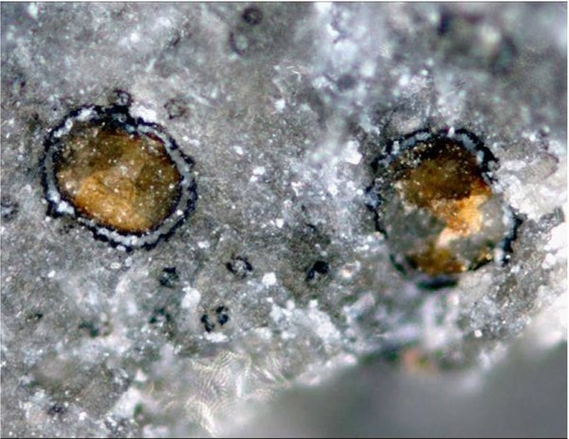
Problem #1: where are the carbonates?
Carbonates are expected to form by water-rock
reaction if pCO2 was high and pH was not acidic
Comanche: 16-34 wt% carbonate
(Morris et al., 2010): but such outcrops are rare
Adding up known
carbonate
reservoirs yields
<< 1 bar CO₂
equivalent
Haberle,
JGR-Planets,
1998

Slide 33
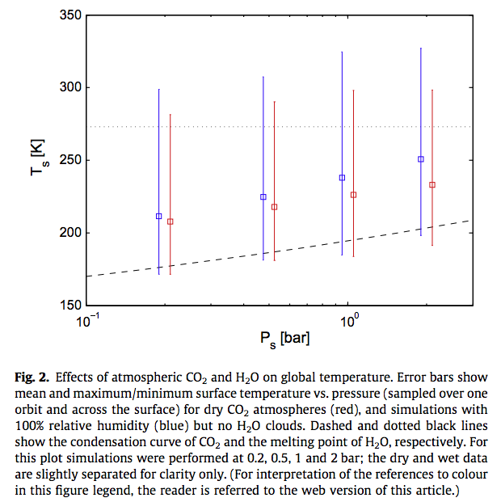
Wordsworth et al. Icarus
2013

Slide 34
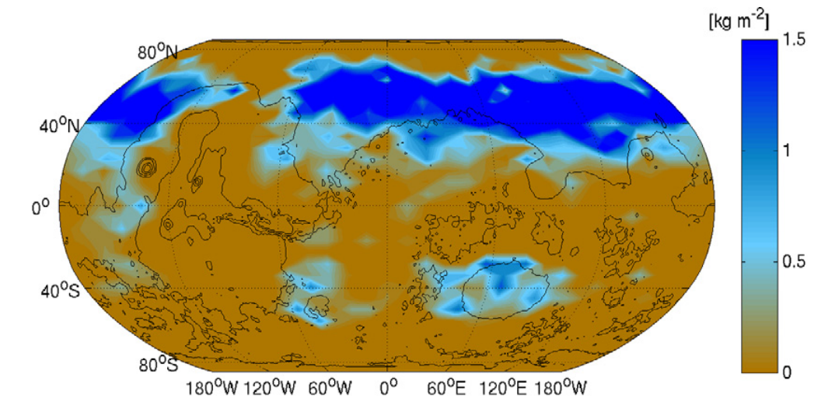
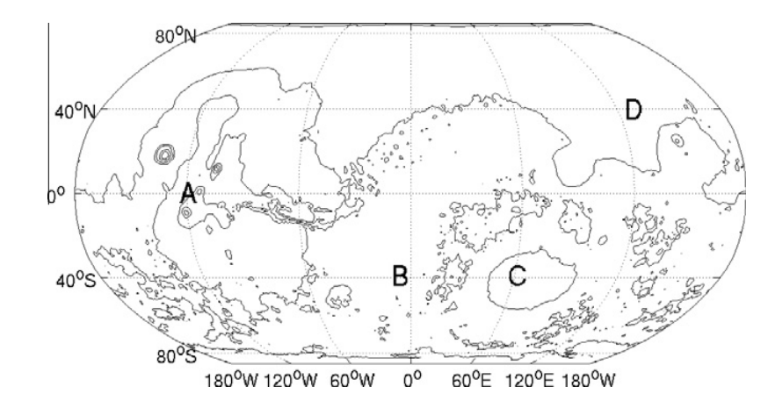
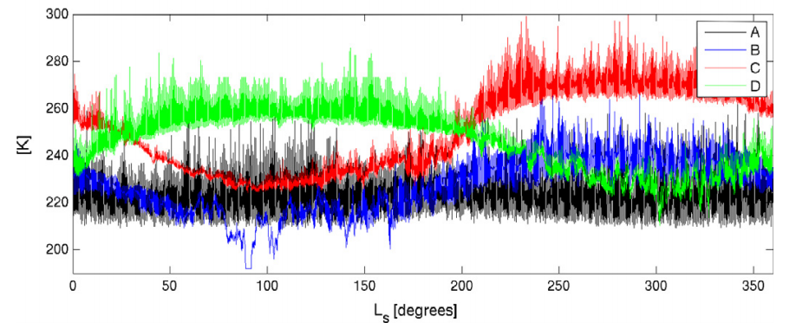
Problem #2: how much CO2 is enough?
Wordsworth et al. Icarus 2013

Slide 35
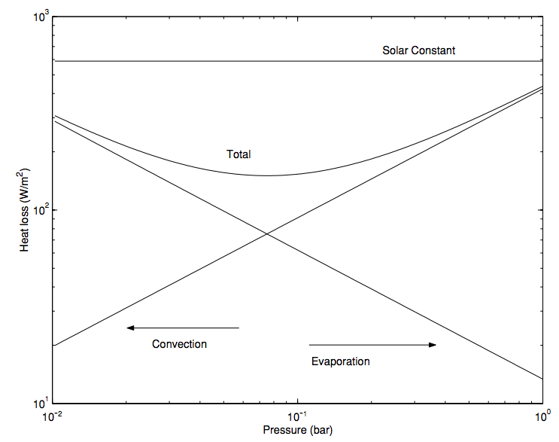
In addition to greenhouse warming, a thicker atmosphere is still useful for suppressing evaporitic cooling
Assumes 273K
surface & 200K
atmosphere
Hecht
2002
Icarus

Slide 36
Climate stabilization on early Mars
MODERN MARS CLIMATE
CARBON FEEDBACKS?
SULFUR FEEDBACKS?
HYDROGEN?
INTERMITTENCY?

Slide 37
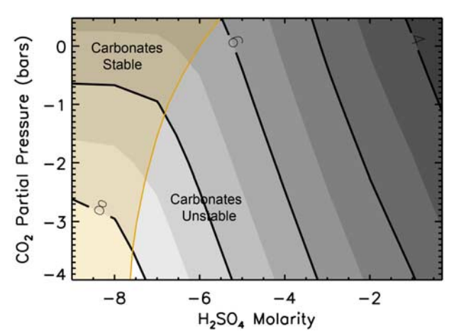
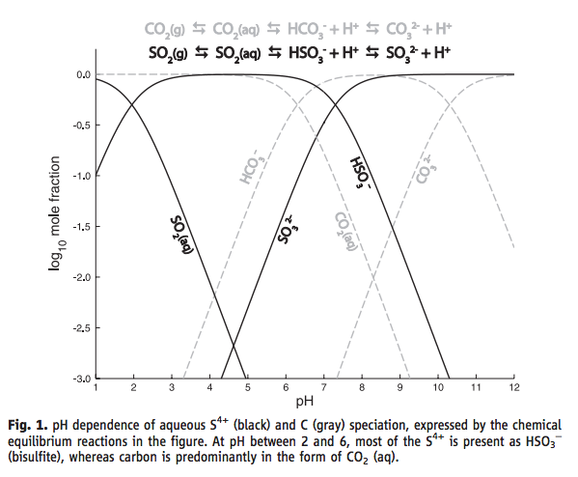
SO₂ inhibition of carbonate precipitation?
Bullock & Moore, GRL 2007
(contours = pH)
Halevy et al. Science 2007

Slide 38
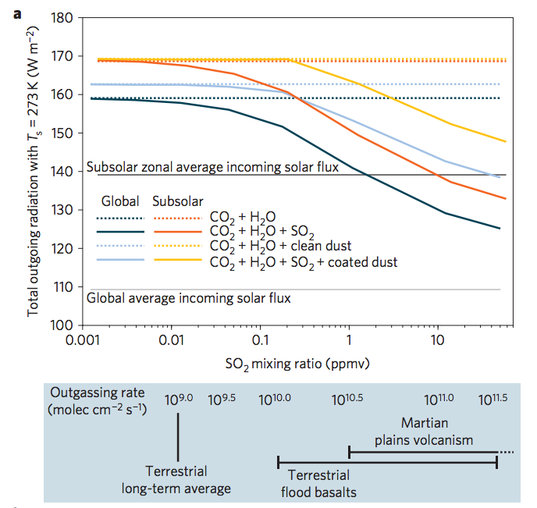
SO₂-driven warming?
fluxes
required
to maintain
these SO₂
concentrations,
at steady state
Halevy & Head, Nature Geoscience, 2014

Slide 39
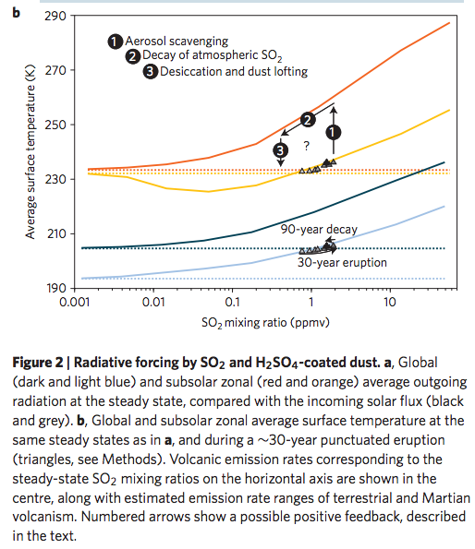
Halevy & Head, Nature Geoscience, 2014

Slide 40
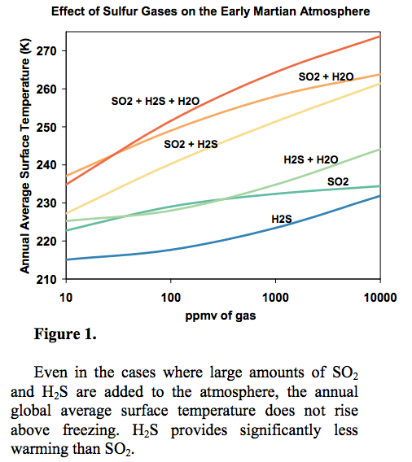
Kerber et al.
JGR-Planets
2015

Slide 41
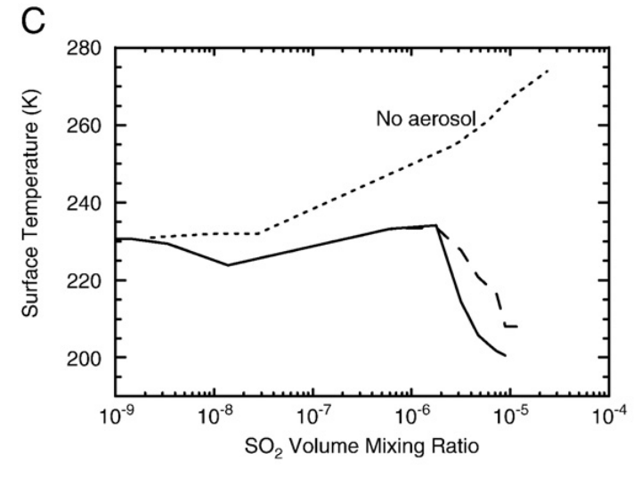
Aerosol formation reduces SO₂ warming
Tian et al. EPSL 2010

Slide 42
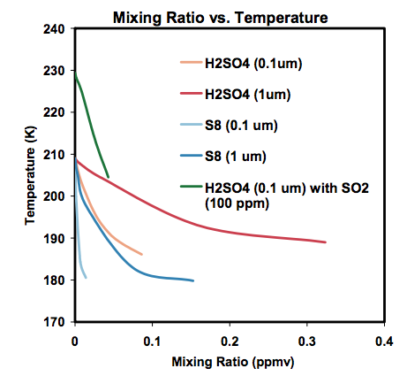
Kerber et al., Oxford Conference on Mars’ Atmosphere, 2014

Slide 43
Climate stabilization on early Mars
MODERN MARS CLIMATE
CARBON FEEDBACKS?
SULFUR FEEDBACKS?
HYDROGEN?
INTERMITTENCY?

Slide 44
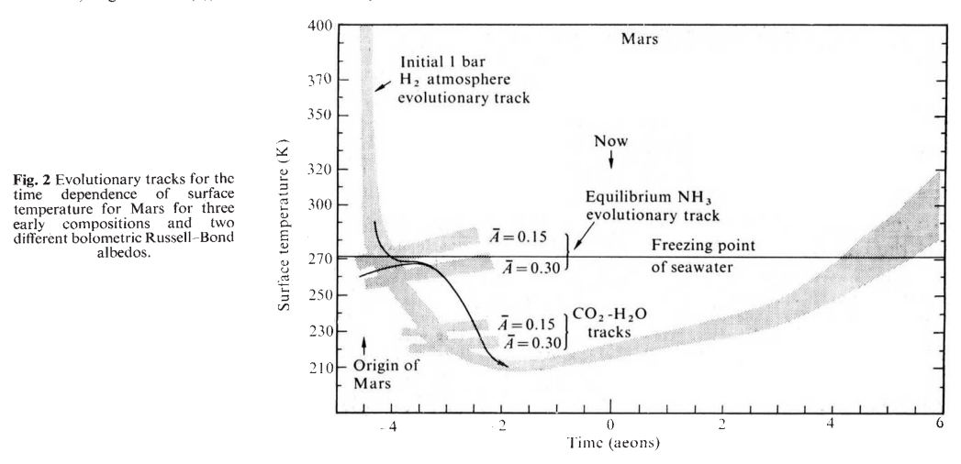
H2 collision-induced absorption
Sagan, Nature, 1977

Slide 45
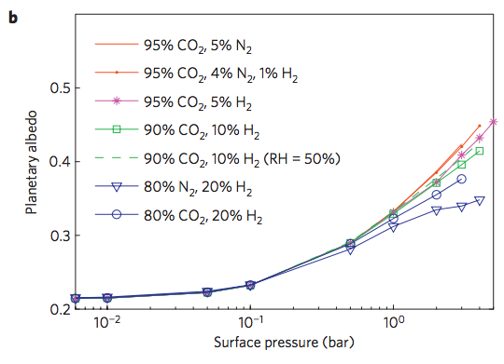
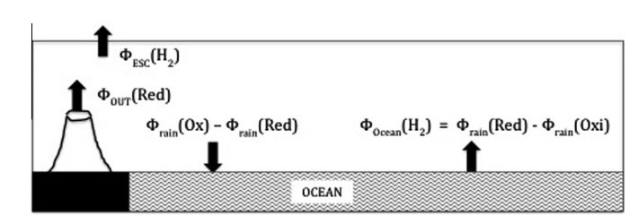
Ramirez et al. Nature Geoscience 2014
Batalha et al. Icarus 2015

Slide 46
Climate stabilization on early Mars
MODERN MARS CLIMATE
CARBON FEEDBACKS?
SULFUR FEEDBACKS?
HYDROGEN?
INTERMITTENCY?

Slide 47
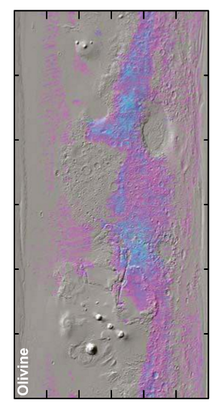
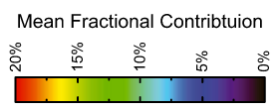
Olivine places an upper limit of 10⁷ yr of water over most of the surface
Koeppen & Hamilton, JGR-Planets, 2008
Refers to soil-water contact (ice can shield soil from water)
Physical erosion can ‘reset’ the surface

Slide 48
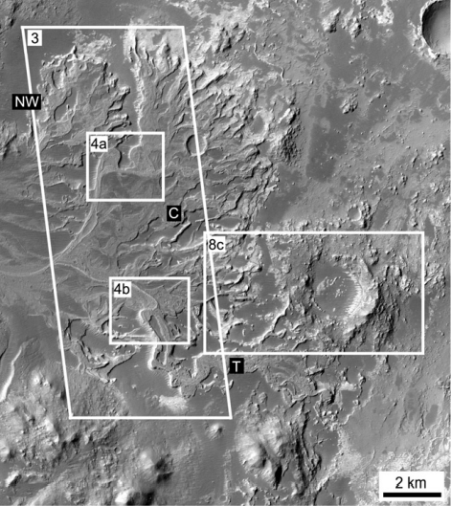
Paleolake hydrology requires >10⁴⁻⁵ continuous wet years (e.g., seasonal runoff)
Irwin et al., Geomorphology 2015

Slide 49
Statistics of intermittent habitability on Mars
P_{CO2}
obliquity
Ongoing work
(Kite et al. LPSC 2015; Mansfield et al. JGR 2018.)

Slide 50
Falcon Heavy:
17 tons to Mars
Can Mars be made habitable in the near future?
Difficult at best
Bad news: No credible source for breathable levels of O2
Good news: ~1 bar CO2 would be sufficient to warm surface for modern solar luminosity
Bad news: The CO2 may have all (or mostly) escaped to space
(Ehlmann & Edwards, Geology, 2014)
Good news: CFCs or SF6 can provide very strong warming
(Marinova et al., JGR-Planets, 2005)
Bad news: CFC/SF6 warming would probably not trigger
runaway atmospheric re-inflation
(Bierson et al. GRL 2016)
Good news: …?
Common assumptions in the literature:
Initiate with relatively near-term
(21st-century) technologies
Goal: Habitable for photosynthetic algae/plants
Asteroid kinetic energy, nuclear bombs, e.t.c. is insufficient
Practical
robot
mining
vehicles
exist
Liu et al. Chinese J. Mech. Eng. 2016

Slide 51
Somerville et al. Journal of Quantitative Spectroscopy & Radiative Transfer 2016
Can Mars be made habitable in the near future? Gases vs. particles
Gases option:
Make on surface: Marinova+ 2005 JGR
Particles option: inject resonant absorbers at
stratospheric height
Deliver via impacts:
Double Asteroid Redirection Test
(launch 2020)
See also Teller et al., Lawrence Livermore National Lab
report UCRL-231636/UCRL JC 128715

Slide 52
Key points: Mars
Current Mars T, P, and magnitude of present day annual cycles of H₂O, CO₂, and dust;
reasons in favor of, and problems with, the CO₂, SO₂, and H₂ solutions to the
Early Mars Climate Problem;
significance of the olivine and paleolake-hydrology constraints on Early Mars climate.

Slide 53
Backup/additional slides

Slide 54
A new proxy for weathering: ⁷Li
Misra & Froelich, Science 2012
Lithium cycle is mostly in silicate rocks and aluminosilicate clays; none in carbonates.
High weathering intensity: Low riverine ⁷Li concentrations.
Low weathering intensity (e.g. mountains): High riverine ⁷Li concentrations.

Slide 55
0.9% increase
Dissolved Li 50 Ma
suspended Li today?
(Other interpretations
possible).
Misra &
Froelich 2012
Ocean Drilling Program

Slide 56
Evidence for increased chemical weathering at the PETM
Dickson et al., P³, 2015
mbsf = meters below sea floor

Slide 57
Seasonal and interannual variability
Gislason et al. 2009
Icelandic watersheds showing a large,
recent temperature increase
(natural experiment)

Slide 58
Testing the prediction of a pole-to-equator increases in weathering rates

Slide 59
DeConto et al., Nature 2012: polar permafrost as a carbon capacitor

Slide 60
Large-scale organic carbon burial offshore in deltas today
Sequestration of petrogenic C moderates
C release from eroding coal, org.-rich shale
Sequestration of biospheric C draws down
CO2 from atmosphere/ocean.
Galy et al. Nature 2007
Galy et al. Nature 2015*
* Optional reading this week

Slide 61
Survival chances of terrestrial organic matter are slight unless deposition is fast (usually only for the deltas of rivers draining fast-eroding mountain belts)
Because re-oxidation of
organic matter (both terrestrial
and marine) is usually efficient,
oil and coal are rare in the rock
record.

Slide 64
Fluxes vs. stocks: A caution for extrapolation of nutrient flux / productivity calculations to planets-in-general
Example: Oxygen
Suppose a P-starved planet had evolved O2 photosynthesis, but the O2 production rate
was 10,000 times less than on today’s Earth (due to P limitation). Could O2 build up
to the level on today’s Earth?
Net primary productivity ~ 100 Gton/yr

