Slide 1
GEOS 22060/ GEOS 32060 / ASTR 45900
What makes a planet habitable?
Lecture 3
Tuesday 14 January 2020

Slide 2
from last lecture: From Earth history to the Circumstellar Habitable Zone concept: Key points
Small imbalances between the geologic release rate of pCO2 and the geologic consumption rate of pCO2 would have seriously threatened Earth’s habitability.
This strongly suggests a negative feedback has regulated pCO2 over geologic time.
In the last ~10 years, the evidence for a negative feedback has gotten stronger - some people would go further and say a weathering feedback is required to explain the geologic data.
A candidate mechanism for the weathering feedback is carbonate-silicate weathering.
The Habitable Zone is defined as the range of distances from a star within which a weathering feedback might operate.

Slide 3
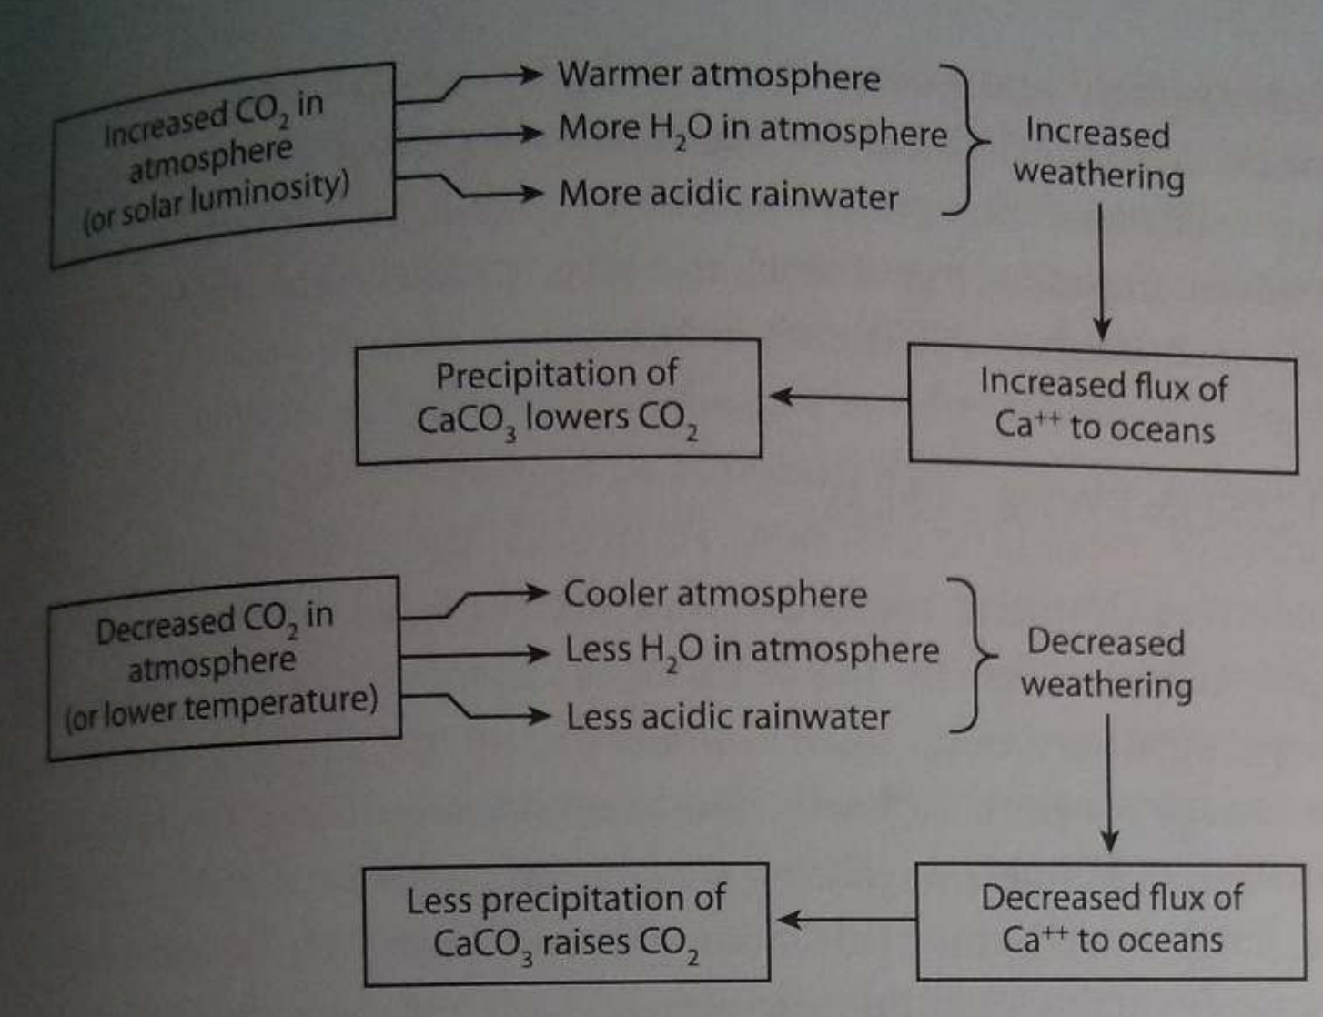
Feedbacks in the carbonate-silicate cycle
Langmuir & Broecker Ch. 9

Slide 4
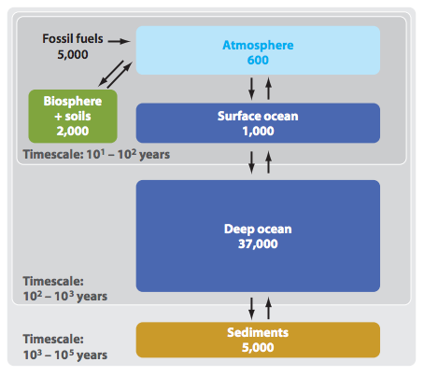
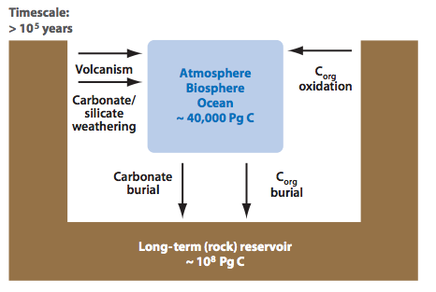
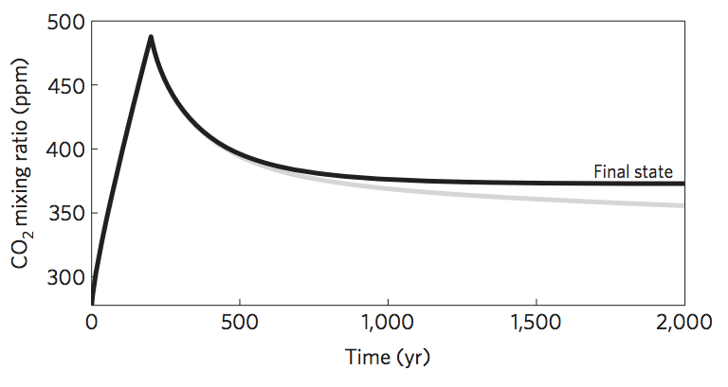
Short-term vs. long term carbon cycle
ANTHROPOGENIC
CLIMATE CHANGE
Units: Pg C
THIS CLASS
Zeebe, Annual Reviews
of Earth and Planetary
Sciences, 2012
Goodwin et al.
Nature Geosci.
2009

Slide 5
Definitions of a habitable planet
(Operational) definition of habitable planet used in this course:
Habitable planet ≈ maintains surface liquid water over timescales relevant to biological macroevolution
On Earth, long-term climate stability involves the nonlinear temperature dependence of greenhouse gas drawdown by weathering.
Stabilizing feedback:
(Walker et al., JGR, 1981; Kasting et al., Icarus, 1993)
increase
increase GHG
concentration
increase temperature
Habitable zone
*
r
too hot
stabilize GHG
concentration
increase
too cold
Dependent on
which atmospheric
volatiles are available
Notes:
RETAIN WATER
So there’s no shortage of planets. And assuming there’s enough stirring of orbits early on to guarantee a non-negligible endowment of water for terrestrial planets, The question of the nearest habitable planet really boils down to whether they can hang on to their water.
Take Earth as an example: this is not easy because the Sun’s luminosity is changing, and the rate of tectonic activity is also changing, and even a small imbalance between greenhouse gas supply and greenhouse gas removal would cause disaster if sustained. So unless our planet is very fortunate there is a need for a stabilizing feedback. And so an idea was developed on the basis that we are not very-lucky: (Carbonate-silicate feedback) (Start in equilibrium – ghg_in = ghg_outthe … → Describe) And this concept is so useful in understanding Earth history, that when we think of the circumstellar HZ on planets-in-general, we think of it as the range of distances from the star within which climate-stabilizing feedback *might* operate.

Slide 6
The Habitable Zone is bounded by luminosities that trigger unrecoverable climate crises
q.v. impacts: Compare impact energy to insolation (work on board)

Slide 7
Lecture 3: Atmospheric science basics: Key points
Describe and qualitatively explain vertical temperature structure of rocky-planet atmospheres.
Apply elementary models of radiation balance.
Explain the greenhouse effect in terms of vertical temperature structure and opacity at visible and thermal wavelengths.
(Explain the theoretical basis for expecting an atmosphere-surface temperature offset).

Slide 8
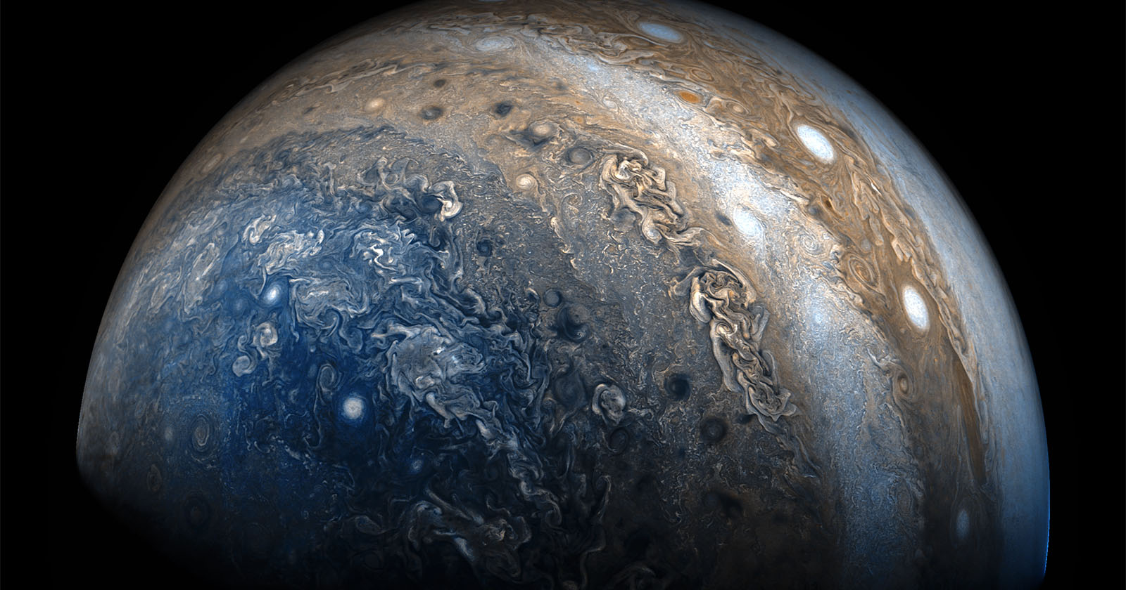
Horizontal structure
JunoCam on JUNO spacecraft (Jupiter polar orbiter)

Slide 9
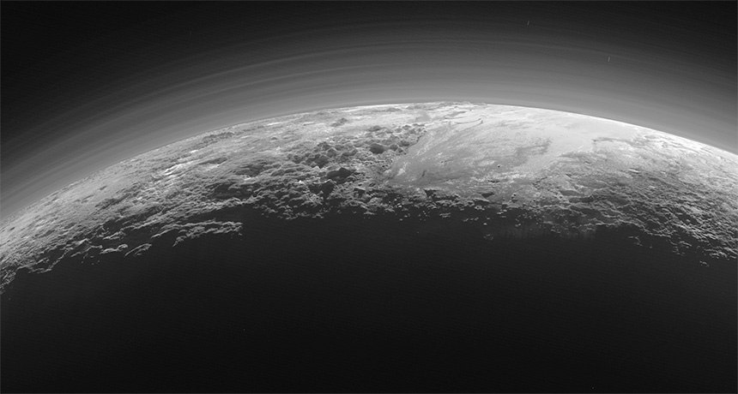
Vertical structure
LORRI (Long Range Reconnaissance Imager) / New Horizons

Slide 10
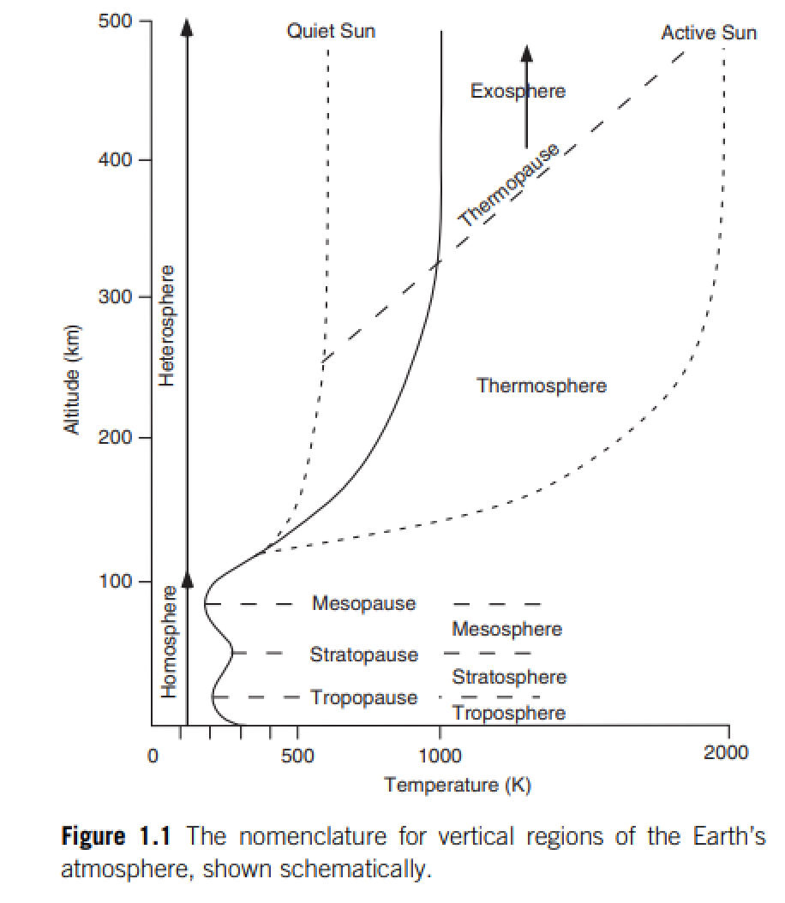
Catling & Kasting
Atmospheric evolution
on inhabited and lifeless
worlds, Chapter 1

Slide 11
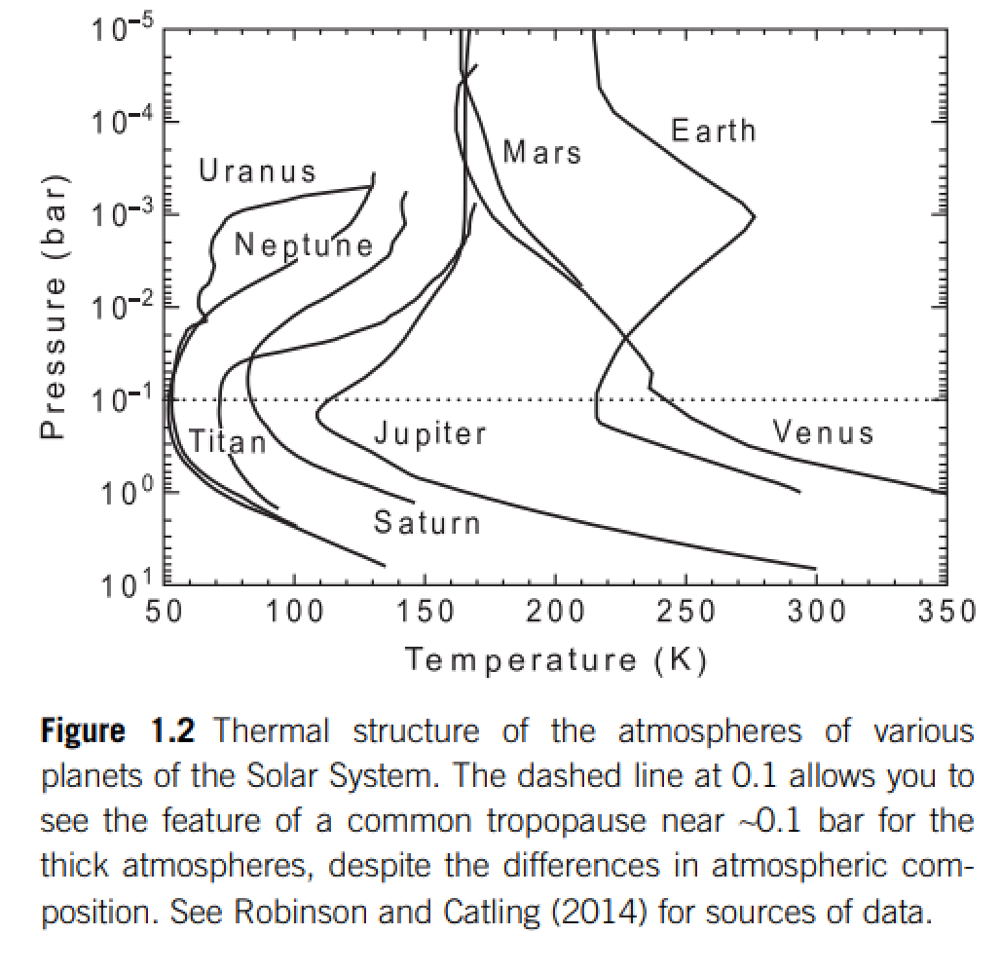
For Earth, sunlight (most energy in 0.1-1 μm wavelengths) is mostly absorbed at the ground
Thermal emission (most energy at 4-20 μm for habitable surfaces)
is mostly re-radiated to space in the upper troposphere
stratospheric
absorption of
sunlight
mostly radiative
heat transport
stratified
STRATOSPHERE
tropopause
mostly convective
heat transport. optically
thick (opaque) in the
thermal, optically thin
(translucent) in the
visible under cloud-free
conditions.
TROPOSPHERE

Slide 12
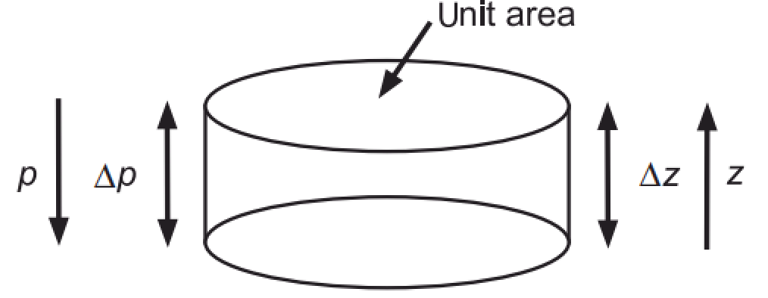
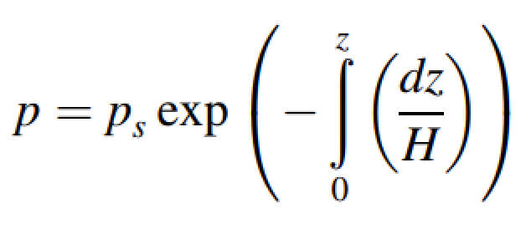
Hydrostatic balance and atmospheric pressure vs. height
ideal gas law

Slide 13
Atmospheric vertical thermal structure
DRY ADIABATIC LAPSE RATE
O(10¹) m/s^2 (for rocky planets, never or almost never
10² m/s^2, per Leslie Rogers’ work)
depends on atm. composition
Describes the troposphere under dry, convective conditions

Slide 14
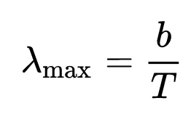
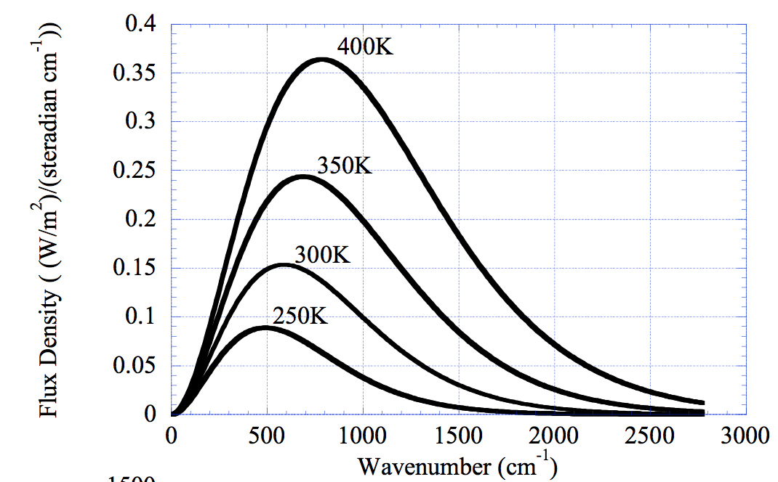
Spectrum of blackbody radiation
Wien’s displacement law:
b = 2900 microns/K
Rayleigh-Jeans tail
Wien tail
(short wavelengths)
Pierrehumbert 2010
Consider the radiation field within a closed cavity that perfectly absorbs and emits radiation at all wavelengths. At equilibrium, production and loss of radiation balance and the intensity of the radiation field is uniform. Max Planck found the spectrum to be uniquely related to the cavity wall temperature, T, by the Planck function.

Slide 15
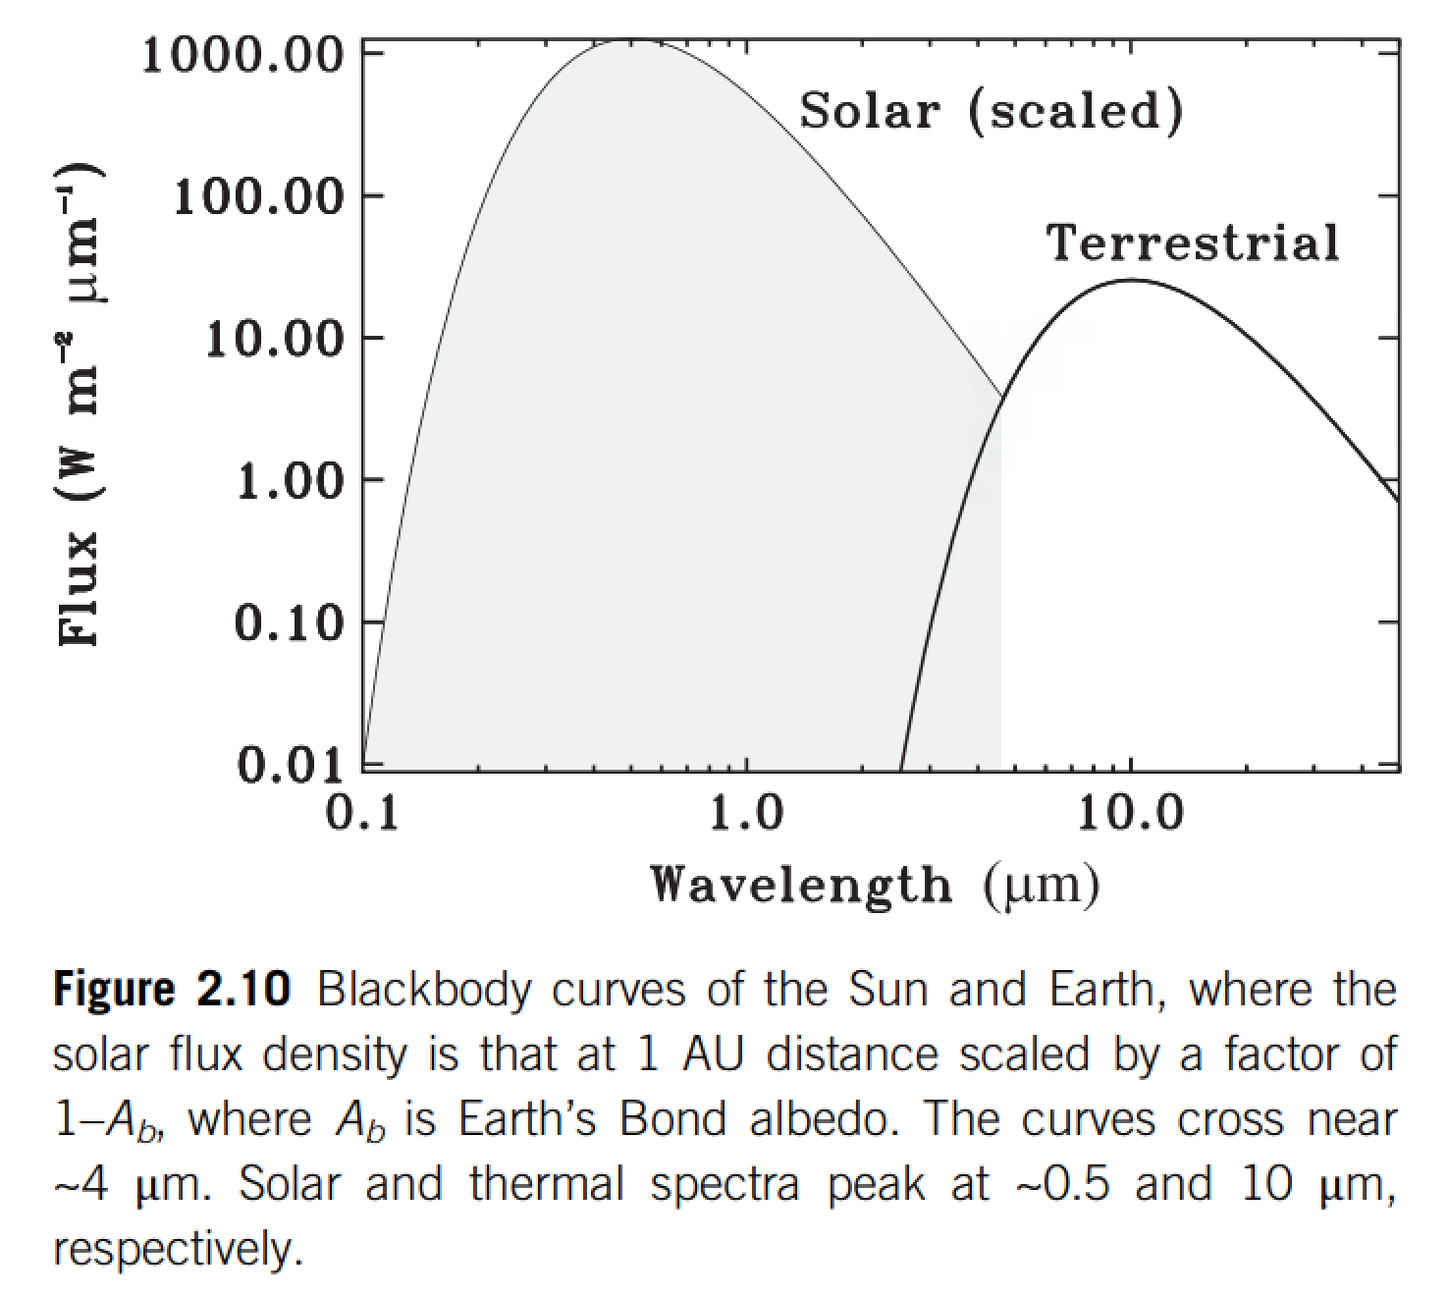

Slide 16
Lecture 3: Atmospheric science basics: Key points
Describe and qualitatively explain vertical temperature structure of rocky-planet atmospheres.
Apply elementary models of radiation balance.
Explain the greenhouse effect in terms of vertical temperature structure and opacity at visible and thermal wavelengths.
(Explain the theoretical basis for expecting an atmosphere-surface temperature offset).

Slide 17
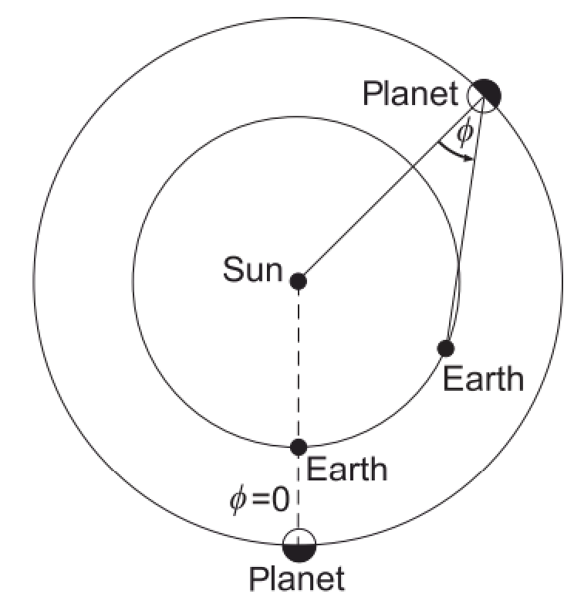
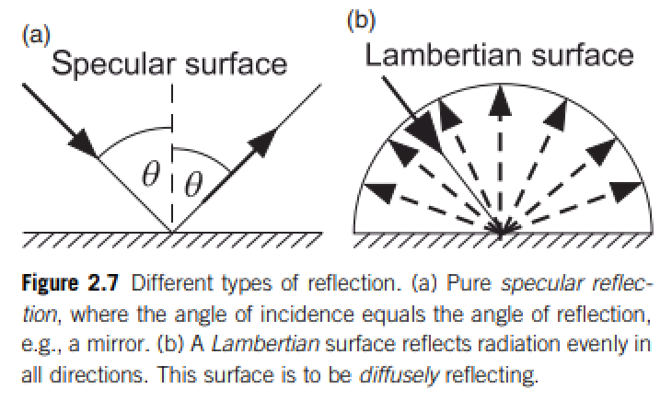
Definition of Bond/planetary albedo (used for climate calculations)
Energy balance:
Kepler space telescope measures the dip in visible light from an exoplanet+star when the
exoplanet passes behind the exoplanet’s host star.
(a) What is the phase angle for this measurement?
(b) Does this measurement constrain the Bond/planetary albedo or the geometric albedo?

Slide 18
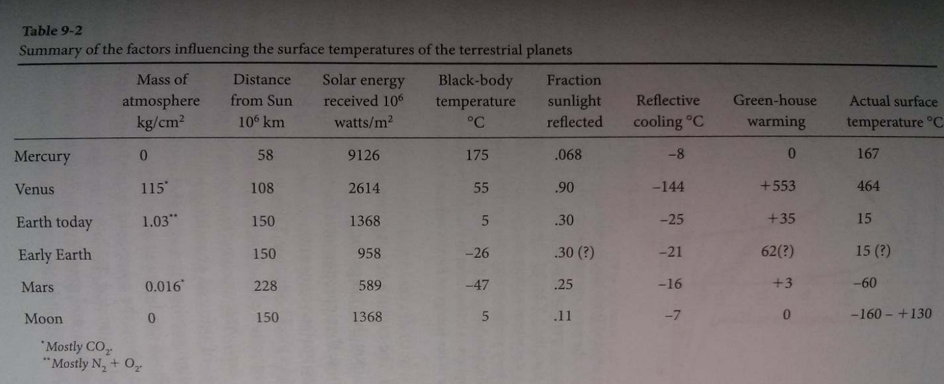
Energy balance:
CO2
CO2
~2/3 from H2O; ~1/3 from CO2
However, “H2O is a slave to CO2.”
Titan: complicated due to interplay of CH4, H2, and antigreenhouse haze
Langmuir & Broecker

Slide 19
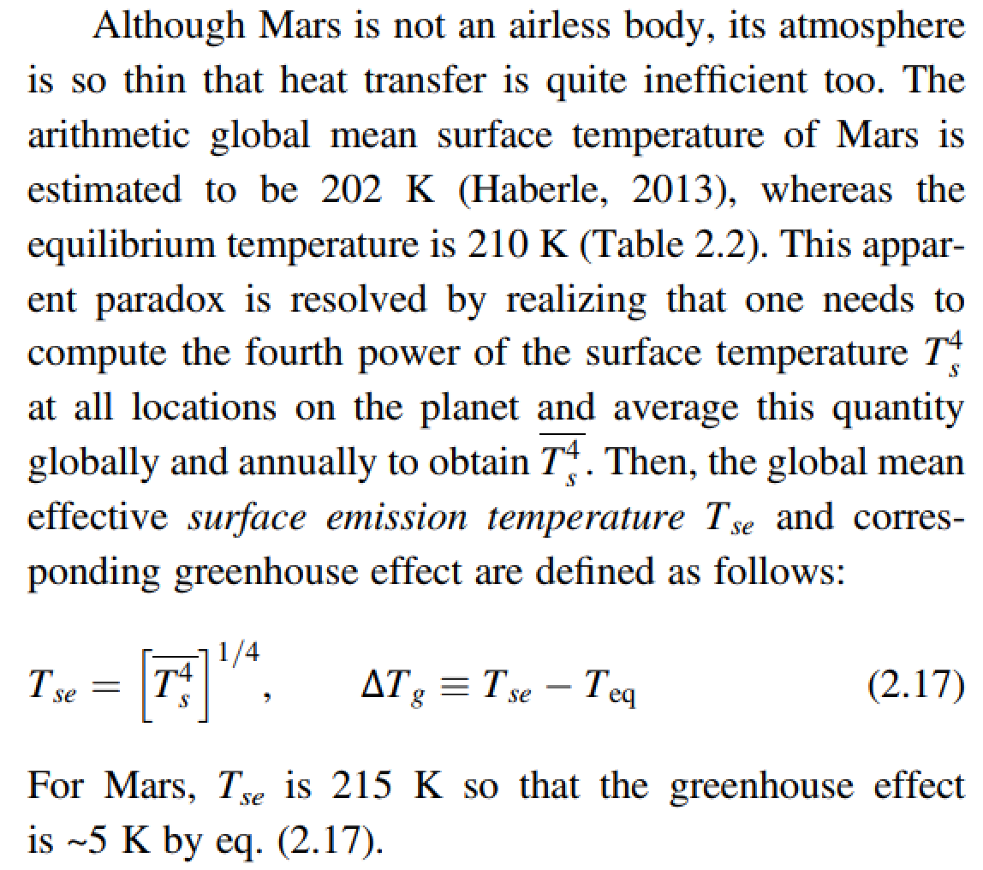
The global mean surface temperature can be a lot less than the effective temperature

Slide 20
Top-of-atmosphere energy in = top-of-atmosphere energy out
is a very good approximation for the purposes of this course
How quickly would Earth’s surface temperature double with a 1 W/m^2 (<1%) top-of-atmosphere energy imbalance?
How quickly did Earth’s surface temperature return to normal following the Chicxulub impact (~15 km diameter asteroid, ~30 km/s)?

Slide 21
Lecture 3: Atmospheric science basics: Key points
Describe and qualitatively explain vertical temperature structure of rocky-planet atmospheres.
Apply elementary models of radiation balance.
Explain the greenhouse effect in terms of vertical temperature structure and opacity at visible and thermal wavelengths.
(Explain the theoretical basis for expecting an atmosphere-surface temperature offset).

Slide 22
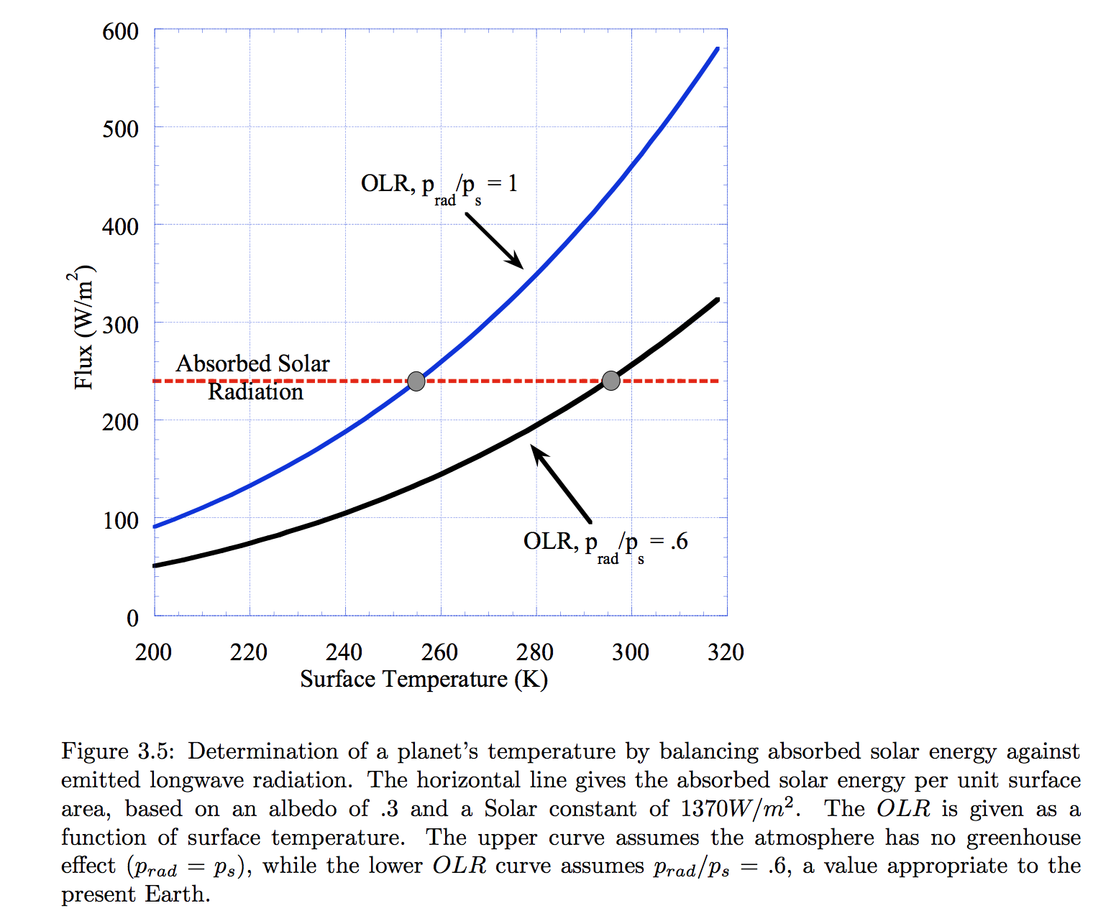
Pierrehumbert Principles of Planetary Climate

Slide 23
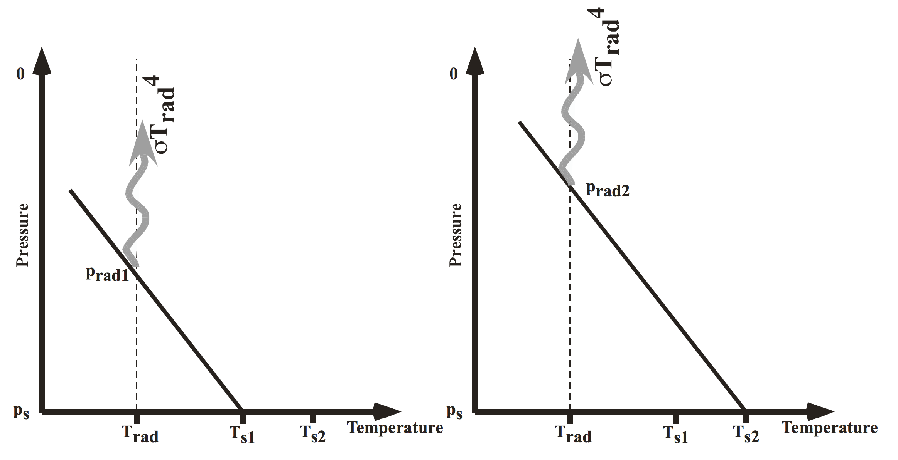
Pierrehumbert, “Principles of planetary climate”

Slide 24
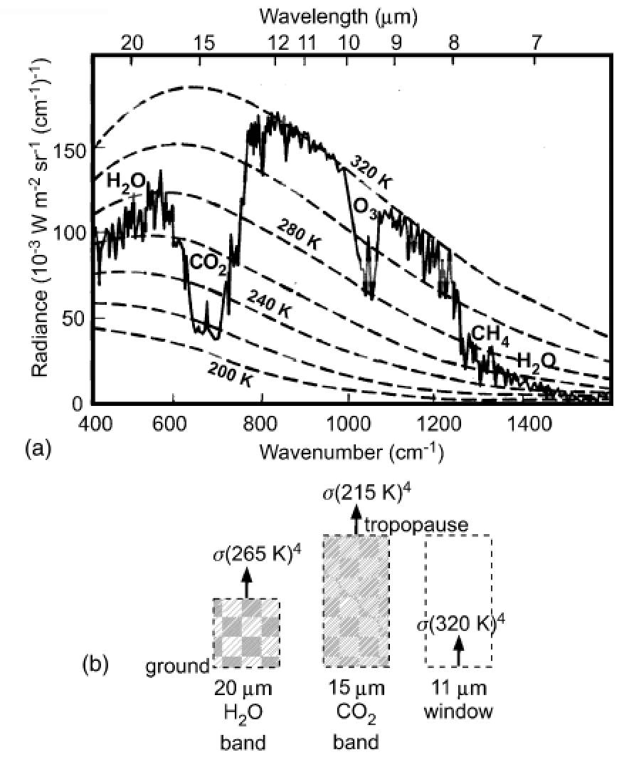
How to read a planet’s thermal
emission spectrum
Earth, Niger valley, warm season →
Absorption of outgoing
Earthlight
dashed lines: theoretical
blackbody curves
solid line: spacecraft observations
chemical species: absorption bands
What could we conclude from this
spectrum if we had obtained it for
a habitable-zone 1-Earth-radius
exoplanet?
Casting & Katling, chapter 2

Slide 25
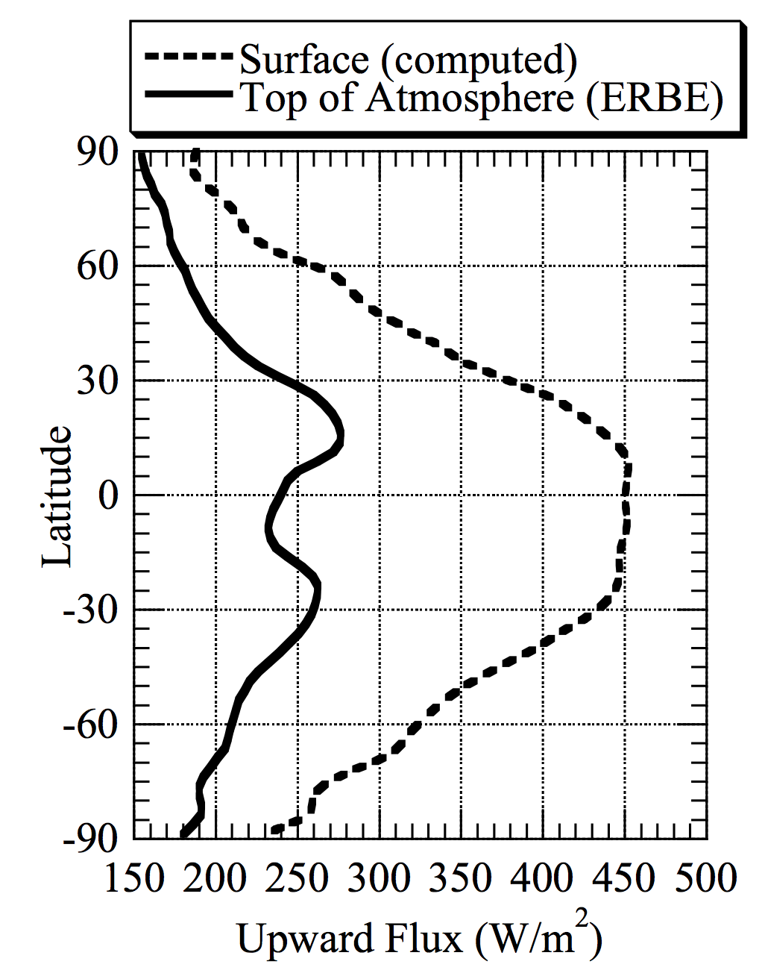
ERBE = Earth
Radiation Budget
Experiment
Pierrehumbert 2010

Slide 26
Lecture 3: Atmospheric science basics: Key points
Describe and qualitatively explain vertical temperature structure of rocky-planet atmospheres.
Apply elementary models of radiation balance.
Explain the greenhouse effect in terms of vertical temperature structure and opacity at visible and thermal wavelengths.
(Explain the theoretical basis for expecting an atmosphere-surface temperature offset).

Slide 27
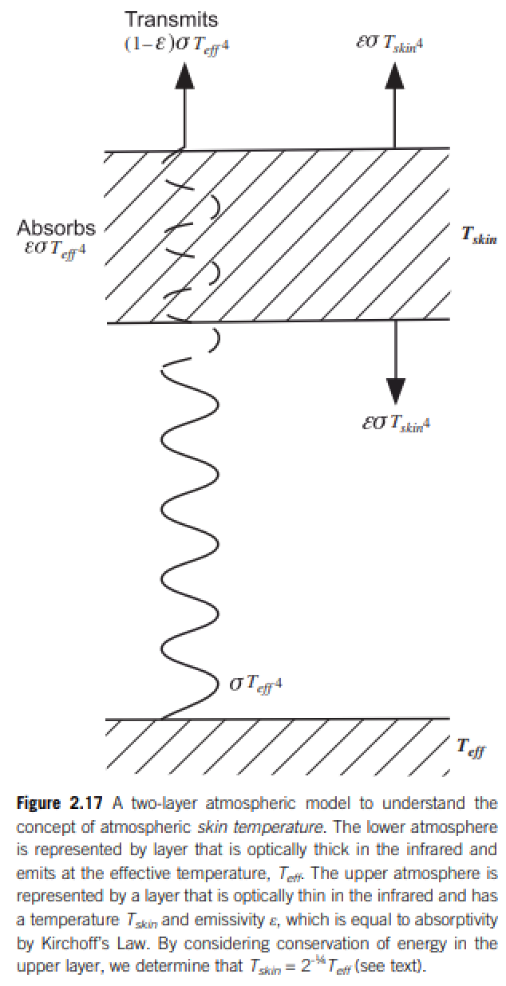
Relationship between surface temperature and atmospheric temperature

Slide 28
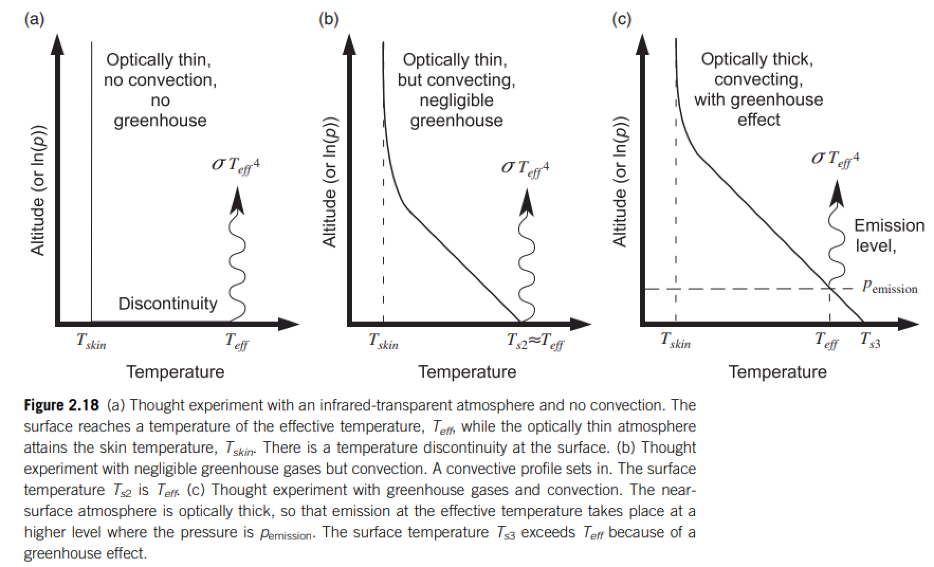
Relationship between surface temperature and atmospheric temperature

Slide 29
End of lecture 3 – start of lecture 4 Course outline
Foundations (1-2 weeks)
Earth history
HZ concept, atmospheric science essentials
Post-Hadean Earth system
Principles – how are habitable planets initiated and sustained? (4-5 weeks)
Volatile supply, volatile escape
Long-term climate evolution
Runaway greenhouse, moist greenhouse
Specifics (~2 weeks)
Early Mars
Hyperthermals on Earth
Oceans within ice-covered moons
Exoplanetary systems e.g. TRAPPIST-1 system
TODAY

Slide 30
Lecture 4 – volatile supply – key points
Volatiles can be supplied directly as molecules, or contained within hydrated minerals, within clathrates, or adsorbed to ice particles
Within protoplanetary disks, the habitable zone is in a region that theory suggests should be dry
Volatiles can be delivered to the habitable zone by within-disk migration of impactors, scattering of impactors, or whole-planet migration
Volatiles can be released on impact, or as the result of planetary differentiation.

Slide 31
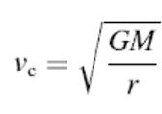
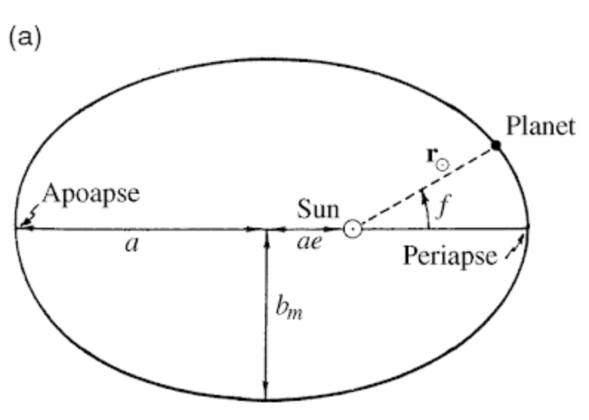
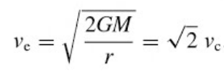
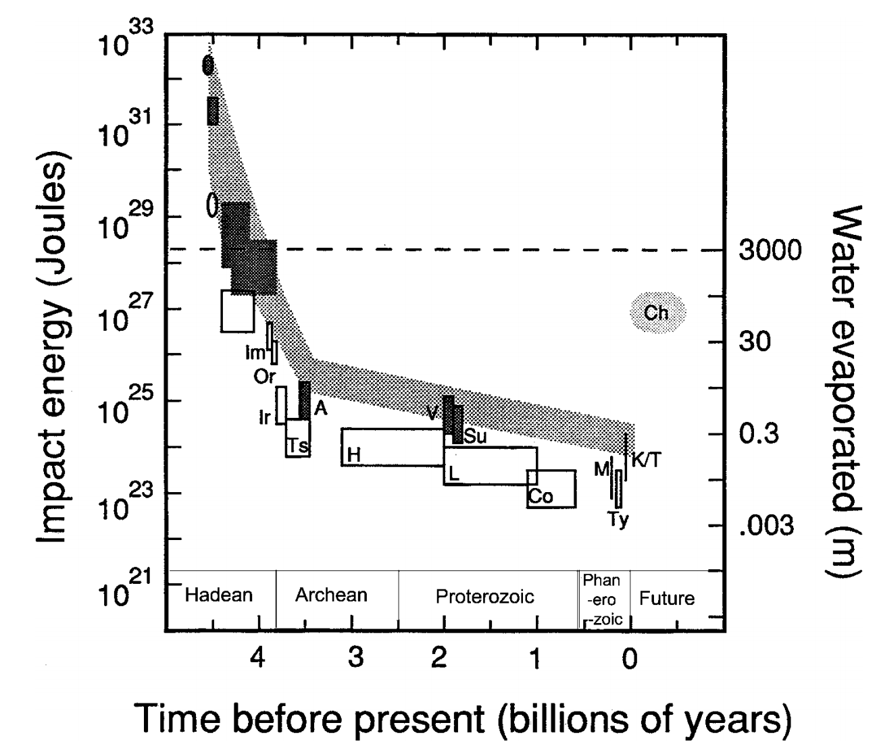
Orbit essentials
Impact energies
de Pater & Lissauer 2001
Compare impact energies and insolation
from Kasting & Catling 2003

Slide 32
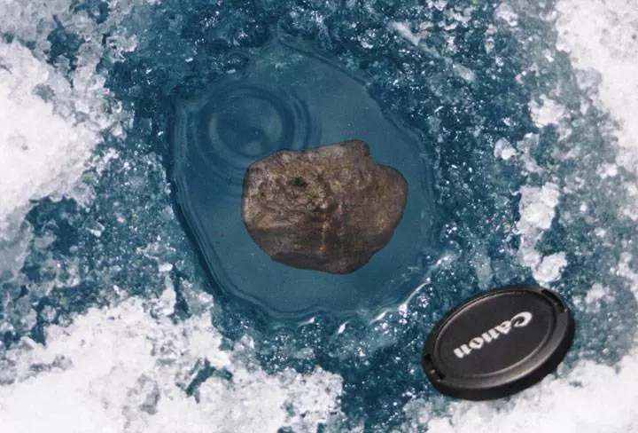
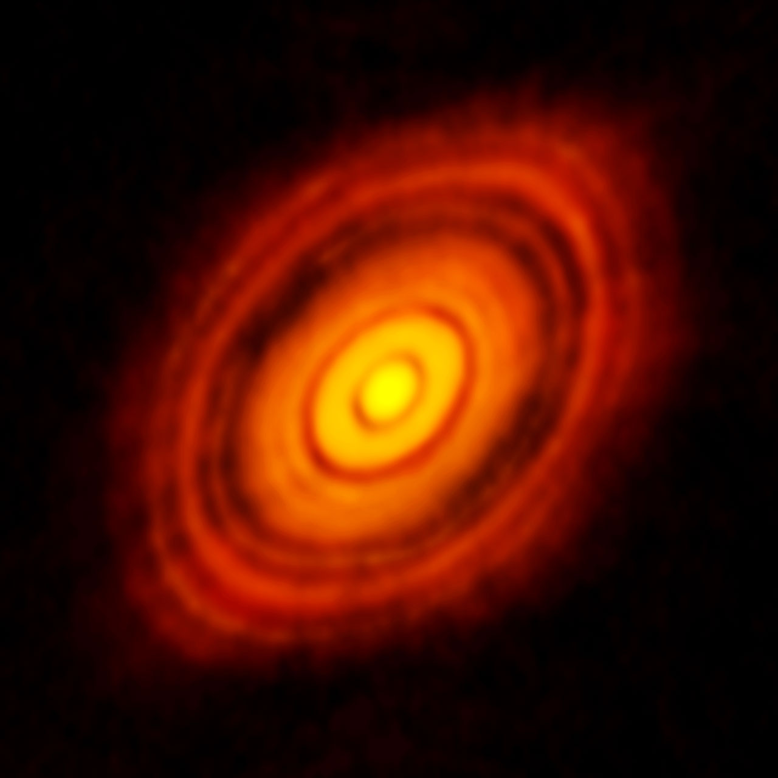
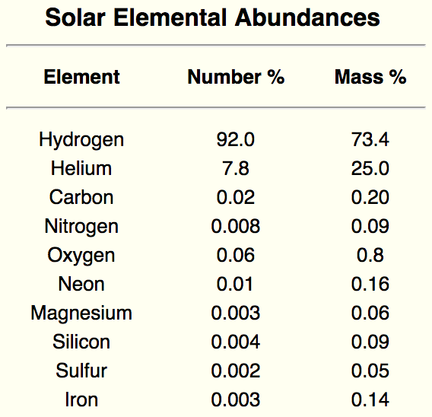
Data sources for planet formation
Tagish Lake meteorite fall
HL Tauri (HL Tau) at mm wavelengths ALMA
Spectra of Sun
Protoplanetary disk starting materials
= star composition
50 AU
1 AU = 1 Astronomical Unit = 150 million km

Slide 33
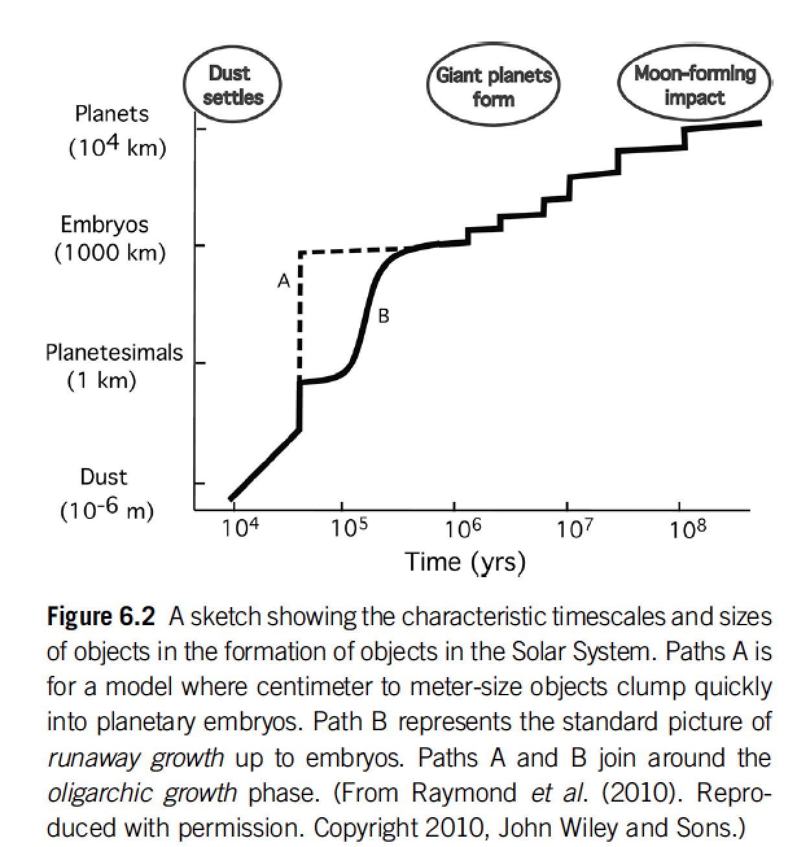

Slide 34
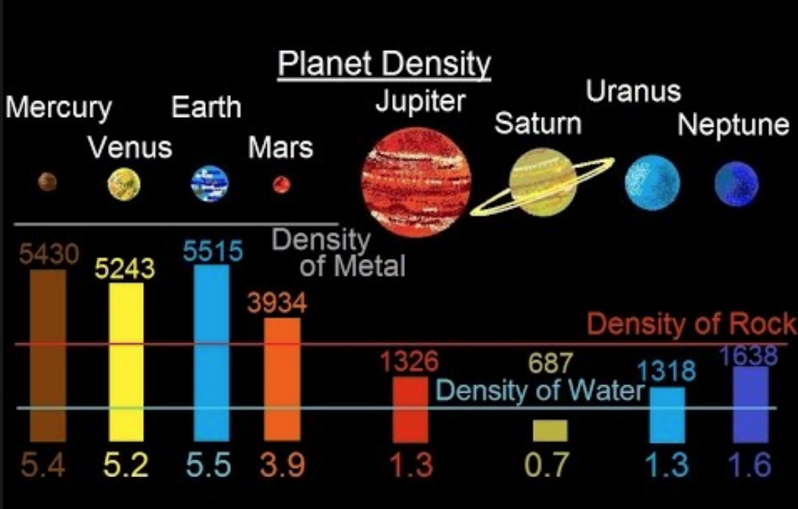

Slide 35
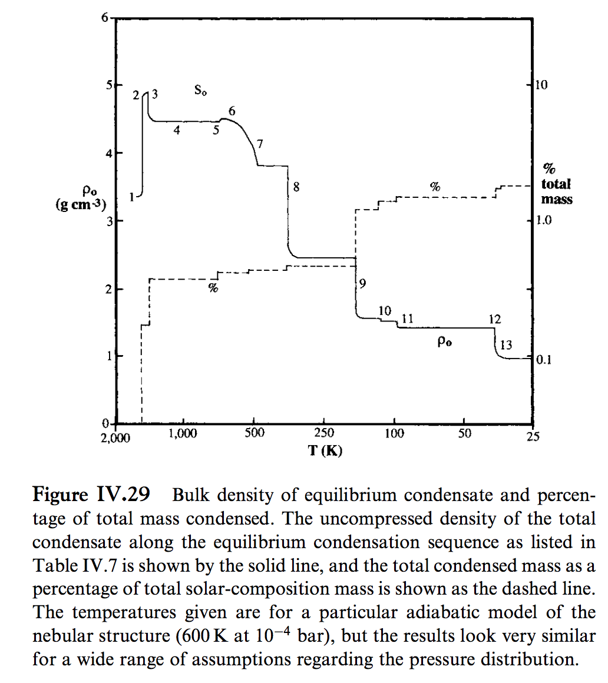
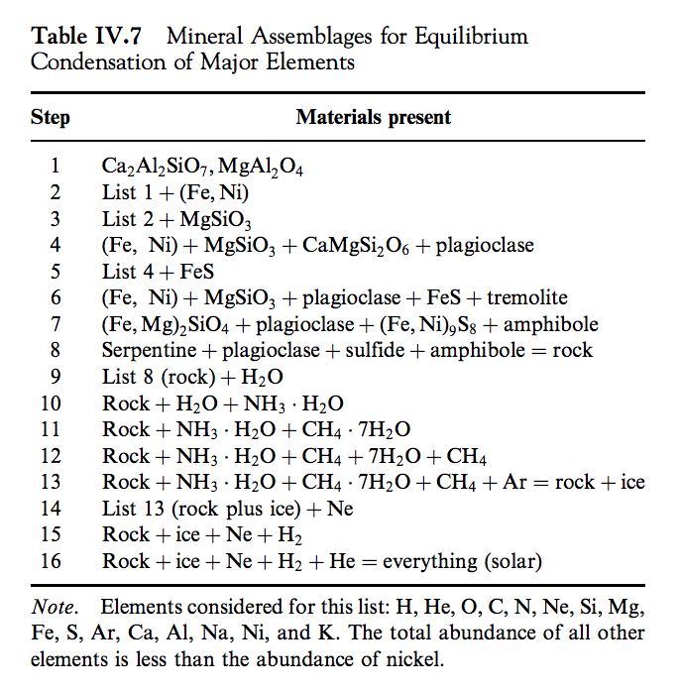
Lewis 2004

Slide 36
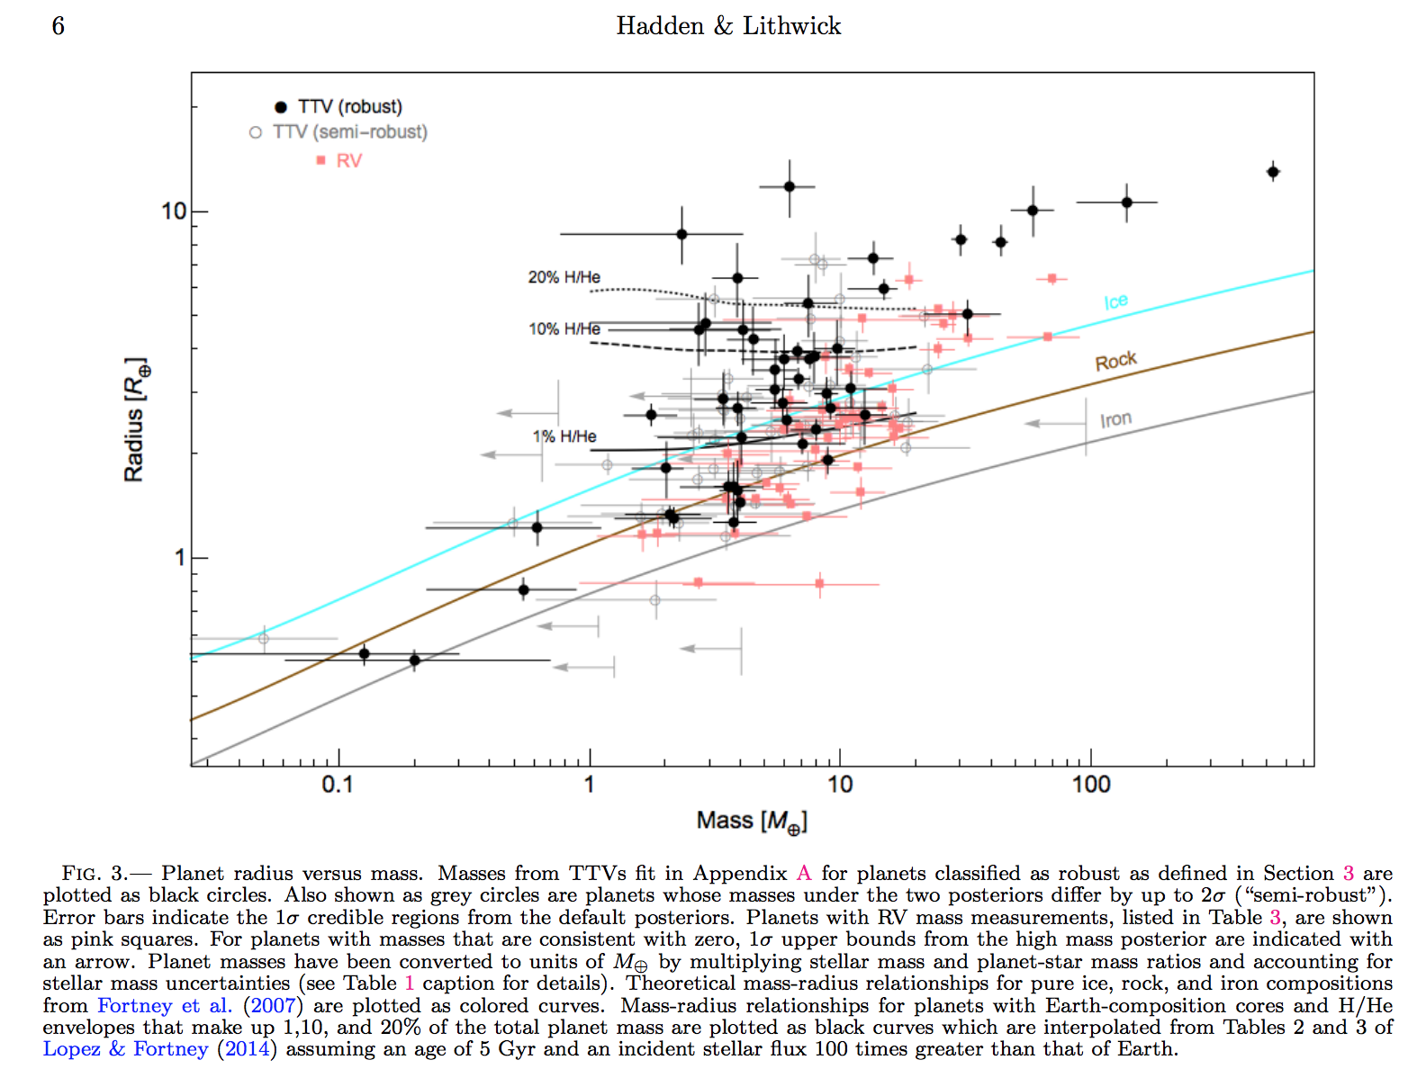
Hadden & Lithwick, Astrophysical Journal 2017
Hilke Schlichting 2018 arXiv

Slide 37
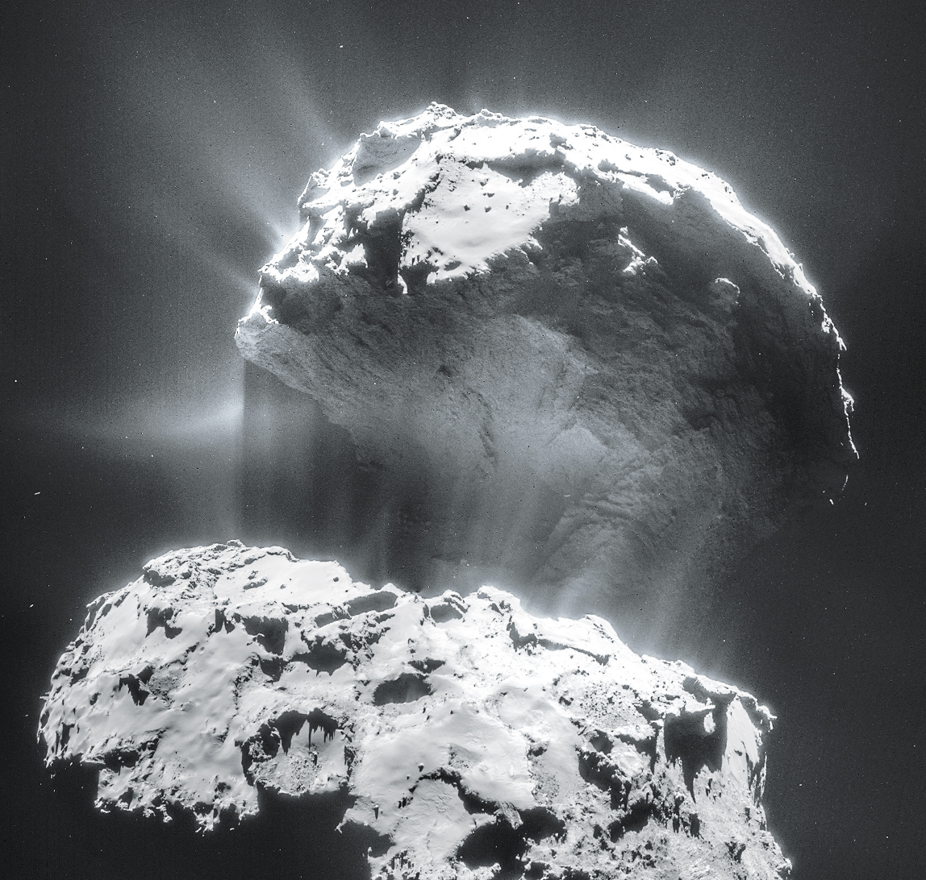
Volatiles can be supplied directly as molecules, or contained within hydrated/C-bearing minerals, within clathrates, or adsorbed to ice particles
Comet 67P from Rosetta
Top lobe is
2.6 km across

Slide 38
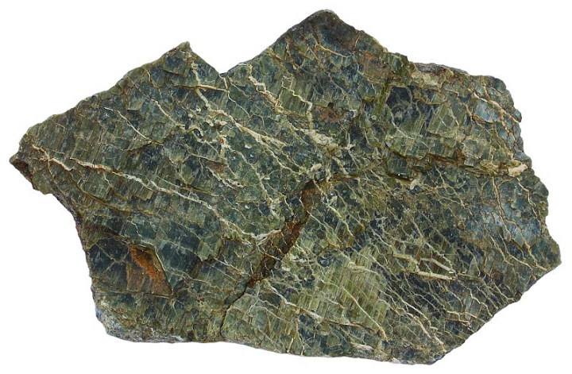
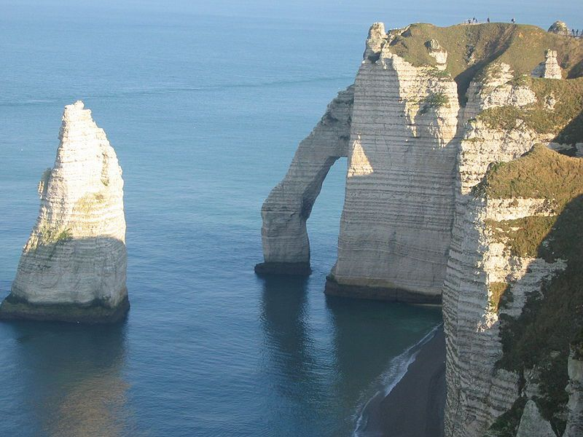
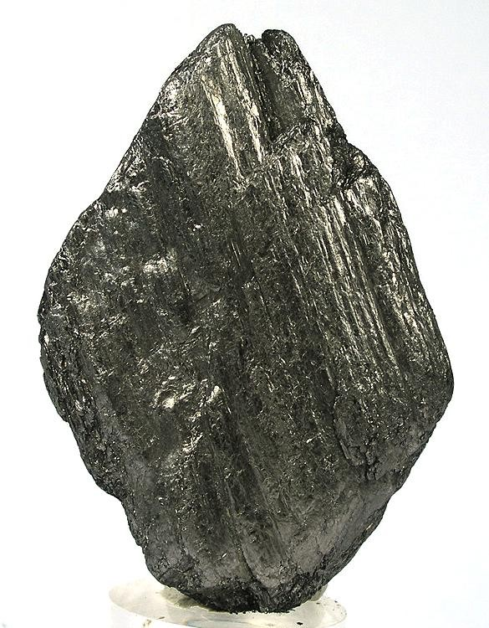
Hydrated/C-bearing minerals
Serpentine
Carbonates
Graphite

Slide 39
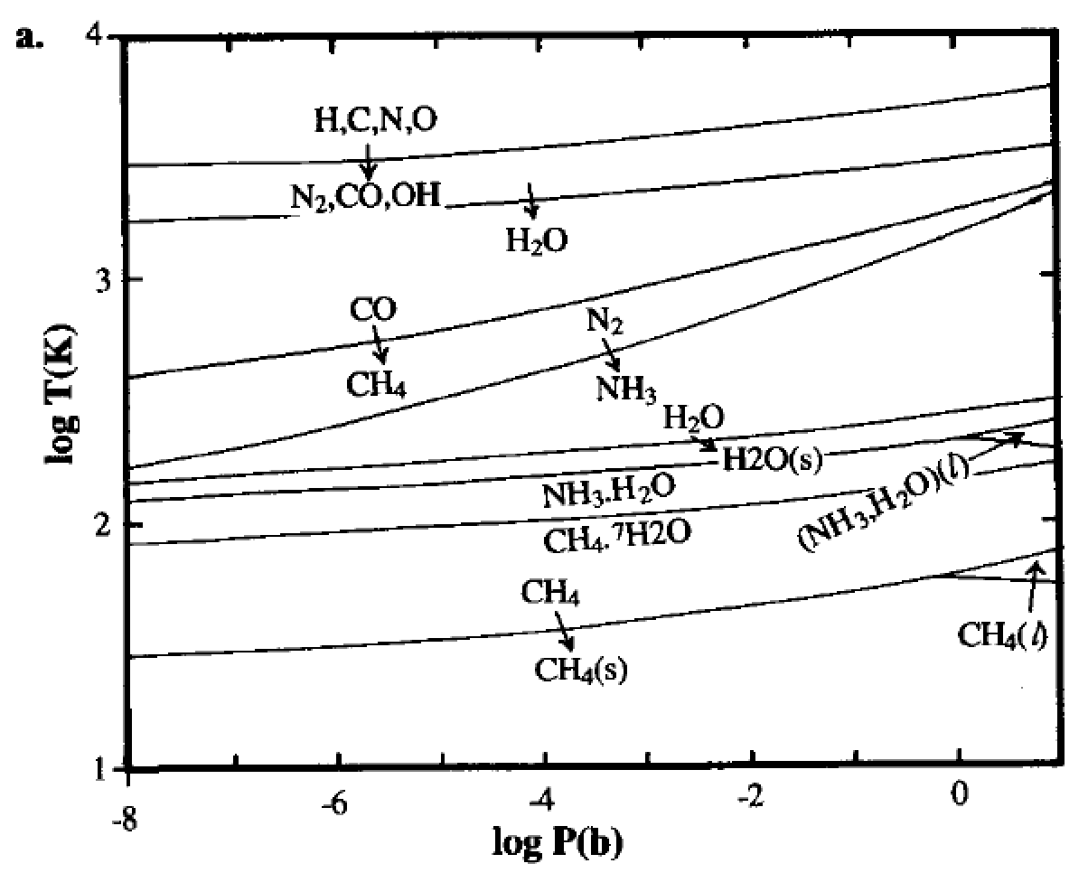
Volatiles can be supplied directly as molecules, or contained within hydrated minerals, within clathrates, or adsorbed to ice particles
Equilibrium
condensation
solar elemental
abundances
Lewis et al. 2004

Slide 40
Volatiles can be supplied directly as molecules, or contained within hydrated minerals, within clathrates, or adsorbed to ice particles
CH4 trapped in H2O-ice lattice

Slide 41
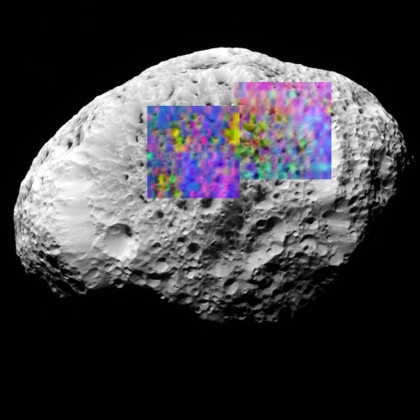
Volatiles can be supplied directly as molecules, or contained within hydrated minerals, within clathrates, or adsorbed to ice particles
H2-adsorbed-to-H2O-ice (yellow) on Saturn’s moon Hyperion (93K)
H2 does not condense until 10K
long axis of Hyperion
= 360 km

Slide 42
Lecture 4 – volatile supply – key points
Volatiles can be supplied directly as molecules, or contained within hydrated minerals, within clathrates, or adsorbed to ice particles
Within protoplanetary disks, the habitable zone is in a region that theory suggests should be dry
Volatiles can be delivered to the habitable zone by within-disk migration of impactors, scattering of impactors, or whole-planet migration
Volatiles can be released on impact, or as the result of planetary differentiation.

Slide 43
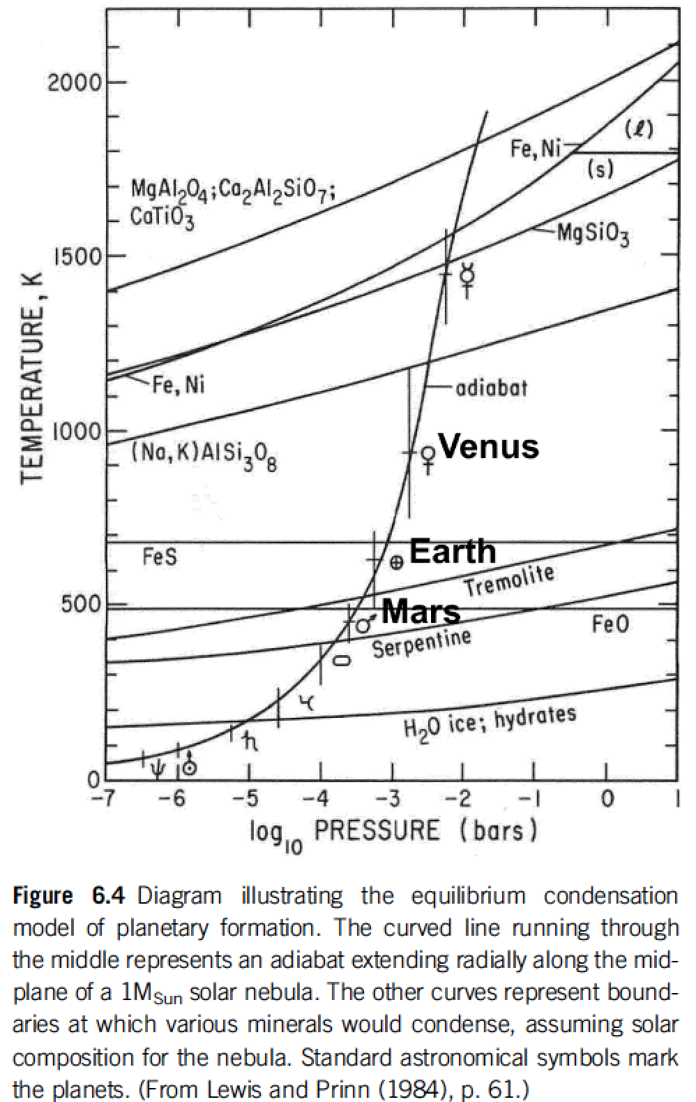
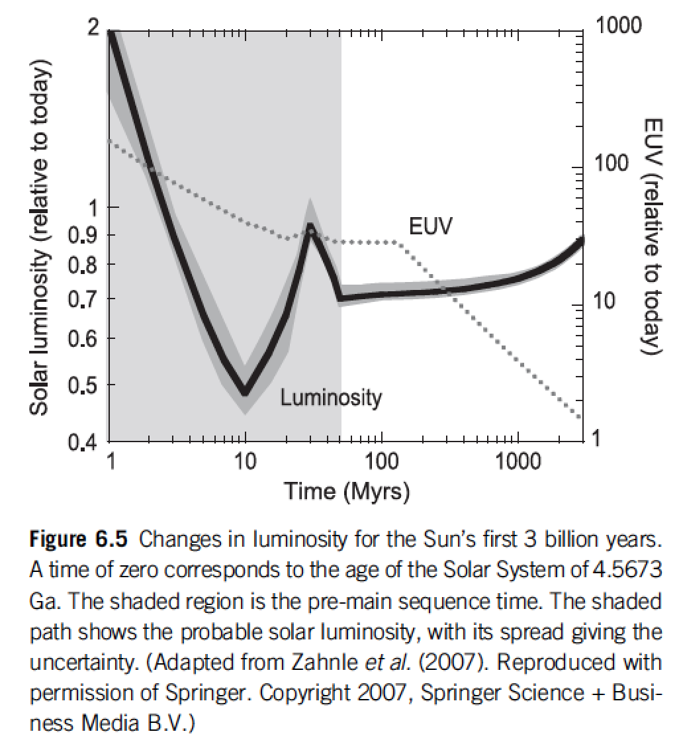
Within protoplanetary disks, the habitable zone is in a region that theory suggests should be dry
rock-forming
minerals + Fe
Snowline concept
Equilibrium condensation model
Catling & Kasting ch. 6

Slide 44
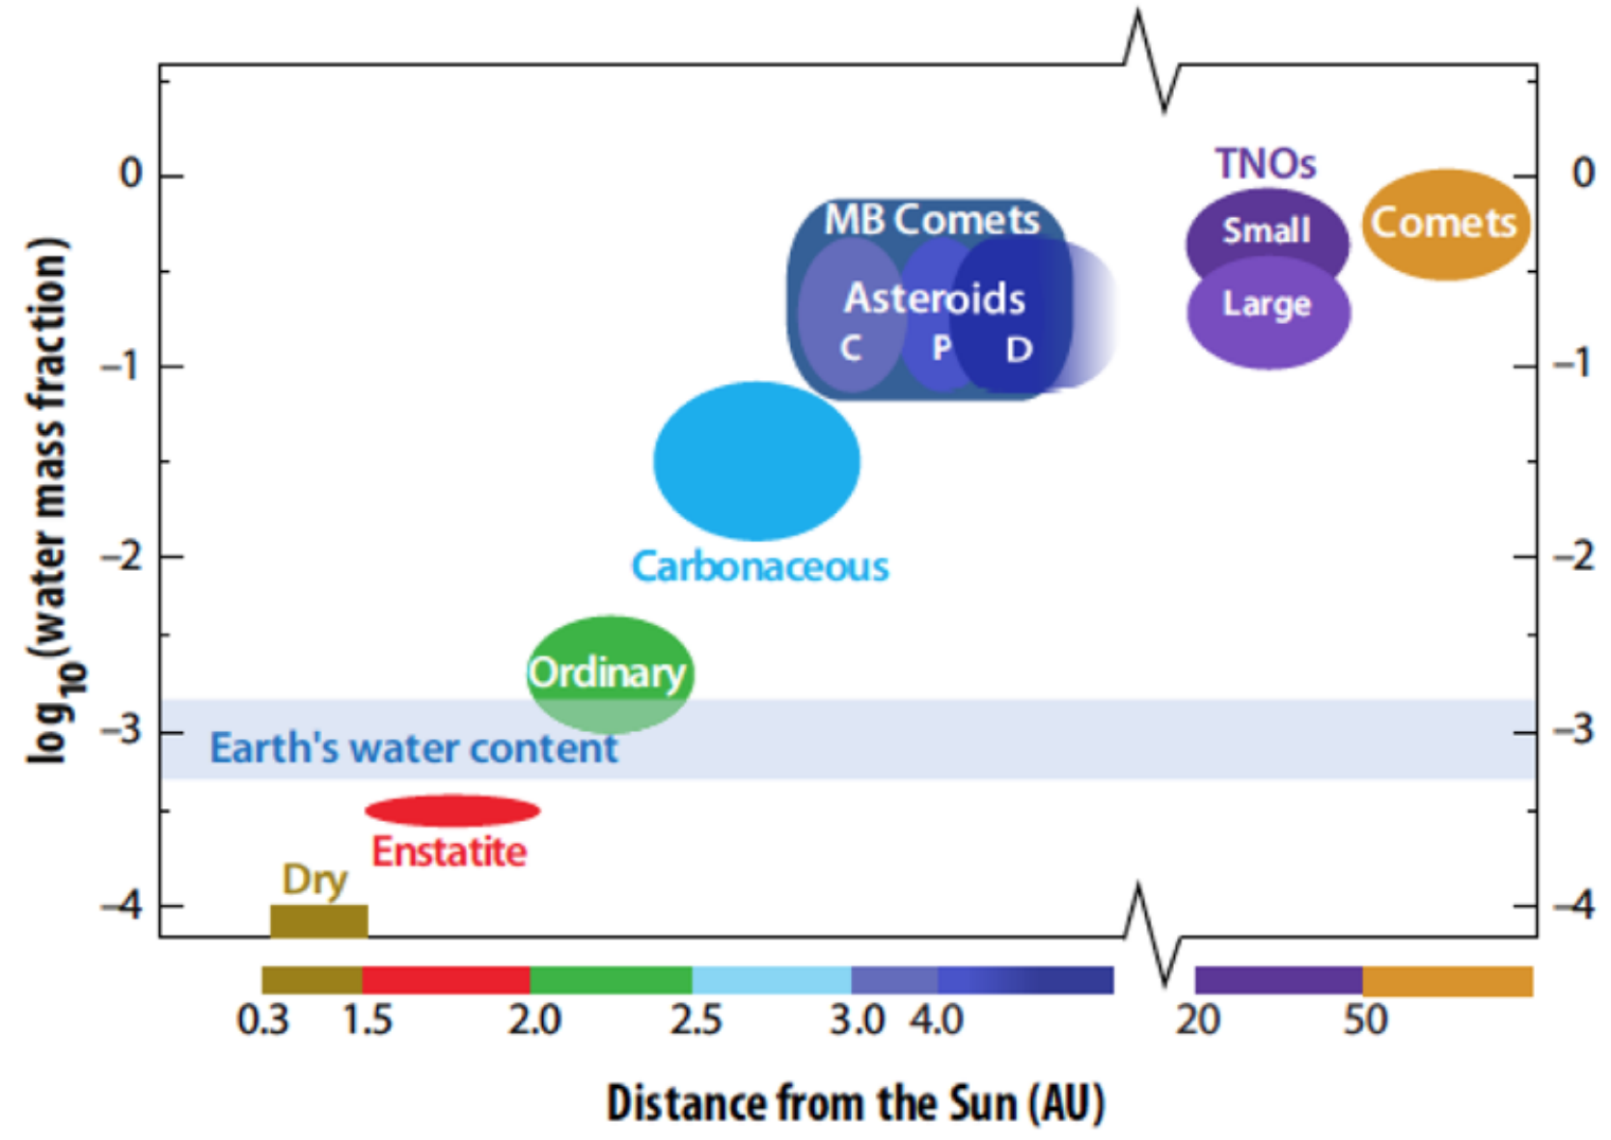
Within protoplanetary disks, the habitable zone is in a region that theory suggests should be dry
MB = Main Belt (2-3.5 AU)
TNO = TransNeptunian Object
von Dishoeck et al. in Protostars & Planets VI, 2014

Slide 45
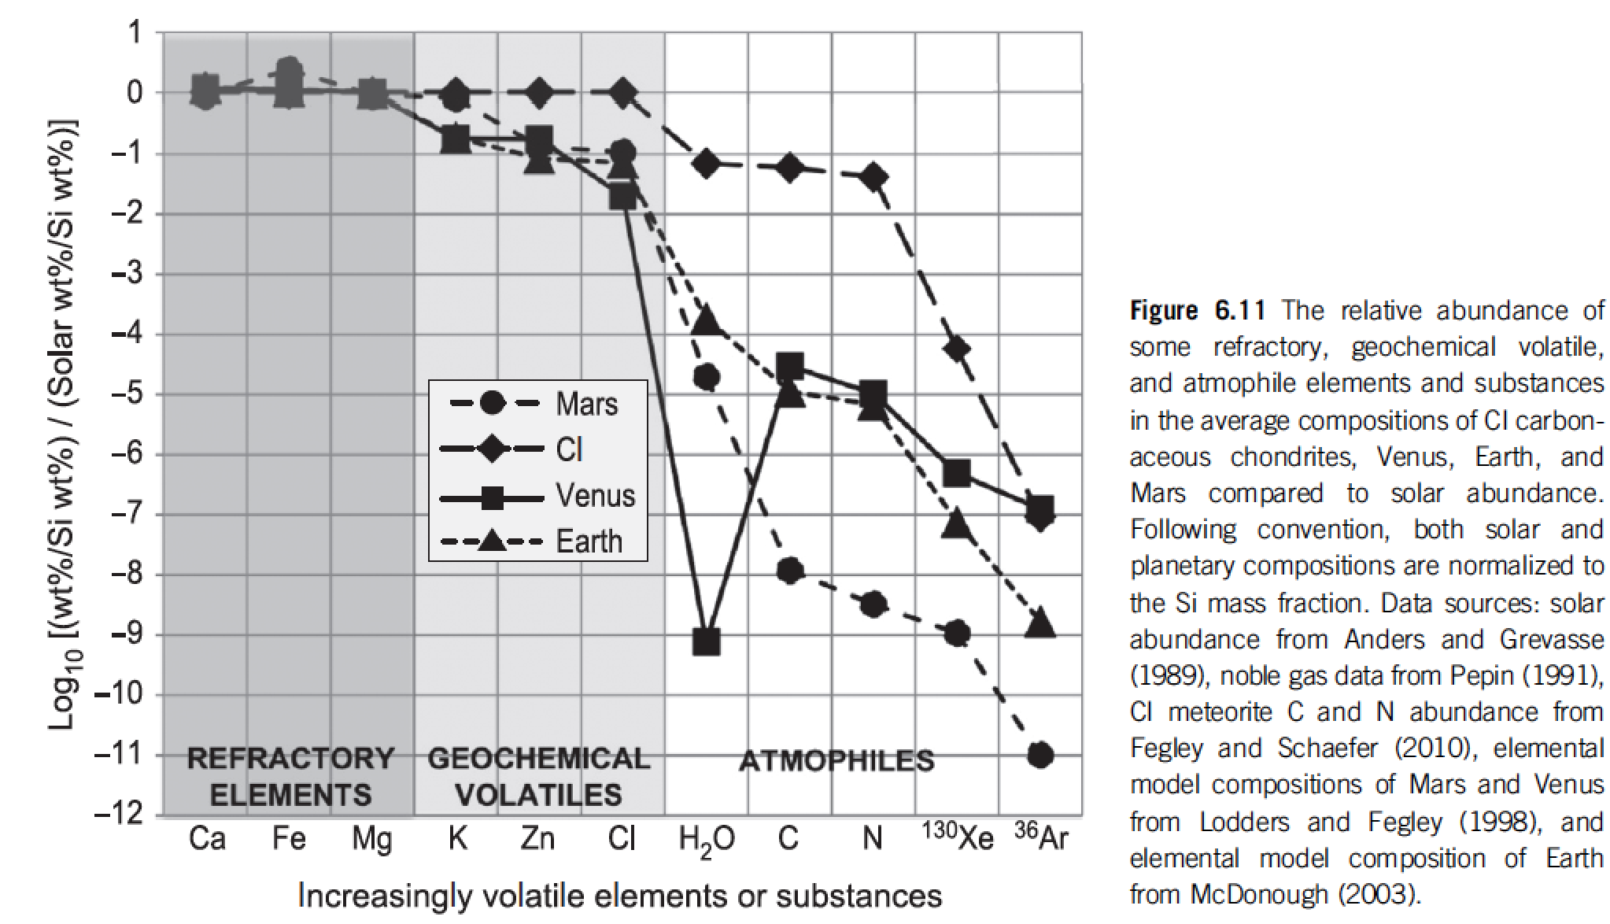
Catling & Kasting 2017, chapter 6

Slide 46
Lecture 4 – volatile supply – key points
Volatiles can be supplied directly as molecules, or contained within hydrated minerals, within clathrates, or adsorbed to ice particles
Within protoplanetary disks, the habitable zone is in a region that theory suggests should be dry
Volatiles can be delivered to the habitable zone by within-disk migration of impactors, scattering of impactors, or whole-planet migration
Volatiles can be released on impact, or as the result of planetary differentiation.

Slide 47
Bonus slides

Slide 48
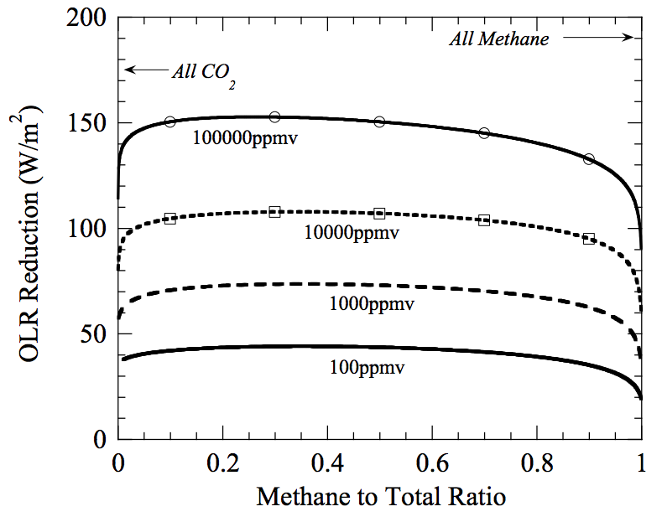
Warming by CH₄ in addition to CO₂?
Which is the more powerful greenhouse gas – CH₄ or CO₂?
Outgoing
Longwave
Radiation reduction
= strength
of greenhouse effect
from Pierrehumbert, Principles of Planetary Climate
mixing ratio of
(CO₂+CH₄)
@280K fixed
surface temperature,
with 1 bar background
radiatively-inert gas

Slide 49
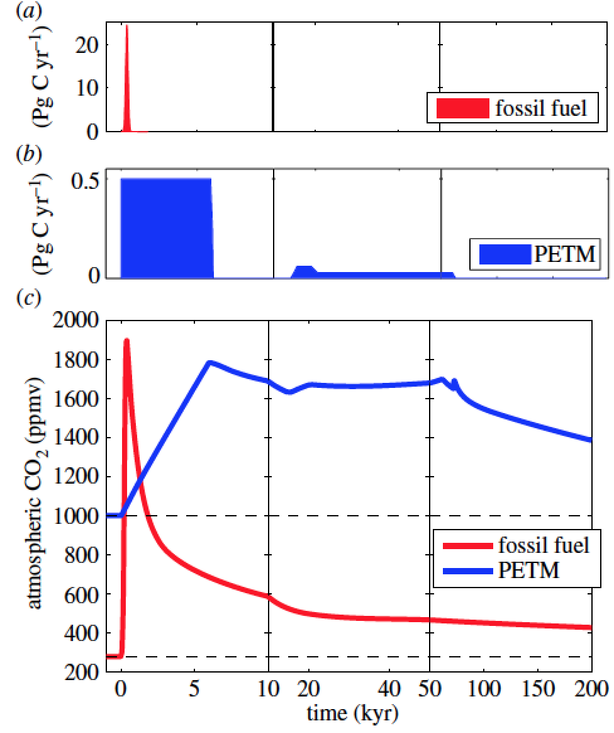
The processes discussed today operate on 10^(5-12) yr timescales, much longer than the ~10^(2-3) yr timescales associated with the human response to human-induced climate change.
Zeebe & Zachos, Philosophical Transactions
of the Royal Society 2013
Common Era
Archer, Kite, et al., ‘The ultimate social cost of carbon,’ in review

