Slide 1
GEOS 22060/ GEOS 32060 / ASTR 45900
What makes a planet habitable?
Lecture 3
Thursday 16 January 2020

Slide 2
Top-of-atmosphere energy in = top-of-atmosphere energy out
is a very good approximation for the purposes of this course
How quickly would Earth’s surface temperature double with a 1 W/m^2 (<1%) top-of-atmosphere energy imbalance?
How quickly did Earth’s surface temperature return to normal following the Chicxulub impact (~15 km diameter asteroid, ~30 km/s)?

Slide 3
Lecture 3: Atmospheric science basics: Key points
Describe and qualitatively explain vertical temperature structure of rocky-planet atmospheres.
Apply elementary models of radiation balance.
Explain the greenhouse effect in terms of vertical temperature structure and opacity at visible and thermal wavelengths.
(Explain the theoretical basis for expecting an atmosphere-surface temperature offset).

Slide 4
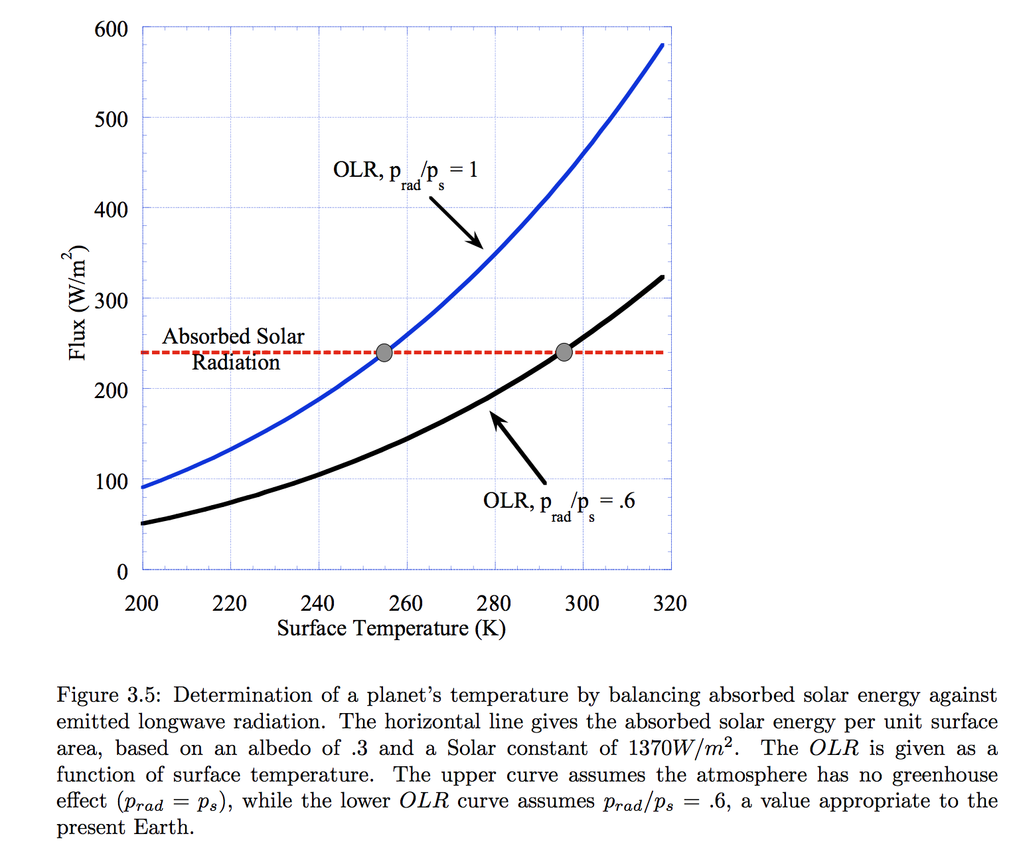
Pierrehumbert Principles of Planetary Climate

Slide 5
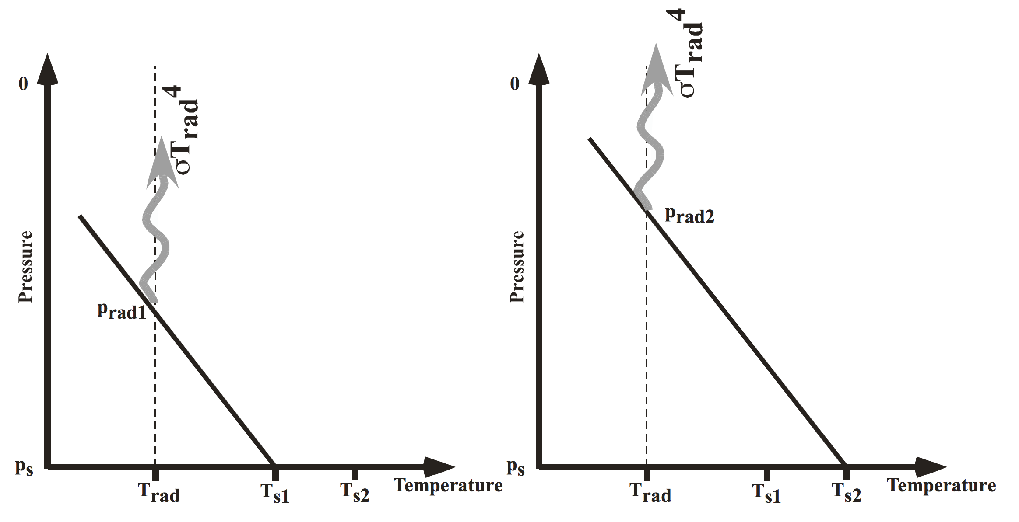
Pierrehumbert, “Principles of planetary climate”

Slide 6
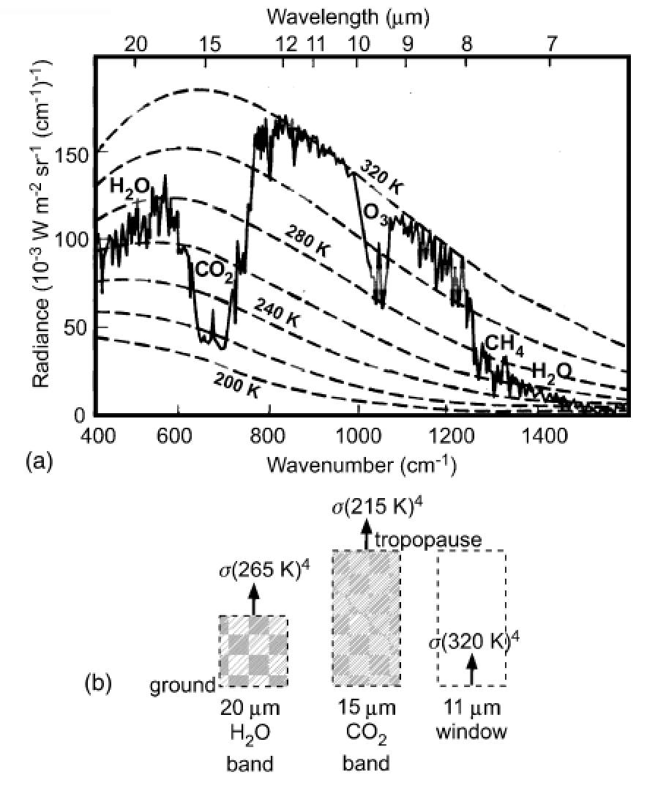
How to read a planet’s thermal
emission spectrum
Earth, Niger valley, warm season →
Absorption of outgoing
Earthlight
dashed lines: theoretical
blackbody curves
solid line: spacecraft observations
chemical species: absorption bands
What could we conclude from this
spectrum if we had obtained it for
a habitable-zone 1-Earth-radius
exoplanet?
Casting & Katling, chapter 2

Slide 7
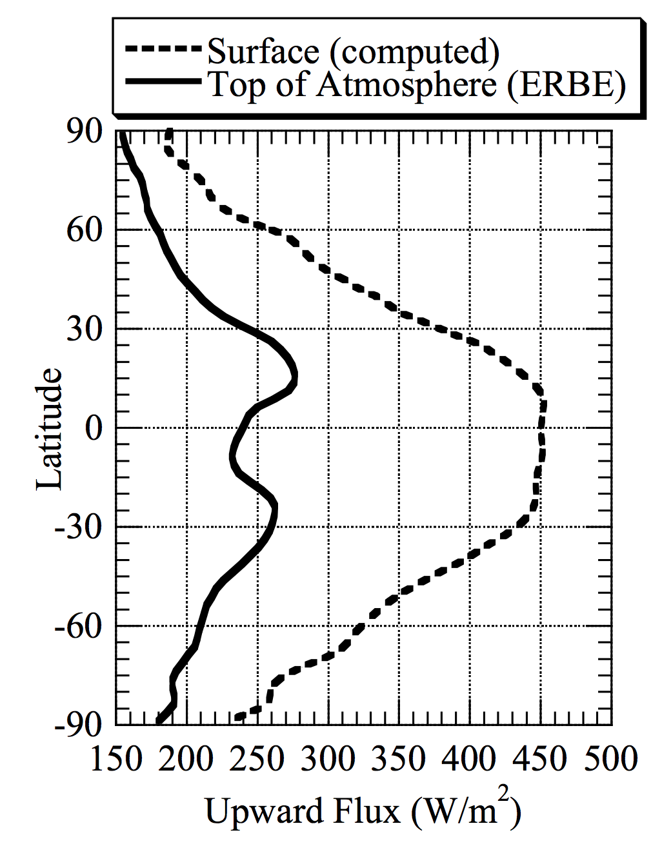
ERBE = Earth
Radiation Budget
Experiment
Pierrehumbert 2010

Slide 8
Lecture 3: Atmospheric science basics: Key points
Describe and qualitatively explain vertical temperature structure of rocky-planet atmospheres.
Apply elementary models of radiation balance.
Explain the greenhouse effect in terms of vertical temperature structure and opacity at visible and thermal wavelengths.
(Explain the theoretical basis for expecting an atmosphere-surface temperature offset).

Slide 9
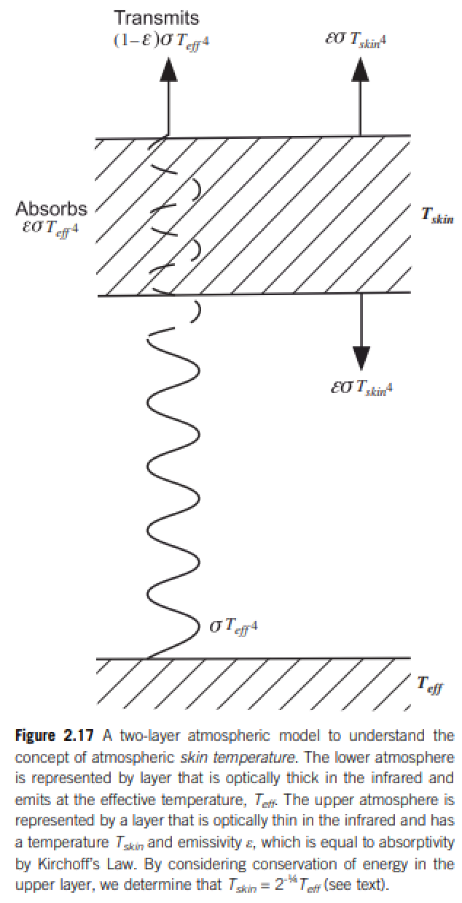
Relationship between surface temperature and atmospheric temperature

Slide 10
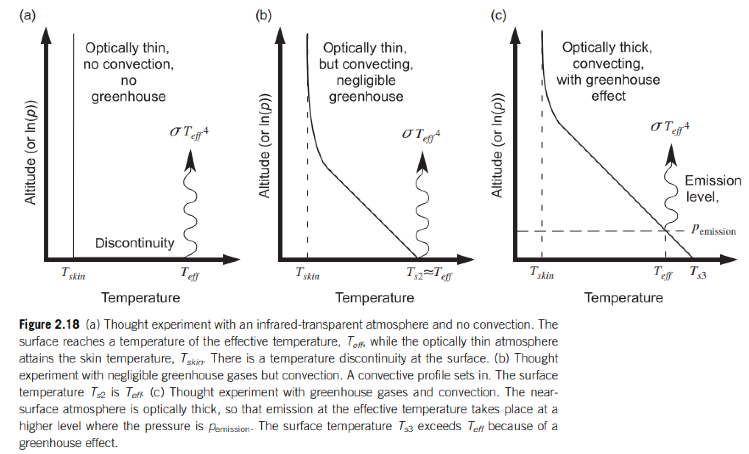
Relationship between surface temperature and atmospheric temperature

Slide 11
End of lecture 3 – start of lecture 4 Course outline
Foundations (1-2 weeks)
Earth history
HZ concept, atmospheric science essentials
Post-Hadean Earth system
Principles – how are habitable planets initiated and sustained? (4-5 weeks)
Volatile supply, volatile escape
Long-term climate evolution
Runaway greenhouse, moist greenhouse
Specifics (~2 weeks)
Early Mars
Hyperthermals on Earth
Oceans within ice-covered moons
Exoplanetary systems e.g. TRAPPIST-1 system
TODAY

Slide 12
Lecture 4 – volatile supply – key points
Volatiles can be supplied directly as molecules, or contained within hydrated minerals, within clathrates, or adsorbed to ice particles
Within protoplanetary disks, the habitable zone is in a region that theory suggests should be dry
Volatiles can be delivered to the habitable zone by within-disk migration of impactors, scattering of impactors, or whole-planet migration
Volatiles can be released on impact, or as the result of planetary differentiation.

Slide 13
Meech & Raymond 2020

Slide 14
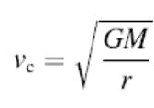
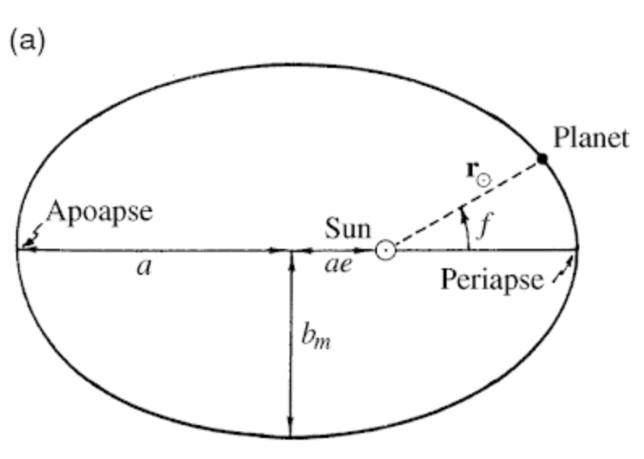
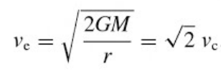
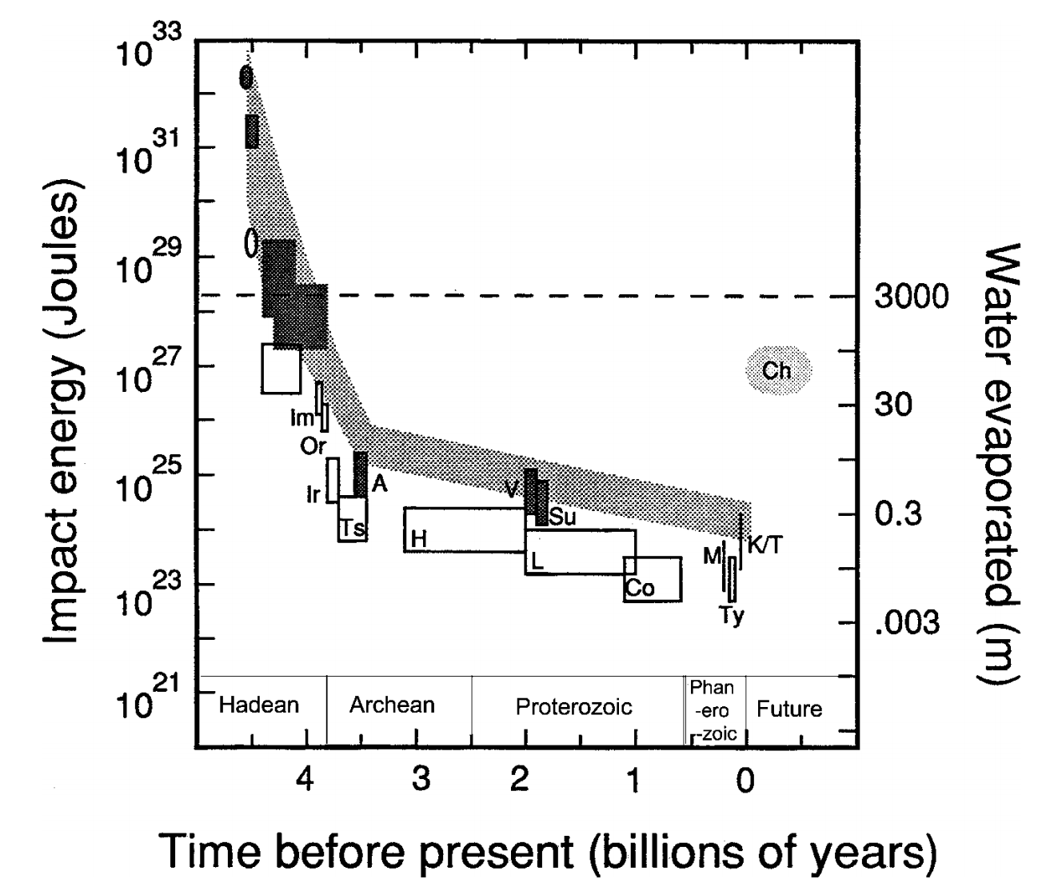
Orbit essentials
Impact energies
de Pater & Lissauer 2001
Compare impact energies and insolation
from Kasting & Catling 2003

Slide 15
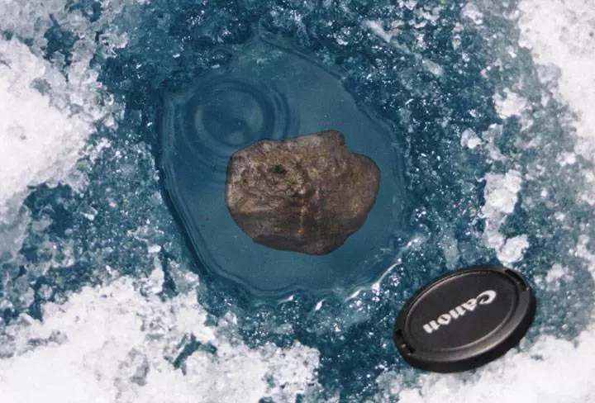
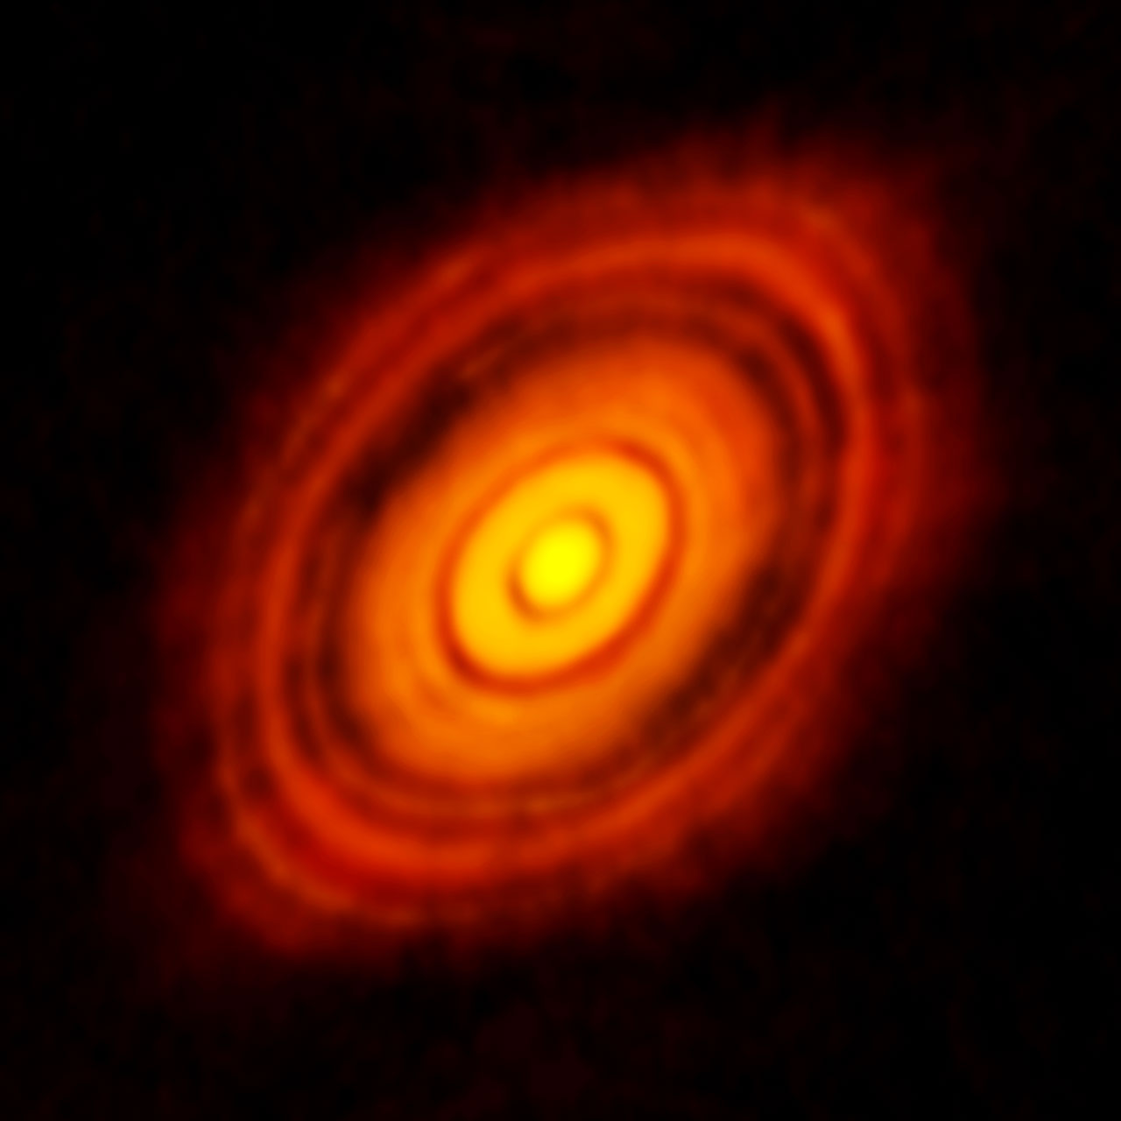
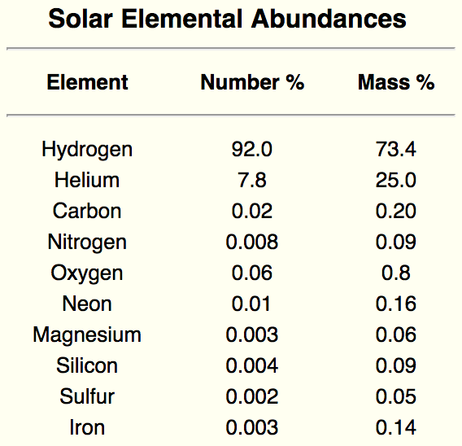
Data sources for planet formation
Tagish Lake meteorite fall
HL Tauri (HL Tau) at mm wavelengths ALMA
Spectra of Sun
Protoplanetary disk starting materials
= star composition
50 AU
1 AU = 1 Astronomical Unit = 150 million km

Slide 16
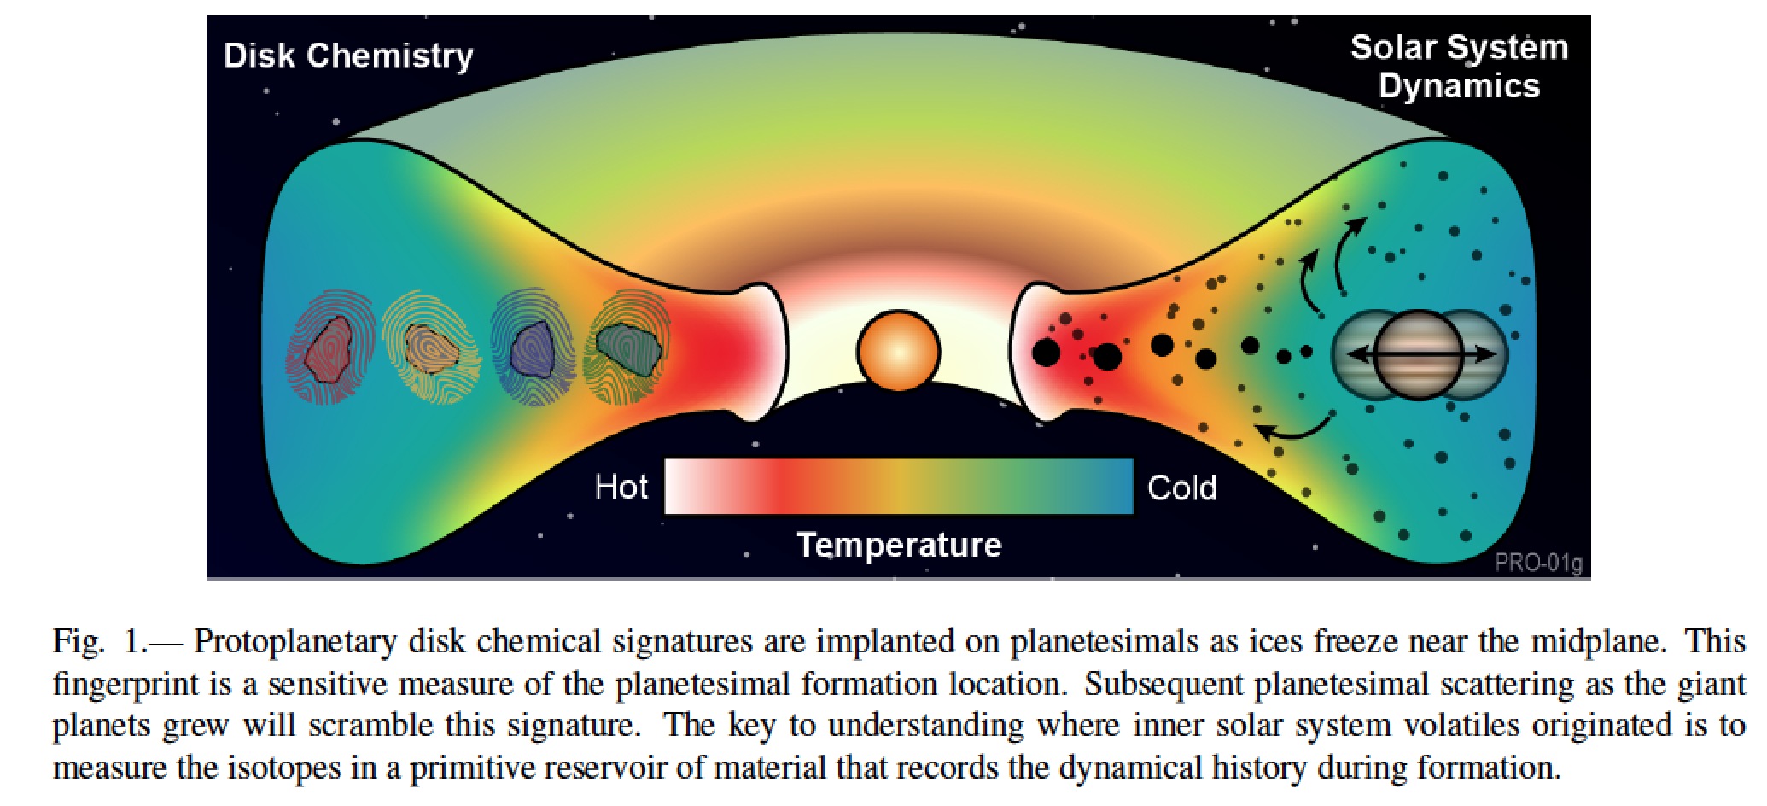
Meech & Raymond 2020

Slide 17
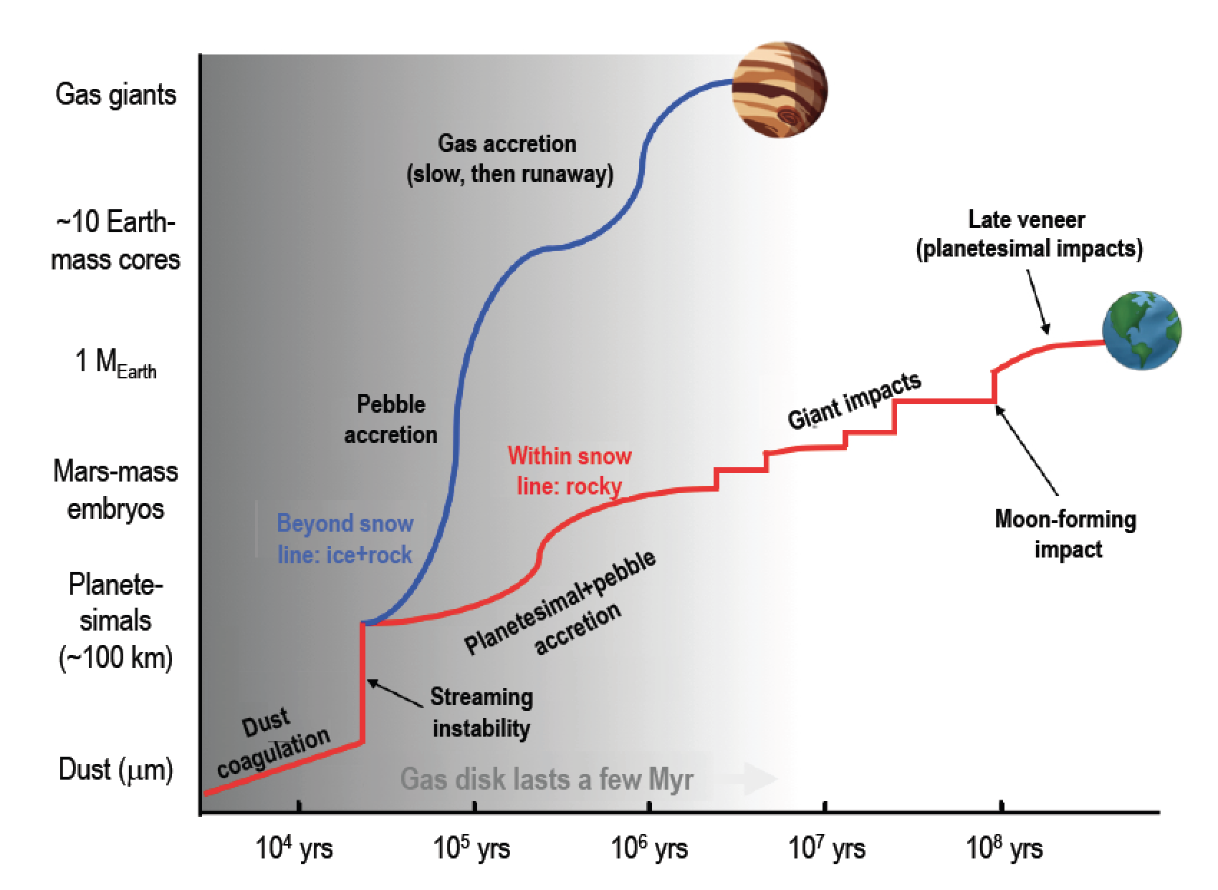
Meech & Raymond 2020

Slide 18
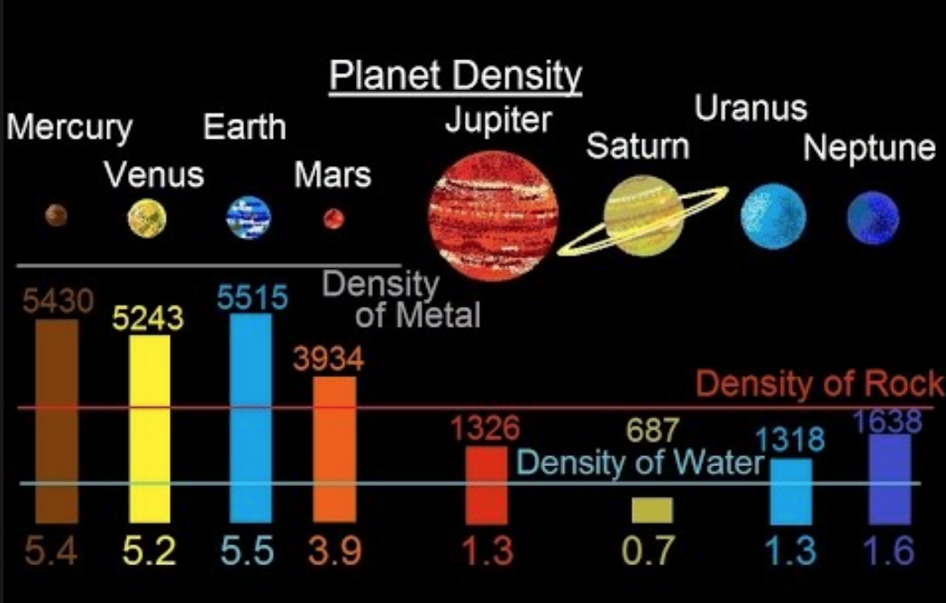

Slide 19
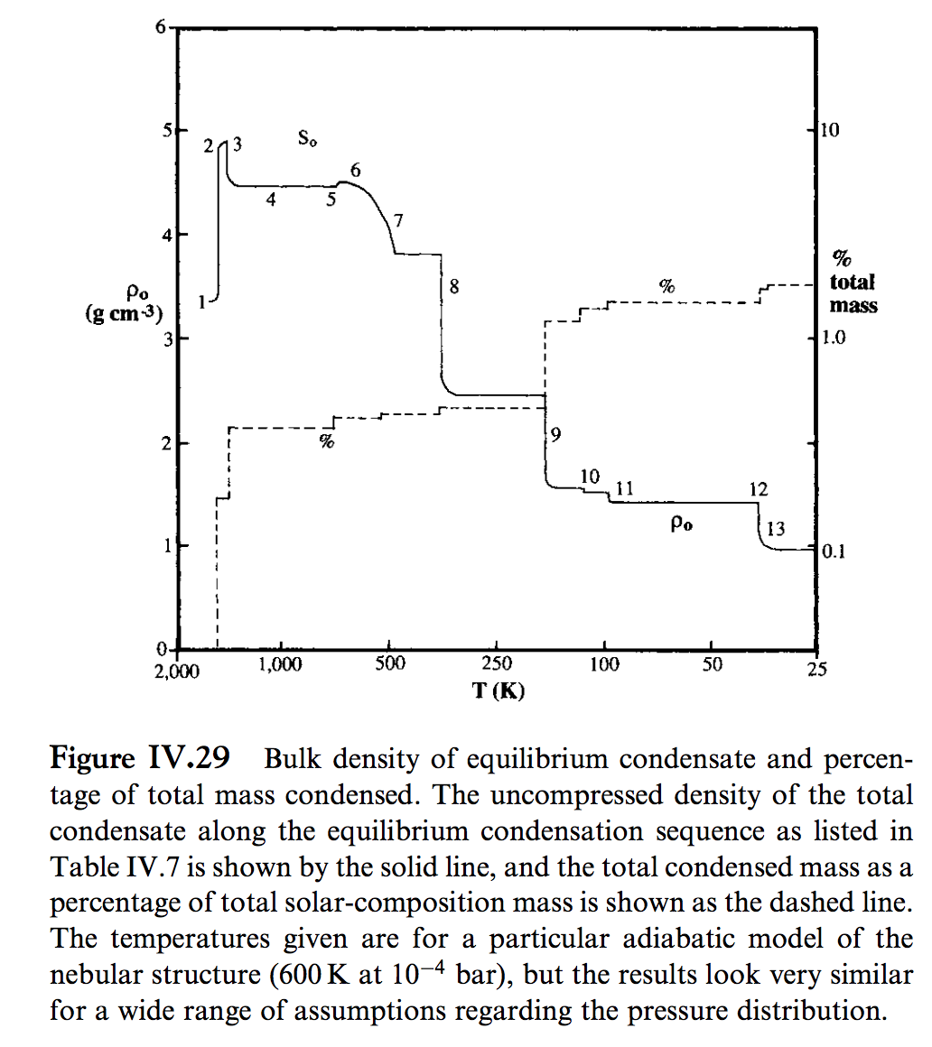
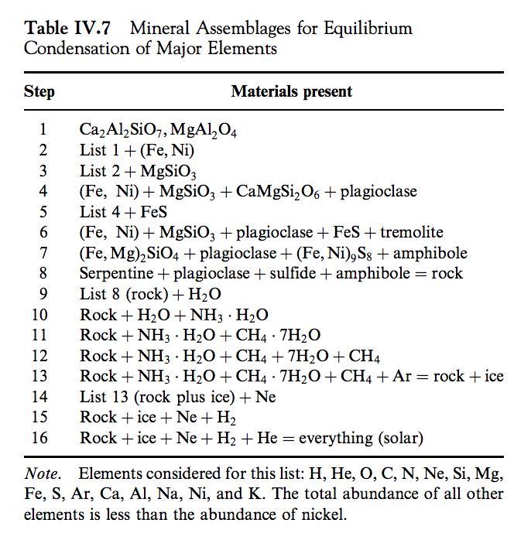
Lewis 2004

Slide 20
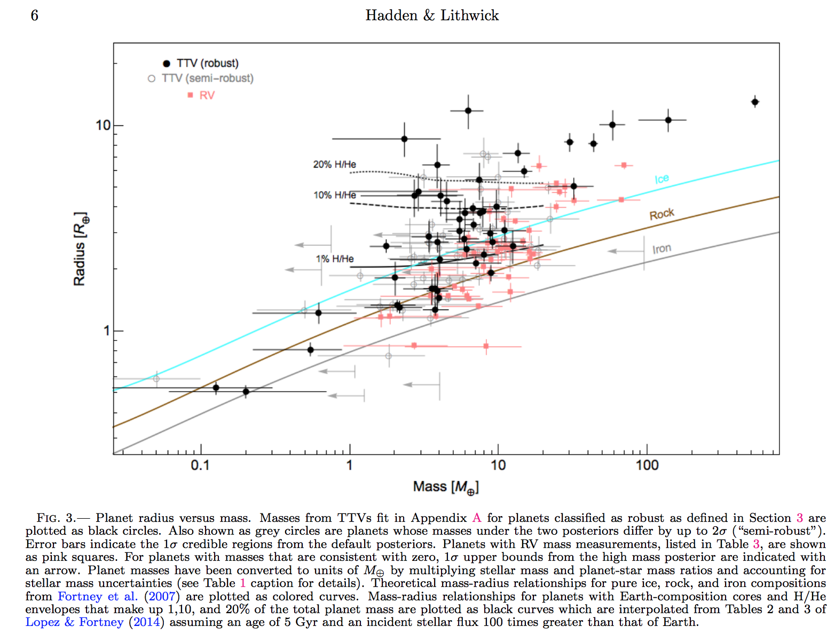
Hadden & Lithwick, Astrophysical Journal 2017
Hilke Schlichting 2018 arXiv

Slide 21
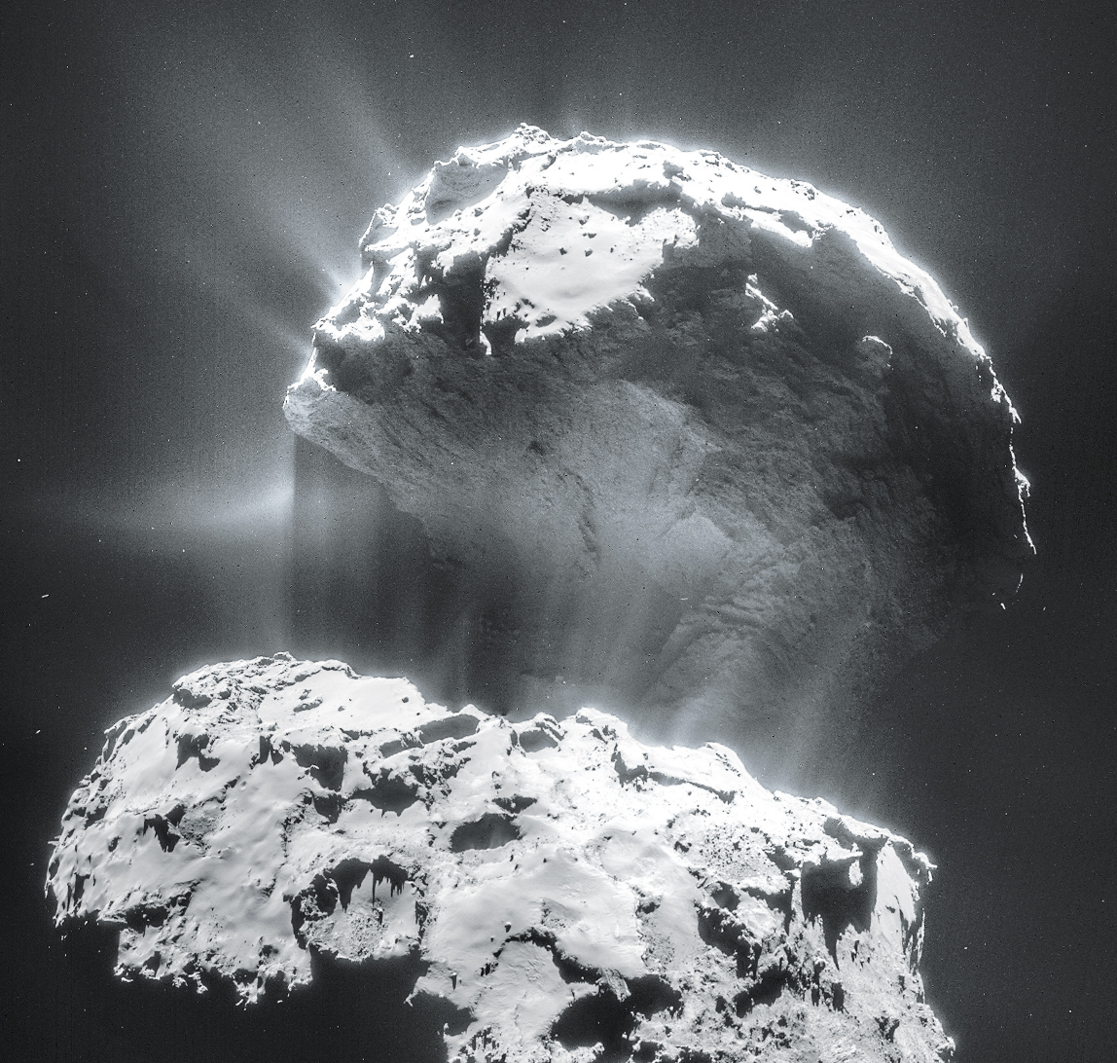
Volatiles can be supplied directly as molecules, or contained within hydrated/C-bearing minerals, within clathrates, or adsorbed to ice particles
Comet 67P from Rosetta
Top lobe is
2.6 km across

Slide 22
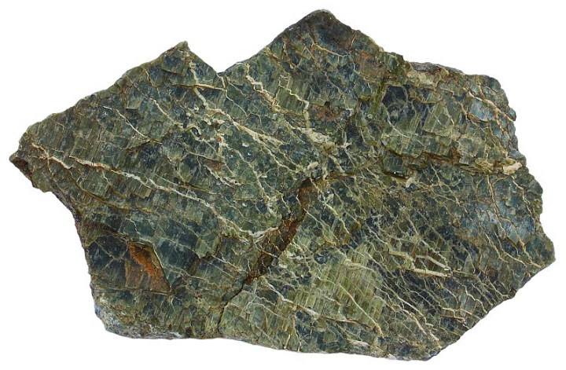
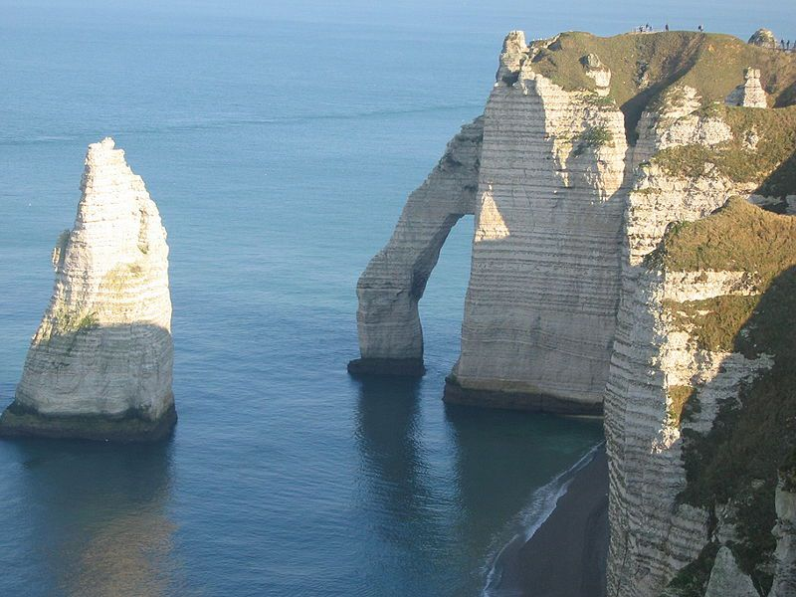
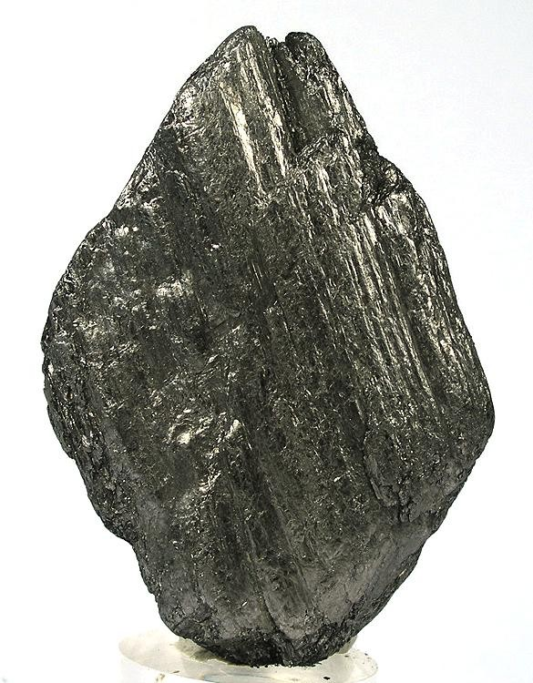
Hydrated/C-bearing minerals
Serpentine
Carbonates
Graphite

Slide 23
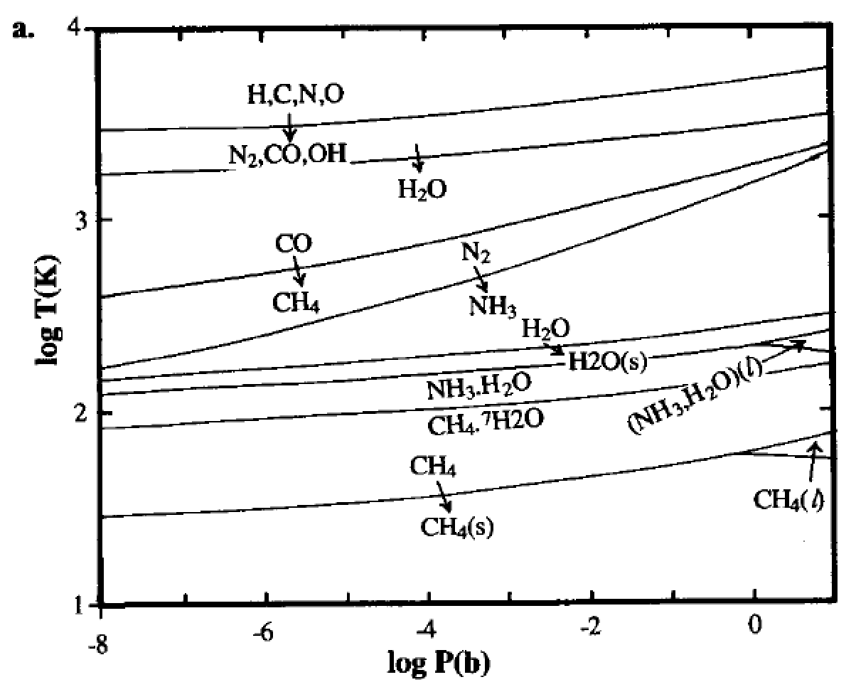
Volatiles can be supplied directly as molecules, or contained within hydrated minerals, within clathrates, or adsorbed to ice particles
Equilibrium
condensation
solar elemental
abundances
Lewis et al. 2004

Slide 24
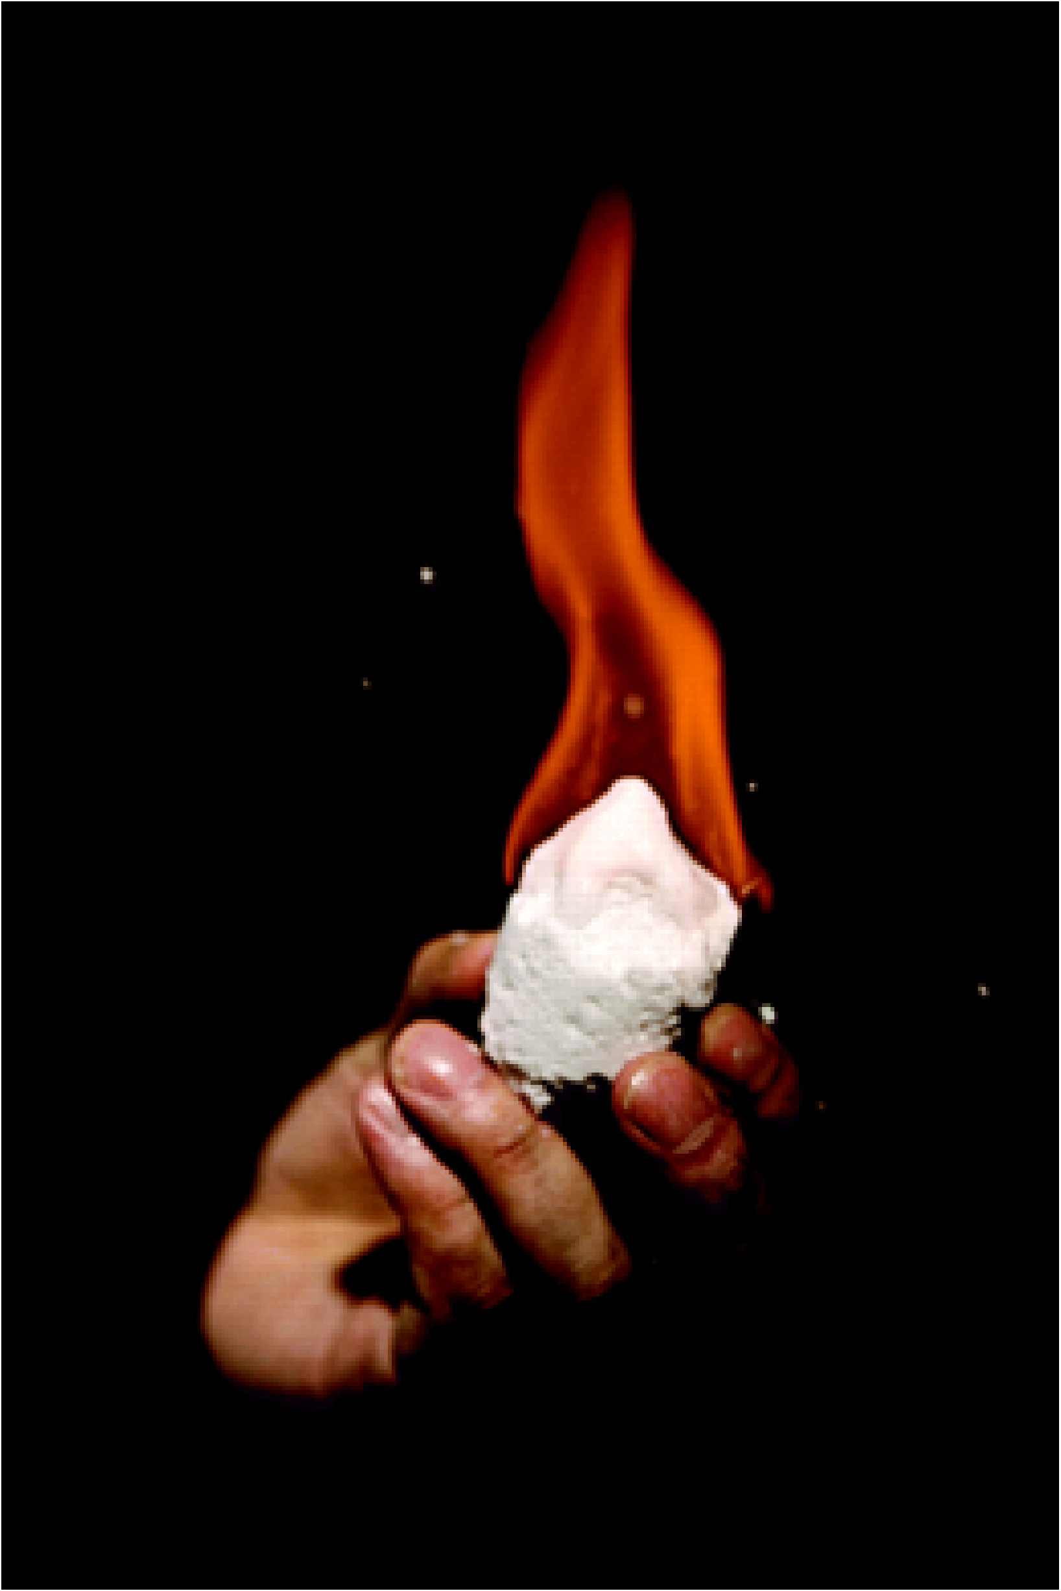
Volatiles can be supplied directly as molecules, or contained within hydrated minerals, within clathrates, or adsorbed to ice particles
CH4 trapped in H2O-ice lattice

Slide 25
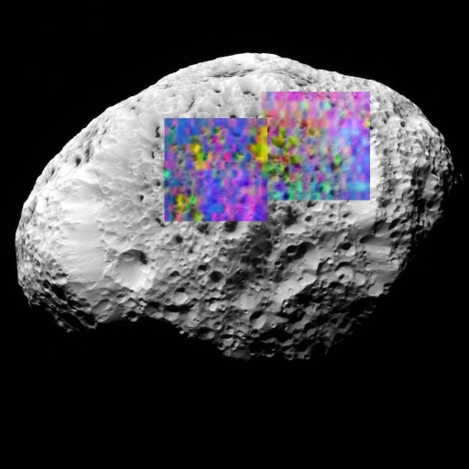
Volatiles can be supplied directly as molecules, or contained within hydrated minerals, within clathrates, or adsorbed to ice particles
H2-adsorbed-to-H2O-ice (yellow) on Saturn’s moon Hyperion (93K)
H2 does not condense until 10K
long axis of Hyperion
= 360 km

Slide 26
Lecture 4 – volatile supply – key points
Volatiles can be supplied directly as molecules, or contained within hydrated minerals, within clathrates, or adsorbed to ice particles
Within protoplanetary disks, the habitable zone is in a region that theory suggests should be dry
Volatiles can be delivered to the habitable zone by within-disk migration of impactors, scattering of impactors, or whole-planet migration
Volatiles can be released on impact, or as the result of planetary differentiation.

Slide 27
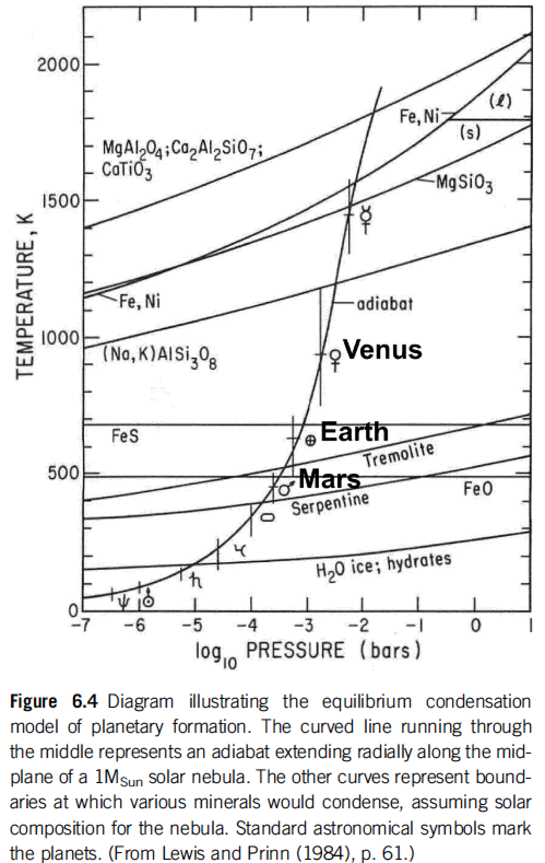
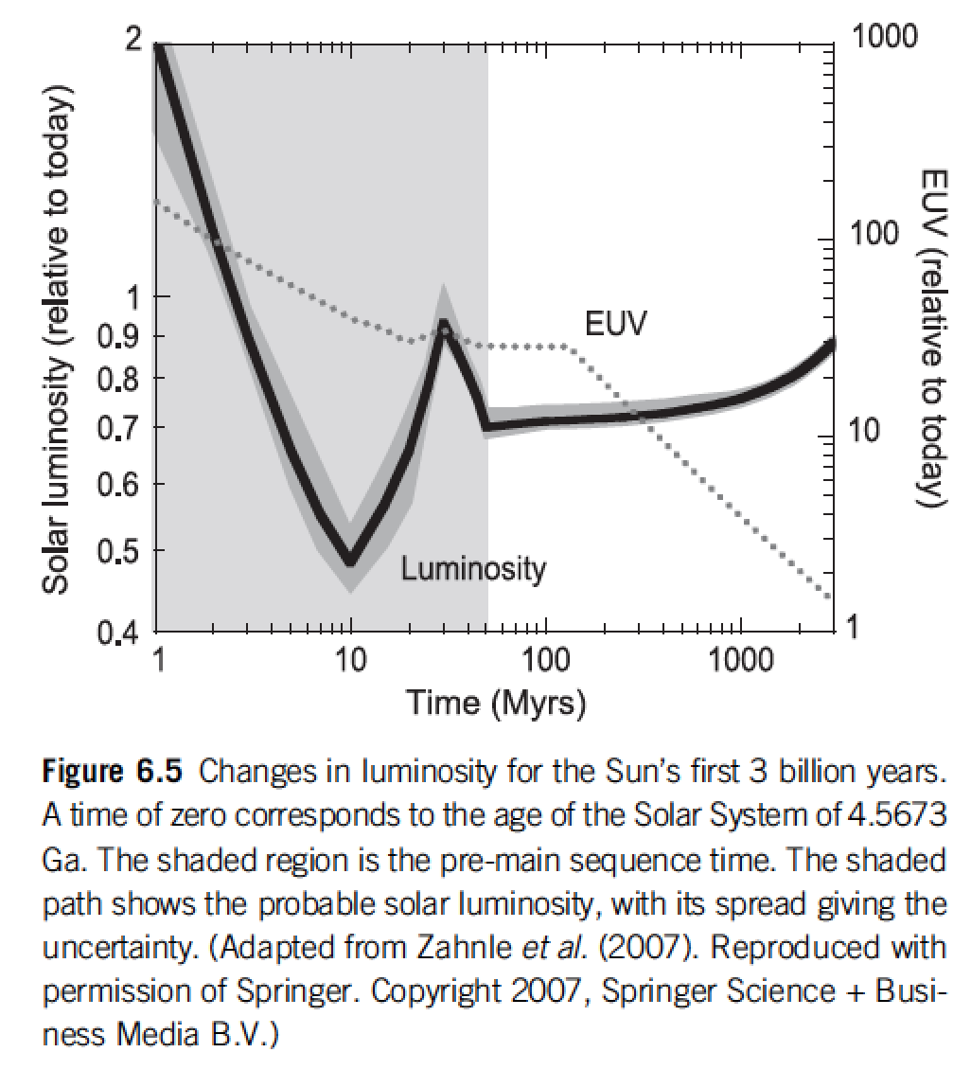
Within protoplanetary disks, the habitable zone is in a region that theory suggests should be dry
rock-forming
minerals + Fe
Snowline concept
Equilibrium condensation model
Catling & Kasting ch. 6

Slide 28
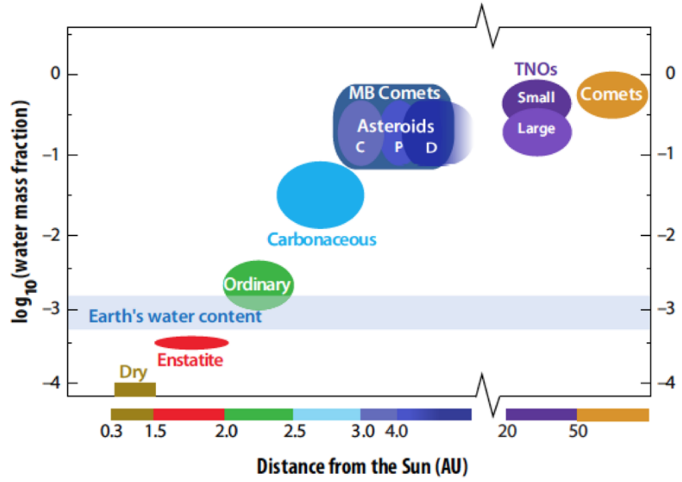
Within protoplanetary disks, the habitable zone is in a region that theory suggests should be dry
MB = Main Belt (2-3.5 AU)
TNO = TransNeptunian Object
von Dishoeck et al. in Protostars & Planets VI, 2014

Slide 29
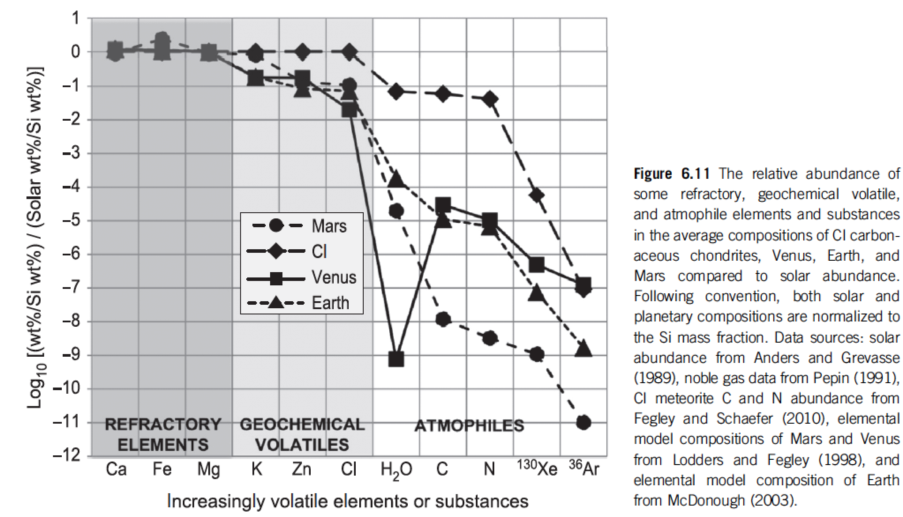
Catling & Kasting 2017, chapter 6

Slide 30
Lecture 4 – volatile supply – key points
Volatiles can be supplied directly as molecules, or contained within hydrated minerals, within clathrates, or adsorbed to ice particles
Within protoplanetary disks, the habitable zone is in a region that theory suggests should be dry
Volatiles can be delivered to the habitable zone by within-disk migration of impactors, scattering of impactors, or whole-planet migration
Volatiles can be released on impact, or as the result of planetary differentiation.

Slide 31
Bonus slides

