Slide 1
GEOS 22060/ GEOS 32060 / ASTR 45900
What makes a planet habitable?
Lecture 5
From volatile supply to volatile escape
Tuesday 21 January 2020

Slide 2
Presentation of Sections 1.1, 1.2, and all of section 3 from Meech and Raymond 2020. This is intended to cement/deepen the material that we will covered in last week's lecture on Volatile Supply. http://geosci.uchicago.edu/~kite/doc/Meech_and_Raymond_2020.pdf

Slide 3
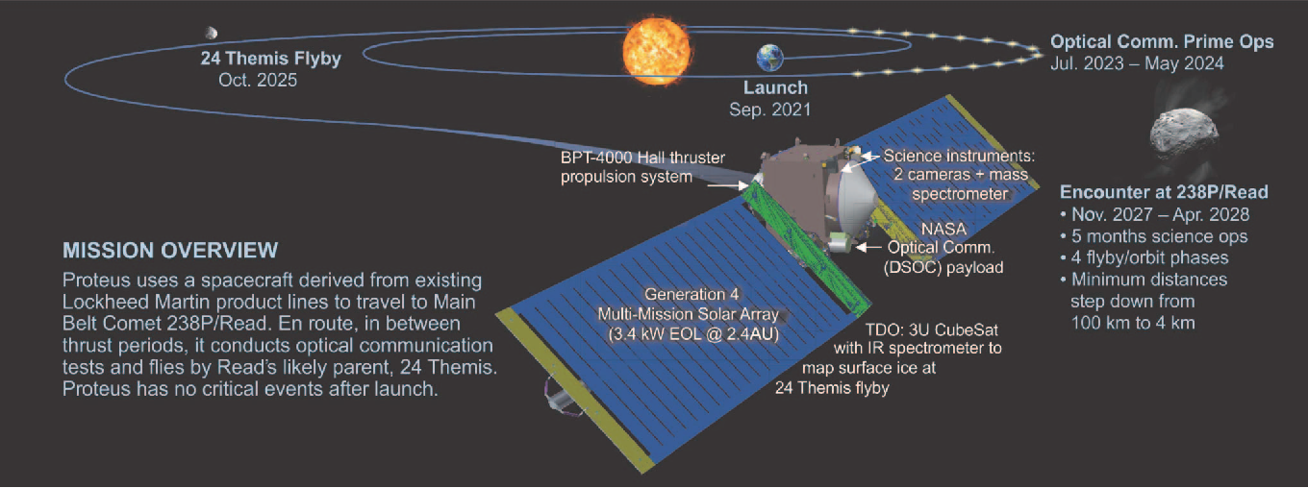
The proposed Proteus mission would investigate the origin of Earth’s water
Karen Meech

Slide 4
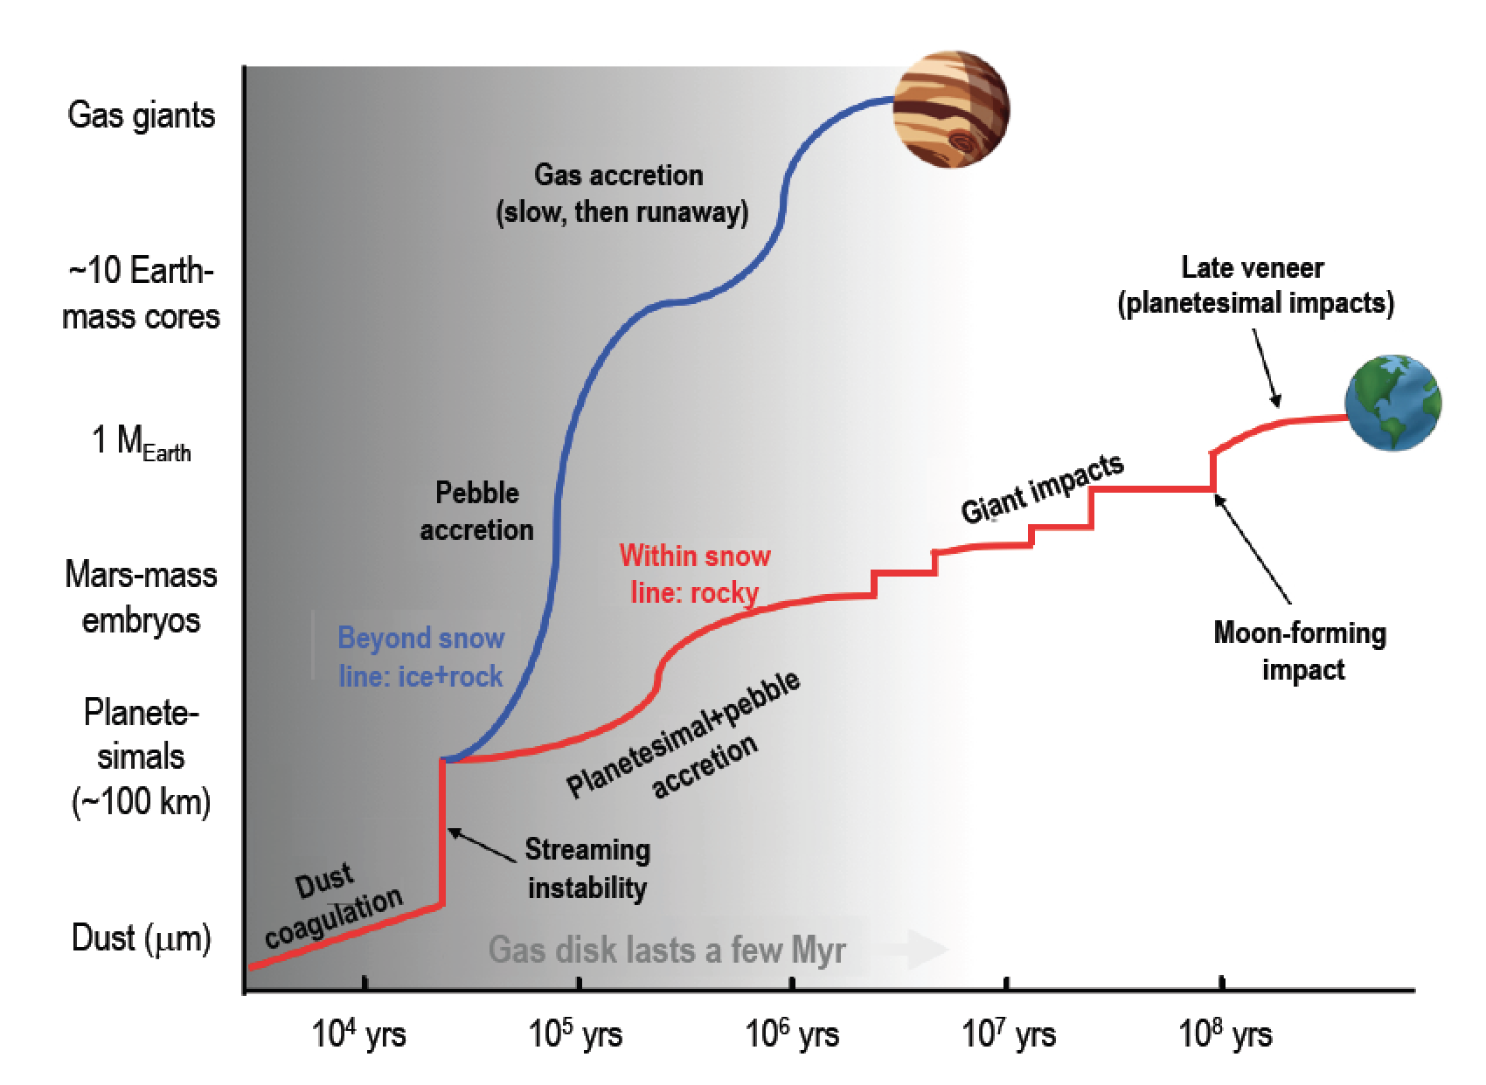
Meech & Raymond 2020

Slide 5
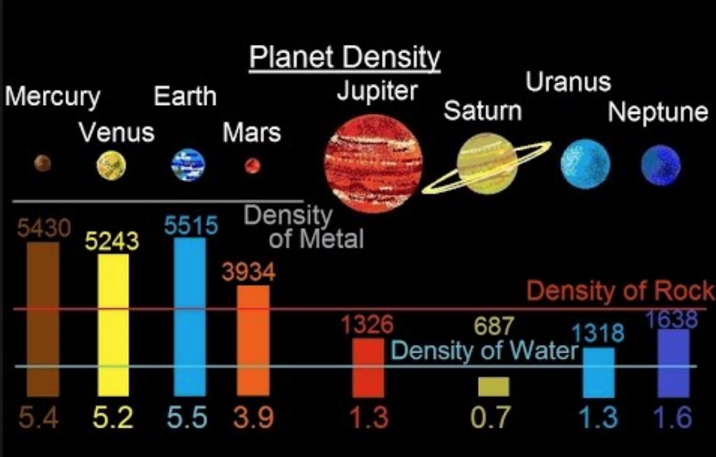

Slide 6
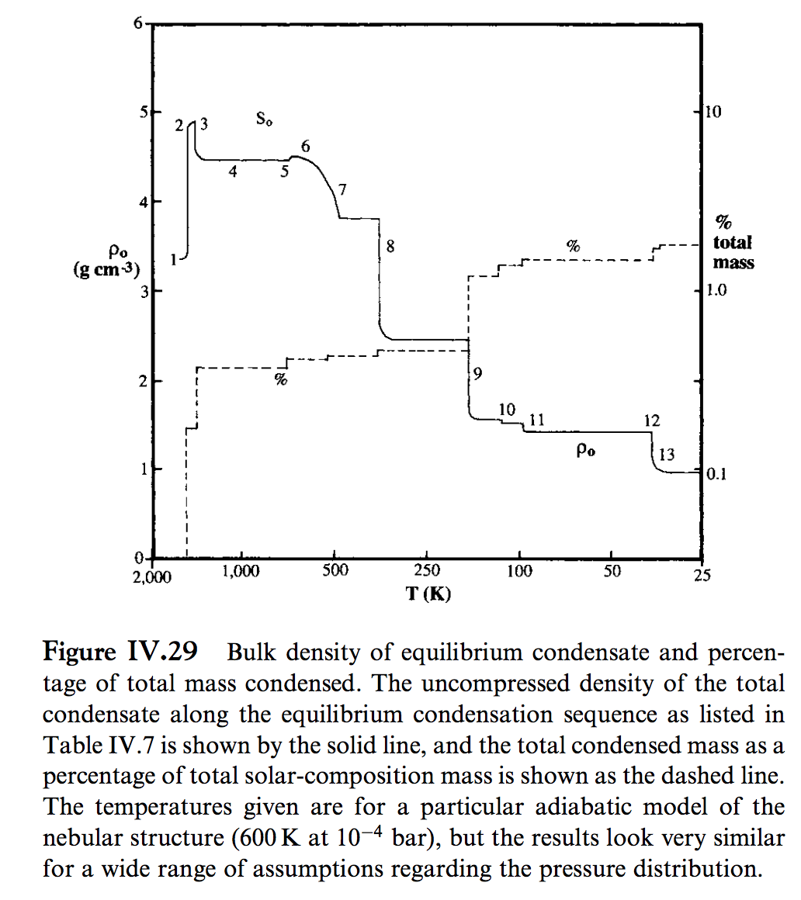
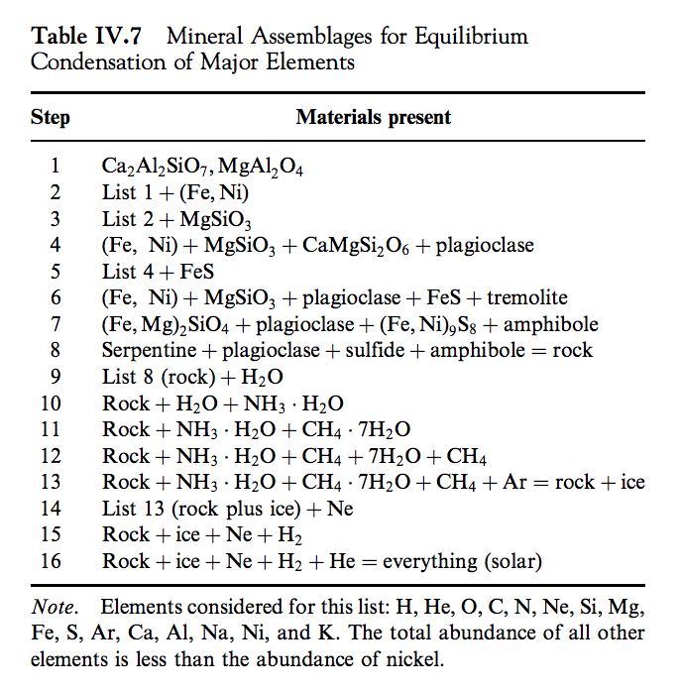
Lewis 2004

Slide 7
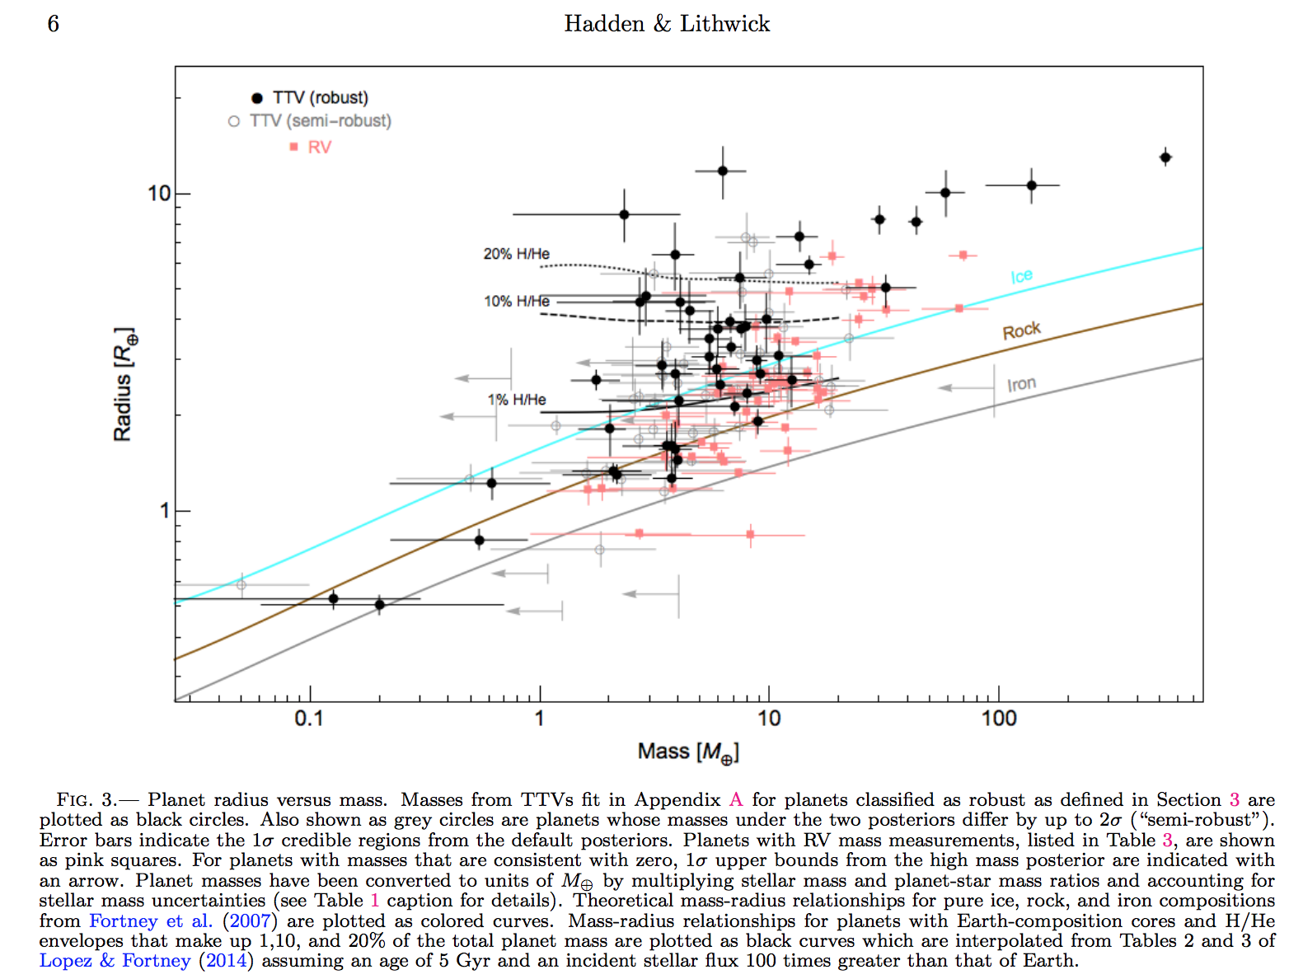
Hadden & Lithwick, Astrophysical Journal 2017
Hilke Schlichting 2018 arXiv

Slide 8
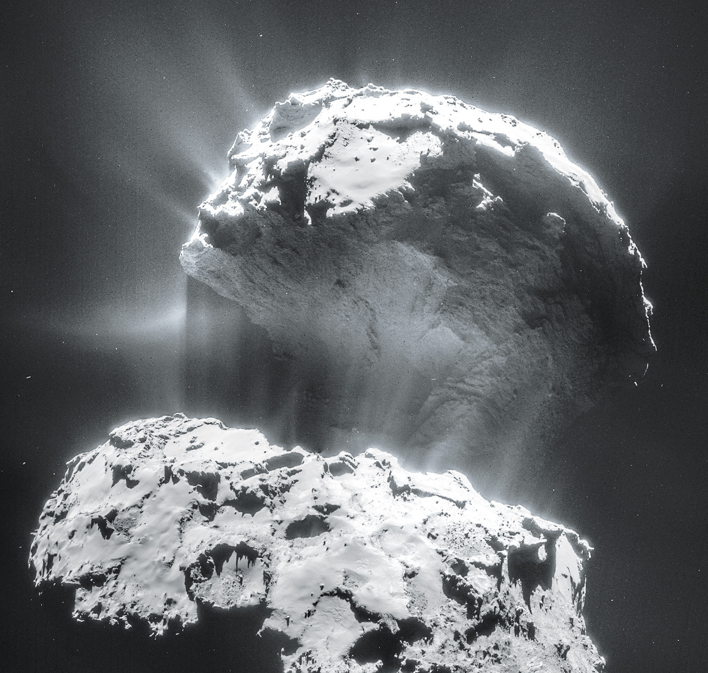
Volatiles can be supplied directly as molecules, or contained within hydrated/C-bearing minerals, within clathrates, or adsorbed to ice particles
Comet 67P from Rosetta
Top lobe is
2.6 km across

Slide 9
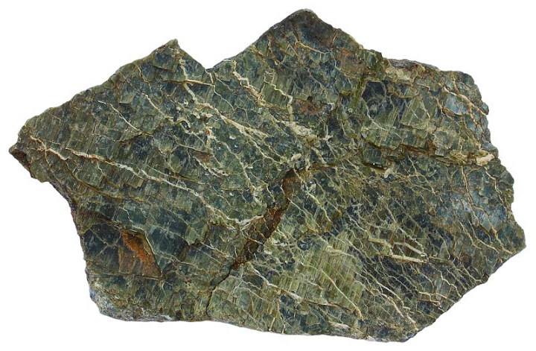
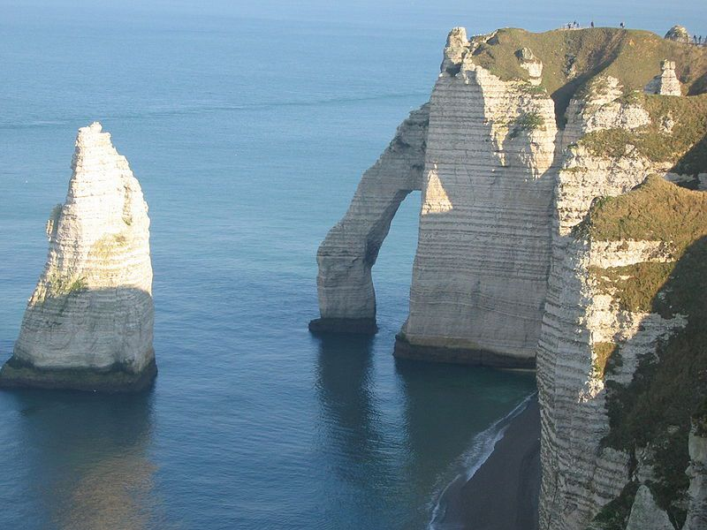
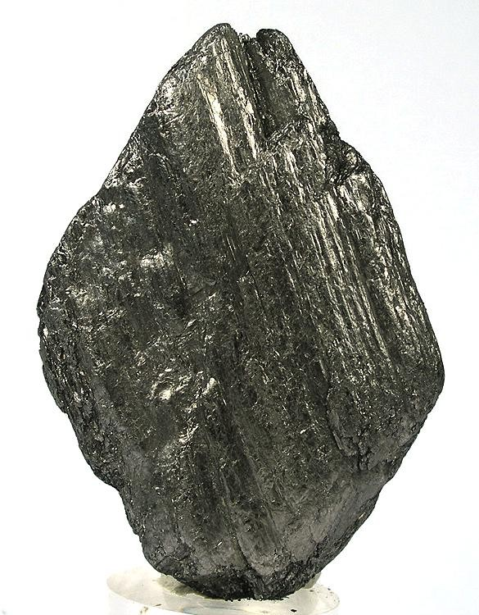
Hydrated/C-bearing minerals
Serpentine
Carbonates
Graphite

Slide 10
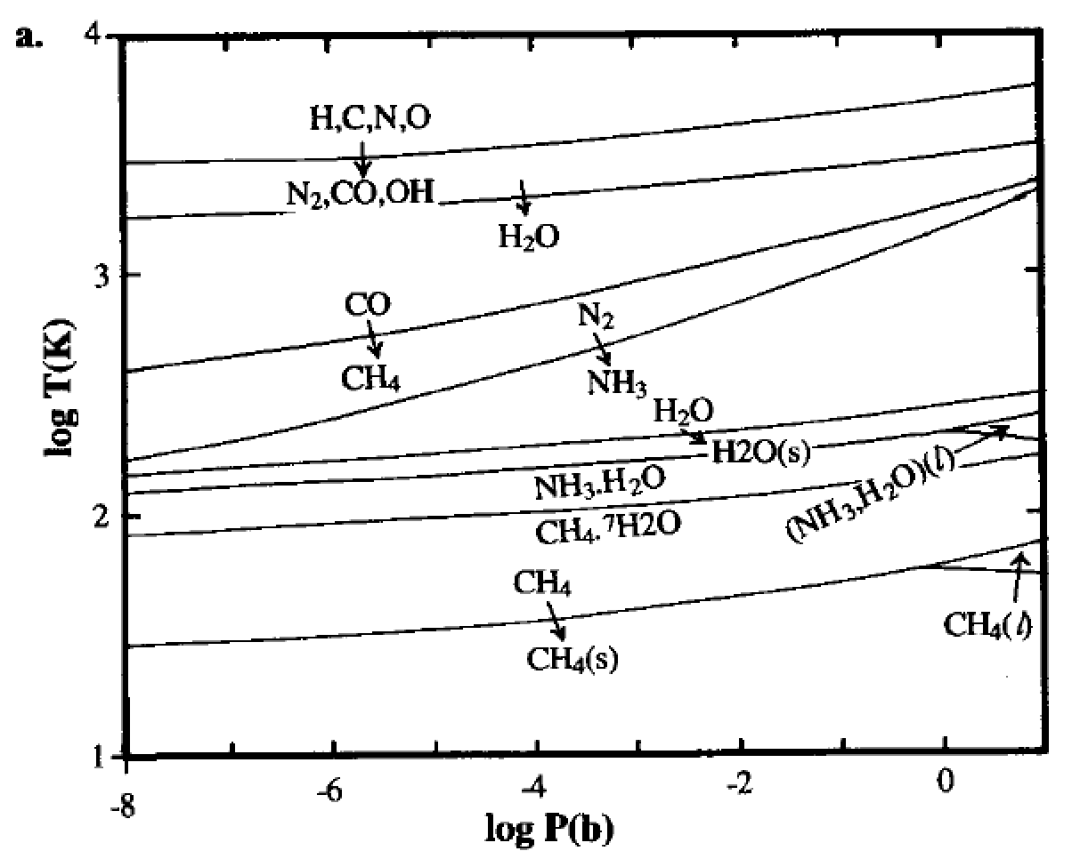
Volatiles can be supplied directly as molecules, or contained within hydrated minerals, within clathrates, or adsorbed to ice particles
Equilibrium
condensation
solar elemental
abundances
Lewis et al. 2004

Slide 11
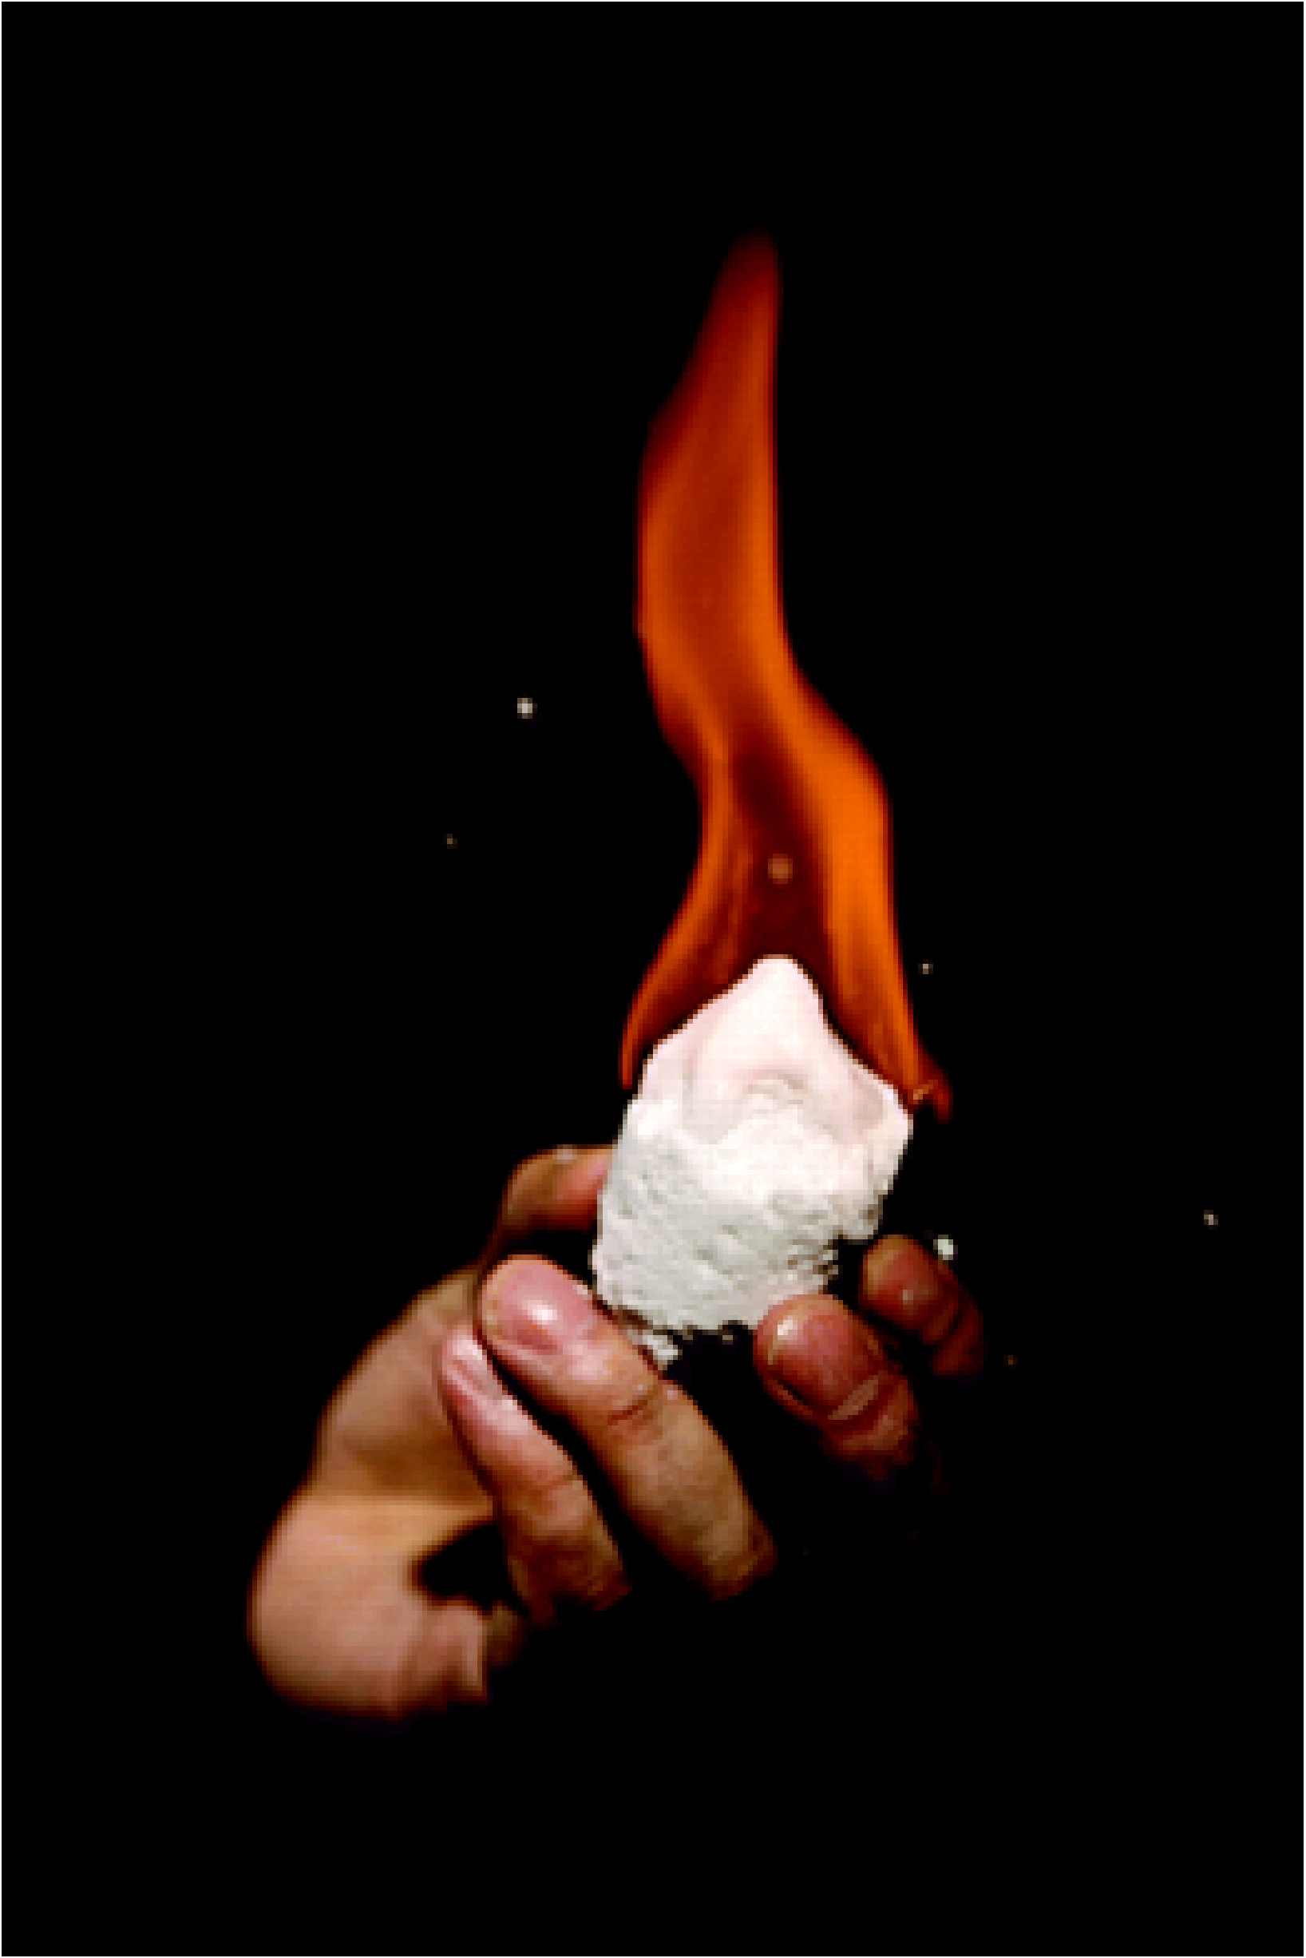
Volatiles can be supplied directly as molecules, or contained within hydrated minerals, within clathrates, or adsorbed to ice particles
CH4 trapped in H2O-ice lattice

Slide 12
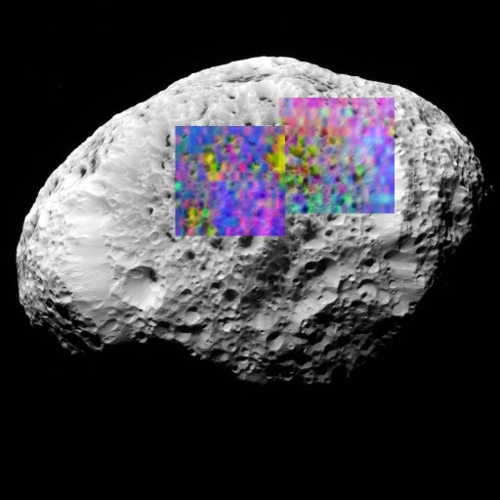
Volatiles can be supplied directly as molecules, or contained within hydrated minerals, within clathrates, or adsorbed to ice particles
H2-adsorbed-to-H2O-ice (yellow) on Saturn’s moon Hyperion (93K)
H2 does not condense until 10K
long axis of Hyperion
= 360 km

Slide 13
Lecture 4 – volatile supply – key points
Volatiles can be supplied directly as molecules, or contained within hydrated minerals, within clathrates, or adsorbed to ice particles
Within protoplanetary disks, the habitable zone is in a region that theory suggests should be dry
Volatiles can be delivered to the habitable zone by within-disk migration of impactors, scattering of impactors, or whole-planet migration
Volatiles can be released on impact, or as the result of planetary differentiation.

Slide 14
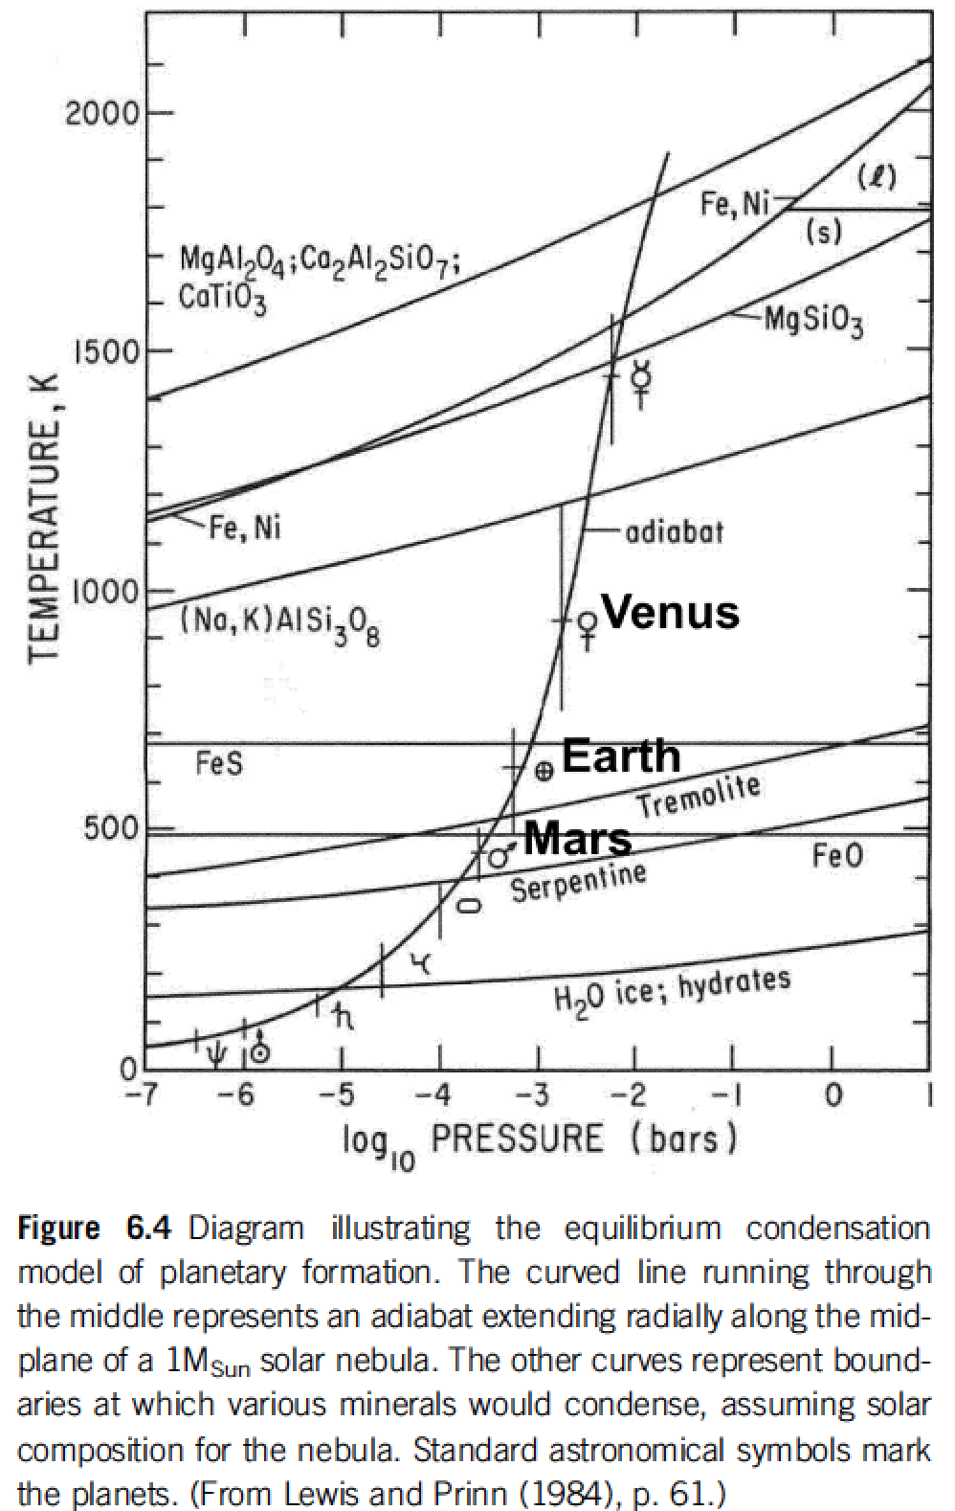
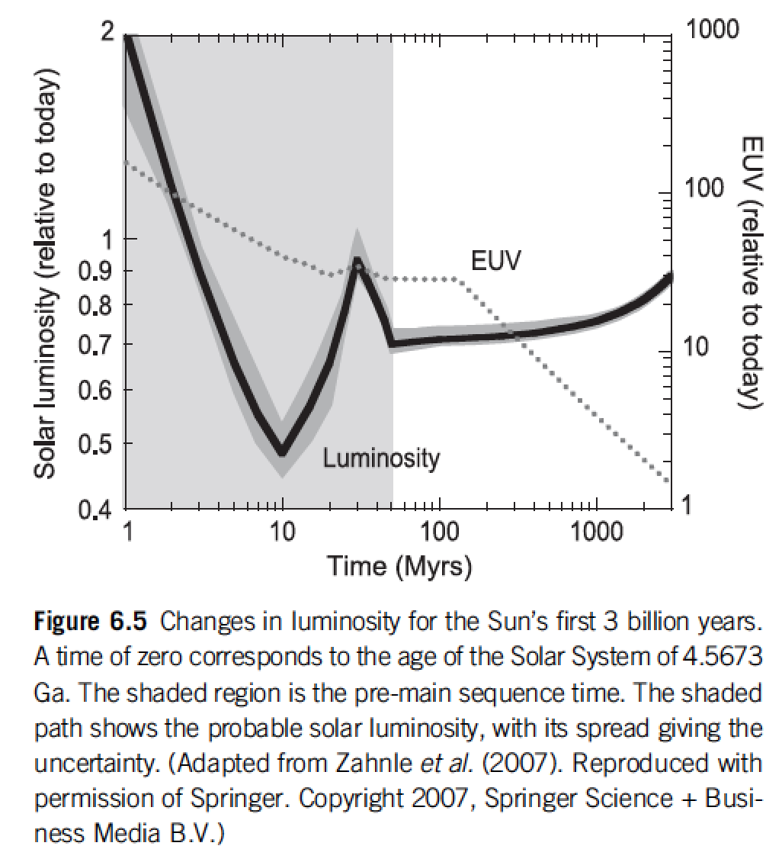
Within protoplanetary disks, the habitable zone is in a region that theory suggests should be dry
rock-forming
minerals + Fe
Snowline concept
Equilibrium condensation model
Catling & Kasting ch. 6

Slide 15
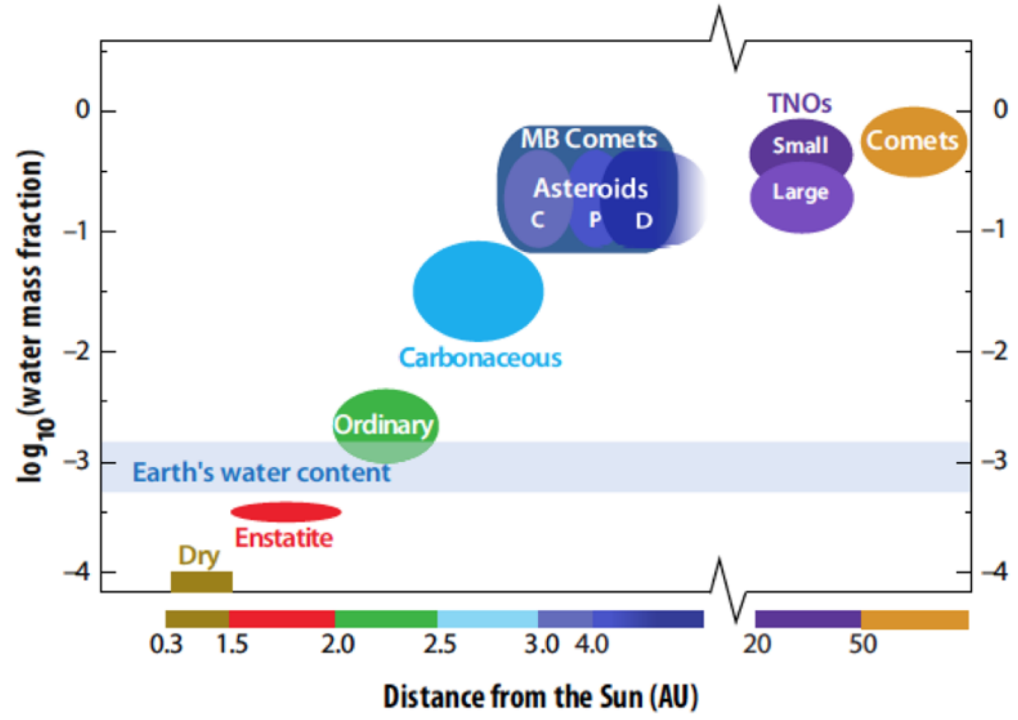
Within protoplanetary disks, the habitable zone is in a region that theory suggests should be dry
MB = Main Belt (2-3.5 AU)
TNO = TransNeptunian Object
von Dishoeck et al. in Protostars & Planets VI, 2014

Slide 16
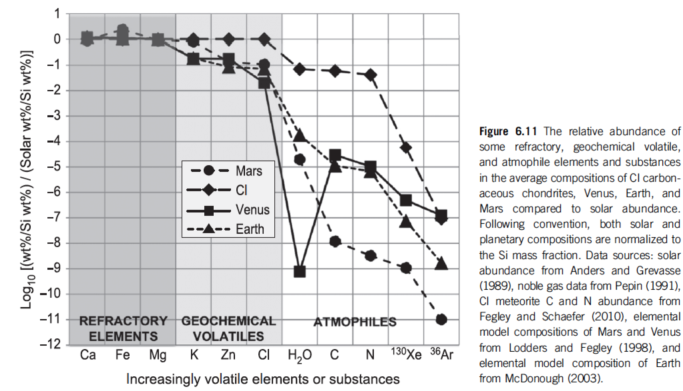
Catling & Kasting 2017, chapter 6

Slide 17
Lecture 4 – volatile supply – key points
Volatiles can be supplied directly as molecules, or contained within hydrated minerals, within clathrates, or adsorbed to ice particles
Within protoplanetary disks, the habitable zone is in a region that theory suggests should be dry
Volatiles can be delivered to the habitable zone by within-disk migration of impactors, scattering of impactors, or whole-planet migration
Volatiles can be released on impact, or as the result of planetary differentiation.

Slide 18
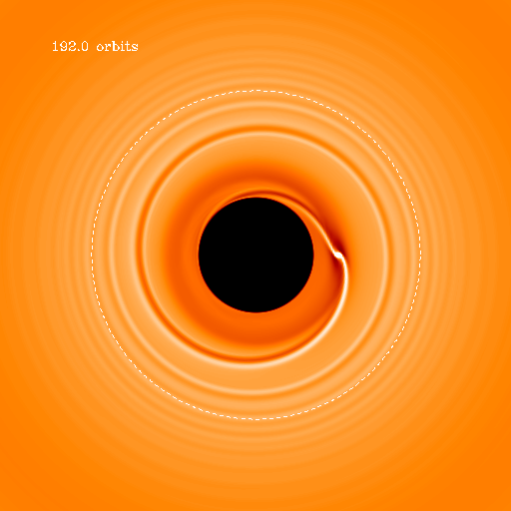
Within-disk migration of impactors
→ Gas drag
Type I migration (gravitational interaction between
planet and disk)

Slide 19
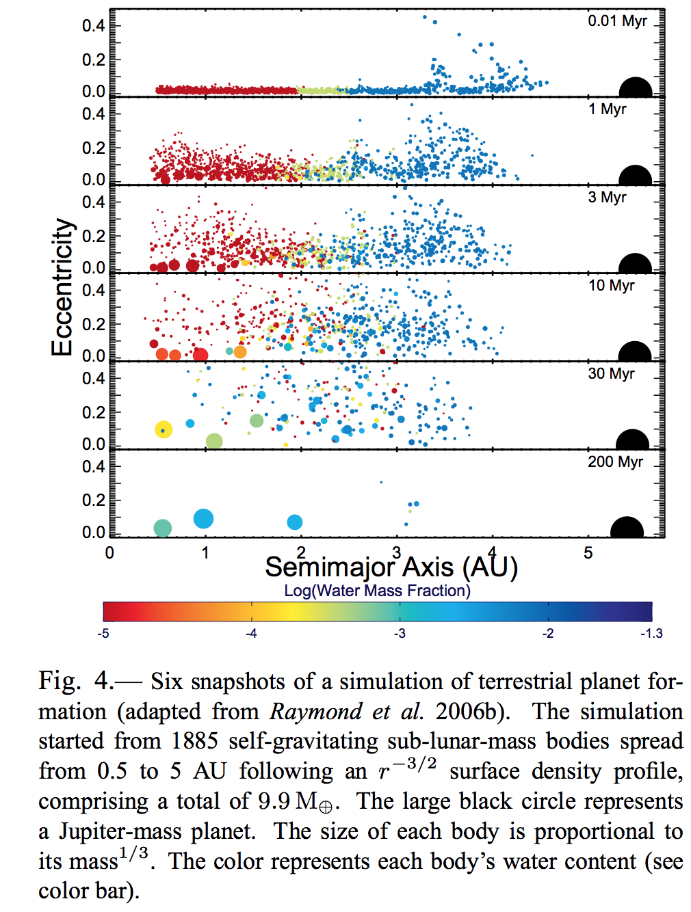
Scattering of impactors
Raymond chapter in Protostars & Planets VI

Slide 20
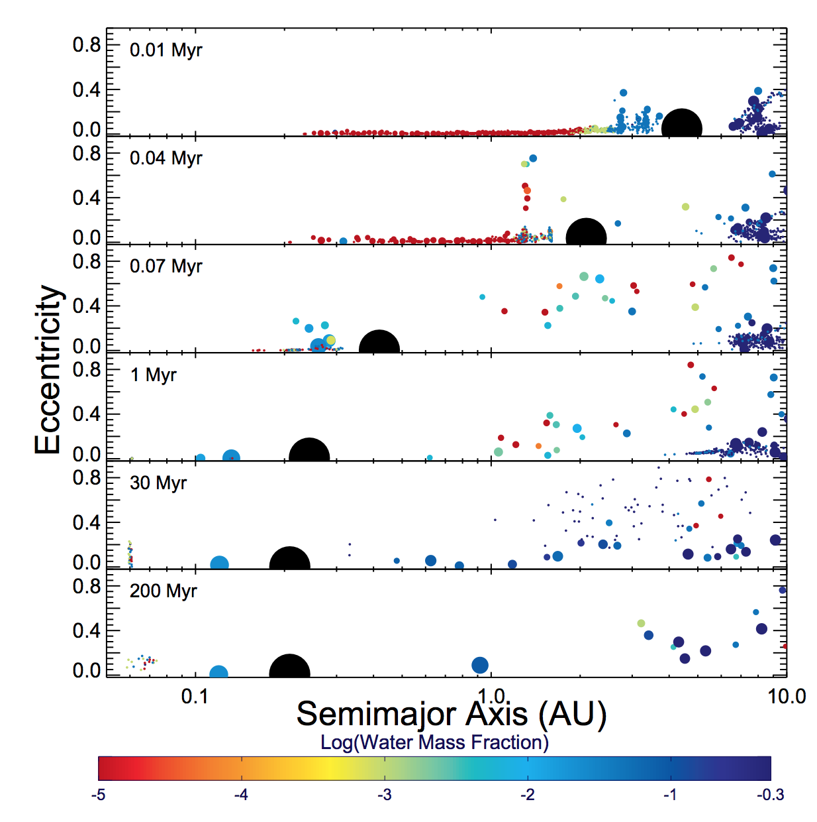
Scattering of impactors
Raymond chapter in Protostars & Planets VI

Slide 21
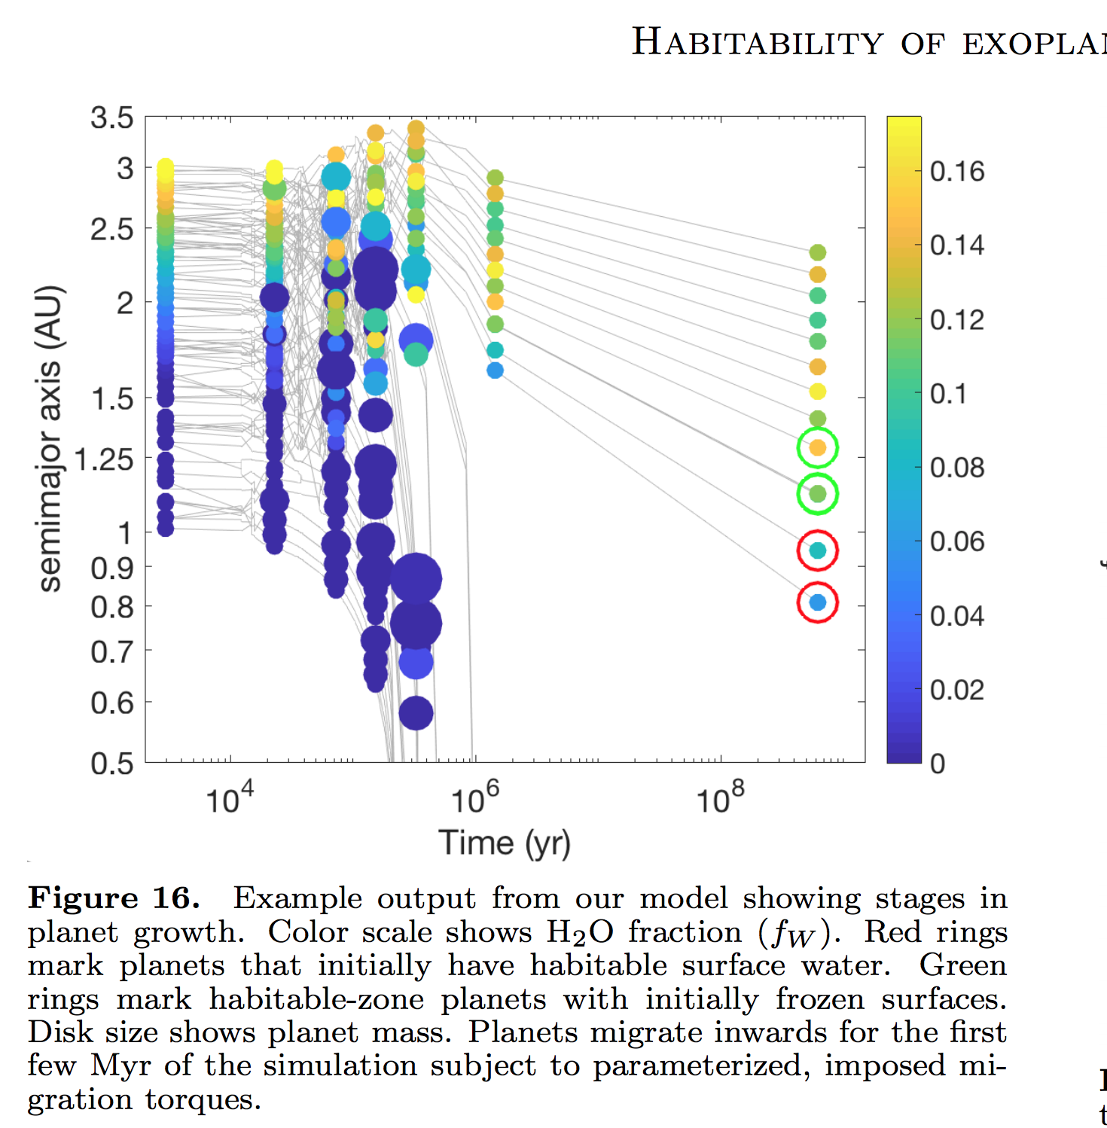
Migration + Scattering of impactors
Kite & Ford arXiv 2018

Slide 22
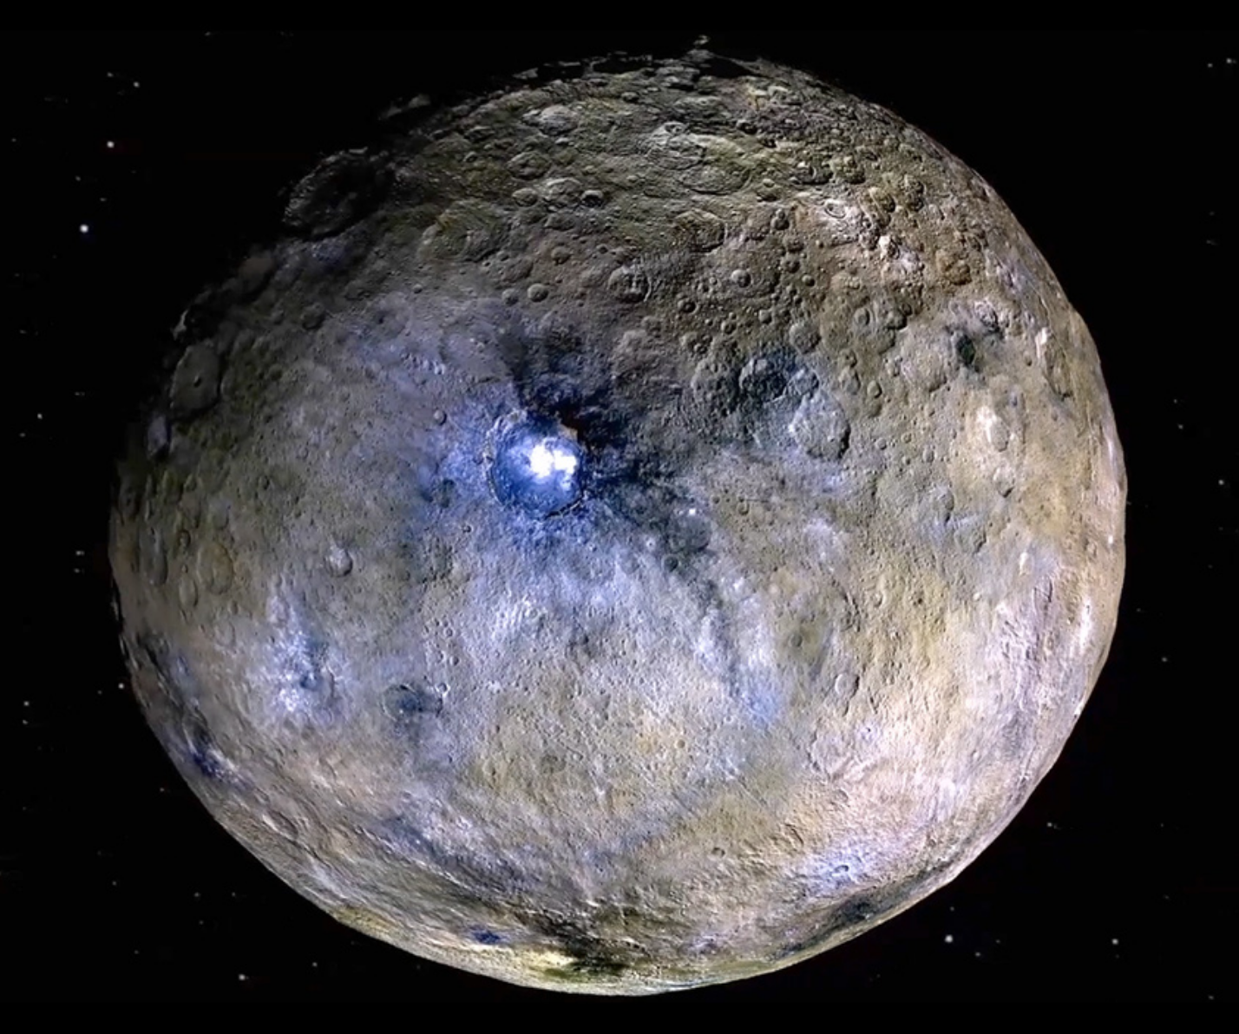
Dwarf planet Ceres is a
possible example of whole-planet migration

Slide 23
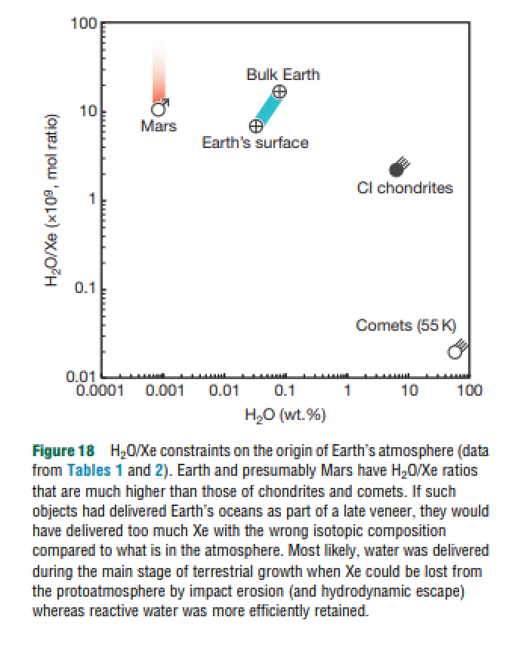
Comets are not likely to be the source of more than a small fraction of the water in Earth’s oceans
Dauphas & Morbidelli 2014

Slide 24
Lecture 4 – volatile supply – key points
Volatiles can be supplied directly as molecules, or contained within hydrated minerals, within clathrates, or adsorbed to ice particles
Within protoplanetary disks, the habitable zone is in a region that theory suggests should be dry
Volatiles can be delivered to the habitable zone by within-disk migration of impactors, scattering of impactors, or whole-planet migration
Volatiles can be released on impact, or as the result of planetary differentiation.

Slide 25
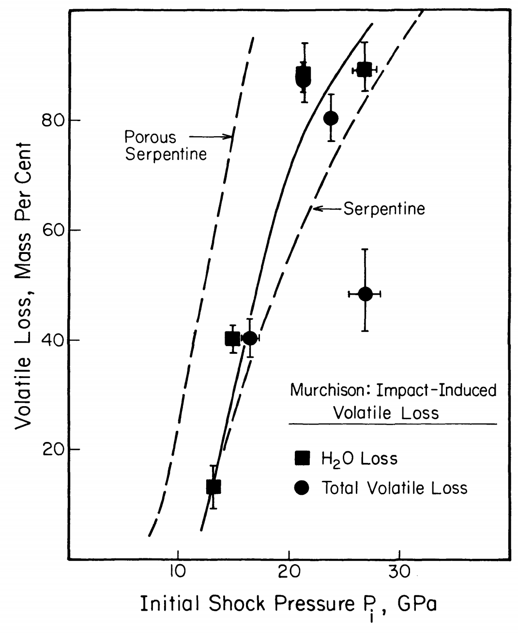
Volatiles can be released on impact
Pressure has units of energy density
(1/2 rho*v^2)
Tyburczy et al. Earth & Planetary Science Letters 1986

Slide 26
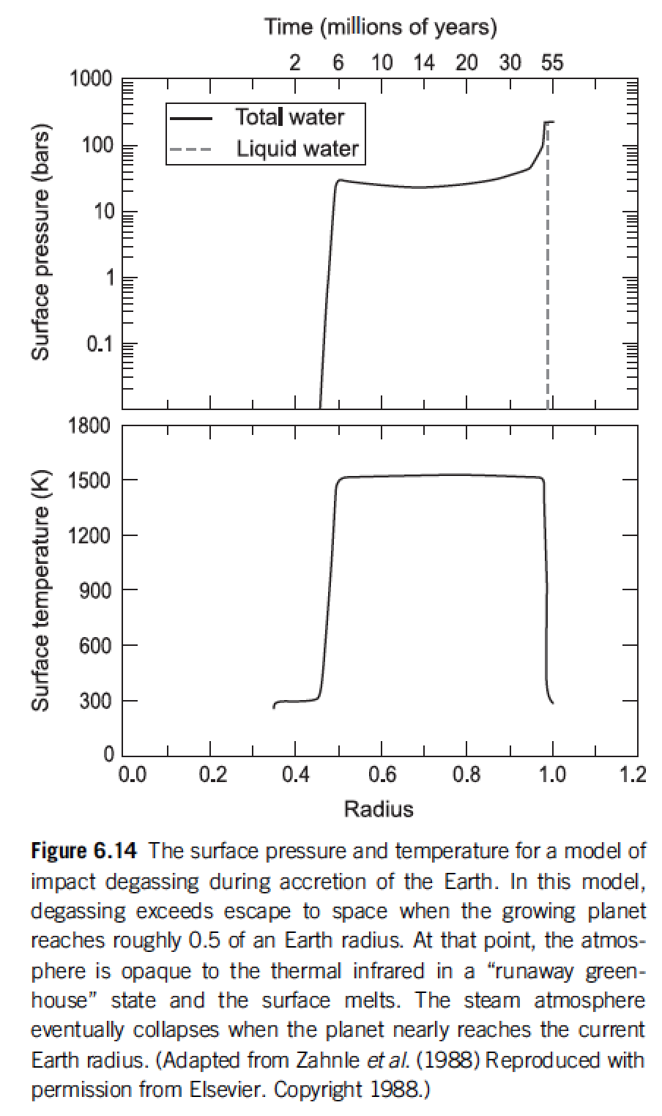
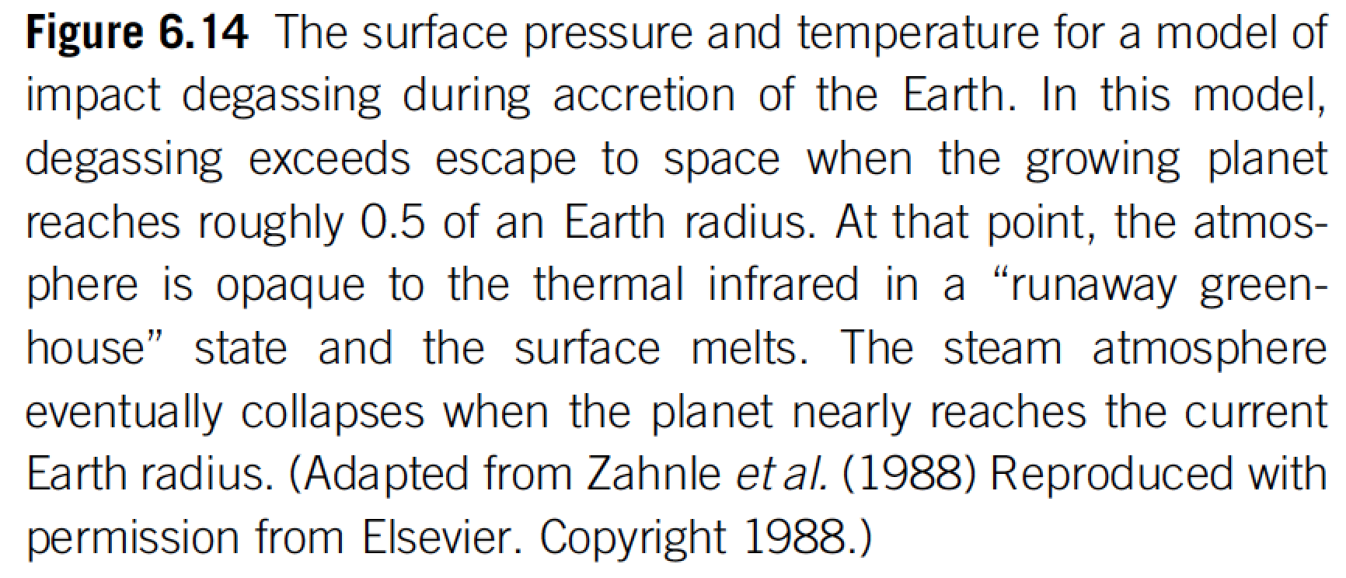
Volatiles can be released on impact
Catling & Kasting ch. 6

Slide 27
Lecture 4/5 – volatile supply – key points
Volatiles can be supplied directly as molecules, or contained within hydrated minerals, within clathrates, or adsorbed to ice particles
Within protoplanetary disks, the habitable zone is in a region that theory suggests should be dry
(equilibrium condensation)
Volatiles can be delivered to the habitable zone by within-disk migration of impactors, scattering of impactors, or whole-planet migration
Volatiles can be released on impact, or as the result of planetary differentiation.

Slide 28
Course outline
Foundations (1-2 weeks)
Earth history
HZ concept, atmospheric science essentials
Post-Hadean Earth system
Principles – how are habitable planets initiated and sustained? (4-5 weeks)
Volatile supply, volatile escape
Long-term climate evolution
Runaway greenhouse, moist greenhouse
Specifics (~2 weeks)
Early Mars
Hyperthermals on Earth
Oceans within ice-covered moons
Exoplanetary systems e.g. TRAPPIST-1 system
TODAY

Slide 29
Volatile escape
Atmospheric Escape
Introduction to Atmospheric Escape
Jeans Escape
Introduction to Hydrodynamic Escape
(If time permits:) Bondi-Hoyle Accretion

Slide 30
Volatile escape - key concepts
Energy sources for atmospheric escape
Thermal, individual-photons, solar wind, impacts
Bottlenecks for atmospheric escape
Energy supply, exobase, homopause, condensation in atmosphere, condensation at surface
Escape parameter, exobase, Jeans escape
The role of the sonic point in hydrodynamic escape

Slide 31
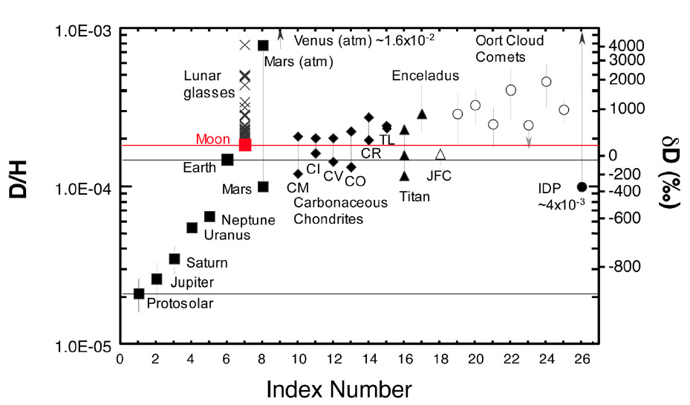
Introduction to Atmospheric Escape
Motivation: Most important process determining whether a planet’s surface can retain volatiles.
Atmospheric escape is the main channel through which the ocean is lost to space (e.g. seas of Mars, ocean-masses of water on Venus).
Is what makes runaway greenhouse irreversible (Venus)

Slide 32
Atmospheric escape
Especially important during the first 100 Myr
Unavoidable for rocky planets

Slide 33
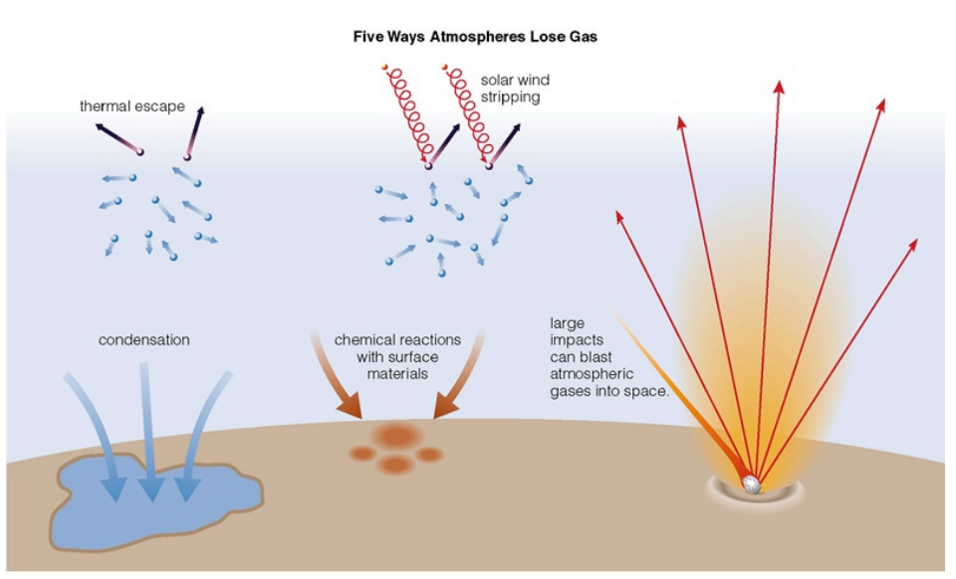
Energy sources for atmospheric escape
Today
not covered
in this course
today
later in this course
via James Wray

Slide 34
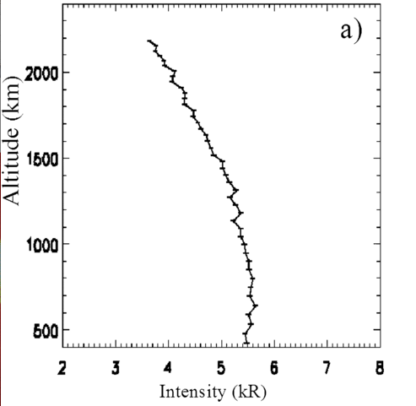
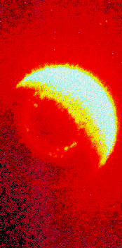
What atmospheric escape looks like (inside the solar system):
Earth hydrogen corona
Mars hydrogen corona (Chauffray et al. 2008)

Slide 35
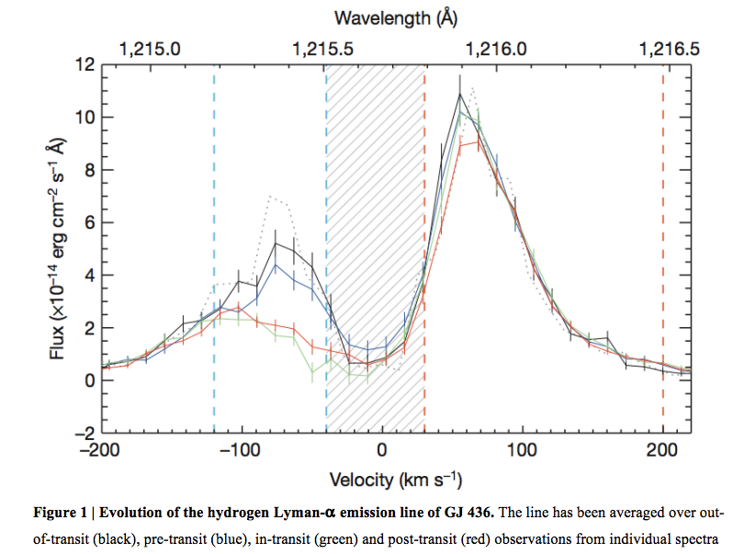
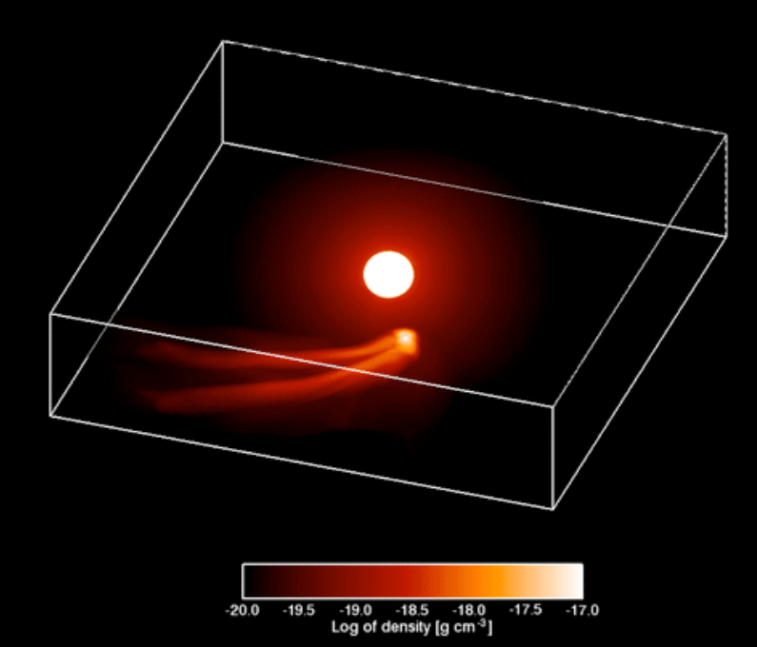
What atmospheric escape looks like (outside the solar system):
Ehrenreich et al. 2015
GJ 436b (Neptune-sized planet in hot orbit)

Slide 36
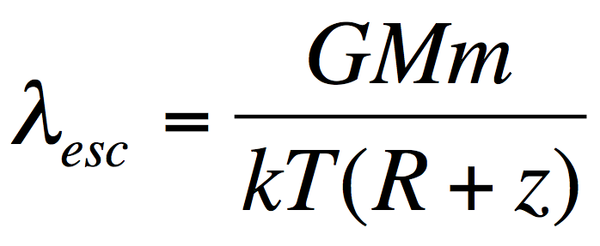
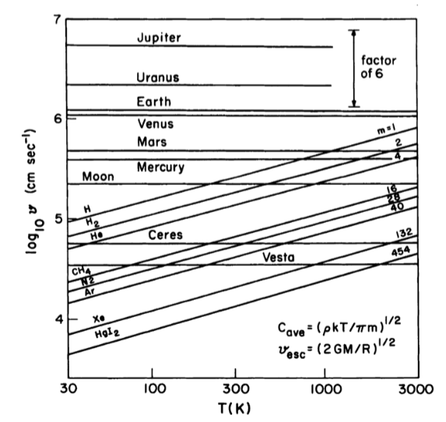
Jeans parameter:
(= “escape parameter”)
>> 1: stable atmosphere,
hydrostatic,
Jeans escape (usually
slow)
~ 1: hydrodynamic
escape (often fast)
Lewis & Prinn,
“Planets and their
atmospheres,” p.108

Slide 37
What sets the rate of atmospheric escape? Possible bottlenecks
Energy supply
Today
Exobase
Homopause
Condensation in atmosphere
Condensation at surface

Slide 38
Jeans Escape (evaporation of atmosphere into space)

Slide 39
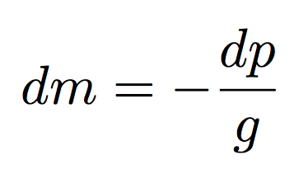
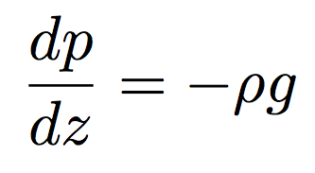
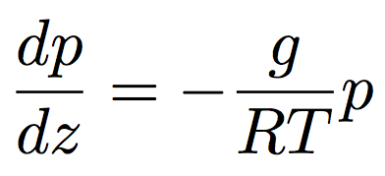
Hydrostatic balance, scale height, exobase
hydrostatic balance
scale height⁻¹
J K⁻¹ kg⁻¹
where

Slide 40
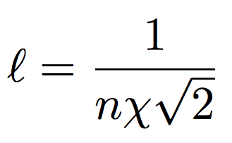
Hydrostatic balance, scale height, exobase
a ~ 10⁻¹⁰ m usually
< 10⁻¹¹ m for atomic H
Exobase: (1) Mean free path l = scale height.
(2) Altitude above which a vertically-rising molecule has a probability of collision of 1/e.
Comparing n_{ex} to the surface number density sets the
dividing line between planets with atmospheres and
worlds with collisionless exospheres (Moon, Mercury)

Slide 41
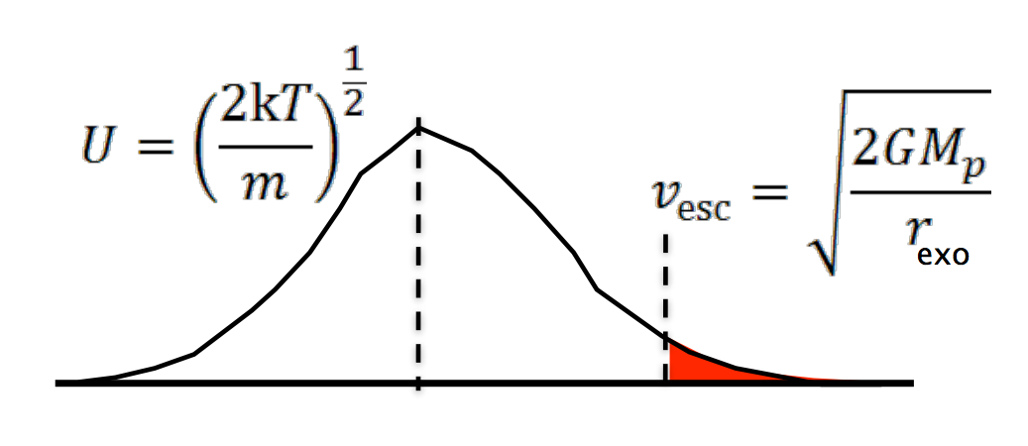
Jeans escape is ‘evaporation’ of an atmosphere in to space
R + z

Slide 42
Introduction to Hydrodynamic Escape
De Laval nozzle (w/polytrope equation of state)
Spherical outflows (polytrope & isothermal)

Slide 43
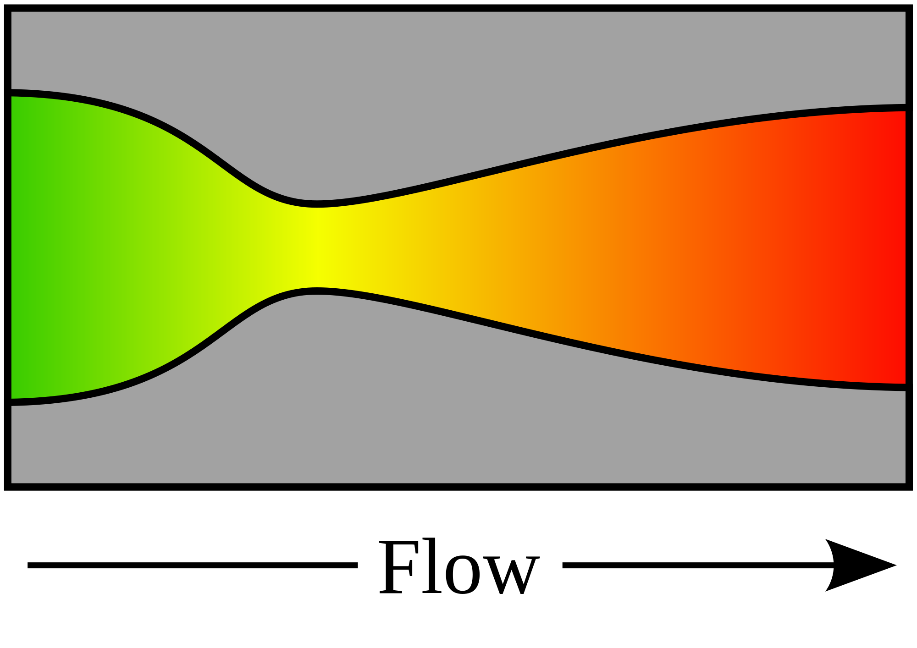
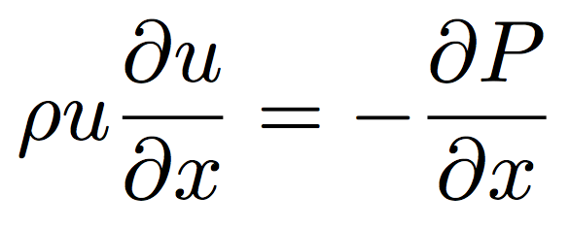
De Laval nozzle
fluid
density
mass
flow rate
nozzle
cross-sectional area
fluid
velocity
continuity
1D, no body forces,
no viscous forces
momentum
“energy”
(equation of state)
(polytrope)
= 1: special case (isothermal)

Slide 44
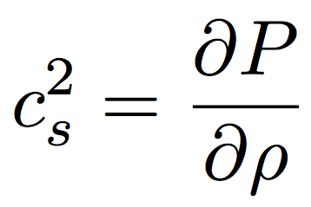
From momentum:
sound speed c_{s}:
Divide by , integrate both sides

Slide 45
From continuity:
Substitute in
(from previous slide):

Slide 46
NOZZLE EQUATION
Neat features:
- Completely reversible (describes inflow and outflow) (u²)
(e.g., loss of gas from a planet and accretion of gas onto a planet)
(inflow of gas onto a star, and outflow of gas from a star = stellar wind / solar wind)
- If subsonic, then will accelerate on convergence and deccelerate on convergence
- If supersonic, then will accelerate on divergence and decelerate on convergence.
(This is because supersonic flows are highly compressible; the increase in A leads to large decrease in density, so u must increase by continuity).
- At the choke point, we must have either a sonic→ supersonic transition, or a maximum or a minimum in velocity.

Slide 47
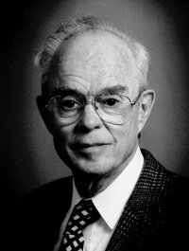
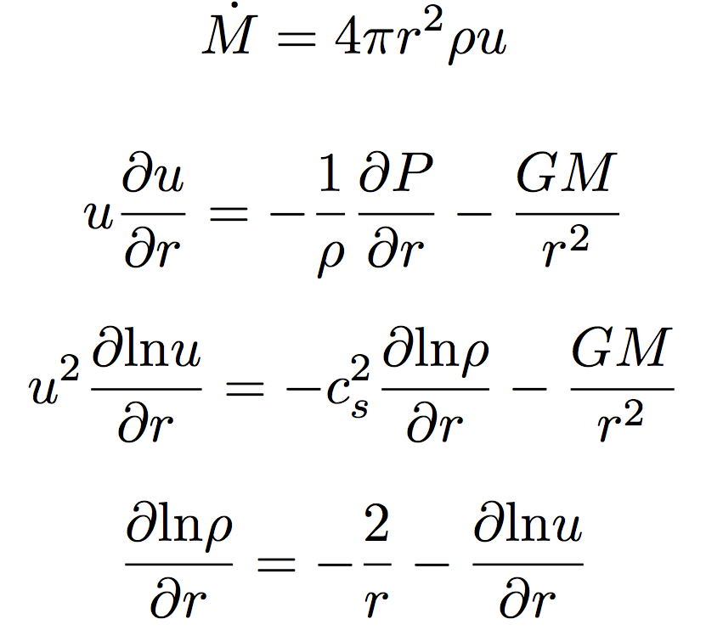
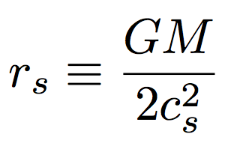
Spherical outflows & the sonic radius
Eugene Parker
(U. Chicago)
Basis for defining
sonic radius
Sonic radius

Slide 48
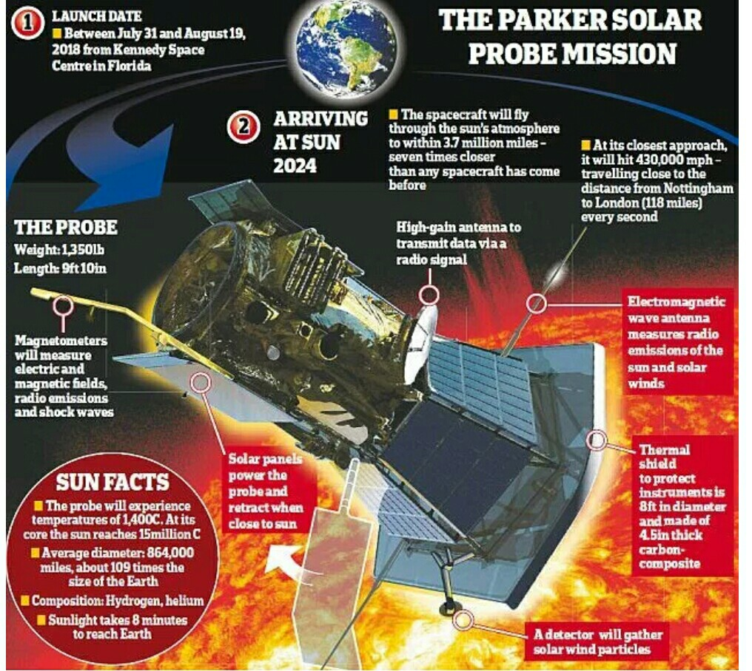

Slide 49
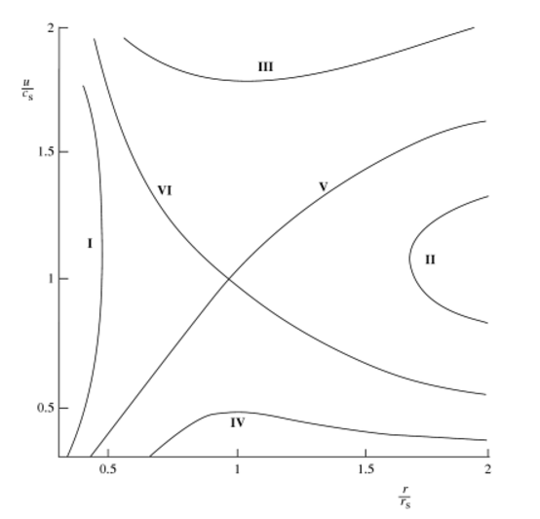
Bernoulli for a
polytrope equation
of state
wind
Sonic radius
breeze
Relevant cases for this course: V and VI
I and II are unphysical
IV requires unrealistic boundary conditions

Slide 50
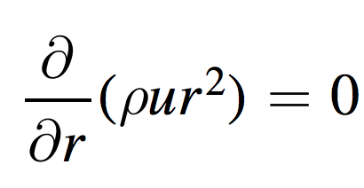
The special case of isothermal escape
Zahnle & Catling 2017 (req’d reading)

Slide 51
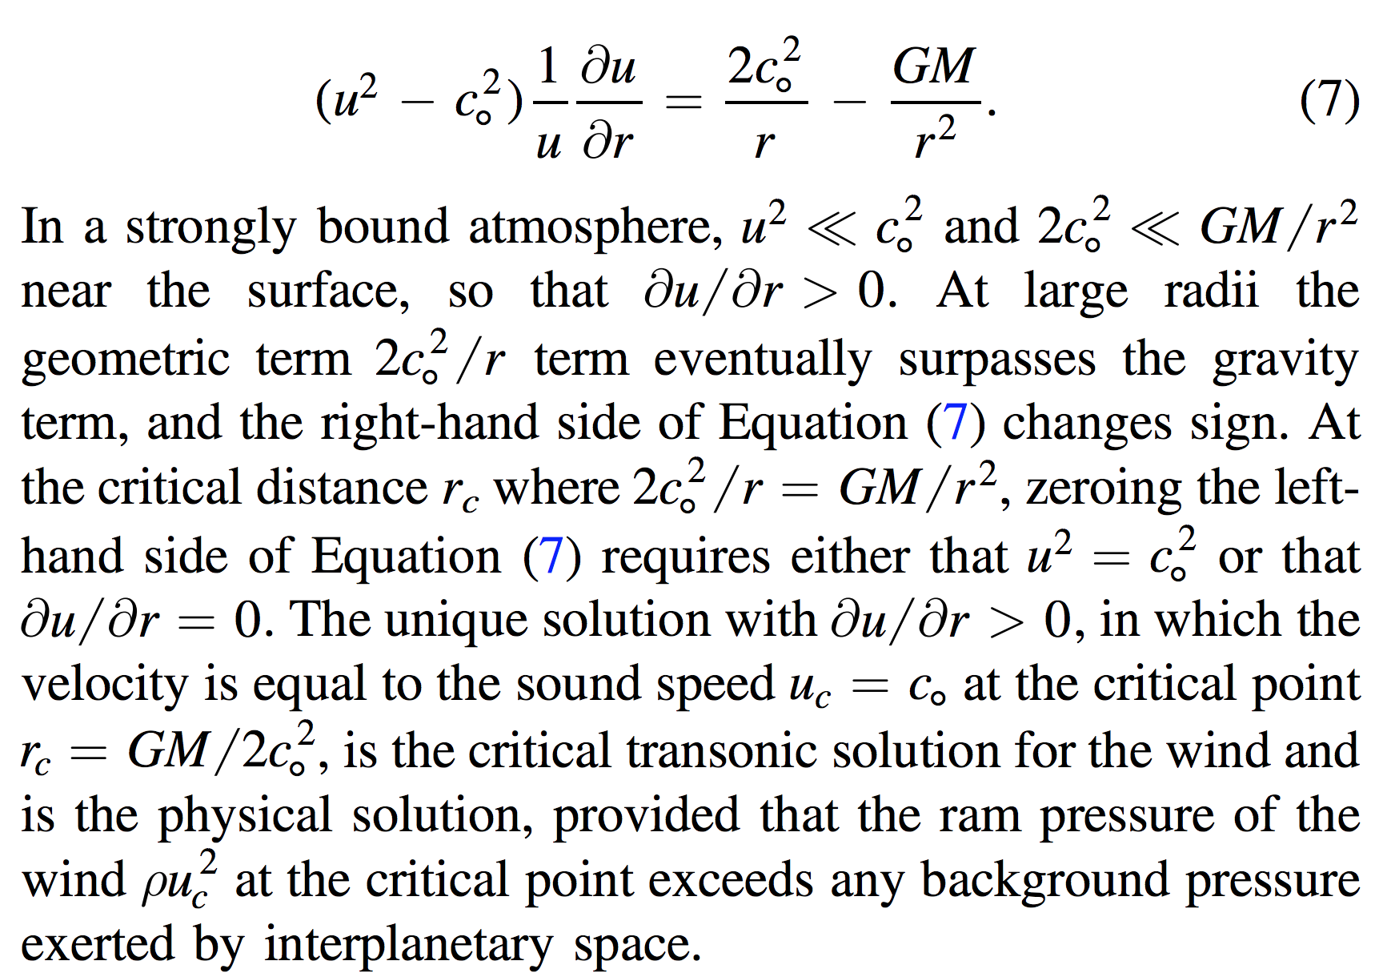

Slide 52
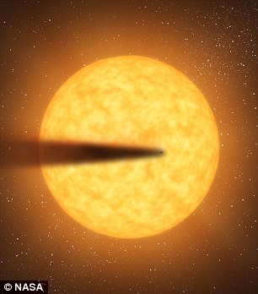
Recent development: Rocky-planet destruction by hydrodynamic escape
N.B. This does not apply to planets near the habitable zone (due to low vapor pressures)
Main-sequence stars orbited by planets that are currently being destroyed: KIC 12557548, KOI-2700, K2-22.
E.g. Perez-Becker & Chiang Astrophysical Journal 2013 “Catastrophic destruction of rocky planets.”
Destruction of Mercury-mass
planet:
Notice the minimum
in gas temperature -
discussed in this week’s
reading (Walker et al.)

Slide 54
Noble gas abundance ratios and isotope ratios provide evidence for atmospheric loss.

Slide 55
Relative to today’s Sun, the Sun around the time of the Moon-forming impact had lower bolometric luminosity, but much higher EUV / soft X-ray luminosity.
Zahnle et al. 2007 (in required reading)

Slide 56
Ocean removal by giant impacts? (Ocean vaporization != ocean removal)
Simulations suggest that the Moon-
forming impact was marginally able
to remove any pre-existing Earth
ocean
Q_{s} ~ v_{e}² for oligarchic impact
Lock et al. LPSC 2014
escape velocity
There have also been major recent developments in our understanding of Moon formation,
the Moon’s orbital evolution, and Moon-induced tidal heating, but orbital/tidal effects are
not part of this course.

Slide 57
Volatile escape - key concepts
Bottlenecks for atmospheric escape
Energy supply, exobase, homopause, condensation in atmosphere, condensation at surface
Energy sources for atmospheric escape
Thermal, individual-photons, solar wind, impacts
Escape parameter, exobase, Jeans escape
The role of the sonic point in hydrodynamic escape

Slide 58
Bonus slides – Volatile Delivery

Slide 59
Key points from Forget & Leconte (2014): range of possible atmospheres (and the processes that separate them)
Forget & Leconte, Phil. Trans. 2014

Slide 60
Pluto & kin = The Kuiper Belt:
(Planetary science with large n!)
Range of albedos, sizes, compositions,
distances from the sun. Principal volatiles: N2, CO2, CO, CH4. H2O has negligible saturation
vapor pressure (only way to remove H2O is
Nonthermal mechanisms, or cryovolcanism).
G. Kuiper (U. Chicago)
ASIDE – NOT REQUIRED FOR HOMEWORK OR FINAL

Slide 61
CH₄ distribution
on Pluto from 2015
flyby
Has CH4
Brown & Schaller ApJ 2007
ASIDE – NOT REQUIRED FOR HOMEWORK OR FINAL

Slide 63
Rankine-Hugoniot equation-of-state:
adiabatic
heating
+entropy from
shock deformation
Gruneisen parameter
Karato, Proc. Japanese Acad. Series B, 2014

Slide 65
Bonus slides – Volatile escape

Slide 67
Formation of Earth-sized planets involves giant (oligarchic) impacts.
Masses of resulting
planets (Earths)
* = giant impacts
The output
underlying this plot
was generated by
C. Cossou.
The Moon-forming
impact was not
the last big impact
on Earth, but it was
the last time that
Earth hit another
planet.
Simulation intended to
reproduce “typical”
Kepler system of short-period,
tightly-packed inner planets

Slide 68
(If time permits:) Bondi-Hoyle Accretion
Isothermal Bondi-Hoyle
(Bernoulli)
but
so

Slide 69
Isothermal Bondi-Hoyle
As r → 0, gas is in free fall
As r → infinity, u = 0 implies

