Slide 1
GEOS 22060/ GEOS 32060 / ASTR 45900
What makes a planet habitable?
Lecture 6
Volatile escape
Thursday 23 January 2020

Slide 2
Presentation of Sections 1 and 2.1 from Zahnle and Catling 2017. This is intended to cement/deepen the material that we will cover in the Volatile Loss section of the course. http://geosci.uchicago.edu/~kite/doc/Zahnle_and_Catling_2017.pdf

Slide 3
Review: Volatile supply – key points
Volatiles can be supplied directly as molecules, or contained within hydrated minerals, within clathrates, or adsorbed to ice particles
Within protoplanetary disks, the habitable zone is in a region that theory suggests should be dry
(equilibrium condensation)
Volatiles can be delivered to the habitable zone by within-disk migration of impactors, scattering of impactors, or whole-planet migration
Volatiles can be released on impact, or as the result of planetary differentiation.

Slide 4
Course outline
Foundations (1-2 weeks)
Earth history
HZ concept, atmospheric science essentials
Post-Hadean Earth system
Principles – how are habitable planets initiated and sustained? (4-5 weeks)
Volatile supply, volatile escape
Long-term climate evolution
Runaway greenhouse, moist greenhouse
Specifics (~2 weeks)
Early Mars
Hyperthermals on Earth
Oceans within ice-covered moons
Exoplanetary systems e.g. TRAPPIST-1 system
TODAY

Slide 5
Volatile escape
Atmospheric Escape
Introduction to Atmospheric Escape
Jeans Escape
Introduction to Hydrodynamic Escape
(If time permits:) Bondi-Hoyle Accretion

Slide 6
Lecture 6 key concepts
Energy sources for atmospheric escape
Thermal, individual-photons, solar wind, impacts
Bottlenecks for atmospheric escape
Energy supply, exobase, homopause, condensation in atmosphere, condensation at surface
Escape parameter, exobase, Jeans escape
The role of the sonic point in hydrodynamic escape

Slide 7
Introduction to Atmospheric Escape
Motivation: Most important process determining whether a planet’s surface can retain volatiles.
Atmospheric escape is the main channel through which the ocean is lost to space (e.g. seas of Mars, ocean-masses of water on Venus).
Is what makes runaway greenhouse irreversible (Venus)
Especially important during the first 100 Myr
Unavoidable for rocky planets

Slide 8
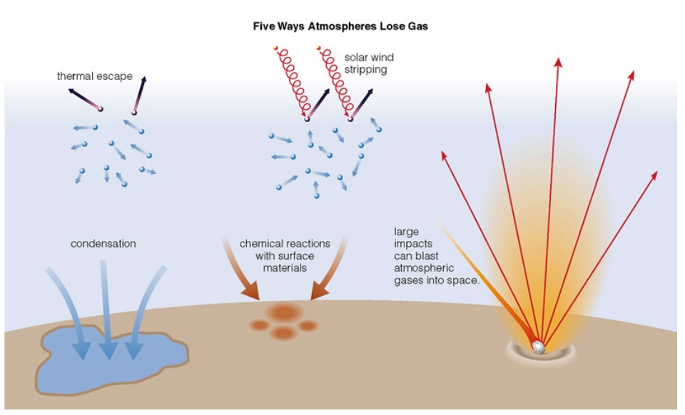
Energy sources for atmospheric escape
Today
not covered
in this course
today
later in this course
via James Wray

Slide 9
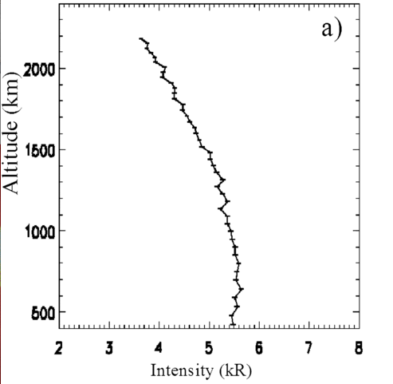
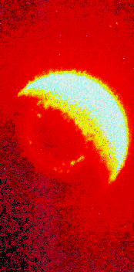
What atmospheric escape looks like (inside the solar system):
Earth hydrogen corona
Mars hydrogen corona (Chauffray et al. 2008)

Slide 10
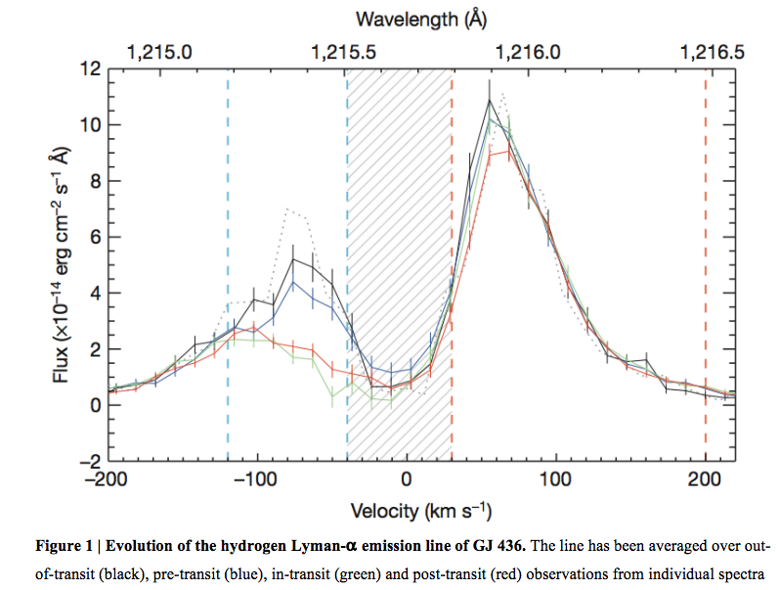
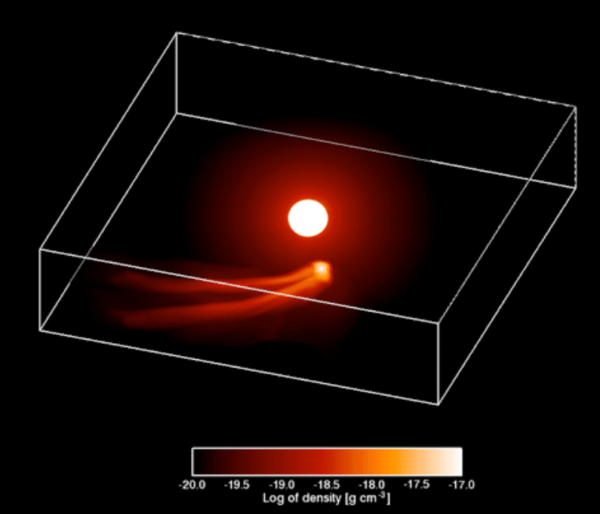
What atmospheric escape looks like (outside the solar system):
Ehrenreich et al. 2015
GJ 436b (Neptune-sized planet in hot orbit)

Slide 11
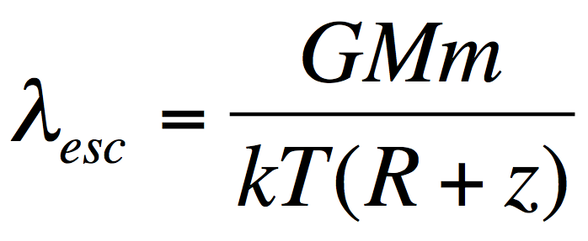
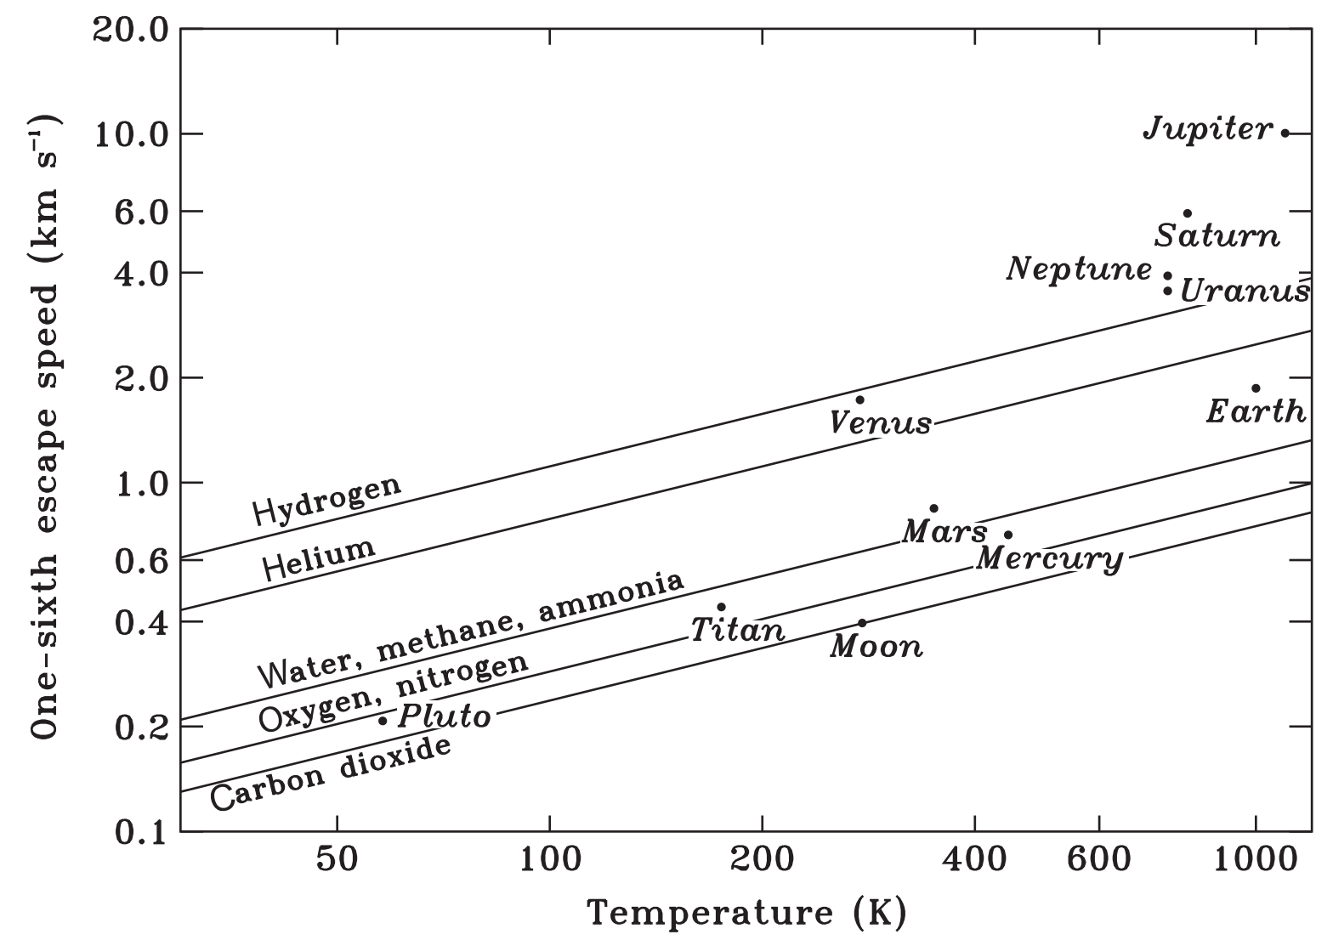
Jeans parameter:
(= “escape parameter”)
>> 1: stable atmosphere,
hydrostatic,
Jeans escape (usually
slow)
~ 1: hydrodynamic
escape (often fast)
Catling & Kasting Fig. 5.4

Slide 12
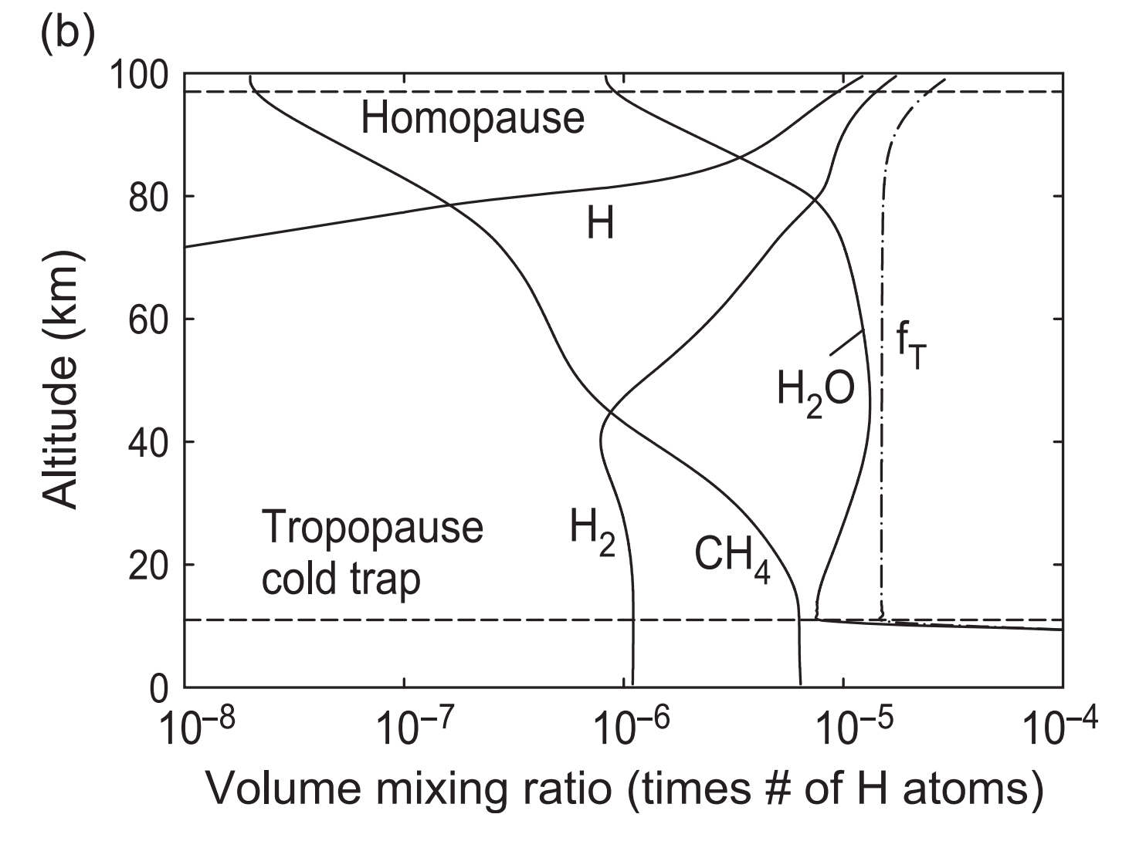
What sets the rate of atmospheric escape? Possible bottlenecks
Energy supply
Today
Exobase
Homopause
Condensation in atmosphere
Condensation at surface
H₂O: 0.4% in troposphere
H-bearing species on Earth today

Slide 13
Jeans Escape (evaporation of atmosphere into space)

Slide 14
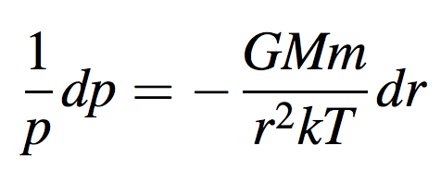
Failure of the hydrostatic equation
Following Catling & Kasting, section 5.3
gravity varies with height
integrate from surface
to some distance r
(!)
finite atmospheric
pressure at infinite distance?

Slide 15
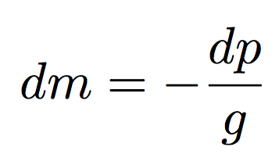
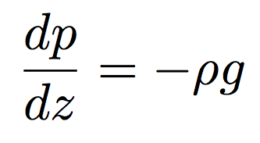
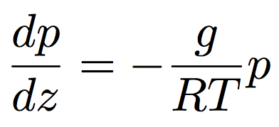
Hydrostatic balance, scale height, exobase
hydrostatic balance
scale height⁻¹
J K⁻¹ kg⁻¹
where

Slide 16
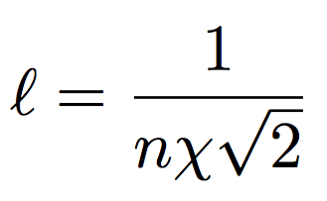
Hydrostatic balance, scale height, exobase
a ~ 10⁻¹⁰ m usually
< 10⁻¹¹ m for atomic H
Exobase: (1) Mean free path l = scale height.
(2) Altitude above which a vertically-rising molecule has a probability of collision of 1/e.
Comparing n_{ex} to the surface number density sets the
dividing line between planets with atmospheres and
worlds with collisionless exospheres (Moon, Mercury)
Exobase on Earth today: Density ~4 x 10⁷ cm⁻³.
Dominant species at exobase is atomic O, which does not escape.

Slide 17
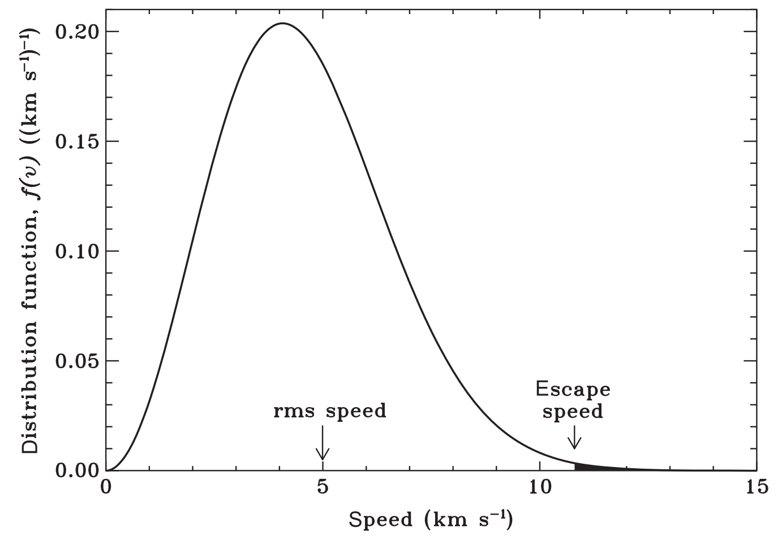
Jeans escape is ‘evaporation’ of an atmosphere in to space
H atoms @ 1000K
(Earth exobase)
What will the O
distribution look like?

Slide 18
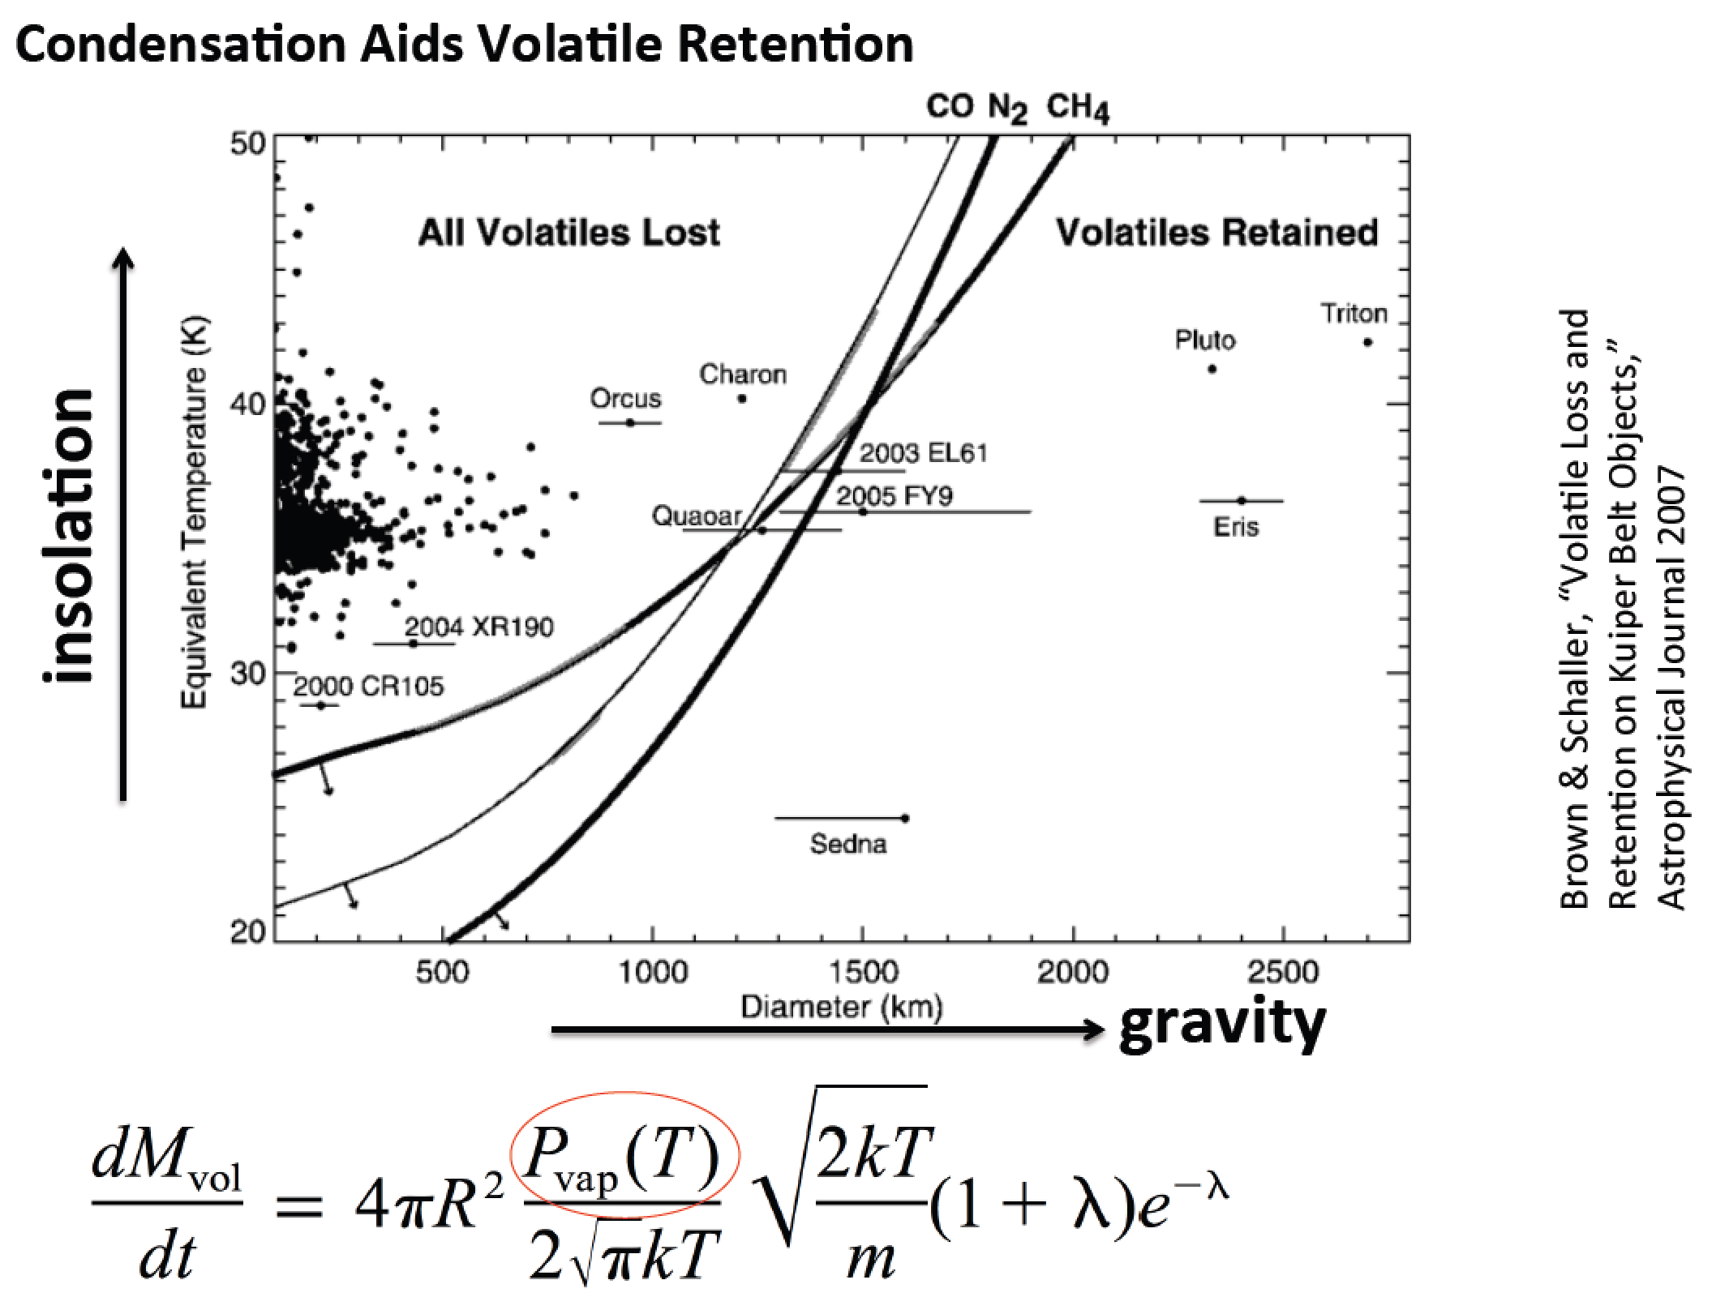
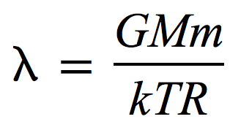
v

Slide 19
Introduction to Hydrodynamic Escape
De Laval nozzle (w/polytrope equation of state)
Spherical outflows/inflows (polytrope & isothermal)
Relevant to solar wind, Bondi-Hoyle accretion of stars and gas-giant planets, and hydrodynamic escape

Slide 20
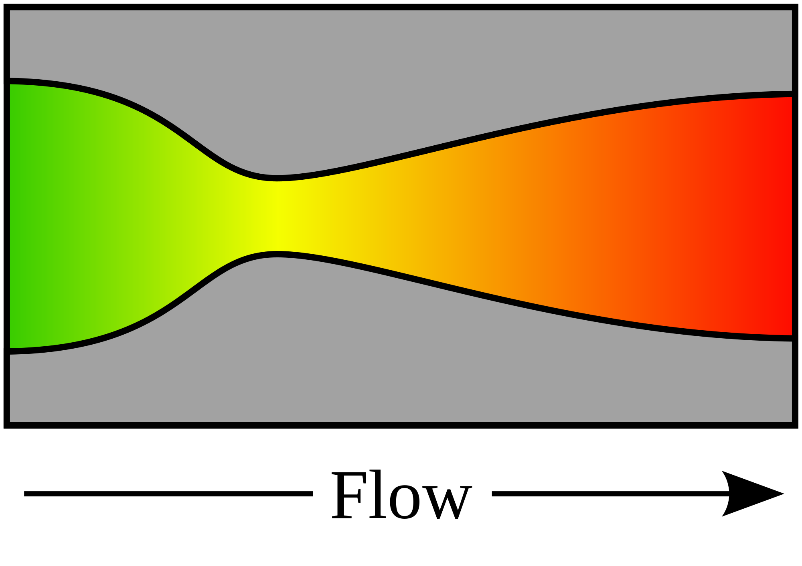
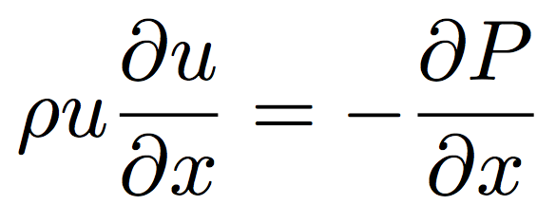
De Laval nozzle
fluid
density
mass
flow rate
nozzle
cross-sectional area
fluid
velocity
continuity
1D, no body forces,
no viscous forces
momentum
“energy”
(equation of state)
(polytrope)
= 1: special case (isothermal)

Slide 21
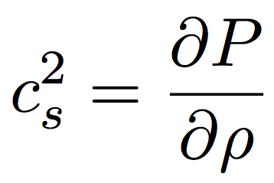
From momentum:
sound speed c_{s}:
Divide by , integrate both sides

Slide 22
From continuity:
Substitute in
(from previous slide):

Slide 23
NOZZLE EQUATION
Neat features:
- Completely reversible (describes inflow and outflow) (u²)
(e.g., loss of gas from a planet and accretion of gas onto a planet)
(inflow of gas onto a star, and outflow of gas from a star = stellar wind / solar wind)
- If subsonic, then will accelerate on convergence and deccelerate on convergence
- If supersonic, then will accelerate on divergence and decelerate on convergence.
(This is because supersonic flows are highly compressible; the increase in A leads to large decrease in density, so u must increase by continuity).
- At the choke point, we must have either a sonic→ supersonic transition, or a maximum or a minimum in velocity.

Slide 24
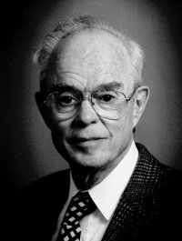
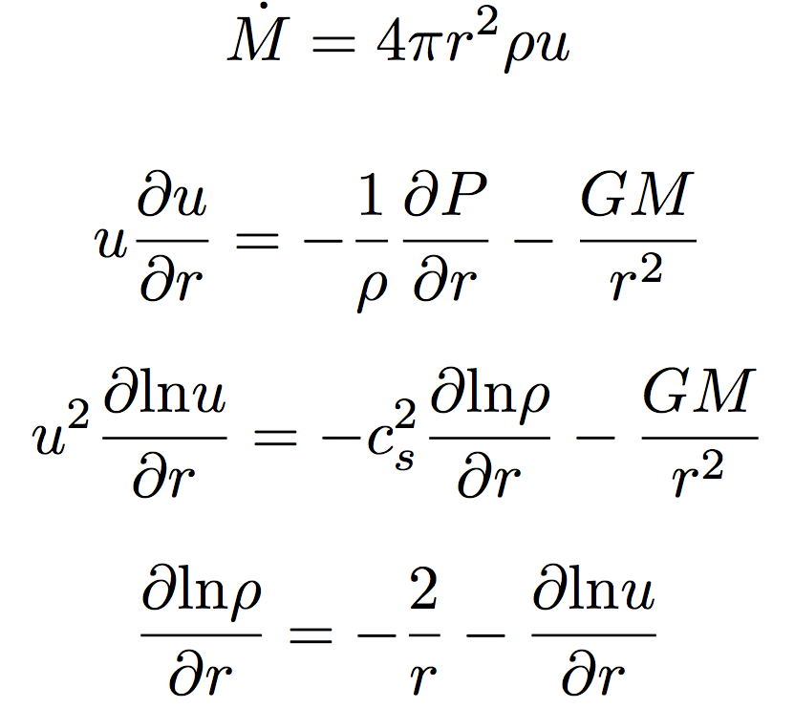
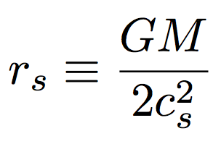
Spherical outflows & the sonic radius
Parker &
Chandra &
Fermi &
Compton &
Hubble
Eugene Parker
(U. Chicago)
Basis for defining
sonic radius
Sonic radius

Slide 25
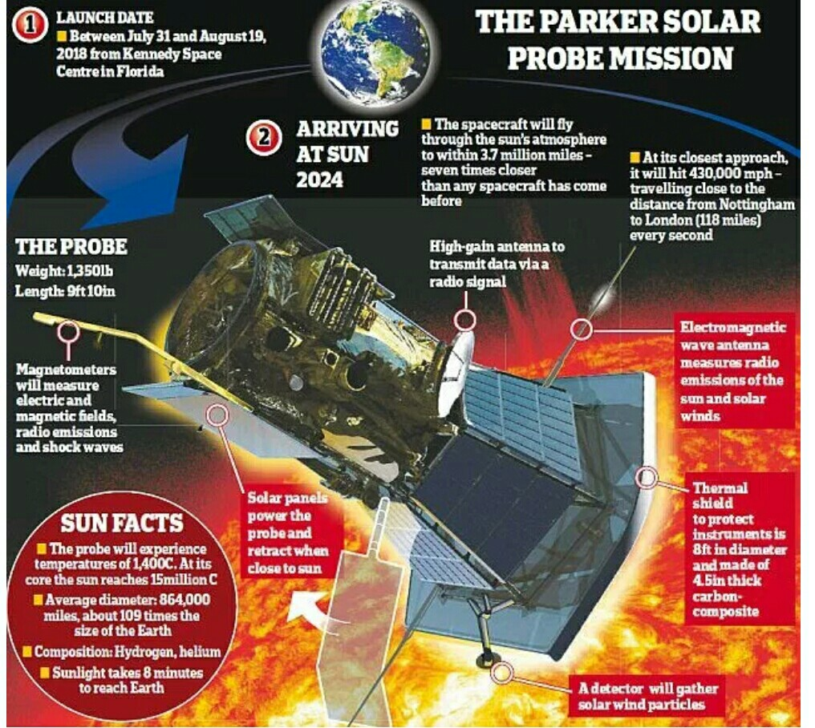

Slide 26
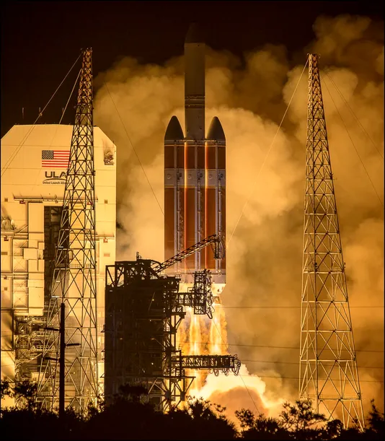

Slide 28
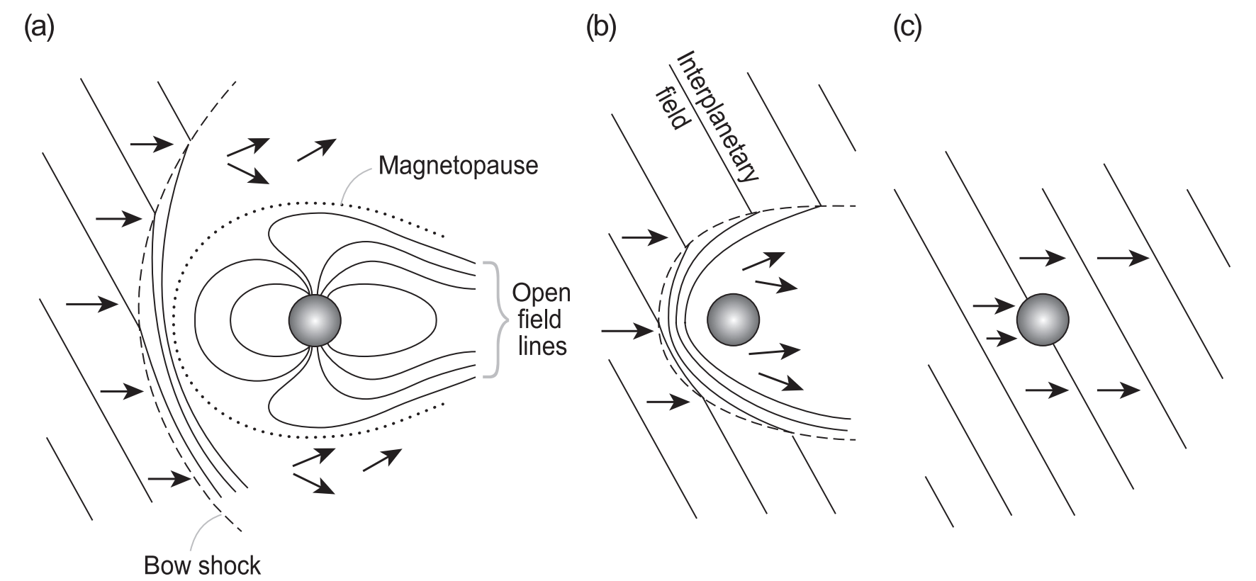
Protective (?) role of planetary magnetic field with respect to solar wind stripping

Slide 30
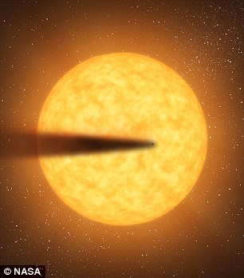
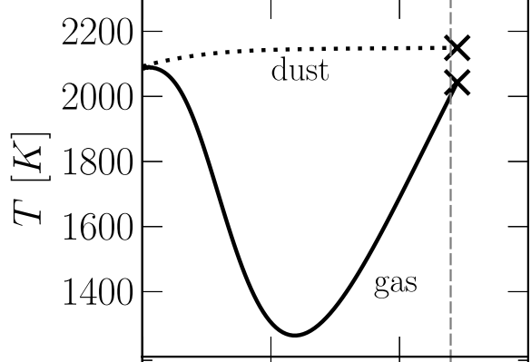
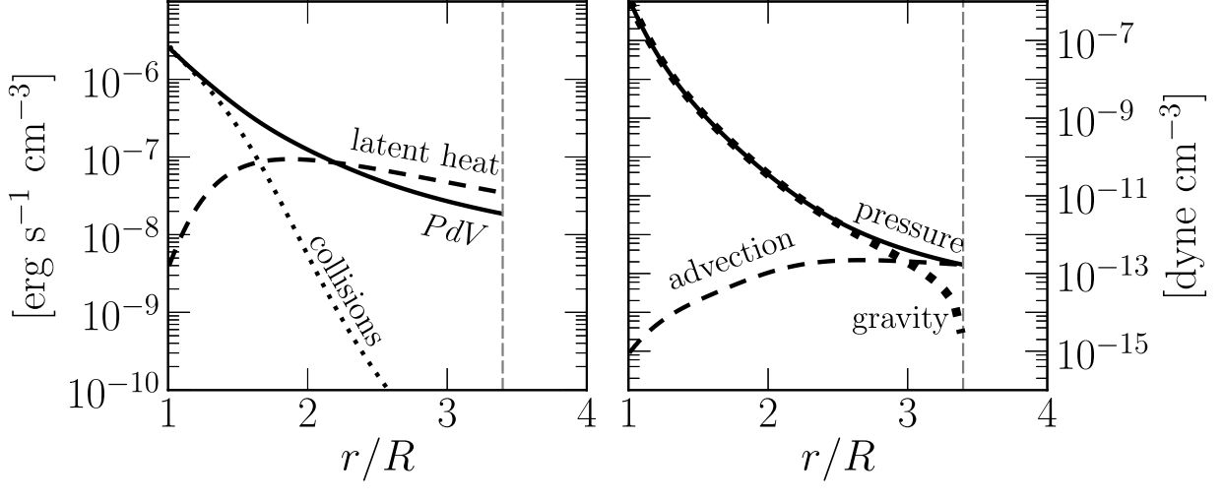
Recent development: Rocky-planet destruction by hydrodynamic escape
N.B. This does not apply to planets near the habitable zone (due to low vapor pressures)
Main-sequence stars orbited by planets that are currently being destroyed: KIC 12557548, KOI-2700, K2-22.
E.g. Perez-Becker & Chiang Astrophysical Journal 2013 “Catastrophic destruction of rocky planets.”
Destruction of Mercury-mass
planet:
Notice the minimum
in gas temperature -
discussed in this week’s
reading (Walker et al.)

Slide 31
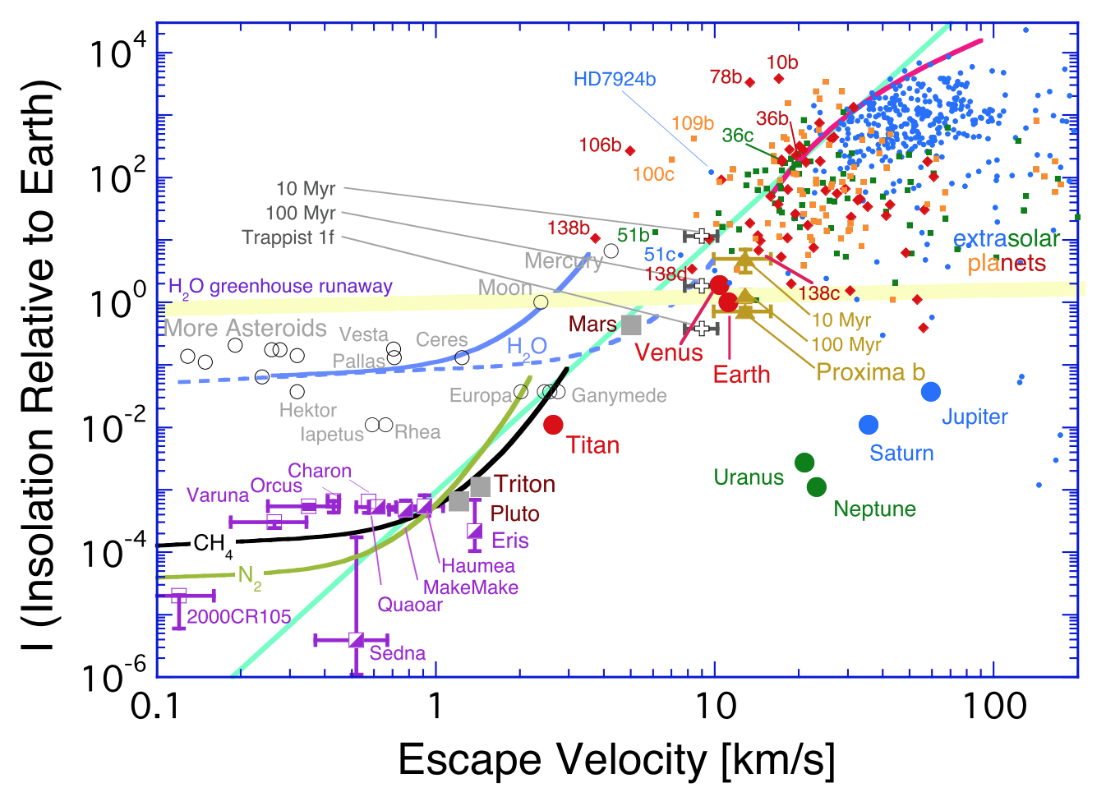

Slide 32
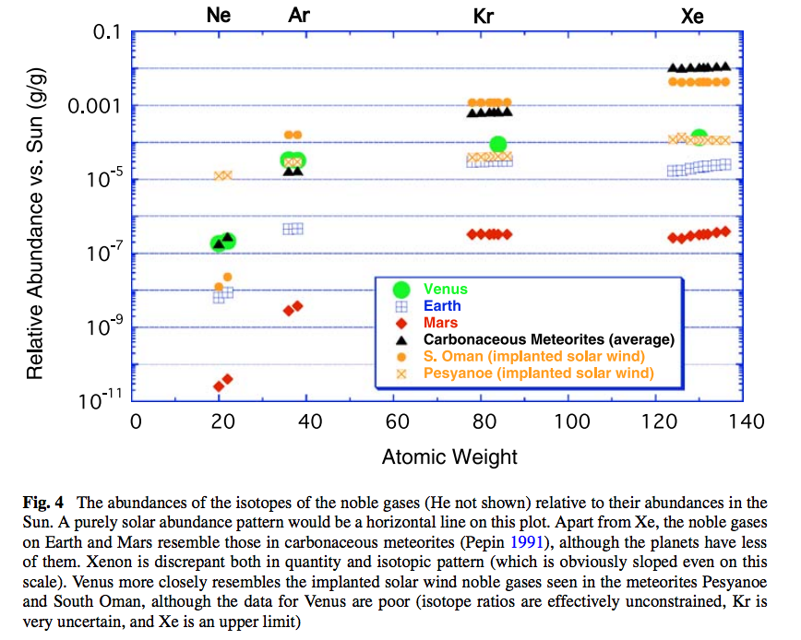
Noble gas abundance ratios and isotope ratios provide evidence for atmospheric loss.

Slide 33
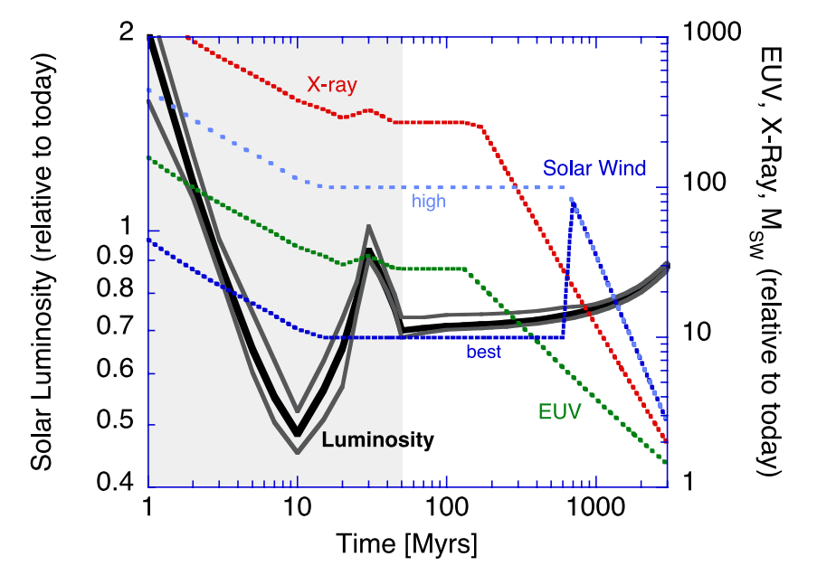
Relative to today’s Sun, the Sun around the time of the Moon-forming impact had lower bolometric luminosity, but much higher EUV / soft X-ray luminosity.
Zahnle et al. 2007 (in required reading)

Slide 34
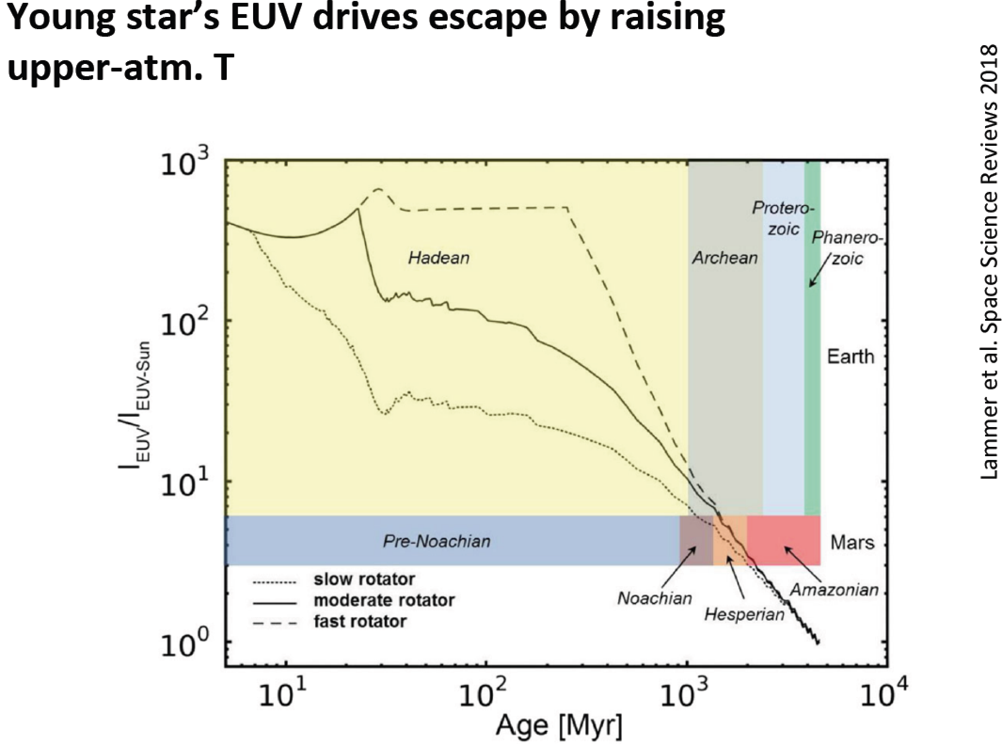

Slide 35
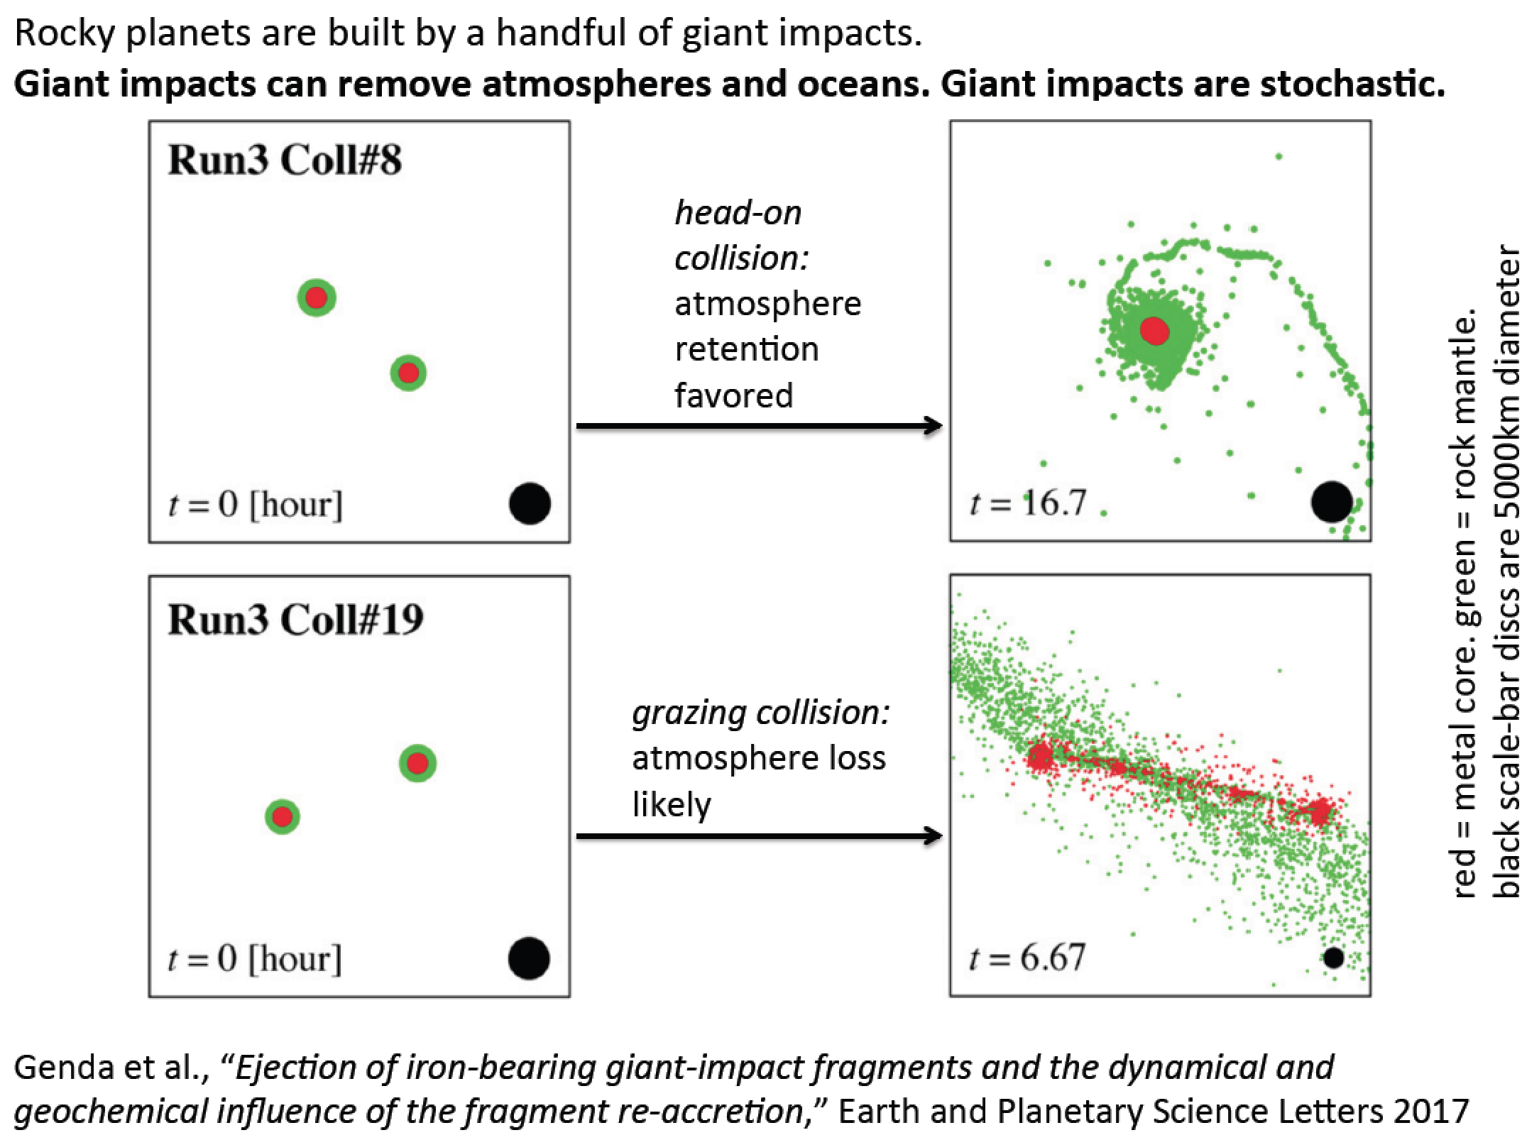

Slide 36
Lecture 6 key concepts
Bottlenecks for atmospheric escape
Energy supply, exobase, homopause, condensation in atmosphere, condensation at surface
Energy sources for atmospheric escape
Thermal, individual-photons, solar wind, impacts
Escape parameter, exobase, Jeans escape
The role of the sonic point in hydrodynamic escape

Slide 37
Bonus slides – Volatile Delivery

Slide 38
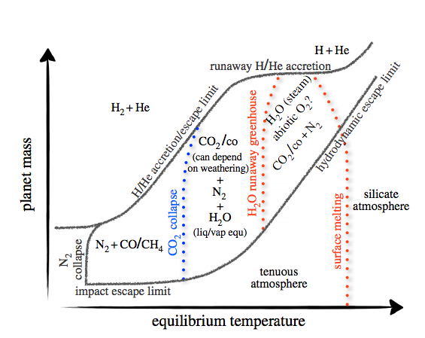
Key points from Forget & Leconte (2014): range of possible atmospheres (and the processes that separate them)
Forget & Leconte, Phil. Trans. 2014

Slide 39
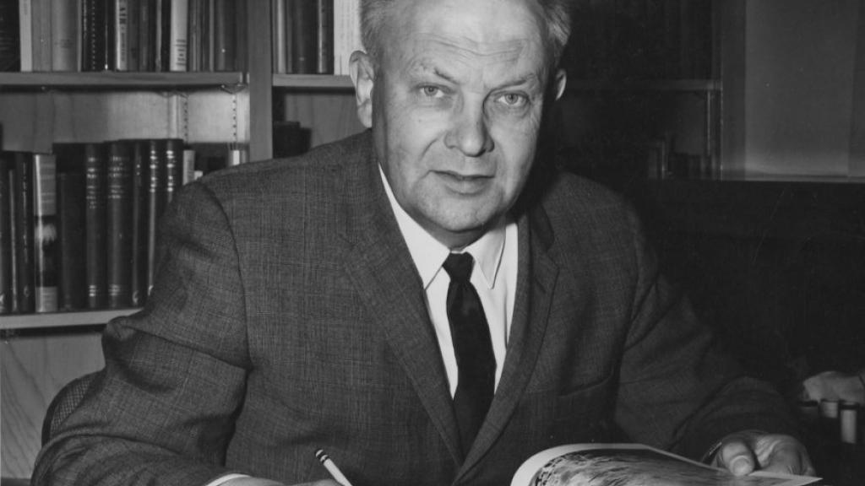
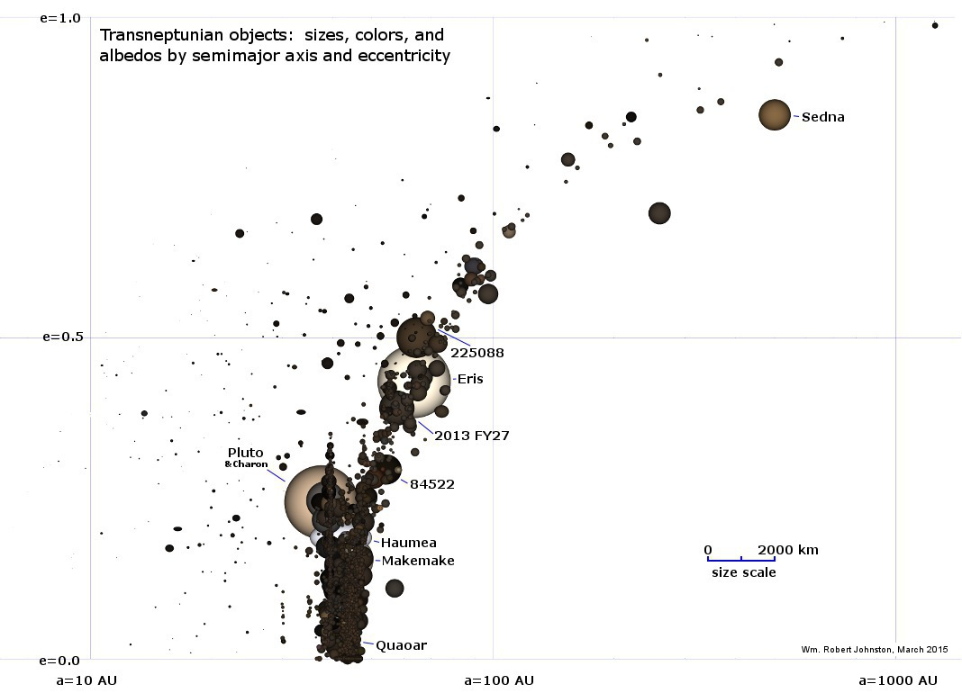
Pluto & kin = The Kuiper Belt:
(Planetary science with large n!)
Range of albedos, sizes, compositions,
distances from the sun. Principal volatiles: N2, CO2, CO, CH4. H2O has negligible saturation
vapor pressure (only way to remove H2O is
Nonthermal mechanisms, or cryovolcanism).
G. Kuiper (U. Chicago)
ASIDE – NOT REQUIRED FOR HOMEWORK OR FINAL

Slide 40
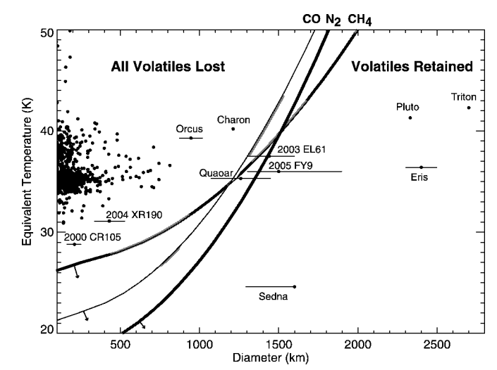
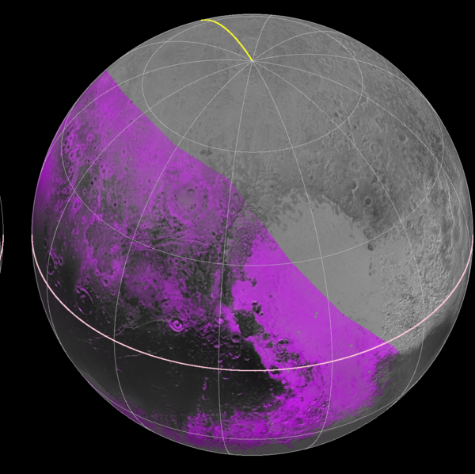
CH₄ distribution
on Pluto from 2015
flyby
Has CH4
Brown & Schaller ApJ 2007
ASIDE – NOT REQUIRED FOR HOMEWORK OR FINAL

Slide 41
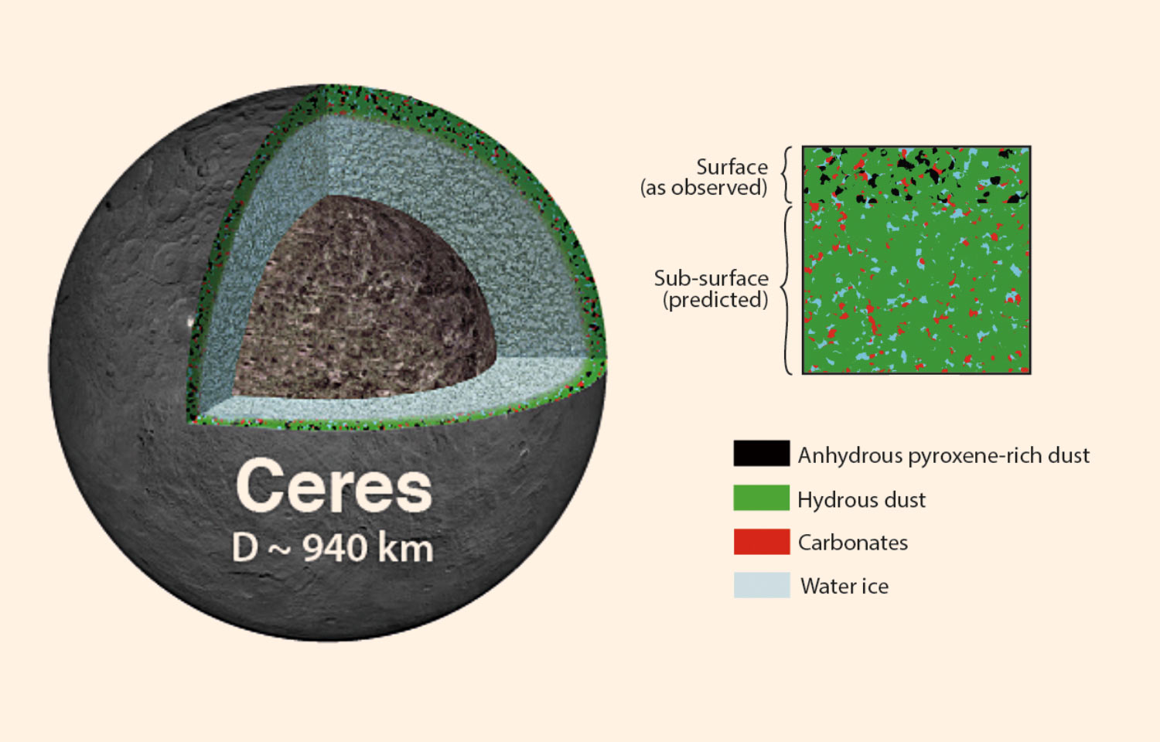

Slide 42
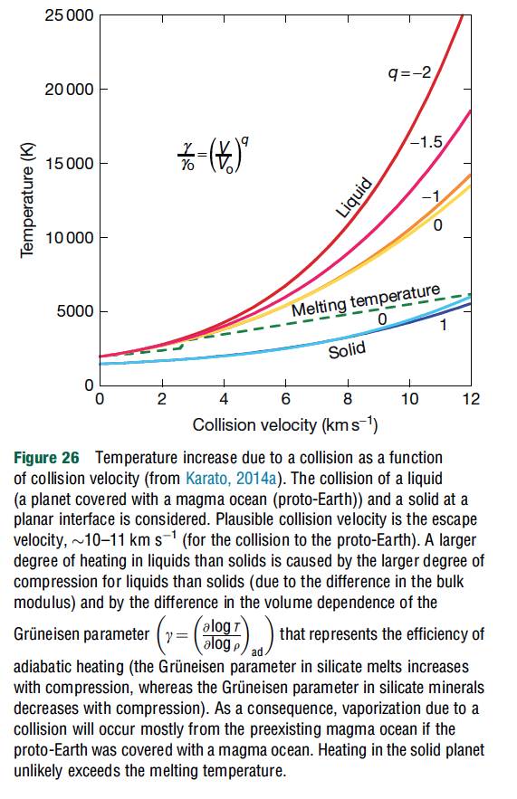
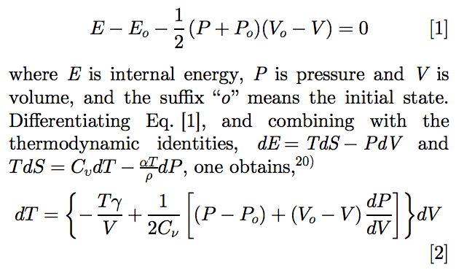
Rankine-Hugoniot equation-of-state:
adiabatic
heating
+entropy from
shock deformation
Gruneisen parameter
Karato, Proc. Japanese Acad. Series B, 2014

Slide 43
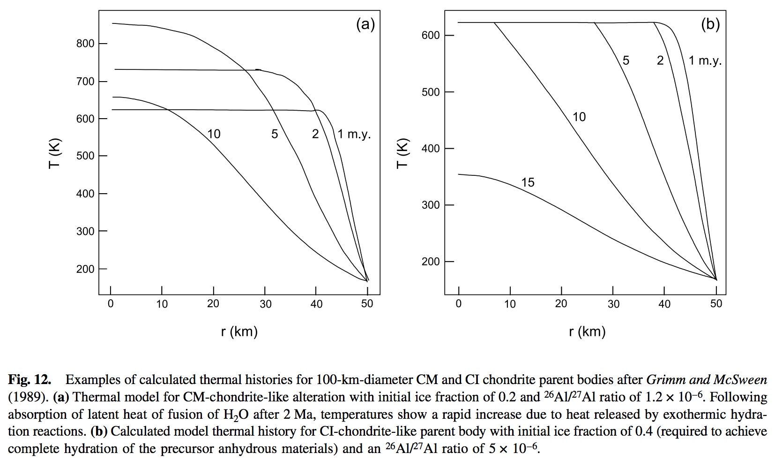

Slide 44
Bonus slides – Volatile escape

Slide 45
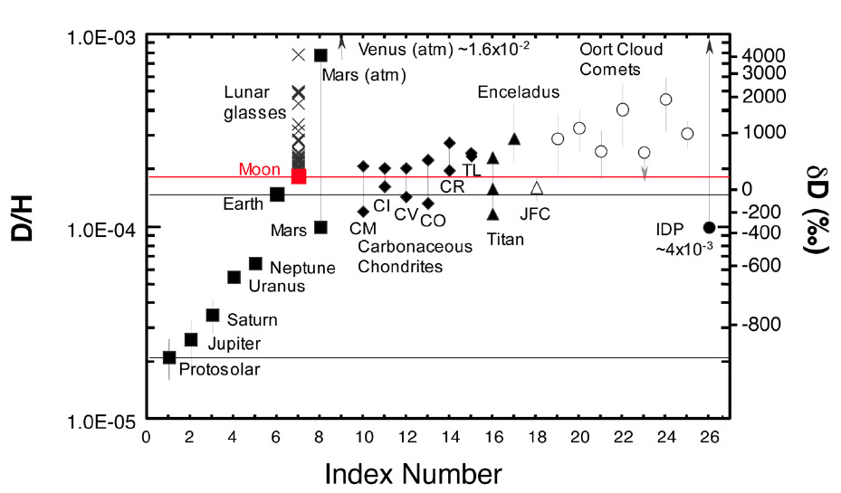

Slide 46
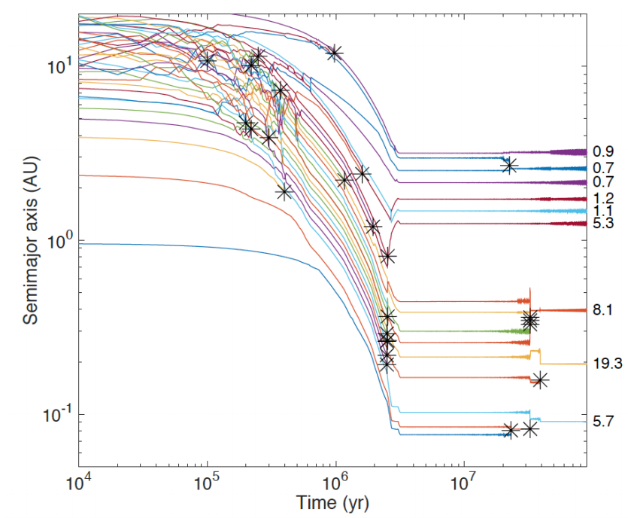
Formation of Earth-sized planets involves giant (oligarchic) impacts.
Masses of resulting
planets (Earths)
* = giant impacts
The output
underlying this plot
was generated by
C. Cossou.
The Moon-forming
impact was not
the last big impact
on Earth, but it was
the last time that
Earth hit another
planet.
Simulation intended to
reproduce “typical”
Kepler system of short-period,
tightly-packed inner planets

Slide 47
(If time permits:) Bondi-Hoyle Accretion
Isothermal Bondi-Hoyle
(Bernoulli)
but
so

Slide 48
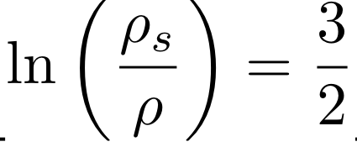
Isothermal Bondi-Hoyle
As r → 0, gas is in free fall
As r → infinity, u = 0 implies

