Slide 1
GEOS 22060/ GEOS 32060 / ASTR 45900
What makes a planet (unin)habitable?
Lecture 8
Runaway greenhouse
Thursday 30 January 2020

Slide 2
Atmospheric escape – key unifying concepts
Energy sources for atmospheric escape
Thermal, individual-photons, solar wind, impacts
Bottlenecks for atmospheric escape
Energy supply, exobase, homopause, condensation in atmosphere, condensation at surface
Escape parameter, exobase, Jeans escape
The role of the sonic point in hydrodynamic escape

Slide 3
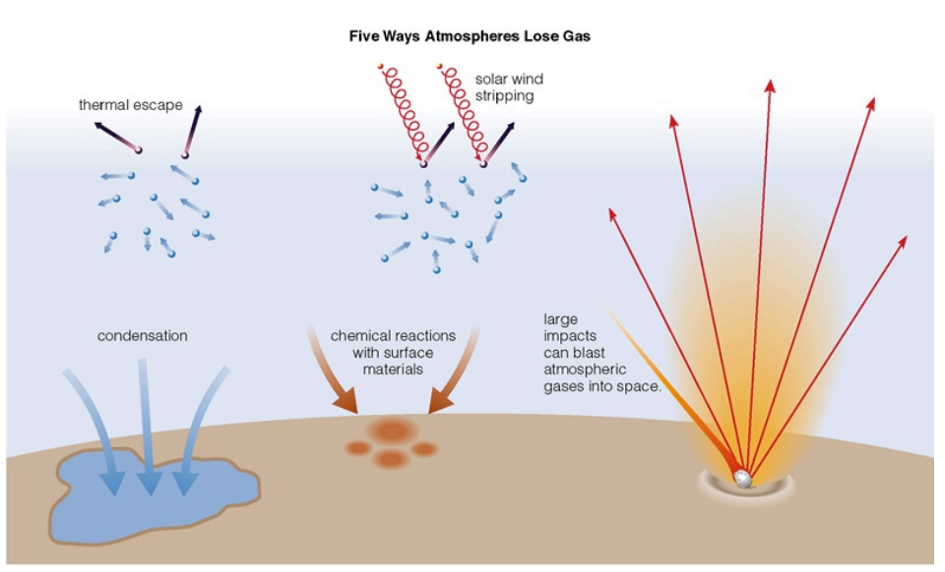
Energy sources for atmospheric escape
not covered
in this course
today
also: lag formation
via James Wray

Slide 4
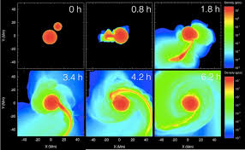
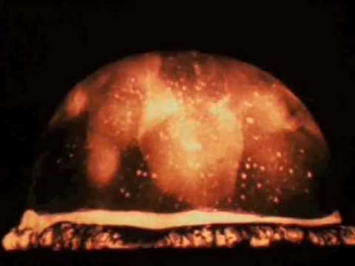
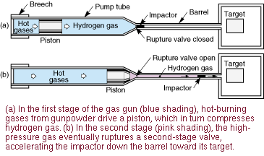
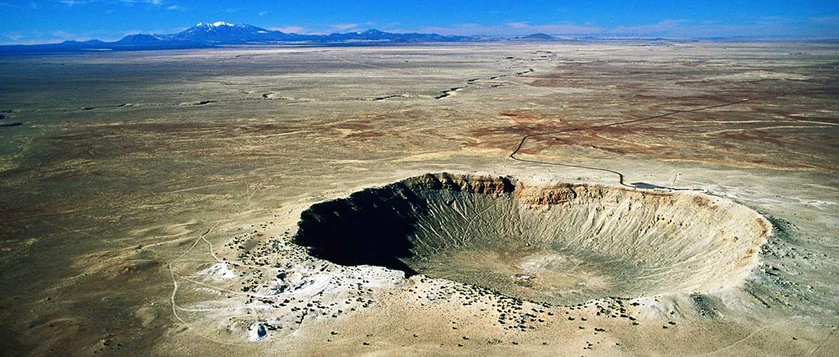
Wrap-up: impact erosion
Nuclear tests
Hydrocode
Terrestrial impact craters
Two-stage gas gun

Slide 5
Lecture 7 topics
Energy-limit: XUV driven escape more-likely-than-not sculpts the exoplanet radius-period distribution (‘photo-evaporation valley’)
Diffusion limit: what regulates H loss from Venus, Earth and Mars today
Impact erosion – giant impacts and planetesimal impacts

Slide 6
Lecture 7 topics
Energy-limit: XUV driven escape more-likely-than-not sculpts the exoplanet radius-period distribution (‘photo-evaporation valley’)
Diffusion limit: what regulates H loss from Venus, Earth and Mars today
Impact erosion – giant impacts and planetesimal impacts

Slide 7
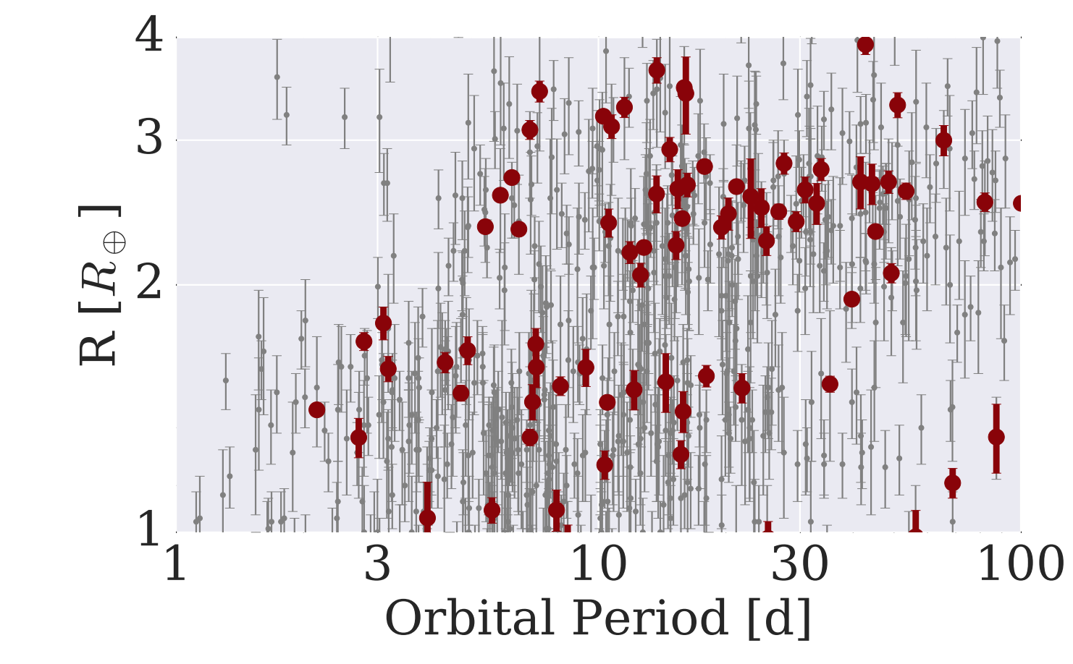
The Galaxy has many H₂-absent Super-Earths and many >~1 wt% H₂ mini-Neptunes: not much in between
mostly not rocky
based on density data
(L. Rogers ApJ 2015)
harder to detect
< 1.6 R_Earth
planets
>1.6 R_Earth
planets
van Eylen et al. MNRAS 2018

Slide 8
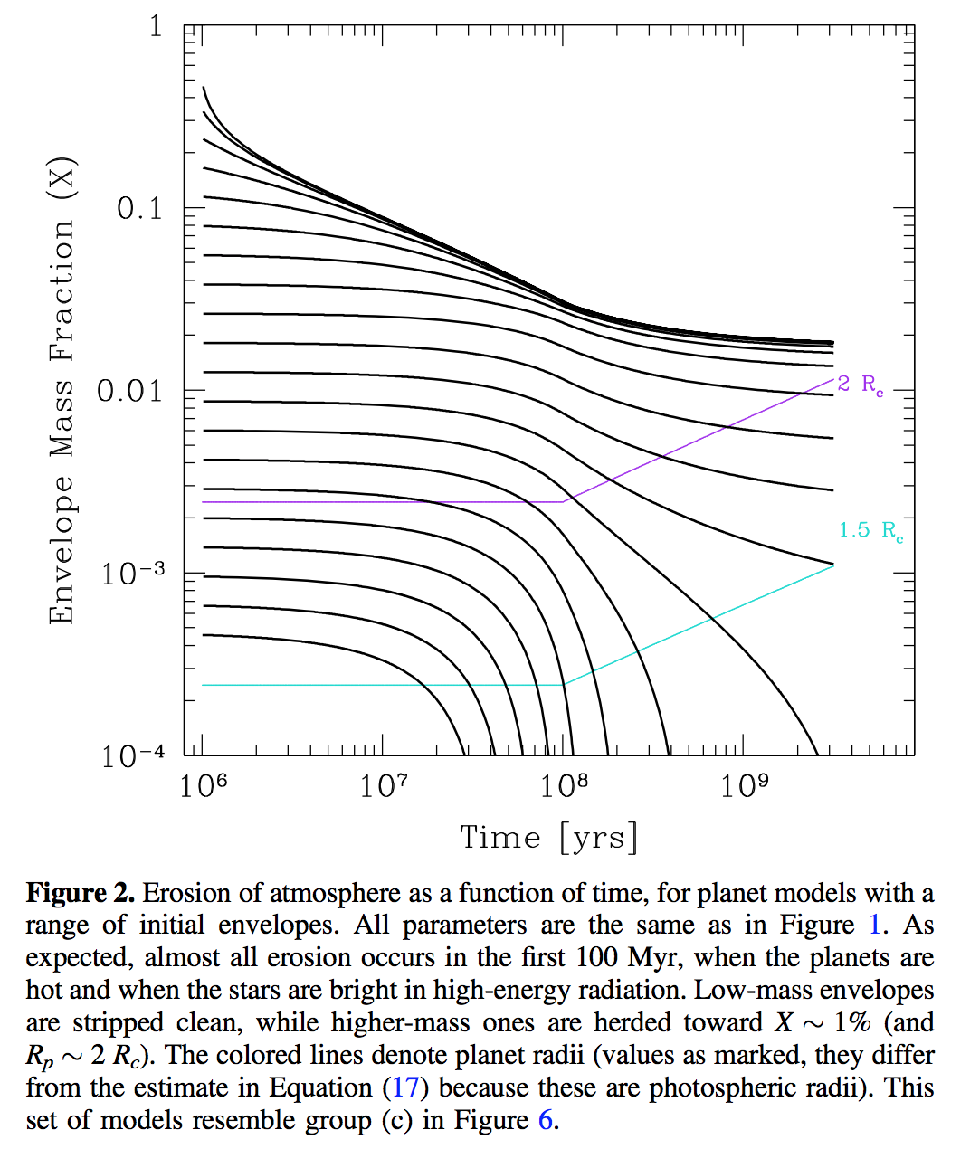
This gap in the radius distribution can be understood as a photo-evaporation valley driven by hydrodynamic escape of hydrogen
Owen & Wu ApJ 2017

Slide 9
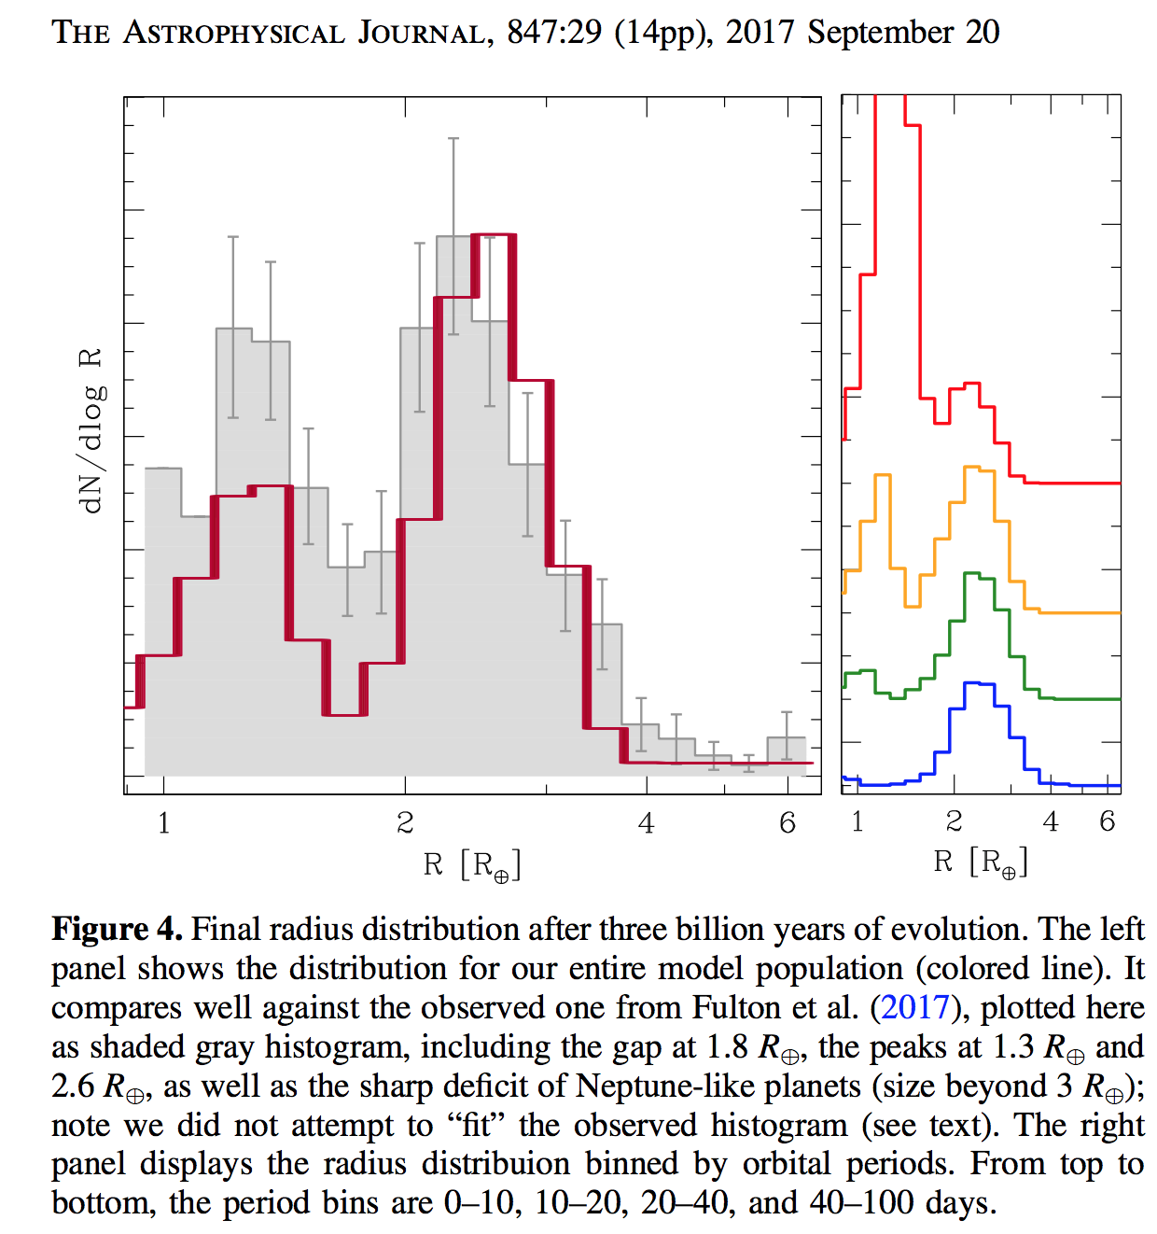
This gap in the radius distribution can be understood as a photo-evaporation valley driven by hydrodynamic escape of hydrogen
Owen & Wu ApJ 2017

Slide 10
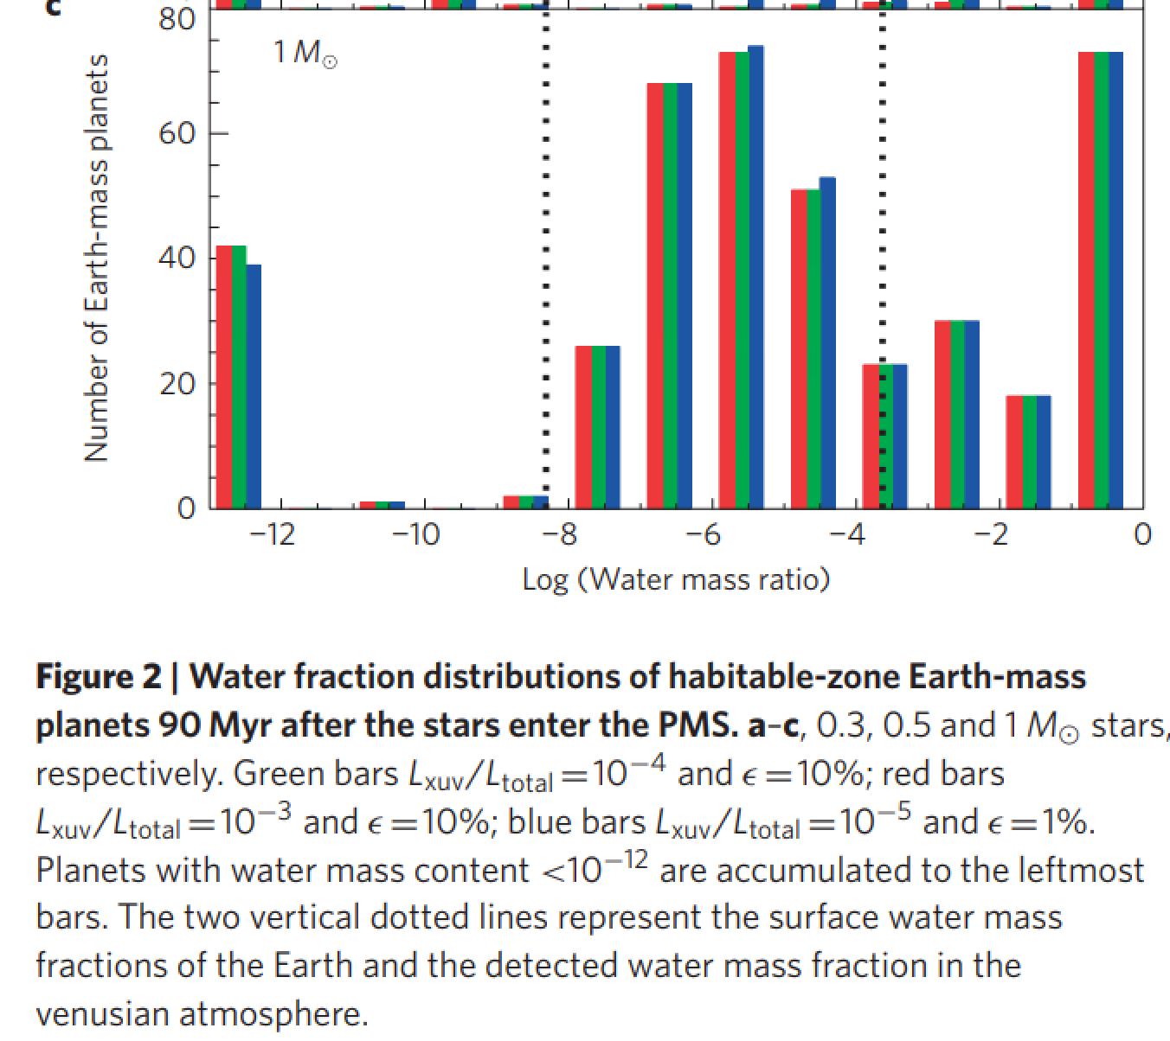
UV-driven atmospheric escape is predicted to lead to a bimodal distribution of water abundance
in the habitable zone (the data to test this hypothesis do not yet exist)
Tian & Ida Nature Geoscience 2015

Slide 11
Lecture 7 topics
Energy-limit: XUV driven escape more-likely-than-not sculpts the exoplanet radius-period distribution (‘photo-evaporation valley’)
Diffusion limit: what regulates H loss from Venus, Earth and Mars today
Impact erosion – giant impacts and planetesimal impacts

Slide 12
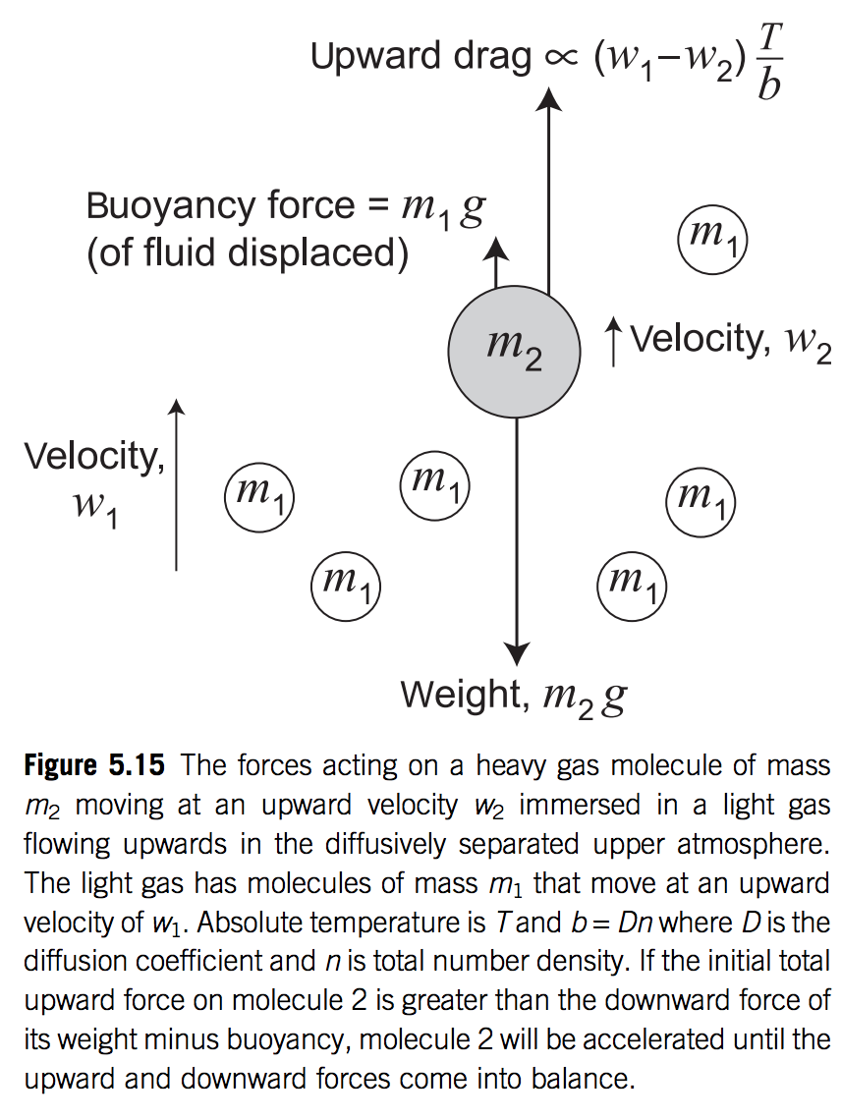

Slide 13
Lecture 8 Runaway greenhouse – key points
The (H₂O-)runaway greenhouse is a geologically rapid increase in planet surface temperature from <500K to >1000K caused by a positive feedback between the saturation vapor pressure of water vapor and the planet surface temperature
Be able to explain the mechanism of the runaway greenhouse
It is almost certain that release of CO₂ by humans cannot cause a runaway greenhouse
The exact threshold for the runaway greenhouse depends on cloud cover, land fraction, and planet rotation rate

Slide 14
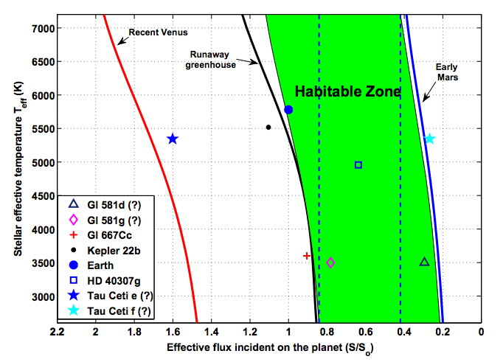

Slide 15
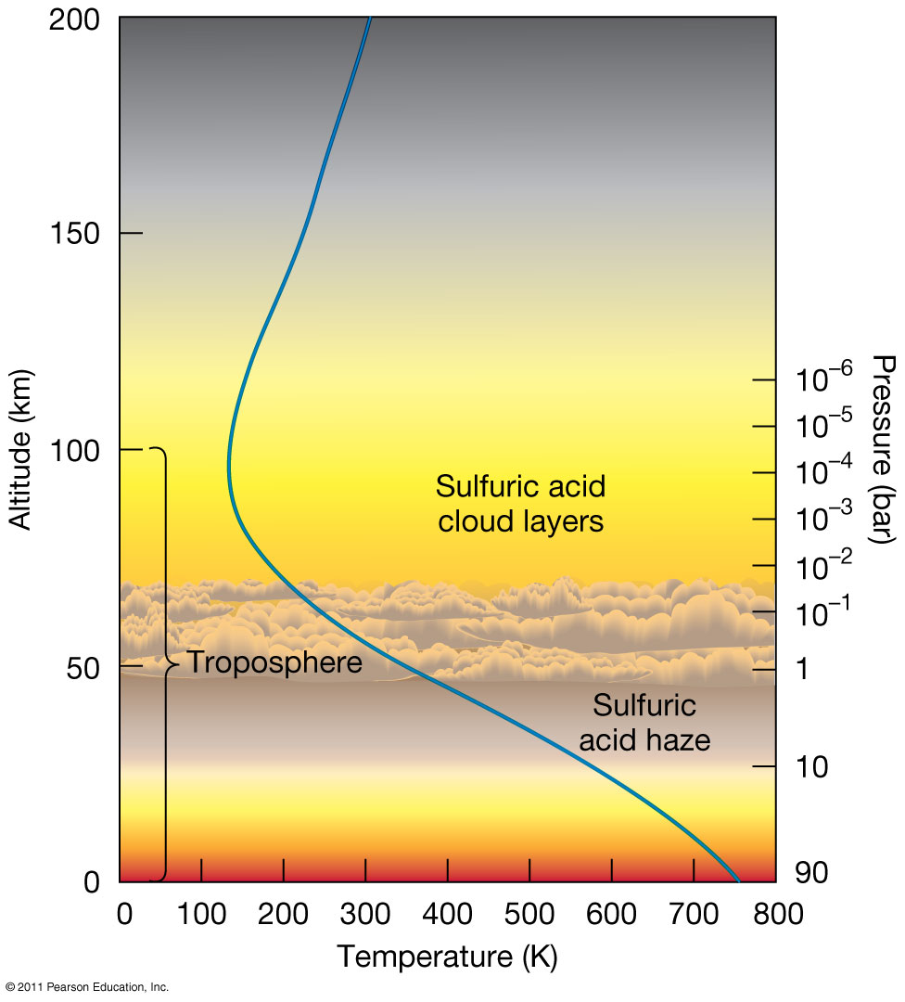
Venus is dry today

Slide 16
One-component (condensible) gray-gas atmosphere
Chalkboard
Energy balance ←→ Planck feedback
Effect of fixed-T-offset high-altitude optically thick IR absorber on Planck feedback
Runaway GH represents failure of the Planck feedback
Following today’s reading from Pierrehumbert (pdf on the class website)
τ = IR optical depth (increasing going up from the surface), τ∞ = IR optical depth of whole atm.
decaying exponential here
means integral is dominated by
contribution from near τ₁ = 0
OLR
dominates at low τ∞
becomes negligible at high τ∞
Dummy variable:

Slide 17
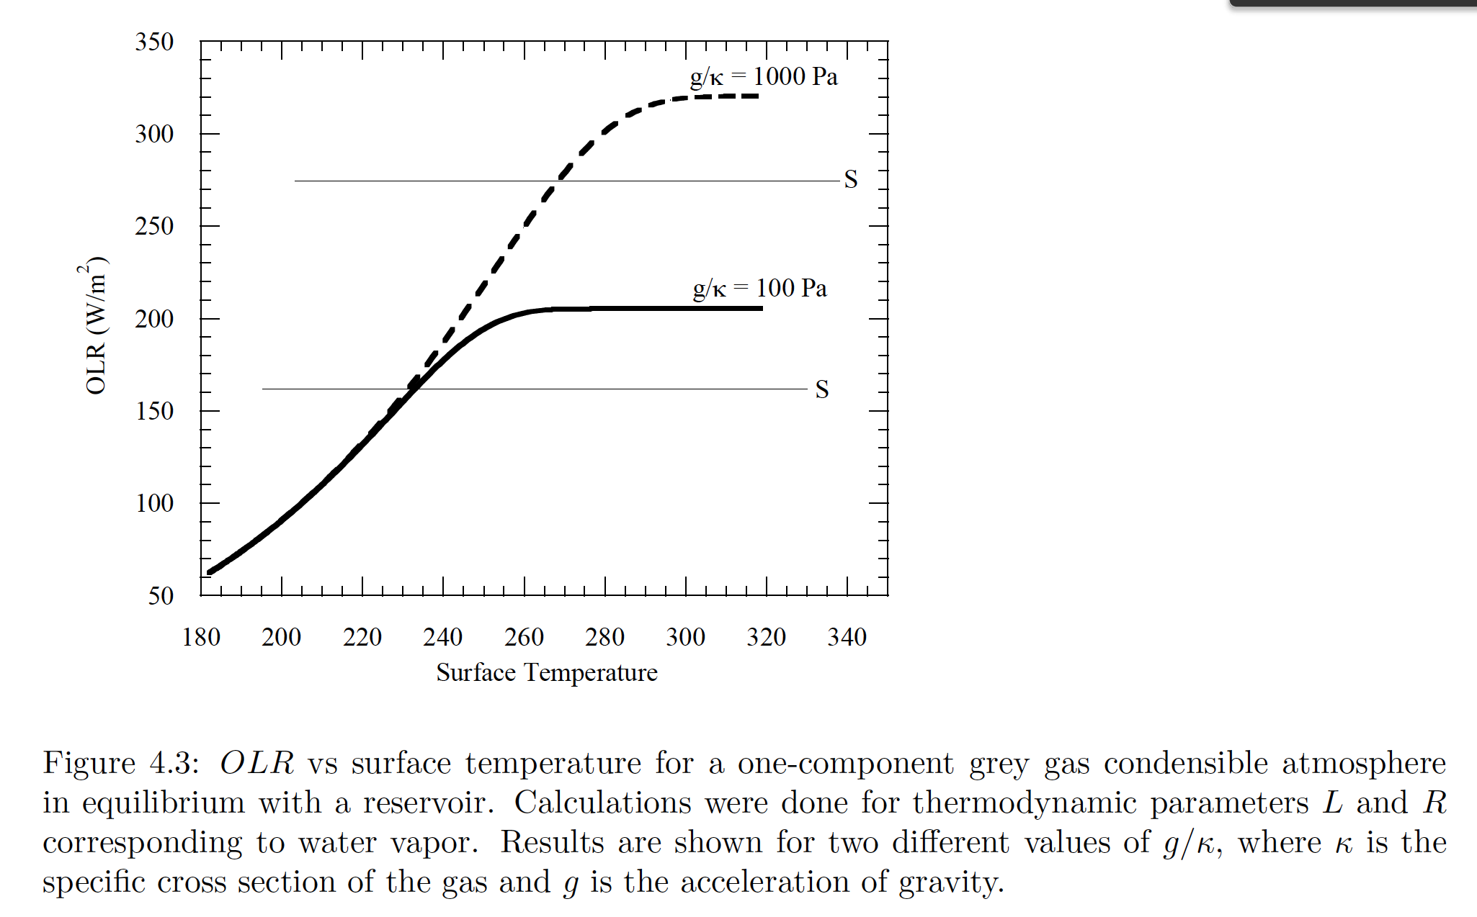
Pierrehumbert, Principles of Planetary Climate, 2010

Slide 18
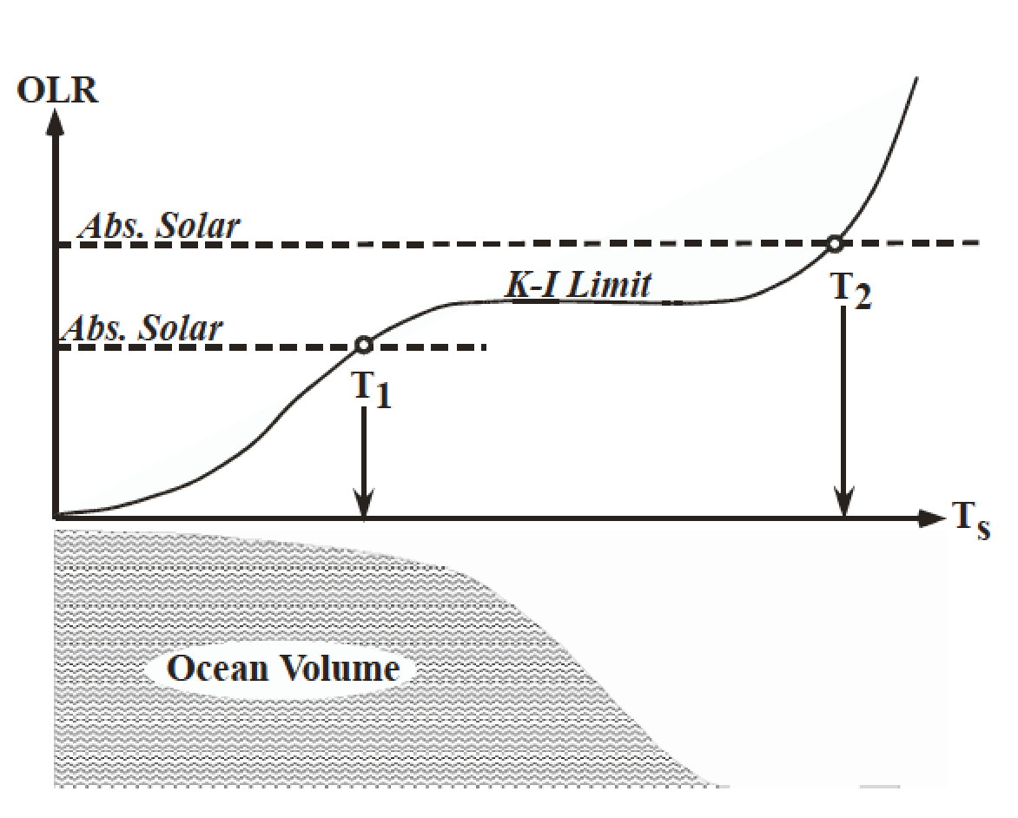
The runaway greenhouse leads to the loss of surface liquid water
(However, a supercritical H2O-rich C-poor phase may persist)
Pierrehumbert 2010 figure 4.4

Slide 19
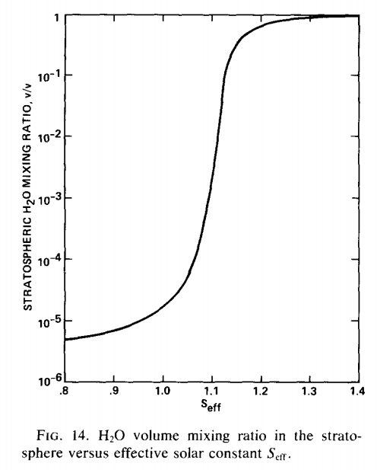
The inner edge of the habitable zone is defined by the runaway greenhouse limit
Earth in <2 Gyr
(uninhabitable)
Earth now
(habitable)

Slide 20
Clasius-Clapeyron relation: exponential increase in water vapor partial pressure with increasing T (7% per degree K, linearizing around modern Earth T)
section 1.1.3.5 of Catling & Kasting, ch. 1

Slide 21
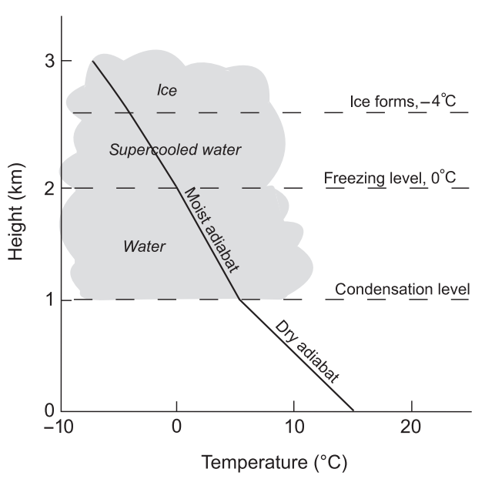
Definitions: adiabat and moist adiabat (1/2)
Going from one-component condensible atmospheres to two-component atmospheres
Earth today

Slide 22
Definitions: adiabat and moist adiabat (2/2)
Going from one-component condensible atmospheres to two-component atmospheres
Condensible “c” (e.g. water) and noncondensible “a” (e.g. O₂/N₂)
Assume instant precipitation of condensate
zero by definition
of adiabat
Assuming saturation (relative humidity = 1),
In the limit r_{sat} = 0 (dry atmosphere), this equation
gives the dry adiabat
In the limit where water vapor is the dominant constituent
of the atmosphere, this tends to the saturation vapor pressure curve.
Mixing ratio at
saturation

Slide 23
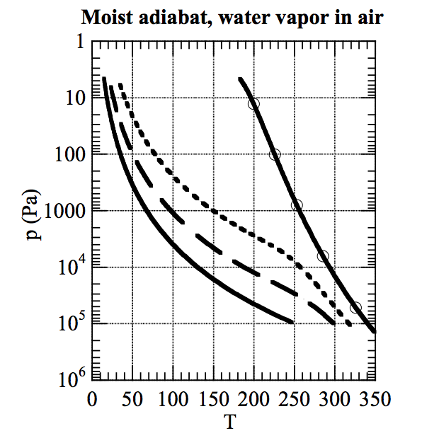
As temperature increases, the moist adiabat increasingly diverges from the dry adiabat
dry adiabat:
RELATIVE HUMIDITY=1
EARTH AIR, 1 BAR (DRY)
Pierrehumbert 2010

Slide 24
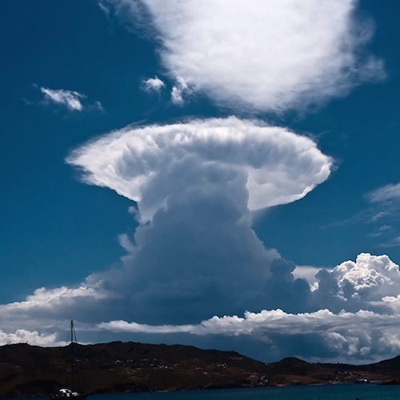
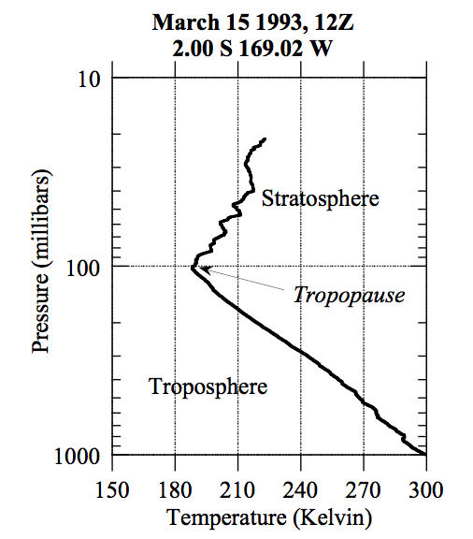
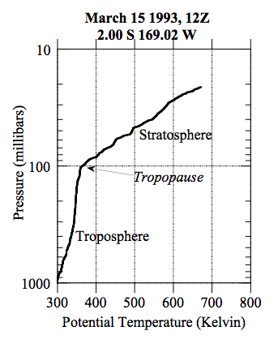
Stratospheric cold-trap
potential temperature:

Slide 25
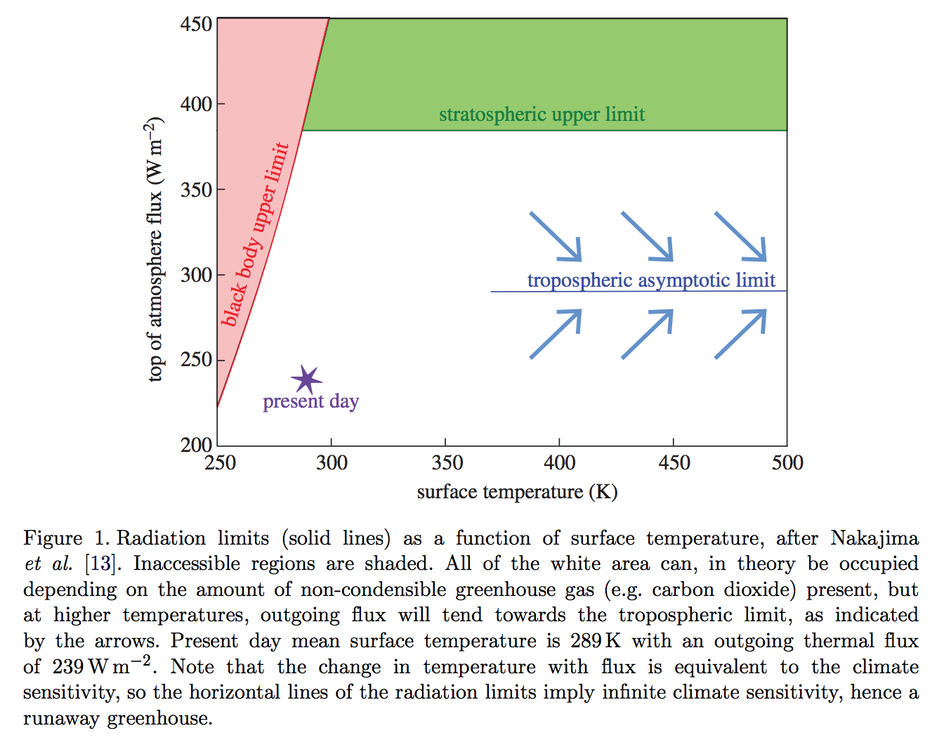
The runaway greenhouse leads to the end of habitability
Goldblatt & Watson 2012, following Nakajima 1992

Slide 26
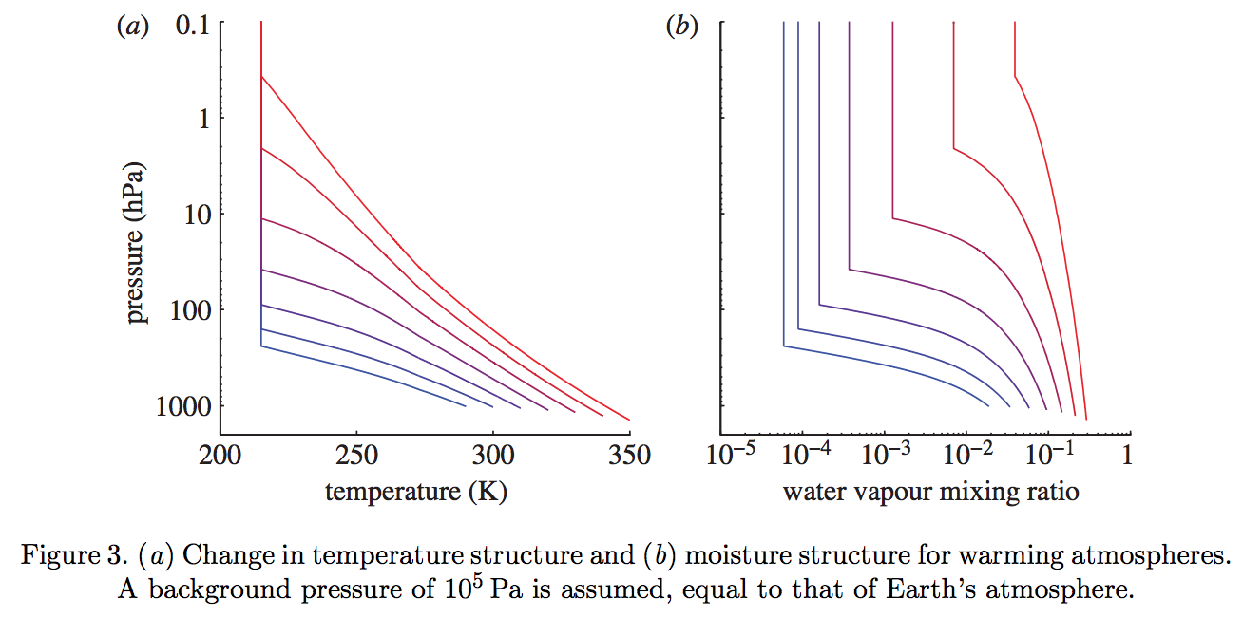
The switch from a dry to a moist stratosphere happens over a narrow range of Tsurf – because of the exponential dependence of s .v.p. on T, combined with the lapse rate feedback
Goldblatt & Watson 2012

Slide 27
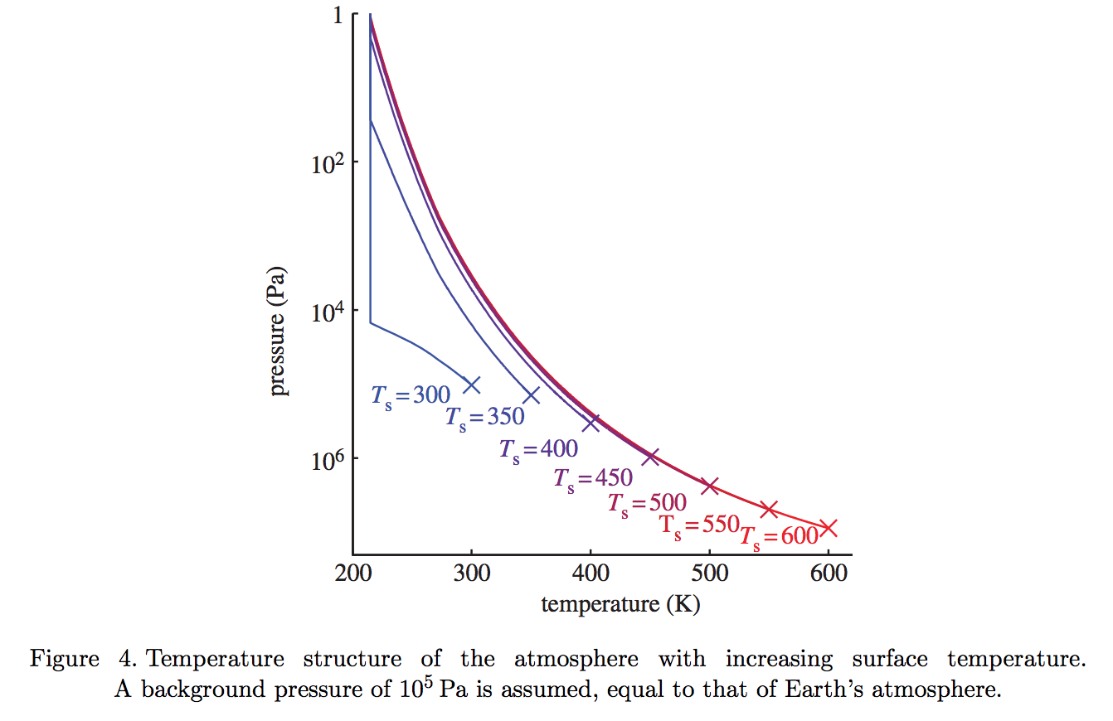
Gray atmosphere:
Optical depth at tropopause:
(1/g) in brackets
Goldblatt & Watson 2012

Slide 28
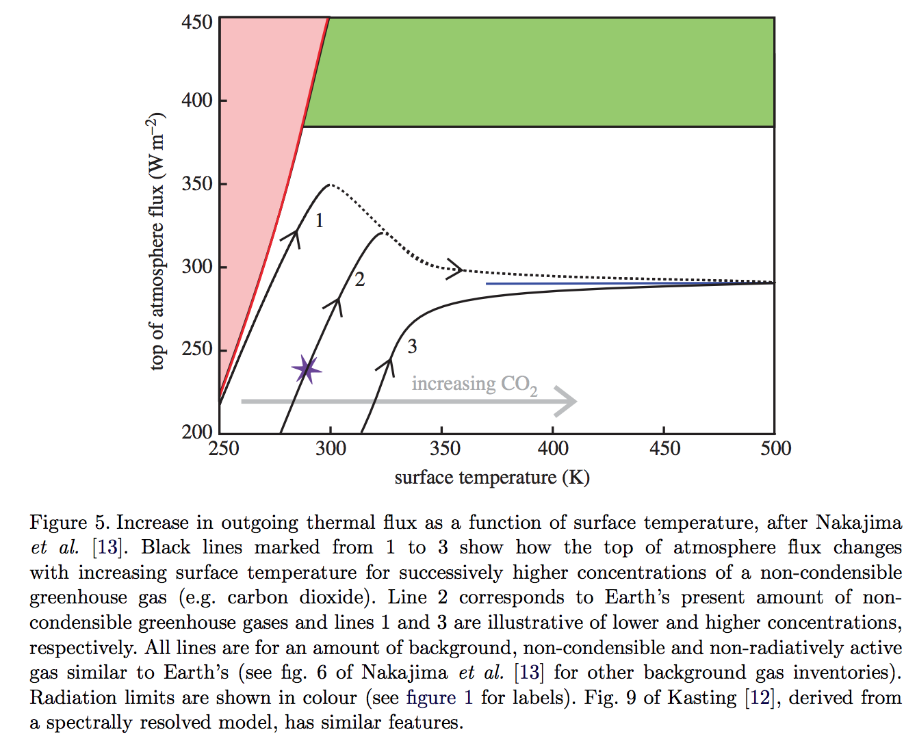
slightly less than the black-body
flux corresponding to the
temperature one optical depth
down from the top of the atmosphere
Goldblatt & Watson 2012

Slide 29
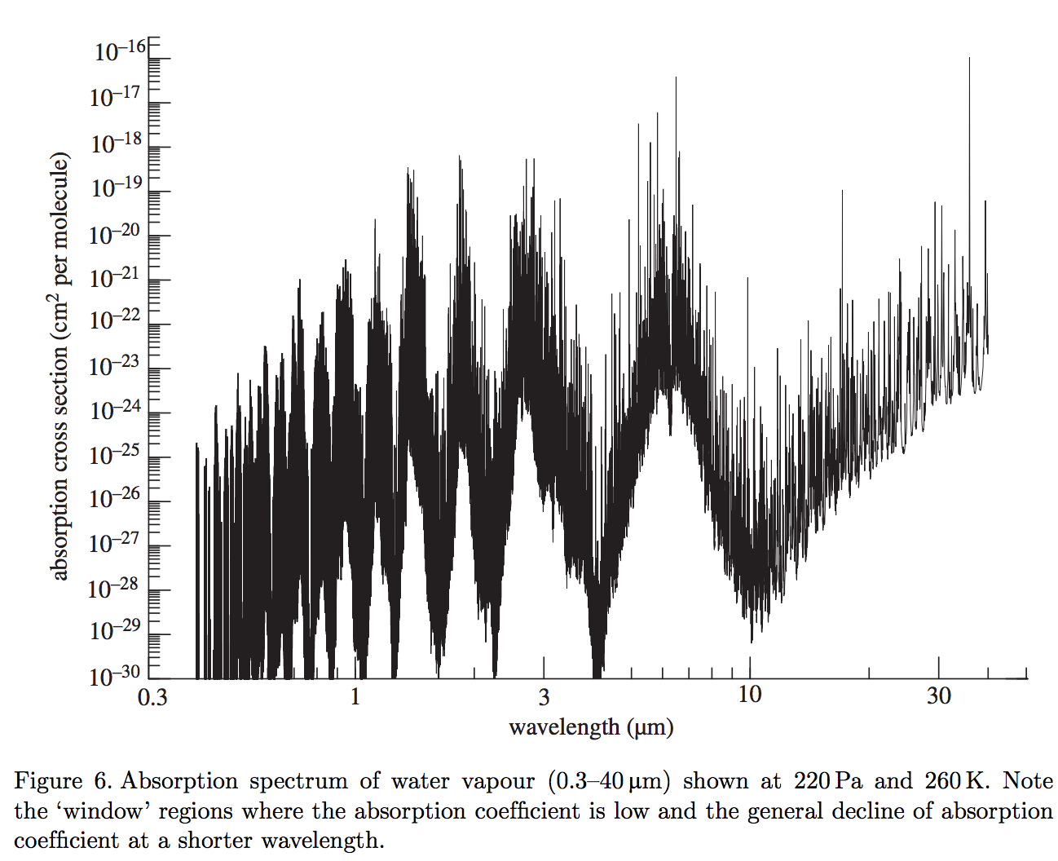
What stops the temperature from going up indefinitely? (Why is it limited to ~1500K?)
(It’s not the latent heat of magma melting – it’s coincidence that the runaway GH stops
around the dry-rock solidus).
Two key windows in the water vapor absorption spectrum: 8-12 microns and <~4 microns

Slide 30
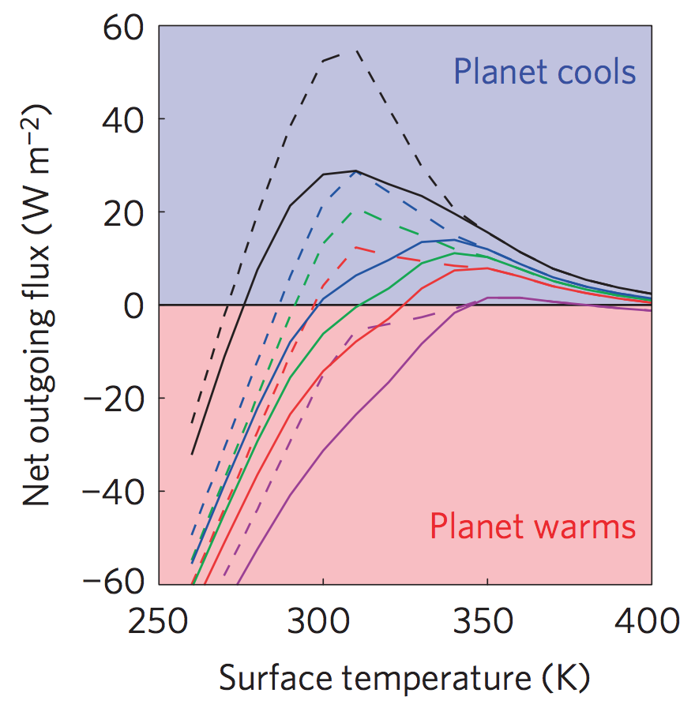
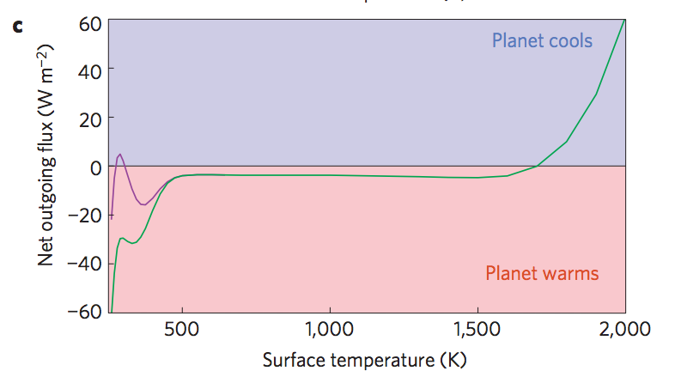
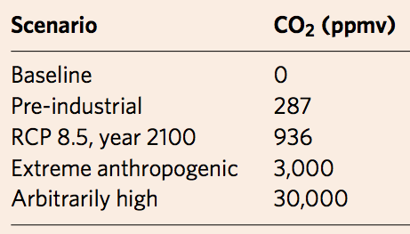
Anthropogenic greenhouse gases (probably) cannot trigger the runaway greenhouse.
Applications and extensions of the runaway greenhouse idea
Goldblatt et al. Nature Geoscience 2014
Black
Green
Blue
Red
purple
Dashed lines: RH < 1
Solid lines: RH = 1
Modern albedo

Slide 31
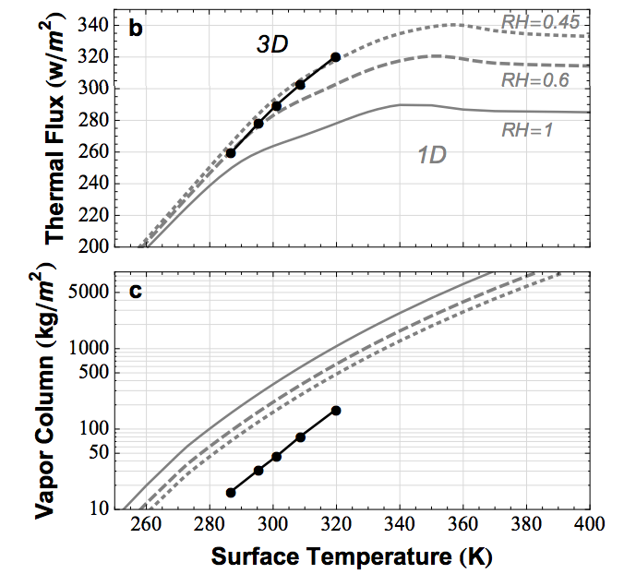
Earth today is close to the runaway greenhouse limit. The runaway greenhouse can be triggered by an increase in solar luminosity
Applications and extensions of the runaway greenhouse idea
Time for loss
(10⁹ yr)
water lost
(bars)
H loss flux
(atoms cm⁻² s⁻¹)
Leconte et al. 2013 Nature

Slide 32
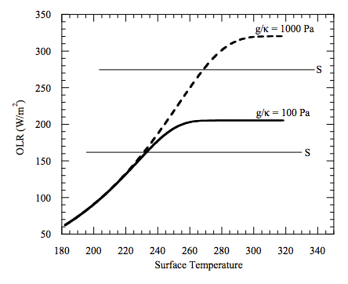
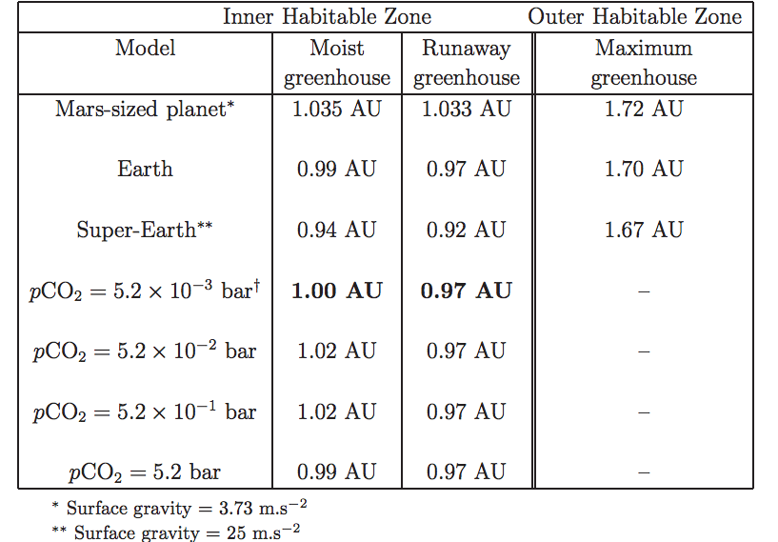
High gravity moves the runaway greenhouse limit closer to the star e.g. metal-rich planet, larger-radius super-Earth
Applications and extensions of the runaway greenhouse idea
Temperature → vapor pressure
Vapor pressure x humidity / gravity → column mass of greenhouse gas
Column mass → greenhouse effect.
Max OLR ~= slightly less than the blackbody
flux corresponding to the temperature one optical
depth down from the top of the atmosphere

Slide 33
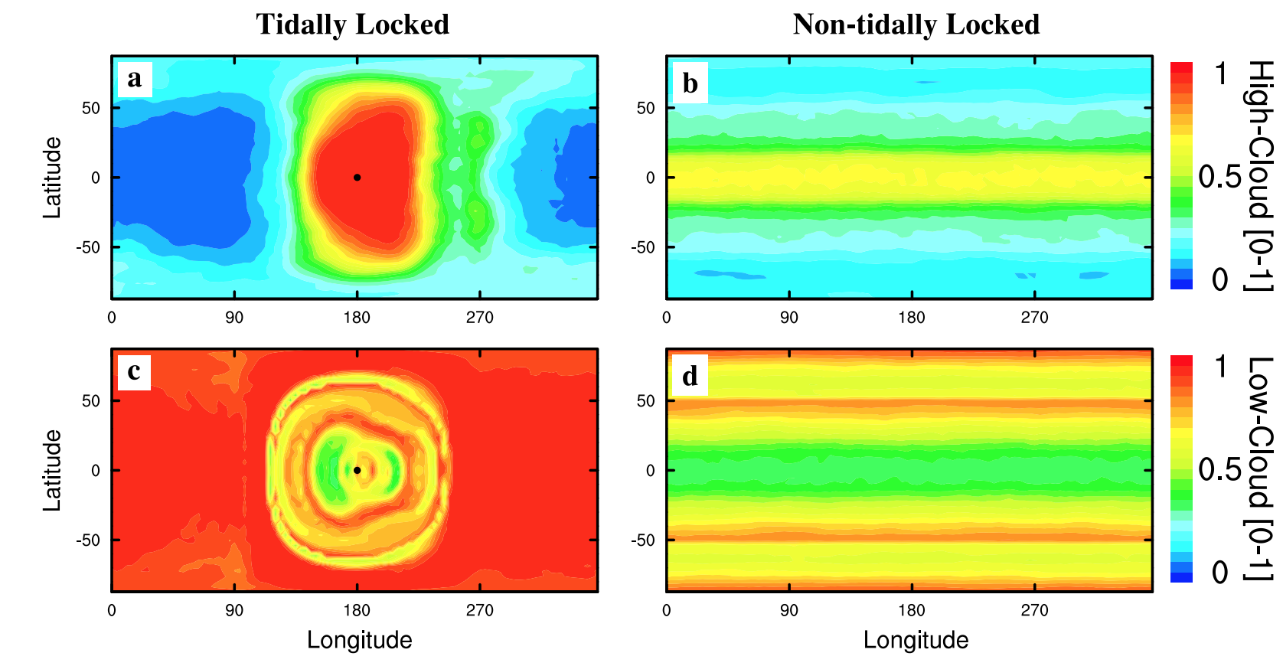
High-albedo clouds can shift the runaway GH boundary closer to the star. High-albedo clouds are at the substellar point when the planet is slowly rotating (e.g., tidally locked and in the habitable zone).
Applications and extensions of the runaway greenhouse idea
Yang et al. 2013

Slide 34
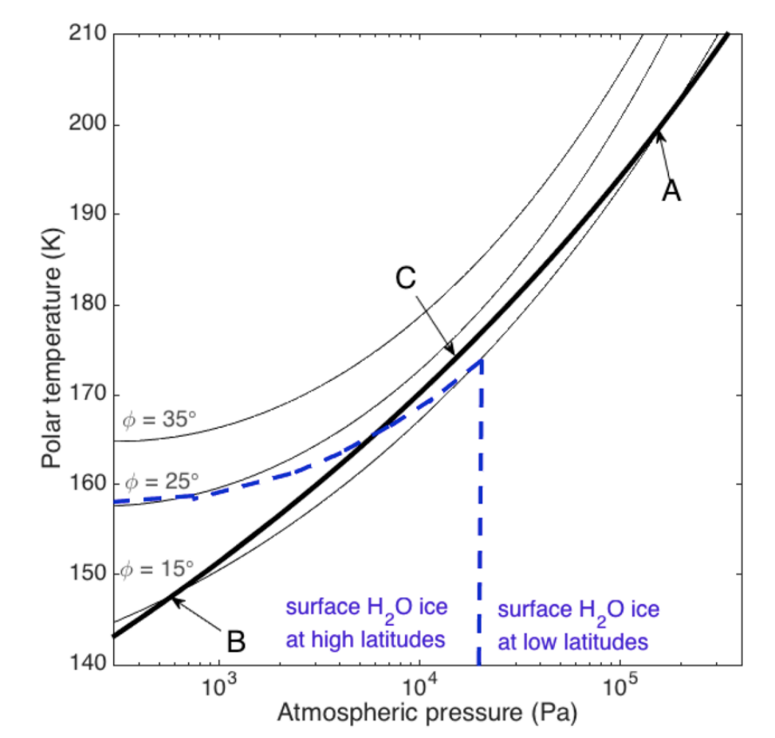
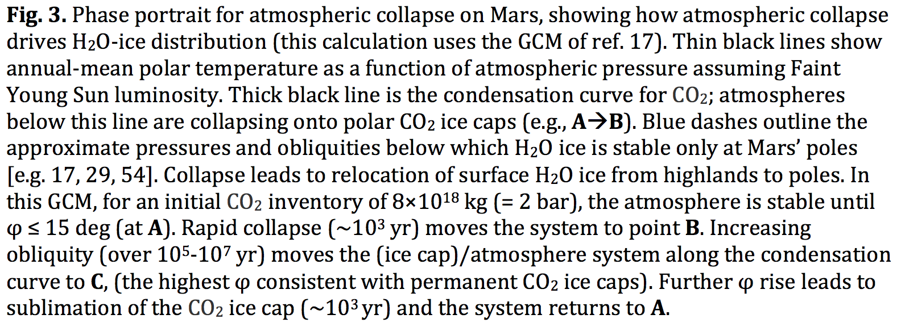
Runaways due to the GH-effect of a condensable apply to non-H₂O condensates as well – e.g., CO₂ on Mars
Applications and extensions of the runaway greenhouse idea
Kite et al. P&SS 2020
Also: N2 runaway on Early Titan?

Slide 35
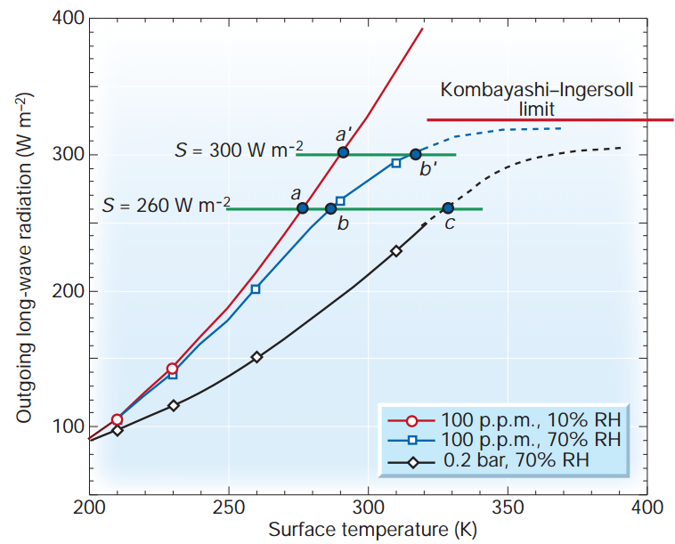
Lecture summary slide: Condensable greenhouse gases lead to climate instability (Kombayashi-Ingersoll limit)
Assumptions:
z
T
Constant RH
(RH = relative
humidity)
Consequences:
(all are important)
H₂O dissociation
VNIR window
Surface magma
All water lost to space
Carbonates decompose
Pierrehumbert, Nature, 2002

Slide 36
Runaway greenhouse – key points
The (H2O-)runaway greenhouse is a geologically rapid increase in planet surface temperature from <400K to >1000K caused by a positive feedback between the saturation vapor pressure of water vapor and the
Be able to explain the mechanism of the runaway greenhouse
It is almost certain that release of CO2 by humans cannot cause a runaway greenhouse
The exact threshold for the runaway greenhouse depends on cloud cover, land fraction, and planet rotation rate

Slide 37
Backup/additional slides

Slide 38
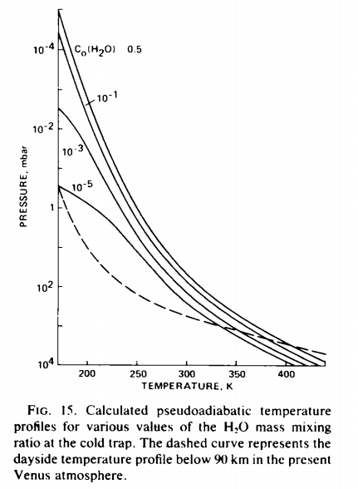
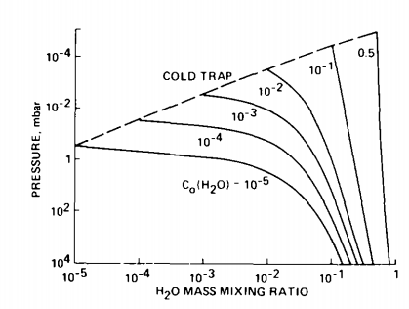
The runaway & moist greenhouses: under the hood
Raising temperature raises the H₂O
mixing ratio at the cold trap (assumed
isothermal)
Kasting 1988

Slide 39
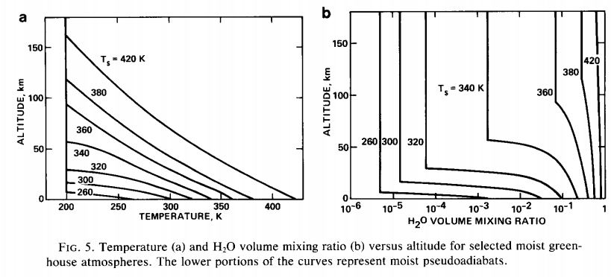
Kasting 1988

Slide 40
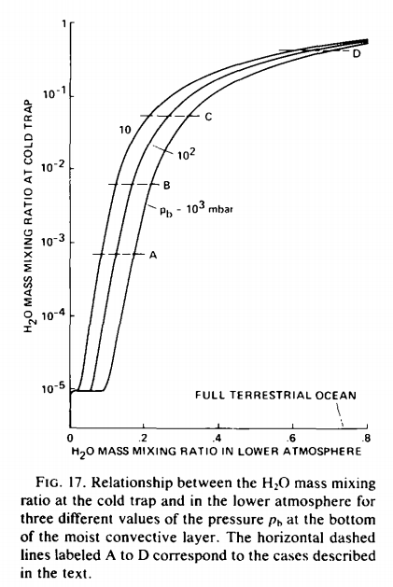
How was the last 10th of Venus’ ocean removed?
Kasting 1988

